Slide 1

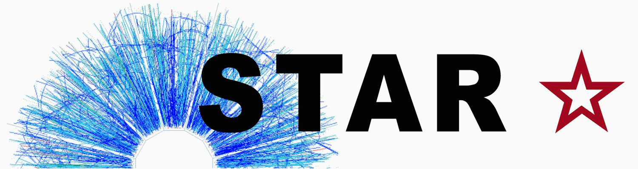
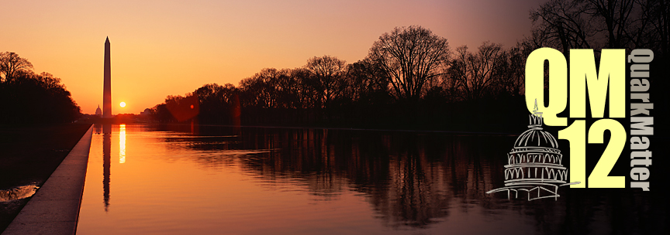

The STAR Dilepton Program
Frank Geurts (Rice University)
for the STAR Collaboration

Slide 2
Outline
Introduction & Motivation
Electron Identification in STAR
Dielectron Production at √s_{NN}= 200 GeV
  p+p and Au+Au results
  elliptic flow of dielectrons
Results from Beam Energy Scan Program
STAR Dilepton Present & Future
Summary

Slide 3
Dilepton Physics
Dileptons are excellent penetrating probes
  very low cross-section with QCD medium
  created throughout evolution of system
Chronological division:
High Mass Range (HMR)
    M_{ee} > 3 GeV/c²
  primordial emission, Drell-Yan
  J/Ψ and ϒ suppression
Intermediate Mass Range (IMR)
    1.1 < M_{ee}< 3 GeV/c²
  QGP thermal radiation
  heavy-flavor modification
Low Mass Range (LMR)
    M_{ee}< 1.1 GeV/c²
  in-medium modification of vector mesons
  possible link to chiral symmetry restoration

Slide 4
Dilepton Elliptic Flow
Elliptic flow is generated very early stage
dileptons can further probe this early stage
possibly constrain QGP EoS
Combination of p_{T} and M_{ll} can set observational windows on specific stages of the expansion
  Chatterjee et al., Phys Rev. C 75 (2007) 054909
Expect interesting structures in p_{T}-integrated v₂(M):
high-mass dileptons
  hot early stage
  flow is still weak
low-mass dileptons
  flow strong, temperature low
modulations from the contributions of vector mesons
  strong variations of relative weights on/off resonances

Slide 5
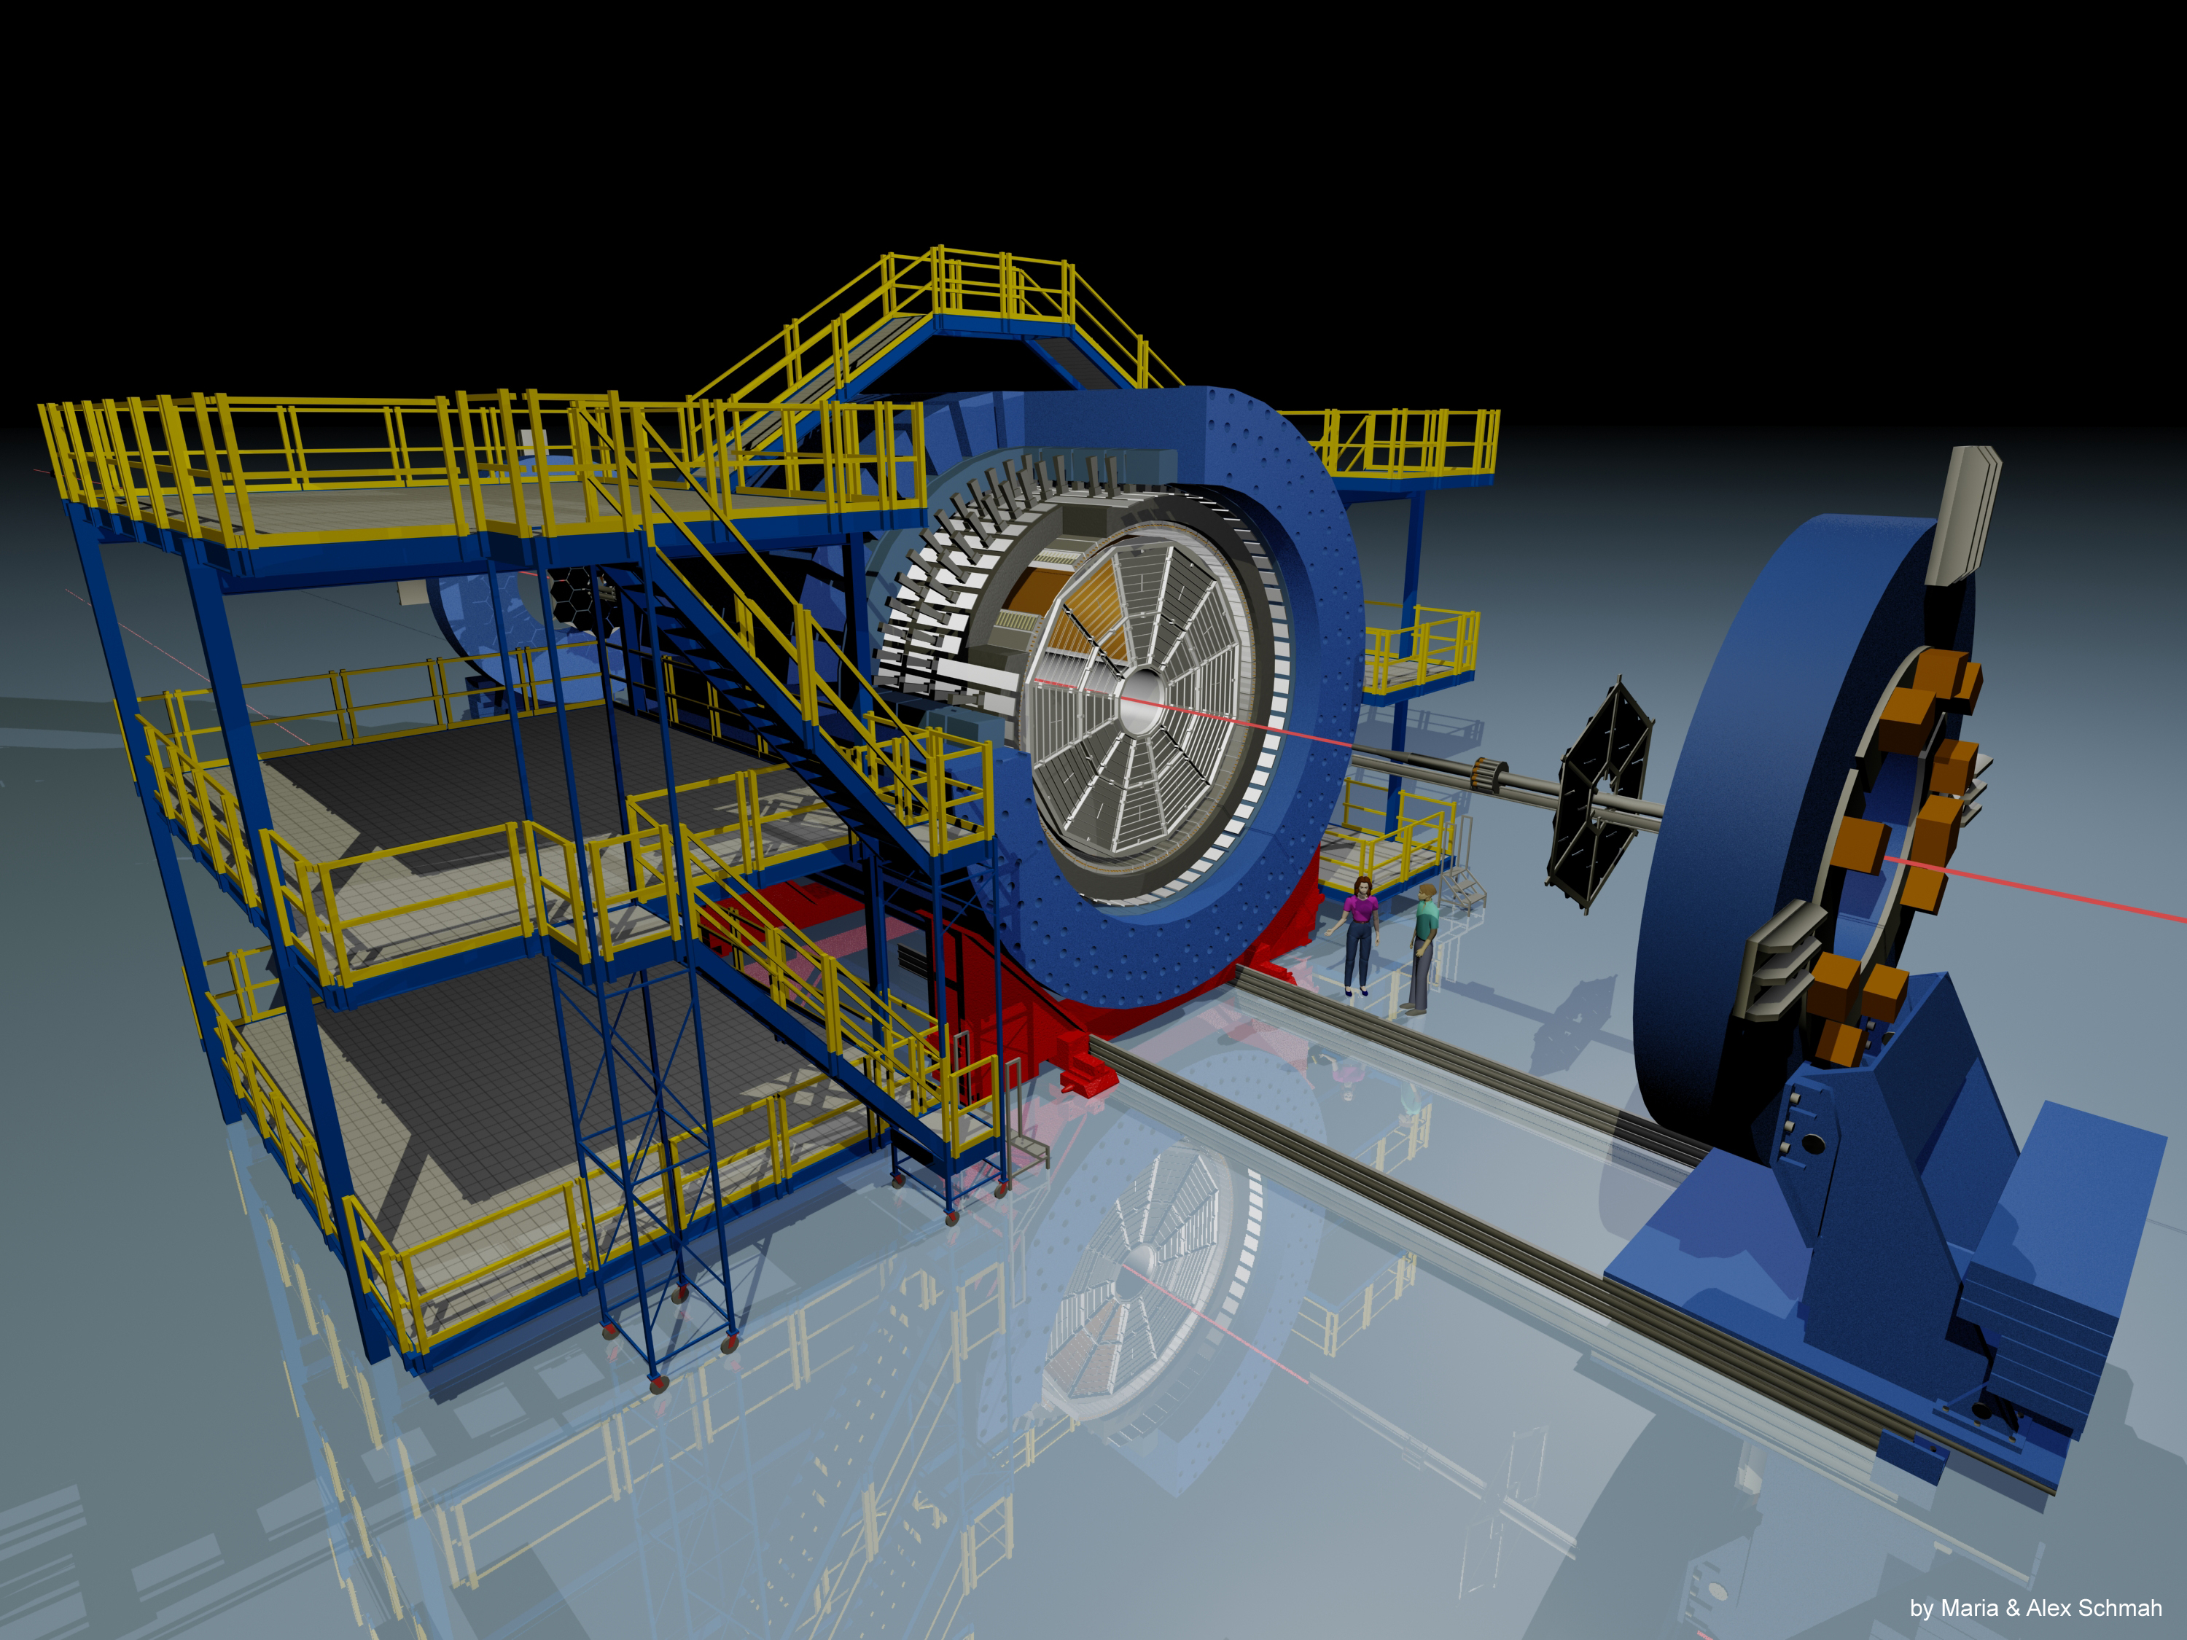
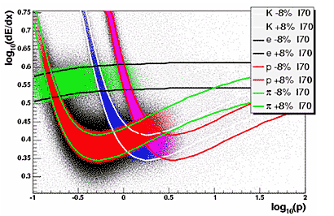
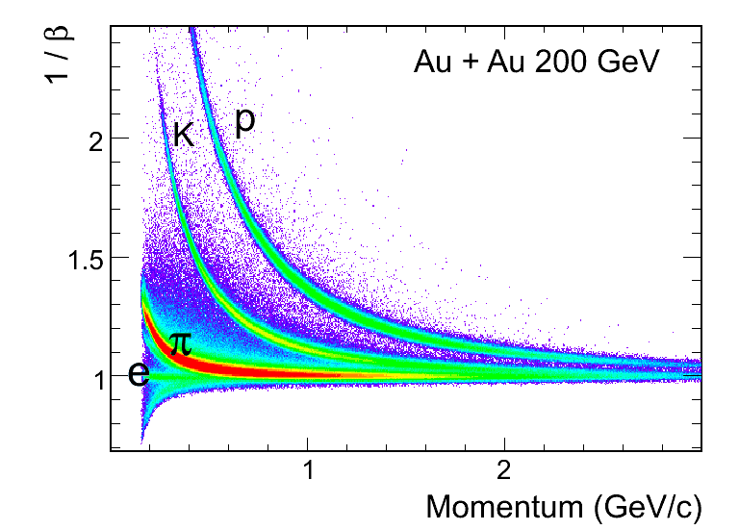
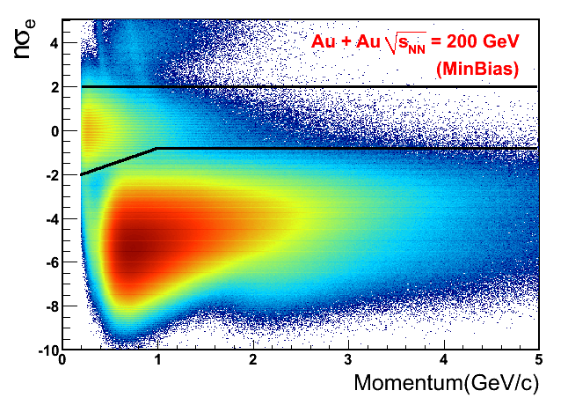
The STAR Detector
Large acceptance electron ID
Time Projection Chamber
Time-of-Flight detector
  2009: 72% completed (p+p)
  2010: fully commissioned
Electromagnetic Calorimeter
Poster: K. Jung (125)
Time Projection Chamber
  0<ϕ<2π, |η|<1
Tracking
dE/dx PID
TOF cut removes “slow” hadrons
improves electron purity
  central events ~92%
  min-bias events ~95%
Time-of-Flight Detector
  0<ϕ<2π, |η|<0.9
Time resolution < 100ps
Significantly improves PID

Slide 6
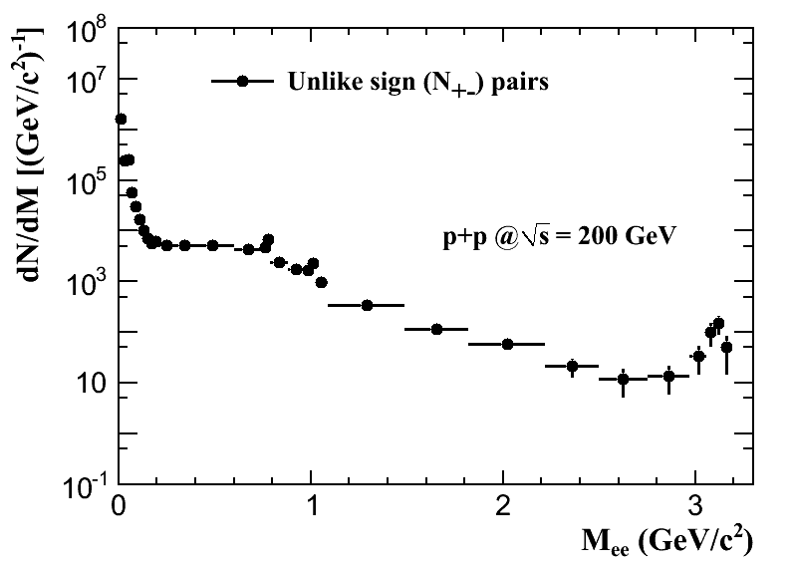
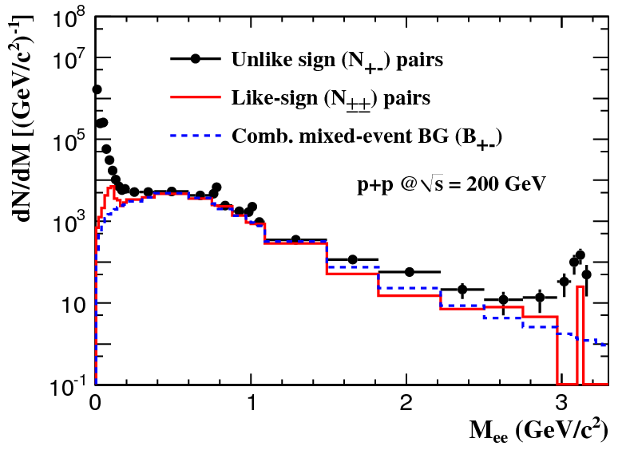
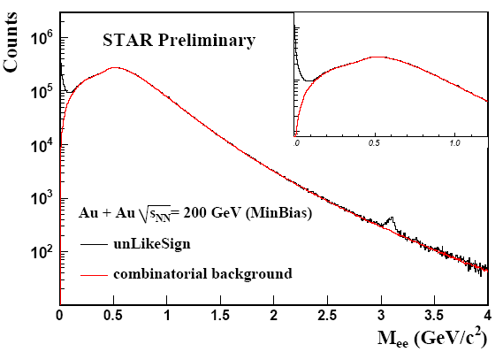
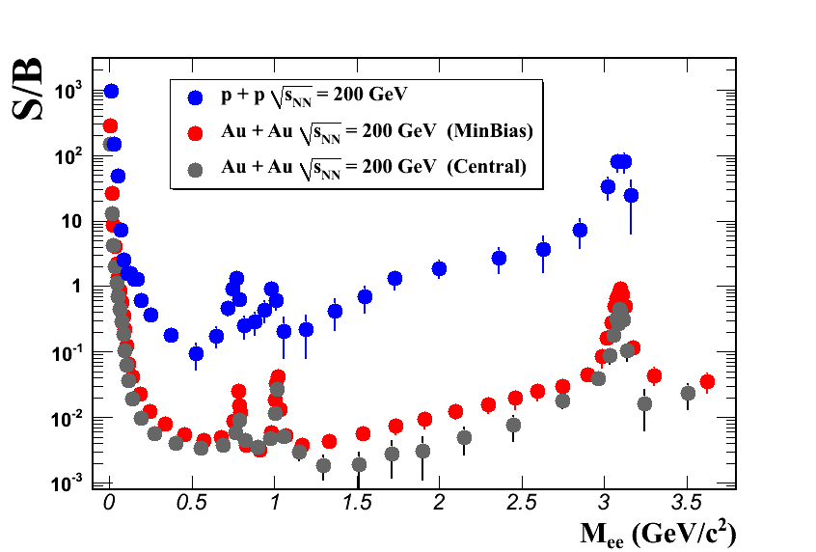
e⁺e⁻ Invariant Mass & Background
Background sources
  combinatorial background (non-physical)
  correlated background
    e.g. double Dalitz decay, jet correlation.
Background methods
  mixed-event method: combinatorial only
    improve statistics
  like-sign method: combinatorial & correlated BG
    correct for acceptance differences
  pair cuts remove photon conversions
Other signals (meson decays)
    Remove by comparing real data with simulations for hadron contamination
  Hadron Simulation Cocktail
Combine both methods:
  p+p: LS < 0.4 GeV/c² < ME
  Au+Au: LS < 0.75 GeV/c² < ME×LS
carefully normalized using overlap in M_{ee}
S/B @ M_{ee}~ 0.5 GeV/c²:
1/10 for p+p
1/250 for Au+Au central

Slide 7
Production in p+p at 200 GeV
Phys. Rev. C 86, 024906 (2012)
Understand the p+p reference
Cocktail simulation consistent with data
  L. Ruan (STAR), Nucl. Phys. A855 (2011) 269
Charm contribution dominates IMR
  scaled with STAR charm cross-section
  Adams et al (STAR), Phys. Rev. Lett. 94 (2005) 062301
Uncertainties:
vertical bars: statistical
boxes: systematic
grey band: cocktail simulation systematic
not shown: 11% normalization

Slide 8
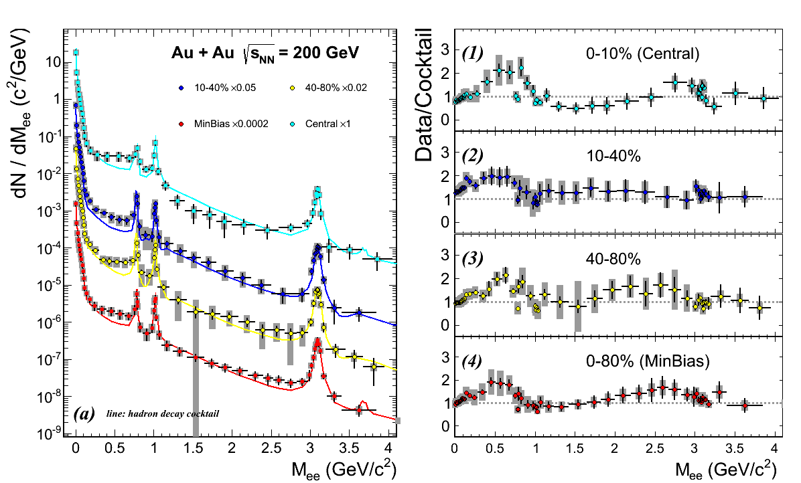
Production in Au+Au at 200 GeV
Low Mass:
  enhancement
  when compared to cocktail (w/o ρ meson)
little centrality dependence
Intermediate Mass:
  cocktail “overshoots” data in central collisions
  but, consistent within errors
  modification of charm?
STAR Preliminary
STAR Preliminary
difficult to disentangle (modified) charm
from thermal QGP contributions
future detector upgrades required
B. Huang (3C, 268)
Poster: Y. Guo (153)
H. Huang (6C - 142)

Slide 9
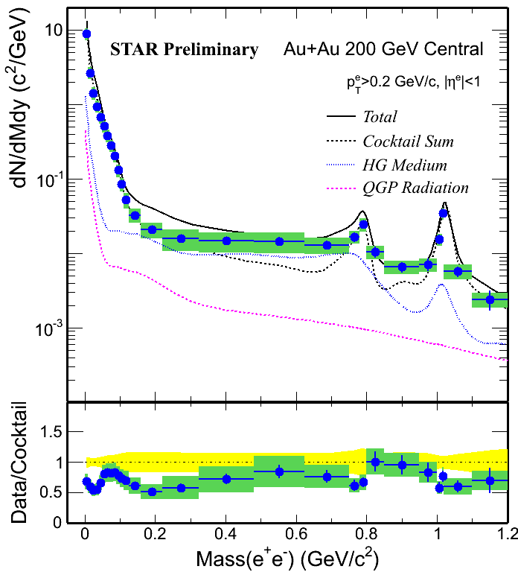
Compare to Rapp, Wambach, v. Hees
STAR central 200 GeV Au+Au
hadronic cocktail (STAR)
Ralf Rapp (priv. comm.)
  R. Rapp, Phys.Rev. C 63 (2001) 054907
  R. Rapp & J. Wambach, EPJ A 6 (1999) 415
Complete evolution (QGP+HG)
cocktail + HG + QGP:
Agreement w/in uncertainties
hadronic phase: ρ “melts” when extrapolated close to phase transition boundary
  total baryon density plays the essential role
top-down extrapolated QGP rate closely coincides with bottom-up extrapolated hadronic rates
Rapp, Wambach, van Hees
arXiv:0901.3289

Slide 10
Compare to Theory: PHSD Model
O. Linnyk et al., Phys. Rev. C 85 024910 (2012)
H. Xu et al., Phys. Rev. C 85 024906 (2012)
Parton-Hadron String-Dynamics
Collisional broadening of vector mesons
Radiation from QGP
Minimum bias collisions (0-80%):
Generally good agreement
Central collisions (0-10%):
PHSD roughly in line with LMR region

Slide 11
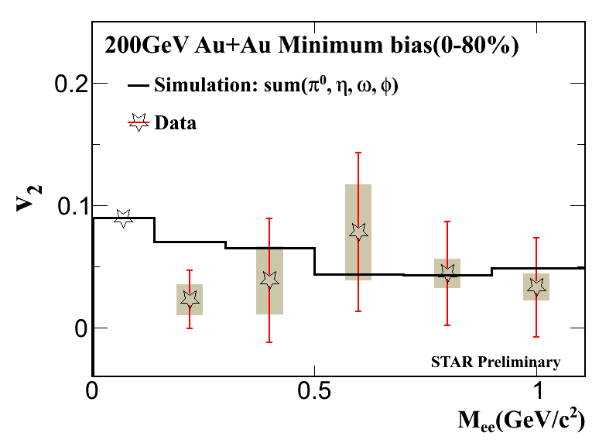
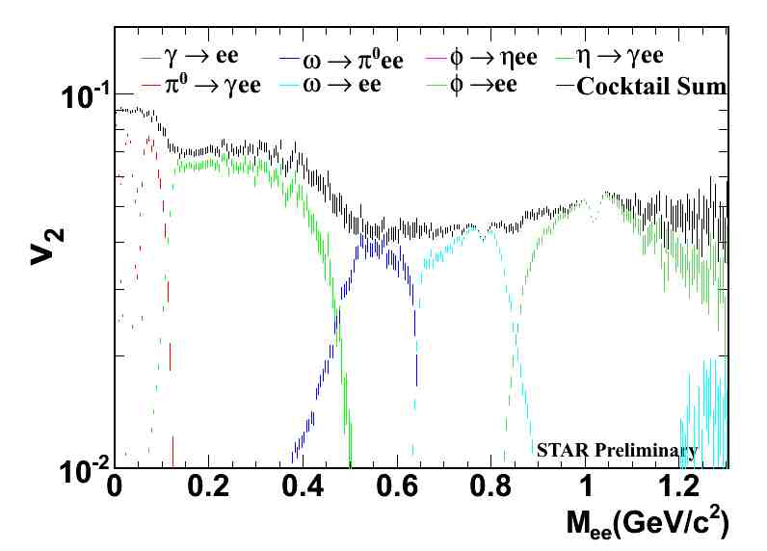
Elliptic Flow in Au+Au at 200 GeV
First measurements from STAR
700M min-bias events
  combined 2010/2011
Background:
  Like-Sign M_{ee}<0.7 GeV/c²
  Mixed-Event M_{ee}>0.7 GeV/c²
Event-Plane method: TPC
Cocktail contributions:
dielectron v₂(M_{ee}): data and simulations consistent
  work in progress to include IMR v₂
Poster: X. Cui (322)

Slide 12
Dielectron v₂ p_{T} Dependence
Poster: X. Cui (322)
Au+Au √s_{NN}= 200GeV 0-80% centrality
Comparison with measured v₂(p_{T})
π± (STAR) and π⁰ (PHENIX)
  M_{ee} < 0.14 GeV/c²
φ K⁺K⁻ (STAR)
  0.98 < M_{ee} < 1.06 GeV/c²
PHENIX, PRC 80 (2009) 054907
v₂(p_{T}) consistent with simulations & measurements

Slide 13
Dielectron v₂ Centrality Dependence
Centrality dependence v₂(p_{T})
    M_{ee}<0.14 GeV/c²
  consistent with simulations
  consistent with measurements
Can we distinguish between HG and QGP v₂ contributions?
Recall: need uncertainties to be <4%
  (compared with model differences) …
Require ~2x more Au+Au min-bias data
  and e-μ measurements at higher M_{ee} to disentangle charm contributions
  no, not yet.

Slide 14
Dielectron Production at lower √s_{NN}
Observed Low-Mass enhancement at top RHIC energy
  in-medium modification effects?
  indication of chiral symmetry restoration?
Explore Low Mass Range down to SPS energies
  possible enhancement, consistent model description?
Beam Energy Scan Dielectrons:
  2010 - 2011
Au+Au at 62.4, 39, and 19.6 GeV
STAR data samples:
55M, 99M, and 34M min-bias events
Posters: P. Huck (113), B. Huang (269)

Slide 15
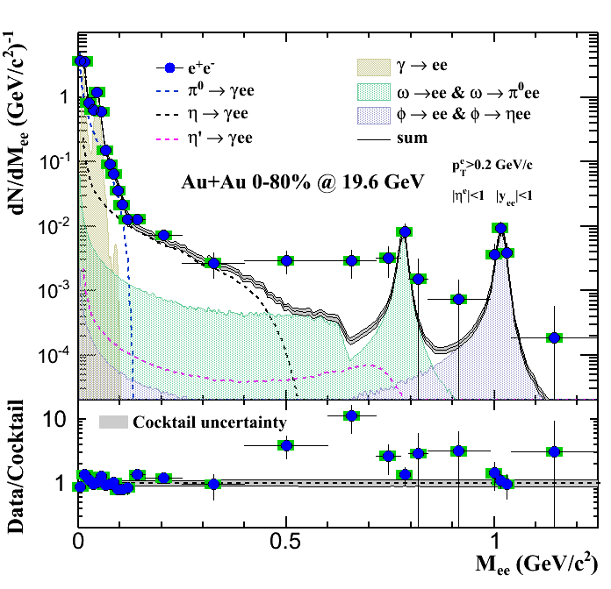
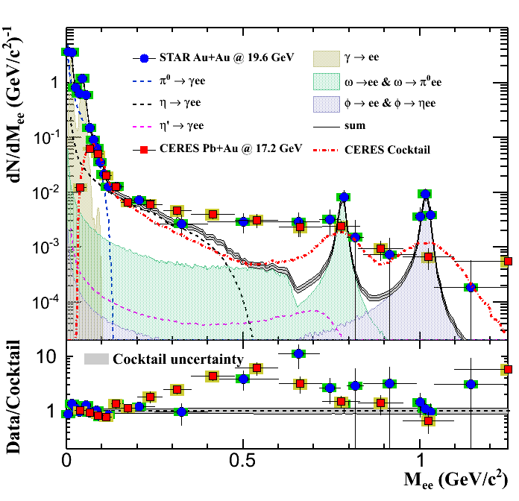
Comparison to SPS measurements
STAR Au+Au at 19.6 GeV/c
  min-bias (0 - 80%)
  p_{T}>0.2GeV/c, |η|<1, |y_{ee}|<1
  Cocktail:
  π⁰ yield: STAR π±
  other mesons: NA49-based, scaled with SPS meson/π⁰ ratio
CERES Pb+Au at 17.2 GeV/c
  CERES, Eur.Phys.J. C 41 (2005) 475
  semi-central (0-28%)
  p_{T}>0.2GeV/c, 2.1<η<2.65, θ_{ee}>35mrad
STAR Preliminary
STAR enhancement comparable to CERES
  … and with better mass resolution
Posters: B. Huang (269)

Slide 16
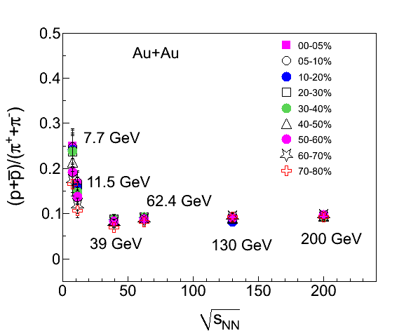
Compare to Theory: in-medium ρ
Robust theoretical description top RHIC down to SPS energies
  calculations by Ralf Rapp (priv. comm.)
  black curve: cocktail + in-medium ρ
Measurements consistent with in-medium ρ broadening
  expected to depend on total baryon density
  tool to look for chiral symmetry restoration
STAR
Preliminary

Slide 17
STAR Dileptons: Present & Future
2009 – 2011
  TPC + TOF + EMC
    dielectron continuum
    dielectron spectra, and v₂ (p_{T})
  vector meson in-medium modifications
  LMR enhancement
  modification in IMR?
2012-2013
  TPC + TOF + EMC + MTD (partial)
    e-μ measurements
  IMR: Improve our understanding of thermal QGP radiation
  LMR: vector meson in-medium modifications
2014 and beyond
  TPC + TOF + EMC + MTD + HFT
    dimuon continuum
    e-μ spectra and v₂
  LMR: vector meson in-medium modifications
  IMR: measure thermal QGP radiation
More on HMR physics:
  Wei Xi – Heavy Flavor Results from STAR (Plenary IIB)
More on MTD and HFT:
  Huan Huang – STAR Upgrade Plan for the Coming Decade (Parallel 6C)
Poster: C. Yang (331)

Slide 18
Summary
STAR detector very well suited for dilepton physics
  recent TOF upgrade allows for large acceptance electron ID
Dielectron in p+p and Au+Au at √s_{NN}=200 GeV: centrality and p_{T} differentials
  observe low mass enhancement
Dielectron elliptic flow measurements in Au+Au at √s_{NN}=200 GeV
  v₂(M_{ee},p_{T}) results consistent with other measurements & cocktail simulations
  need ~2x increase in statistics to distinguish HG and QGP contributions
Dielectron measurements in Au+Au at √s_{NN}= 19.6 – 62.4 GeV
  low mass enhancement down to SPS energies, with comparable magnitude
  consistent with in-medium ρ broadening
  robust and consistent description for √s_{NN}= 19.6, 62.4, and 200 GeV
Future STAR upgrades enable further exploration of the dilepton continuum
  upcoming MTD upgrade allows for large acceptance μ ID
  QGP thermal radiation measurements

Slide 19
STAR Dilepton Presentations at QM’12
B. Huang – parallel session 3C (268)
  Di-electron differential cross section in Au+Au collisions at different beam energies at STAR
X. Cui – poster 322
  Centrality, mass and transverse momentum dependence of di-electron elliptic flow in √s_{NN} = 200 GeV Au+Au collisions at STAR
K. Jung – poster 125
  A Study of High-pT/High-mass Dielectron Production through Trigger Combination in 200 GeV Au+Au Collisions at STAR
B. Huang – poster 269
  Low mass di-electron production in Au+Au collisions at √s_{NN} = 19.6 GeV at STAR
P. Huck – poster 113
  Dielectron Production in Au+Au-Collisions √s_{NN}= 39 & 62.4 GeV at STAR
M. Wada – poster 110
  ω(782) and φ (1020) mesons from di-leptonic decay channels at the STAR experiment
Y. Guo – poster 153
  Centrality and pT dependence study of Dielectron Production √s_{NN} = 200 GeV Au+Au collisions at STAR
H. Huang – parallel session 6C (142)
  STAR Upgrade Plan for the Coming Decade
C. Yang – poster 331
  Performance of the Muon Telescope Detector in STAR at RHIC

Slide 20
BACKUP

Slide 21
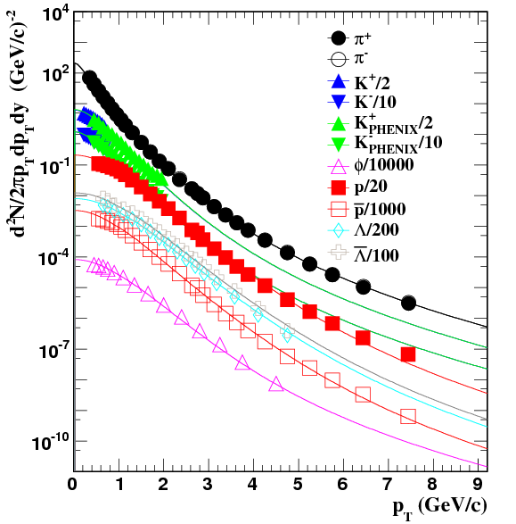
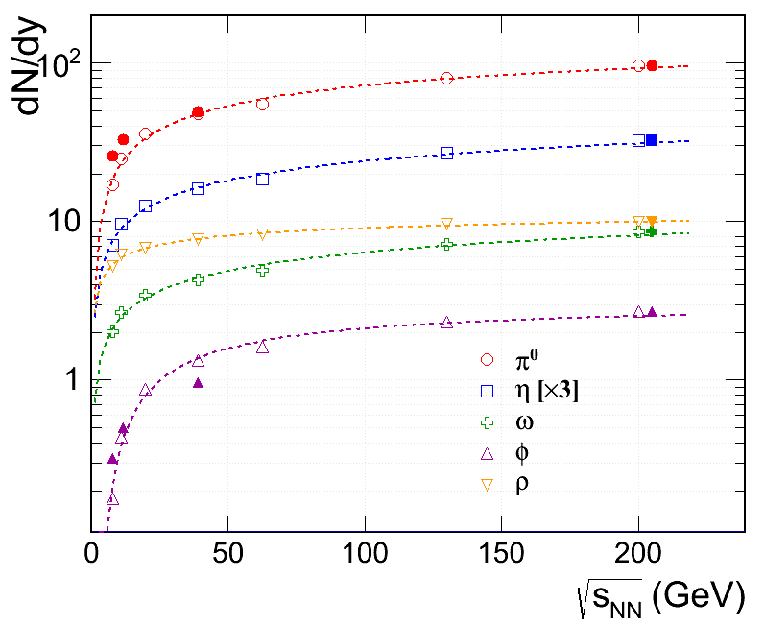
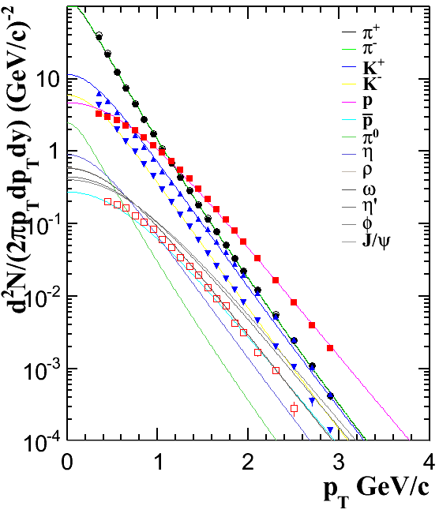
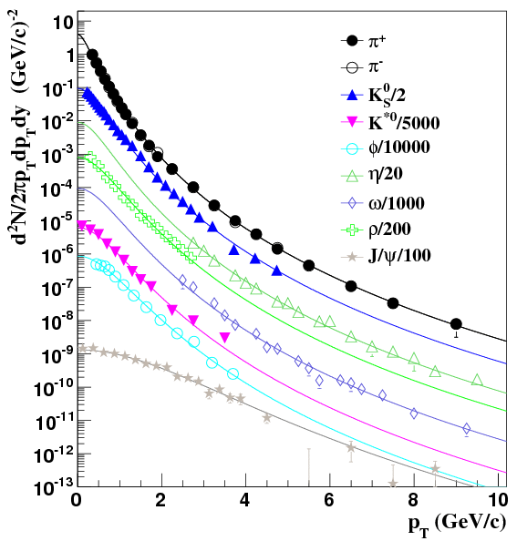
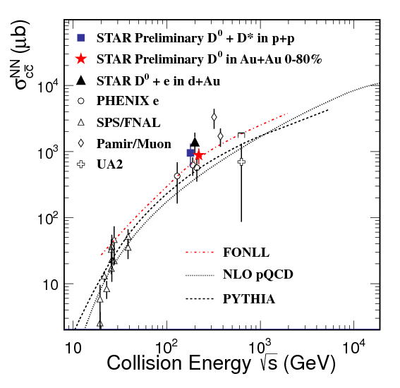
Hadronic Background Simulation
Au+Au 200GeV
Au+Au 39 & 62GeV
Au+Au 19.6 GeV
STAR Preliminary
STAR Preliminary
TBW fit from NA49 data
π yield from STAR
Extrapolated from AMPT calculations.
Scaled to measurements at 200GeV
p+p 200GeV
Hadrons: flat |y|<1.0, and flat full azimuthal input distribution
  p_{T} distribution from Tsallis blast-wave fit to measured particle spectra
Heavy flavor sources:
  STAR measurements, and PYTHIA simulation
  N_{bin} scaled in Au-Au
  at low energy: FONLL
STAR
Preliminary

Slide 22
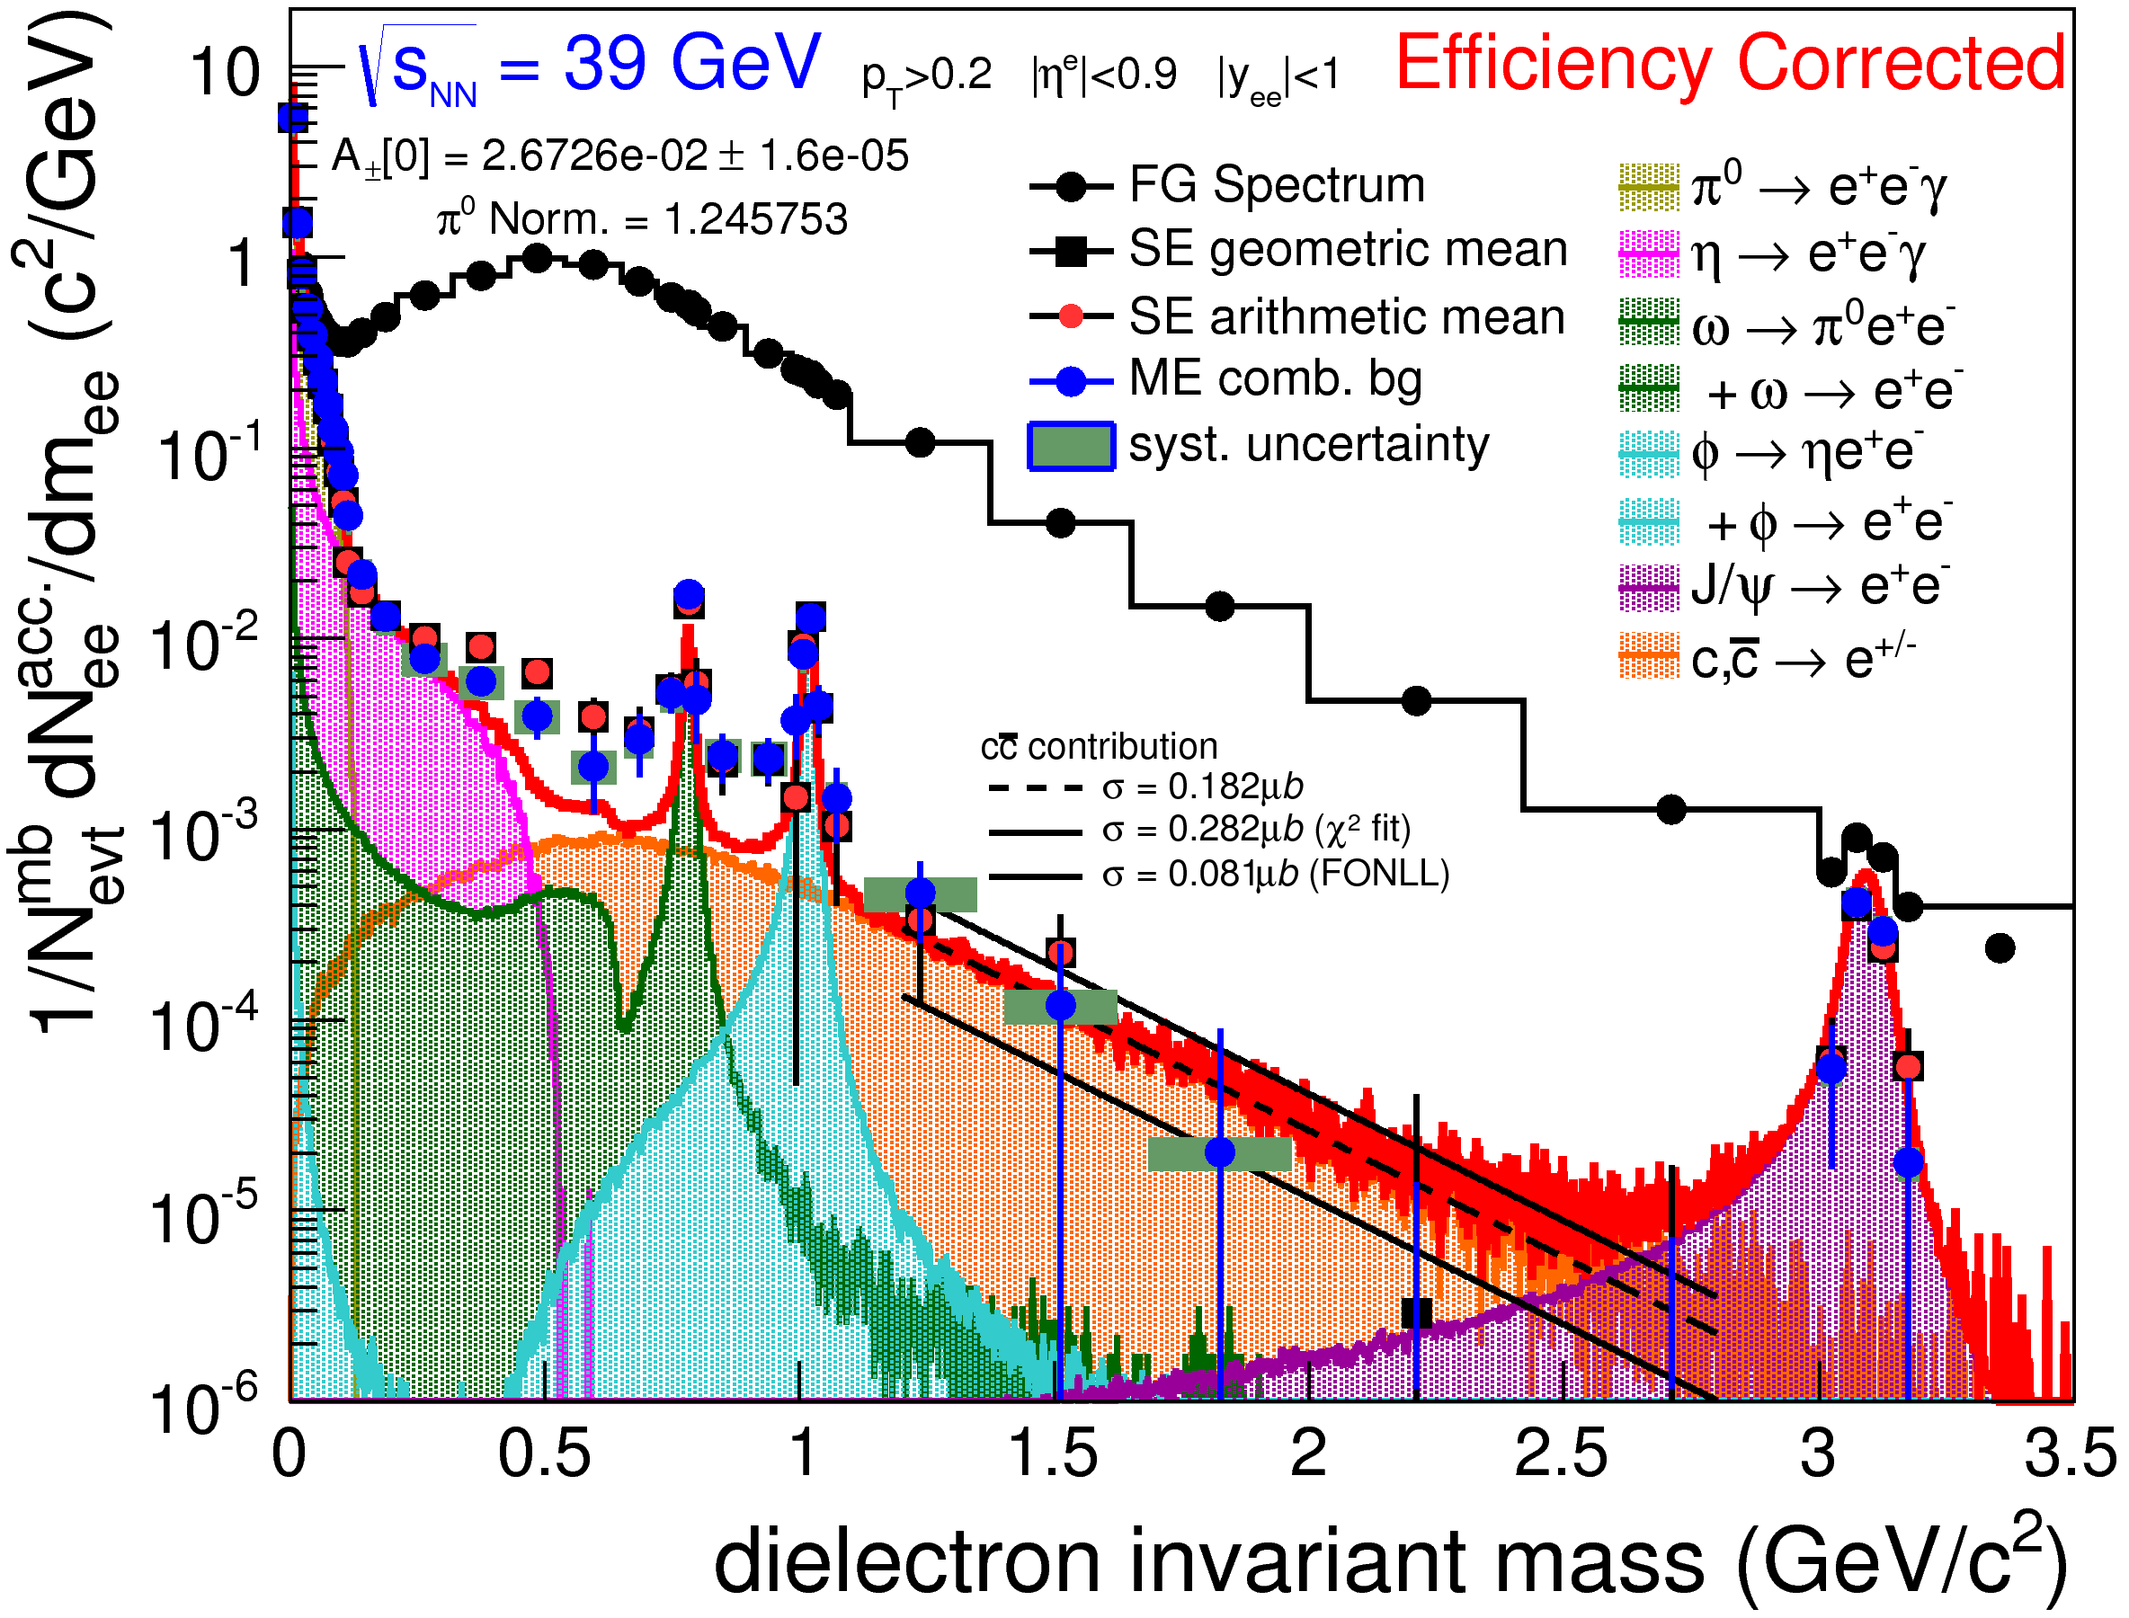
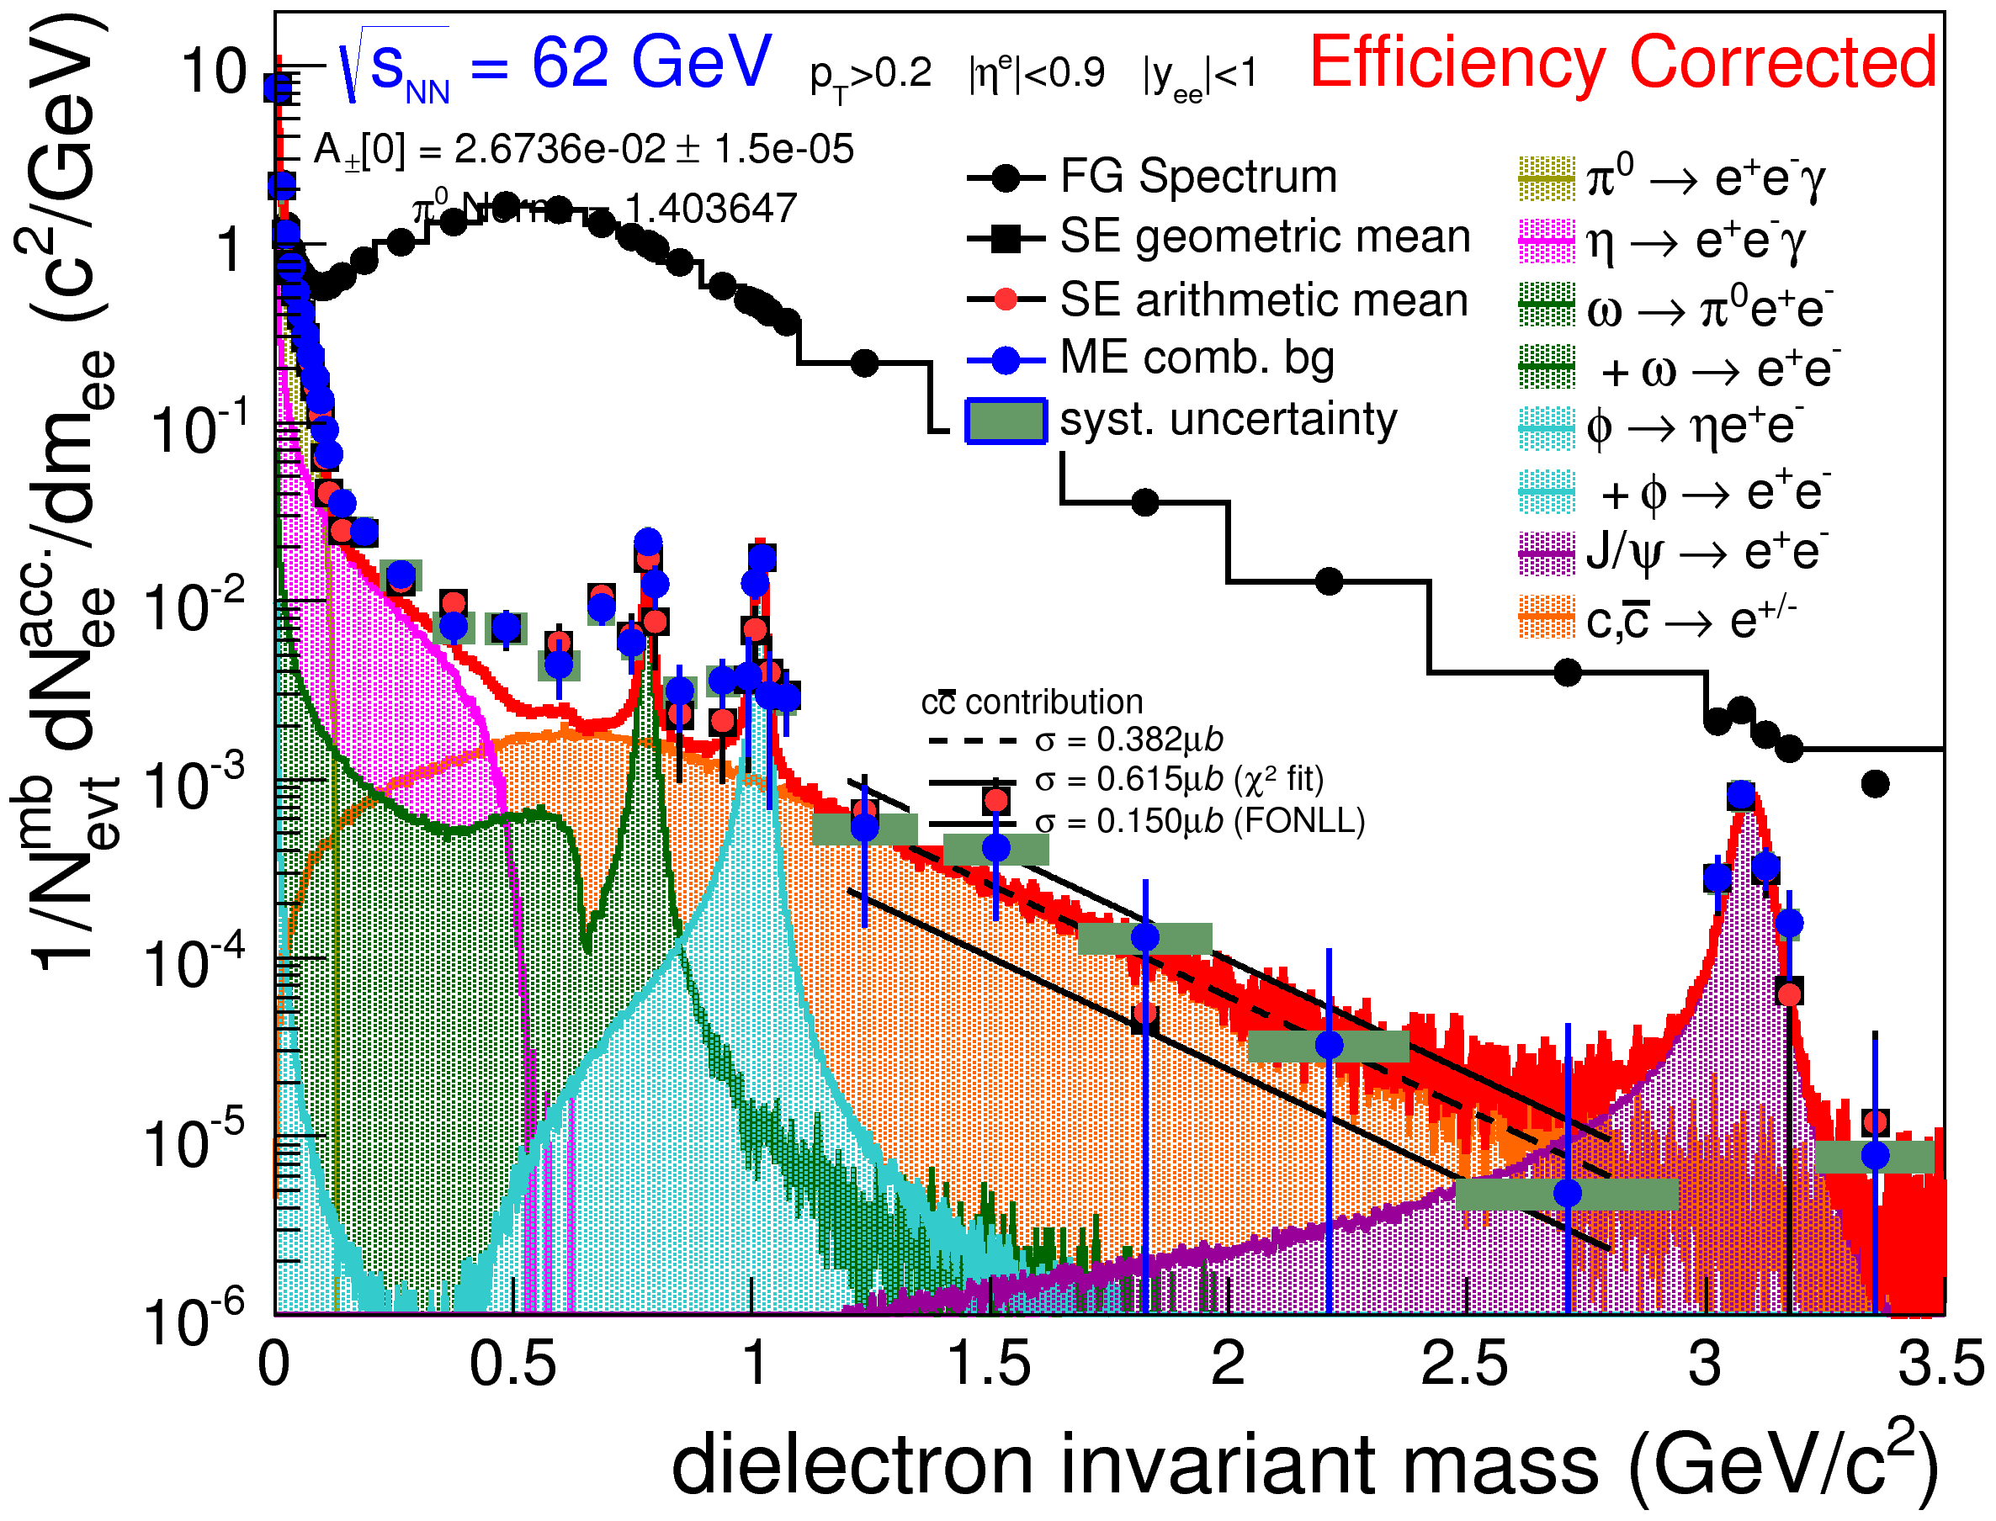
Dielectron M_{ee} for 39 and 62GeV
STAR Preliminary
STAR Preliminary
Poster: P. Huck (113)

Slide 23
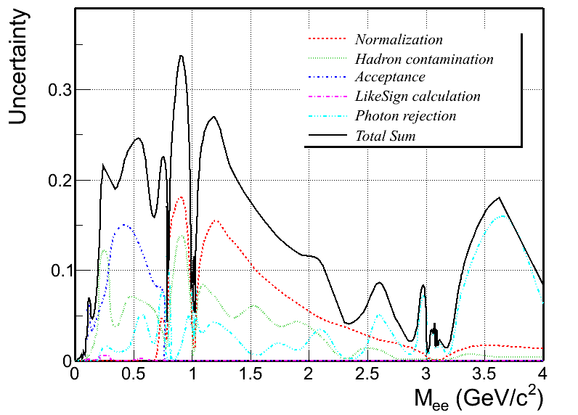
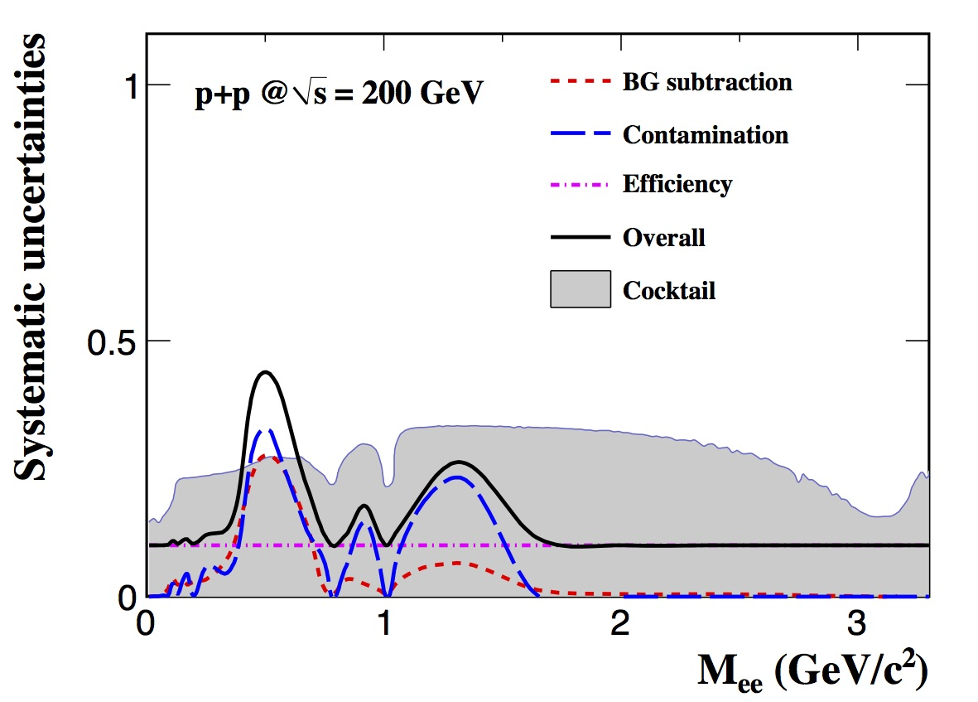
Systematic Uncertainties
p+p@200GeV
Background subtraction 0 - 27%
hadron contamination 0 - 32%
efficiency ~10%
total normalization ~11%
cocktail simulation 14 - 33%
Au+Au@200GeV
STAR Preliminary
Au+Au@19.6GeV
Tracking efficiency 7%
TOF matching 5%
Pair uncertainties (summed) 17%
cocktail uncertainties 12-20%

Slide 24
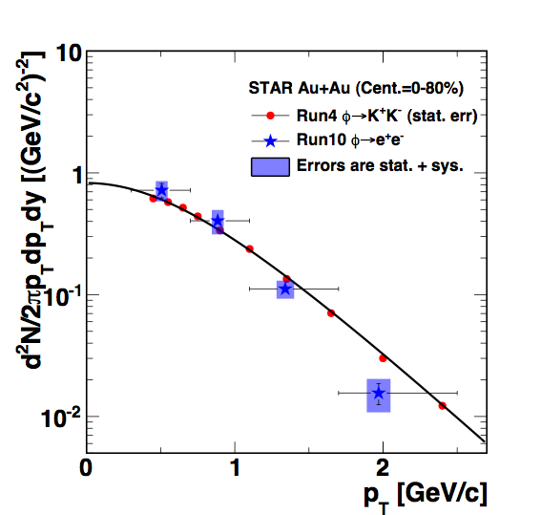
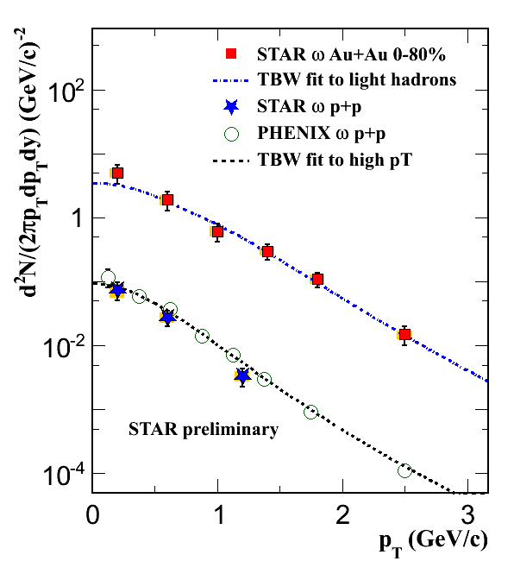
Leptonic Decay of φ and ω Mesons
Lifetimes comparable to fireball
hadronic decay daughters interact with hadronic medium
  sensitive to lifetime of that medium
leptonic decay daughters do not interact with QCD medium
  look for medium modifications to resonance mass & width
  sensitive to chiral phase transition
  small branching ratio
No evidence of φ mass shift or width broadening
  beyond known detector effects
φ yield in dilepton decay channel consistent with hadronic channel
ω p_{T} shapes agree with light hadrons
  ω mass and width are under study
Poster: M. Wada (110)

Slide 25
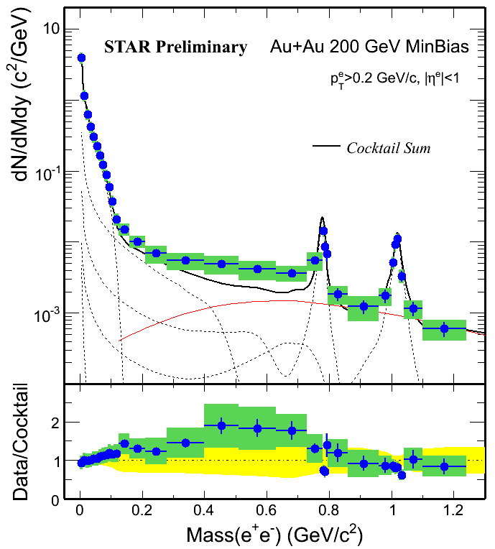
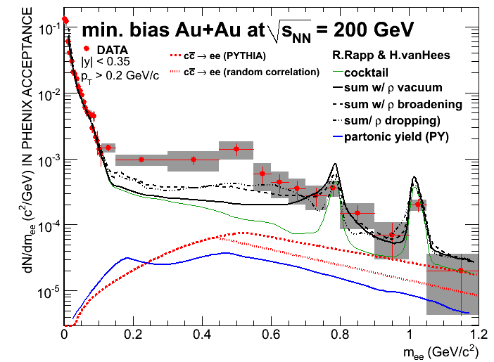
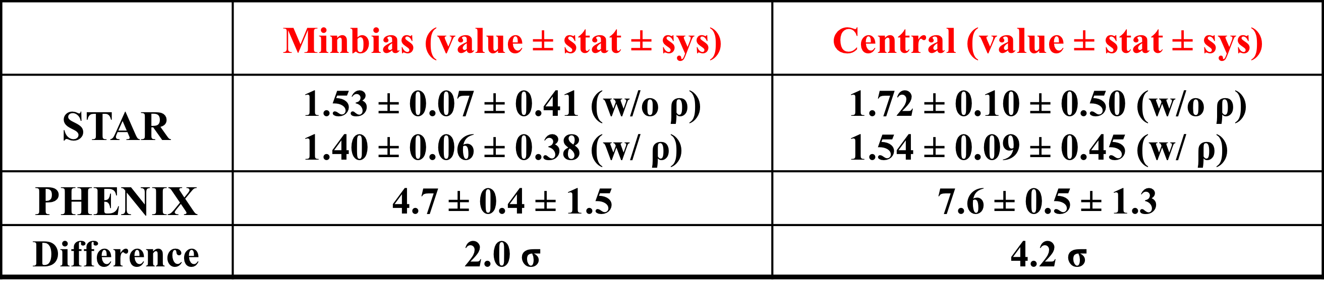
PHENIX & STAR Enhancement Factor
QM/SQM2011
Enhancement factor in 0.15<M_{ee}<0.75 Gev/c²

Slide 26
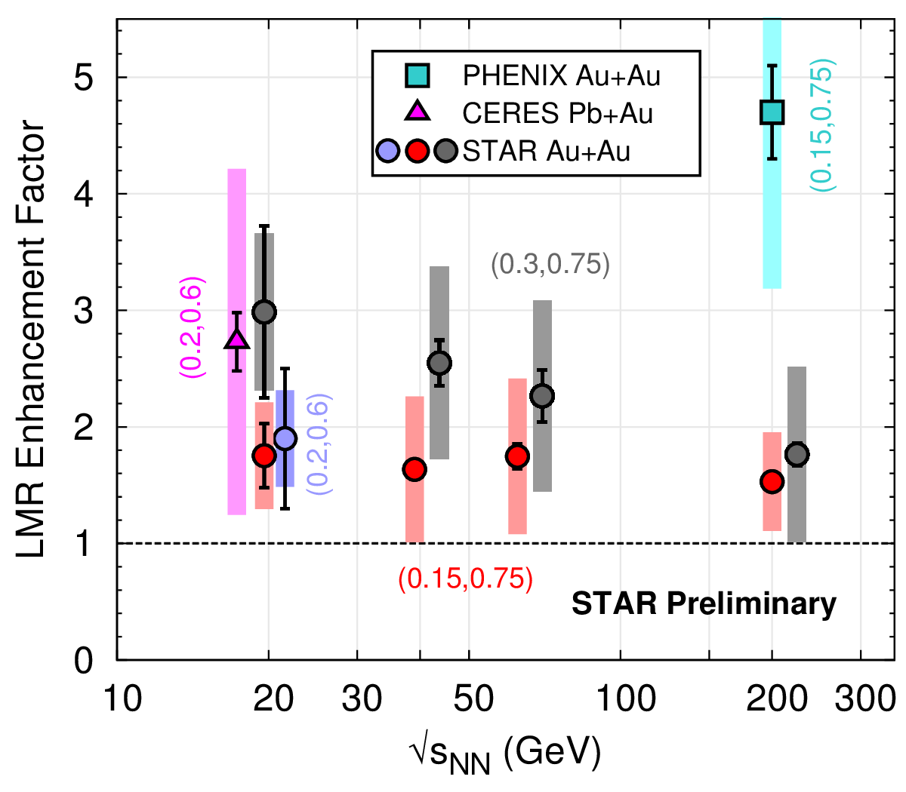
Dielectron Enhancement vs. √s_{NN}
Systematic measurements of
enhancement factor vs. √s_{NN}
STAR data shows no evident beam-energy dependence
  150-750 MeV/c² range
  low energy: comparable with CERES
  high energy: discrepancy with PHENIX
200 < M_{ee} < 600 MeV/c² range
  STAR: 1.9 ± 0.6 ± 0.4
  CERES: 2.73 ± 0.25 ± 0.65 ± 0.82 [decays]
B. Huang (3C, 268)
Poster: P. Huck (113)

Slide 27
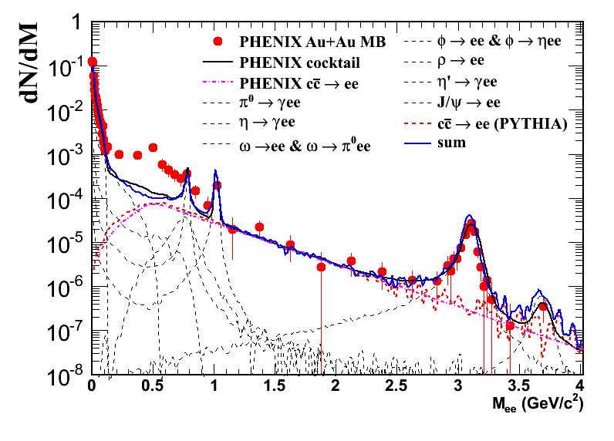
Reproducing the PHENIX Cocktail
Reproduce the cocktail within PHENIX acceptance by our method.
The momentum resolutions are still from STAR.
SQM2011
STAR preliminary
Scaled by all the yields from PHENIX paper[1], STAR reproduces the PHENIX cocktail.
[1]. Phys. Rev. C 81, 034911 (2010).

Slide 28
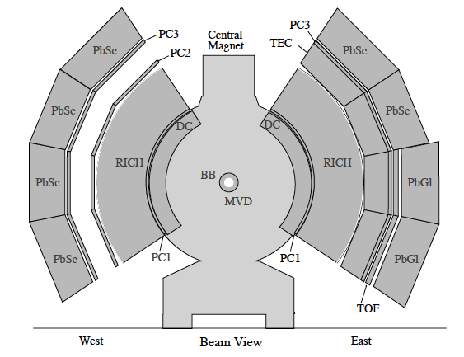
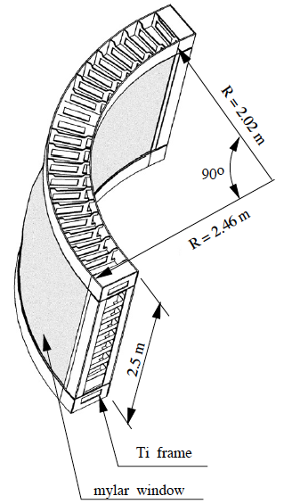
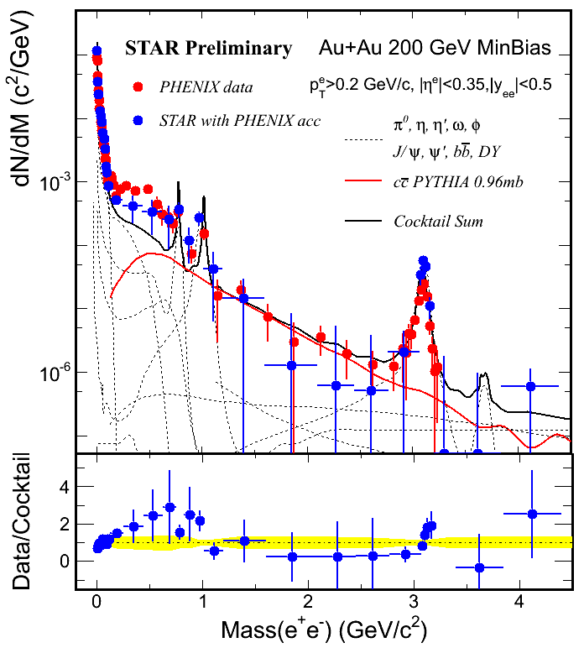
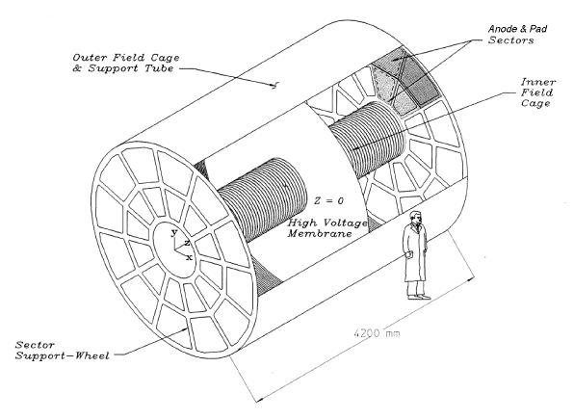
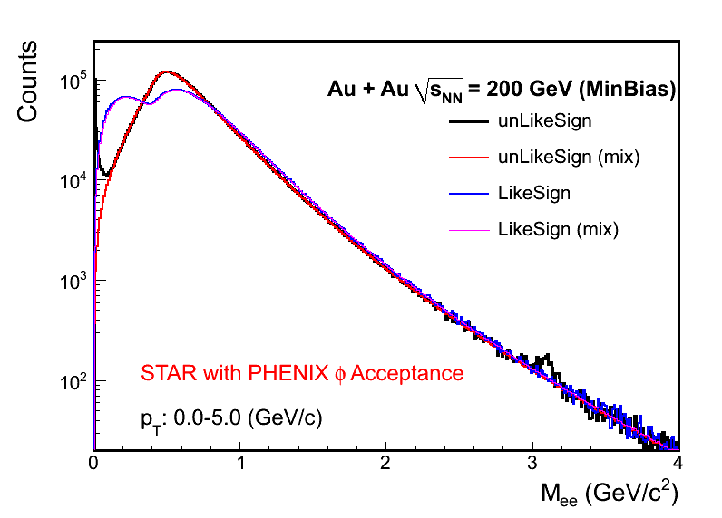
STAR with PHENIX Acceptance
STAR
  12 sectors east and west barrel
  2π coverage, |η|<1
PHENIX
  20 sectors east and west arm
  π coverage, |η|<0.35
Hard Probe 2012

