Slide 1




Towards Measurements of Chiral Effects Using Identified Particles from STAR
Liwen Wen (for the STAR Collaboration)
University of California, Los Angeles
Quark Matter 2017, Chicago, IL, USA

Slide 2
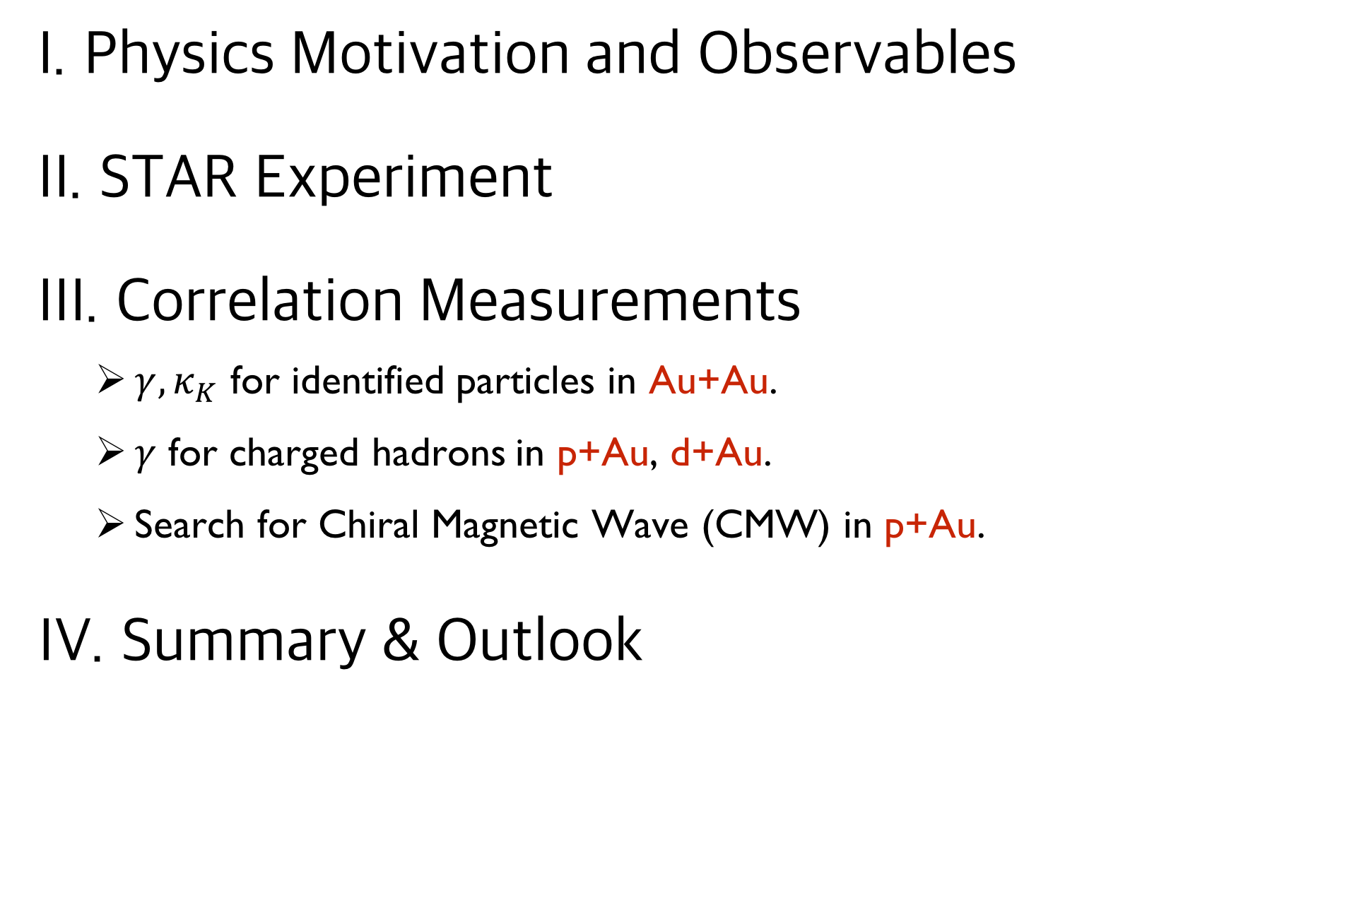
Outline
I. Physics Motivation and Observables
II. STAR Experiment
III. Correlation Measurements
  $γ, κ_{K}$ for identified particles in Au+Au.
  $γ$ for charged hadrons in p+Au, d+Au.
  Search for Chiral Magnetic Wave (CMW) in p+Au.
IV. Summary & Outlook
2

Slide 3
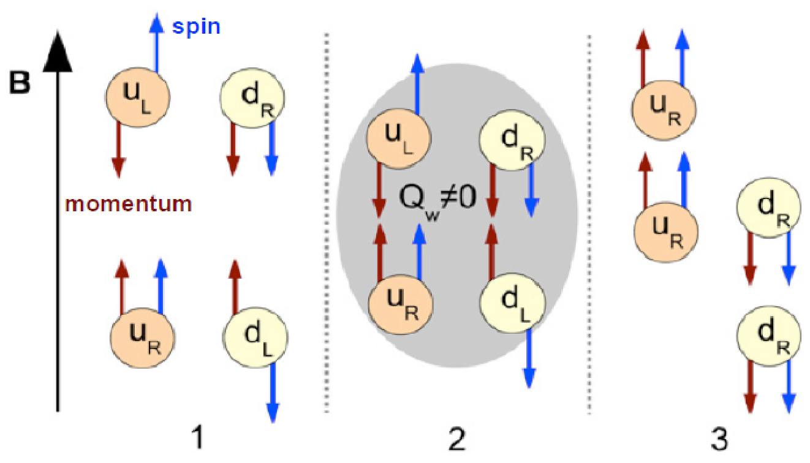

Chiral Magnetic Effect (CME)
D. Kharzeev, etc. NPA 803, 227(2008)
Non-zero topological charge induces excess of right or left handed quarks. Under strong magnetic field (B), an electric current along B direction is generated and leads to electric charge separation.
3

Slide 4
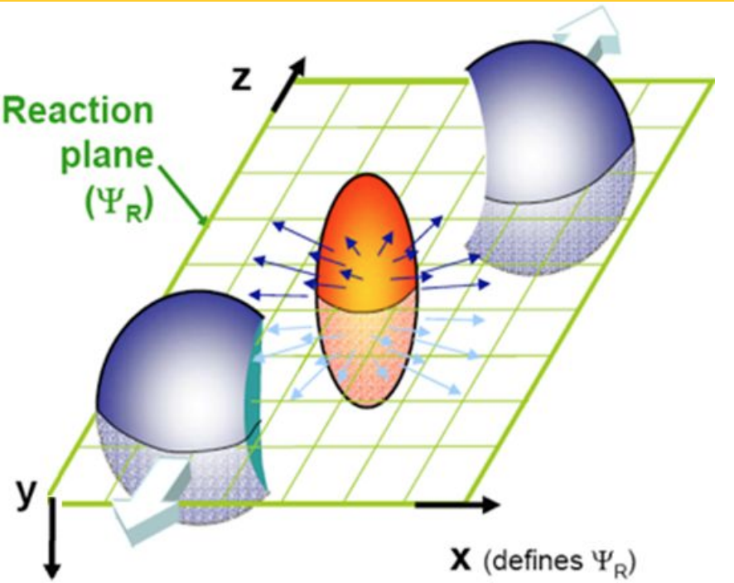


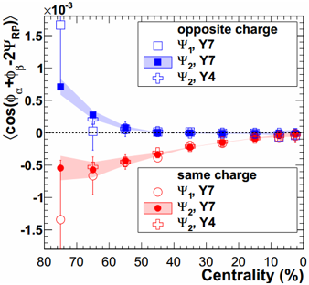




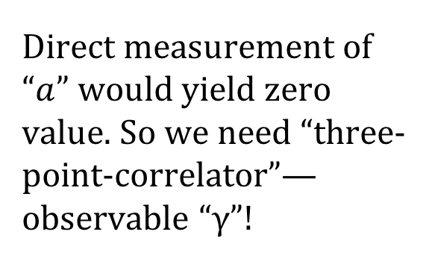
Observable: γ correlator
We investigate the charge dependent two-particle correlations with respect to the reaction plane:
S. Voloshin, Physical Review C. 70 (2004) 057901
Direct measurement of “$a$” would yield zero value. So we need “three-point-correlator”— observable “γ”!
PHYSICAL REVIEW C 81, 054908 (2010)
STAR
Directed flow: expected to be same for “same sign” and “opposite sign”
Background effects: could cancel out, but flow-related background may still exist.
P-even quantity: still sensitive to separation effect, i.e., different for “same sign” and “opposite sign”
4
4￼

Slide 5
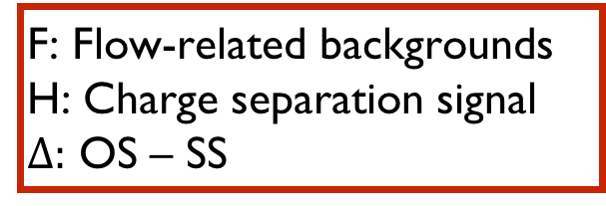

Background!
A. Bzdak, V. Koch and J. Liao, Lect. Notes Phys. 871, 503 (2013).
$$δ≡〈\cos\left(φ_{1}−φ_{2}\right)〉=F+H$$
F: Flow-related backgrounds
H: Charge separation signal
$Δ:$ OS – SS
$$γ≡〈\cos\left(φ_{1}+φ_{2}−2ψ_{ep}\right)〉=κv_{2}F−H$$
5

Slide 6
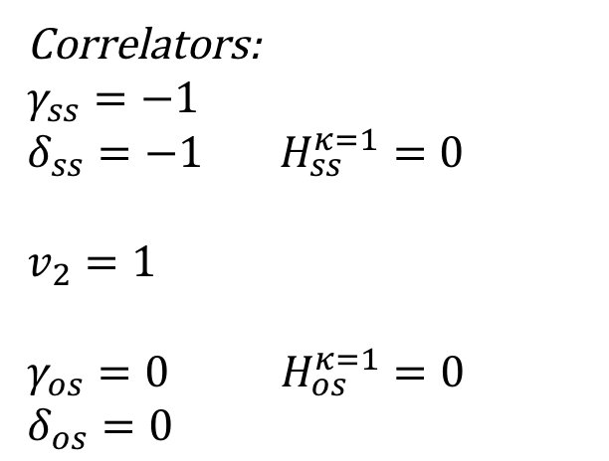
Background!
A. Bzdak, V. Koch and J. Liao, Lect. Notes Phys. 871, 503 (2013).
$$δ≡〈\cos\left(φ_{1}−φ_{2}\right)〉=F+H$$
F: Flow-related backgrounds
H: Charge separation signal
$Δ:$ OS – SS
$$γ≡〈\cos\left(φ_{1}+φ_{2}−2ψ_{ep}\right)〉=κv_{2}F−H$$
Flow
Momentum Conservation
Local Charge Conservation
Decay
Correlators:
$$γ_{ss}=−1$$
$δ_{ss}=−1$ $H_{ss}^{κ=1}=0$
$$v_{2}=1$$
$γ_{os}=0$ $H_{os}^{κ=1}=0$
$$δ_{os}=0$$
H is more robust!
6

Slide 7
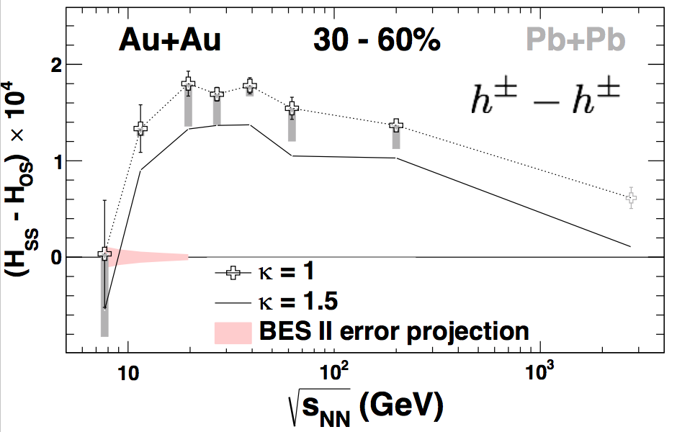
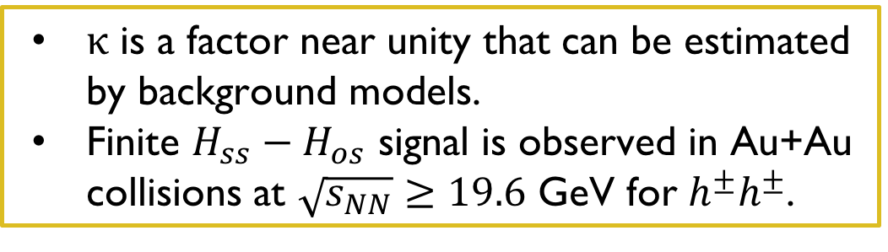
Background!
A. Bzdak, V. Koch and J. Liao, Lect. Notes Phys. 871, 503 (2013).
$$δ≡〈\cos\left(φ_{1}−φ_{2}\right)〉=F+H$$
F: Flow-related backgrounds
H: Charge separation signal
$Δ:$ OS – SS
$$γ≡〈\cos\left(φ_{1}+φ_{2}−2ψ_{ep}\right)〉=κv_{2}F−H$$
Flow
Momentum Conservation
Local Charge Conservation
Decay
Correlators:
$$γ_{ss}=−1$$
$δ_{ss}=−1$ $H_{ss}^{κ=1}=0$
$$v_{2}=1$$
$γ_{os}=0$ $H_{os}^{κ=1}=0$
$$δ_{os}=0$$
$κ$ is a factor near unity that can be estimated by background models.
Finite $H_{ss}−H_{os}$ signal is observed in Au+Au collisions at $\sqrt{s_{NN}}≥19.6$ GeV for $h^{±}h^{±}$.
H is more robust!
7

Slide 8
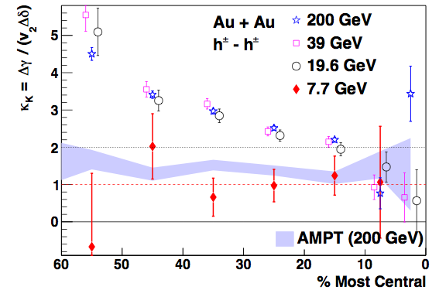
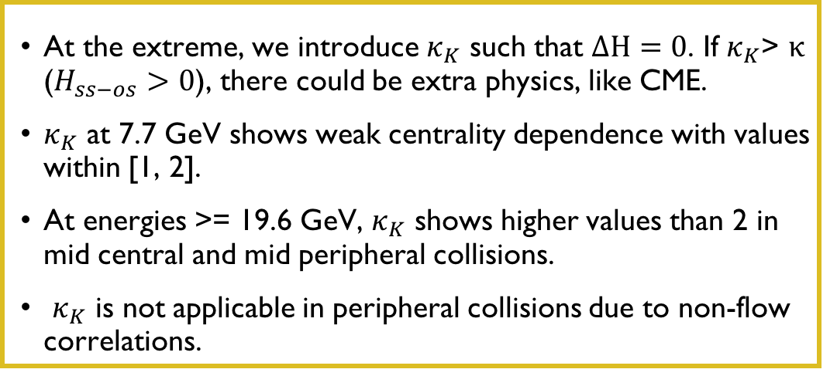


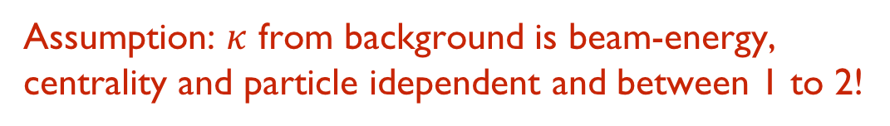
$κ_{K}$: scaled bg+signal
A. Bzdak, V. Koch and J. Liao, Lect. Notes Phys. 871, 503 (2013).
$$δ≡〈\cos\left(φ_{1}−φ_{2}\right)〉=F+H$$
$$γ≡〈\cos\left(φ_{1}+φ_{2}−2ψ_{ep}\right)〉=κv_{2}F−H$$
At the extreme, we introduce $κ_{K}$ such that $ΔH=0$. If $κ_{K}$> $κ$ ($H_{ss−os}>0$), there could be extra physics, like CME.
$κ_{K}$ at 7.7 GeV shows weak centrality dependence with values within [1, 2].
At energies >= 19.6 GeV, $κ_{K}$ shows higher values than 2 in mid central and mid peripheral collisions.
$κ_{K}$ is not applicable in peripheral collisions due to non-flow correlations.
Assumption: $κ$ from background is beam-energy,
centrality and particle idependent and between 1 to 2!
Charge may not be conserved in this version of AMPT
Wen, Wen & Wang, arXiv: 1608.03205
8

Slide 9
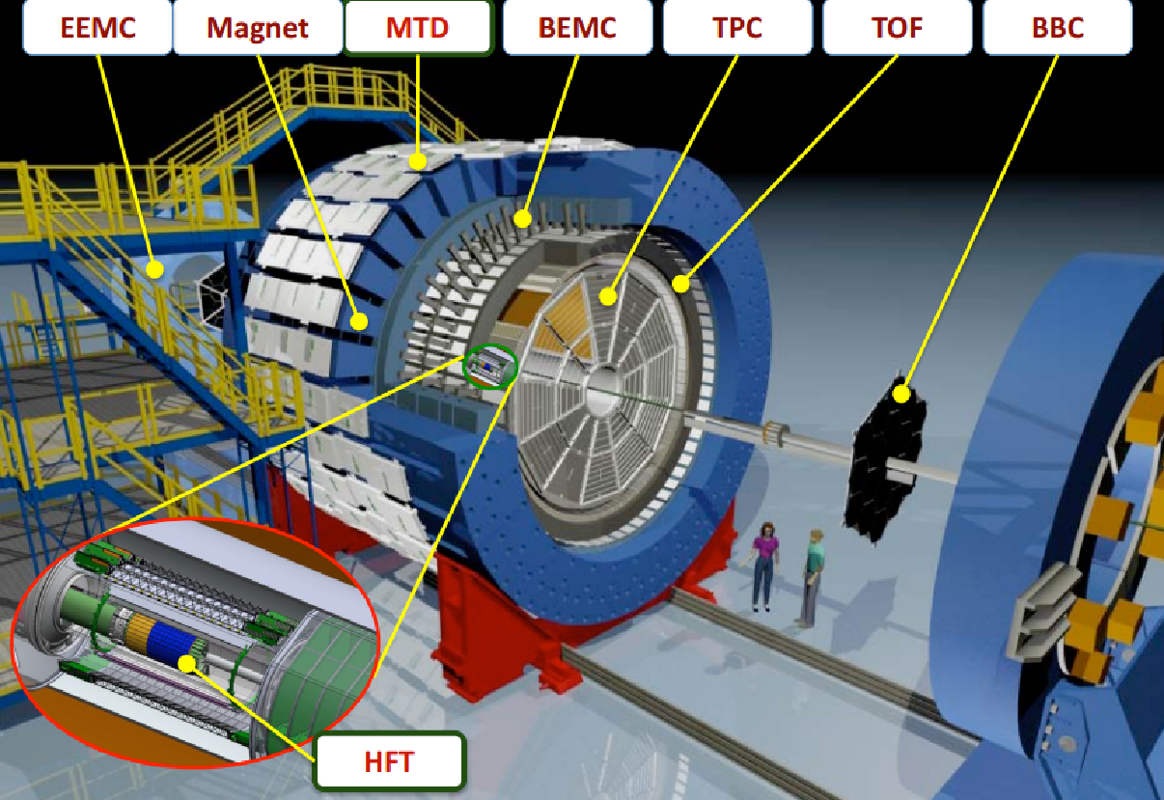
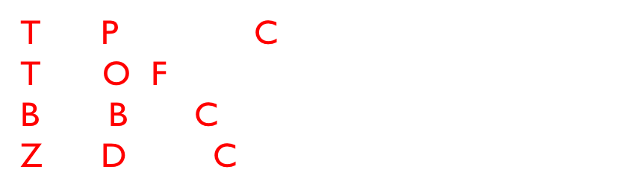
Solenoidal Tracker At RHIC (STAR)
Time Projection Chamber: $\left|η\right|<1$
Time-Of-Flight: $\left|η\right|<1$
Beam-Beam Counter: $3.8<\left|η\right|<5.2$
Zero Degree Calorimeter: $\left|η\right|$ > 6
9

Slide 10
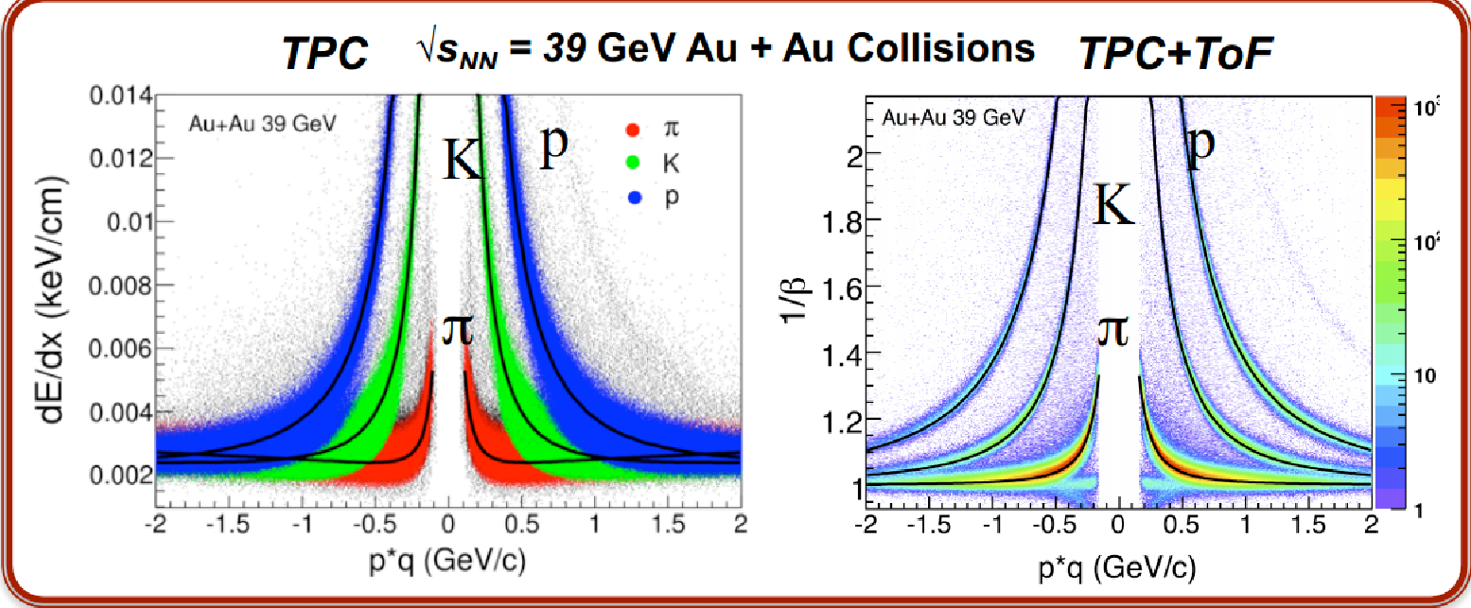
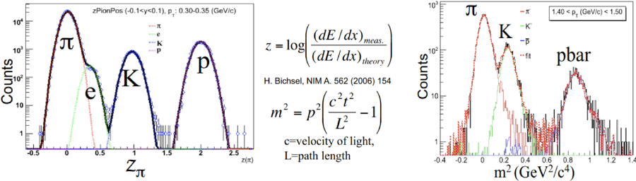




STAR Particle Identification
STAR Preliminary
STAR Preliminary
$p_{T}$: 0.30 - 0.35 GeV/c
1.4 GeV/c < $p_{T}$ <1.5 GeV/c
y : -0.1 - 0.1
10

Slide 11
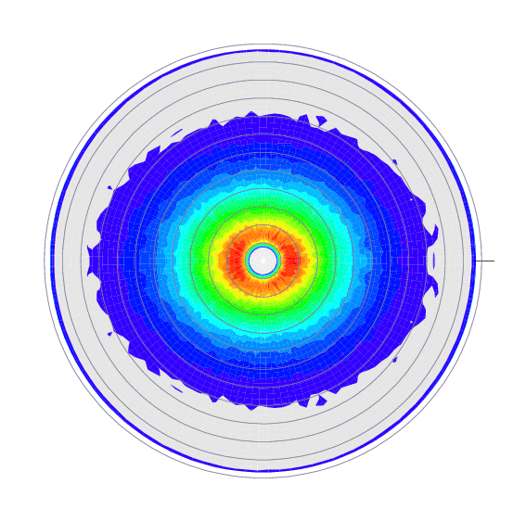
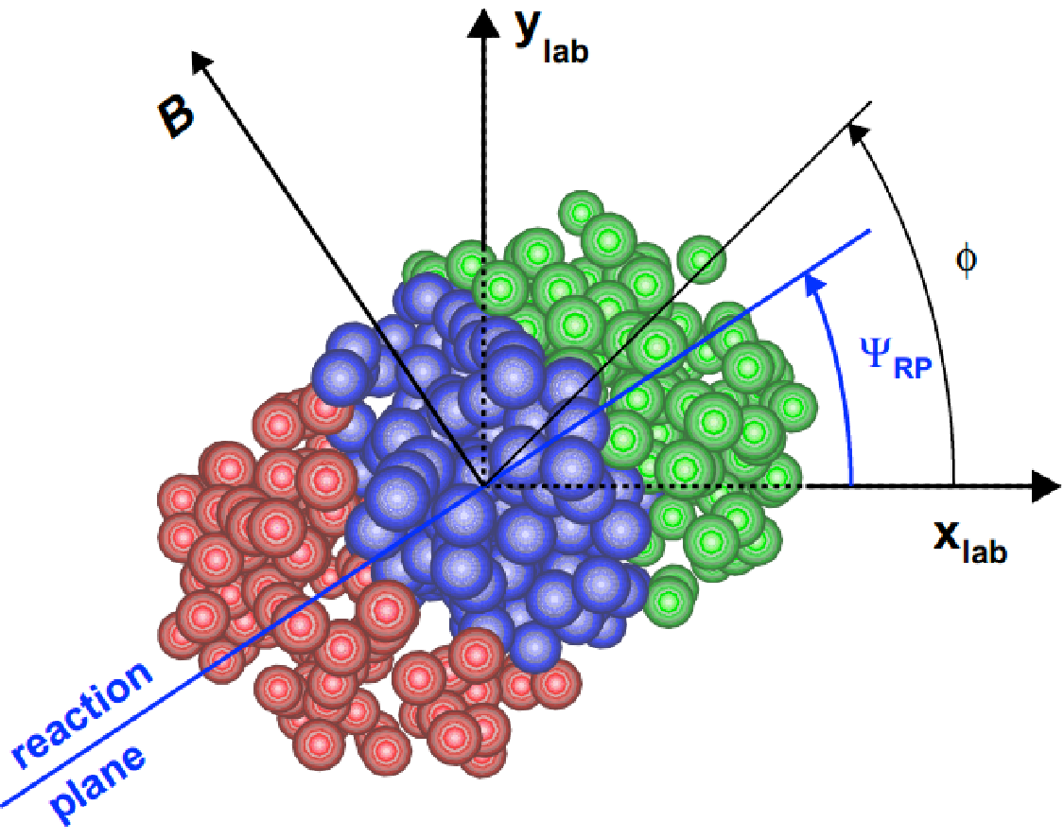
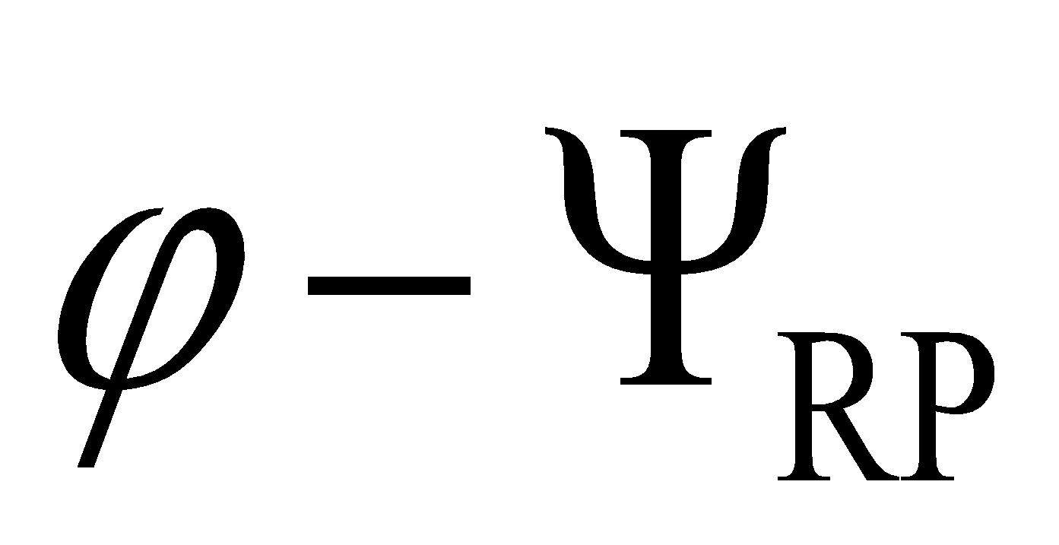
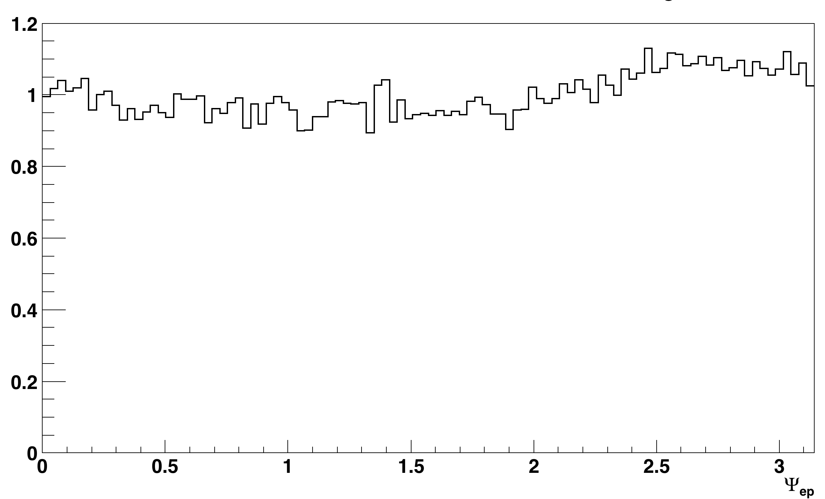
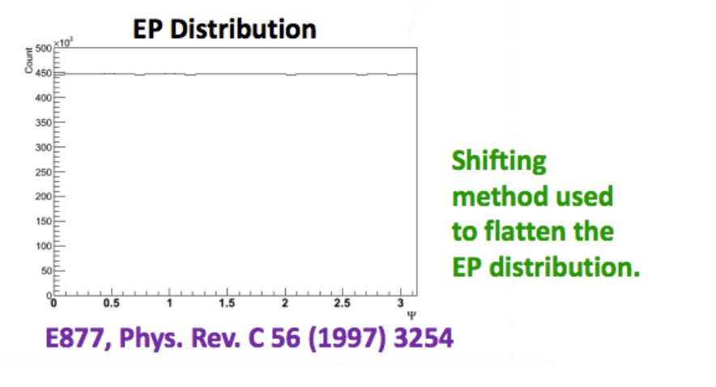
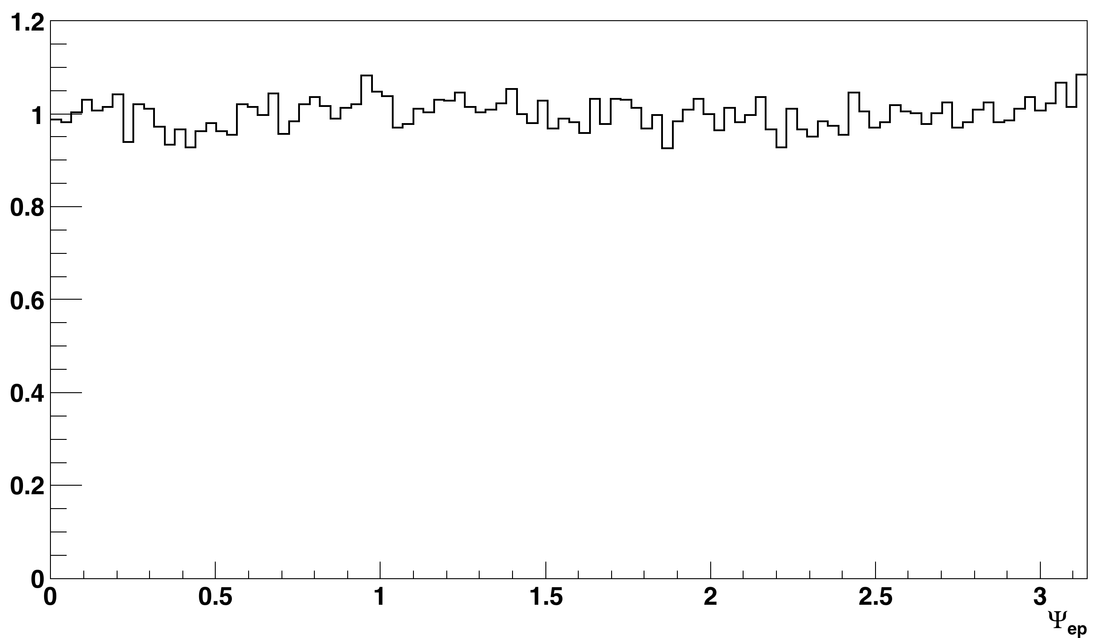
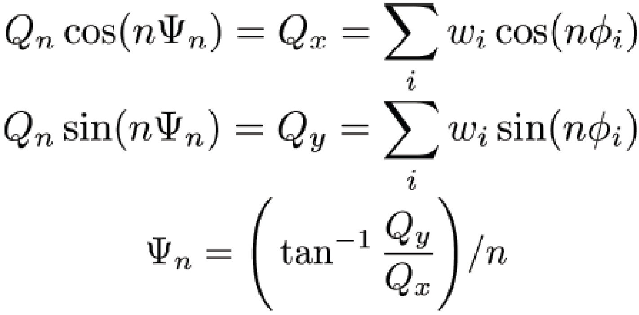


TPC Event Plane Reconstruction
p_{T}
before
after
before
after
$$Ψ_{ep}$$
$$Ψ_{ep}$$
The estimated reaction plane is called the event plane.
Other methods are also used in this study to reconstruct event planes by using BBC and ZDC in small systems.
11

Slide 12

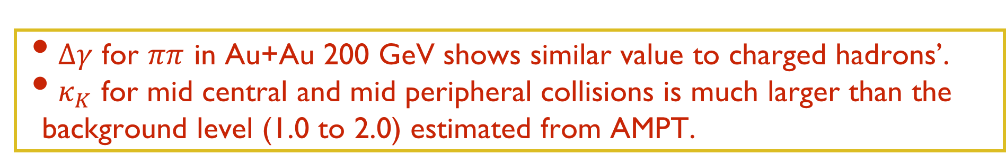
$ππ$ correlation, Au+Au 200 GeV
$Δγ$ for $ππ$ in Au+Au 200 GeV shows similar value to charged hadrons’.
$κ_{K}$ for mid central and mid peripheral collisions is much larger than the background level (1.0 to 2.0) estimated from AMPT.
12

Slide 13

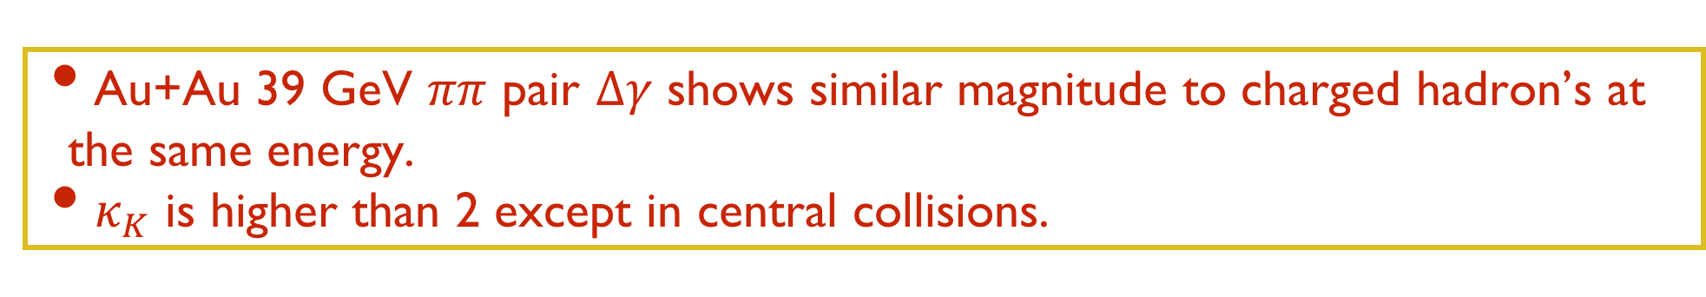
$ππ$ correlation, Au+Au 39GeV
Au+Au 39 GeV $ππ$ pair $Δγ$ shows similar magnitude to charged hadron’s at the same energy.
$κ_{K}$ is higher than 2 except in central collisions.
13

Slide 14


$πK$correlation
STAR Preliminary
STAR Preliminary
$Δγ$ for $πK$ pair is finite in Au+Au at both 200 GeV and 39 GeV.
$κ_{K}$ values are close to or below 2, making it hard to distinguish from background.
14

Slide 15


$pπ$correlation
STAR Preliminary
STAR Preliminary
$Δγ$ for $pπ$ pair is finite in Au+Au at both 200 GeV and 39 GeV.
$κ_{K}$ values are close to or below 2, making it hard to distinguish from background.
15

Slide 16

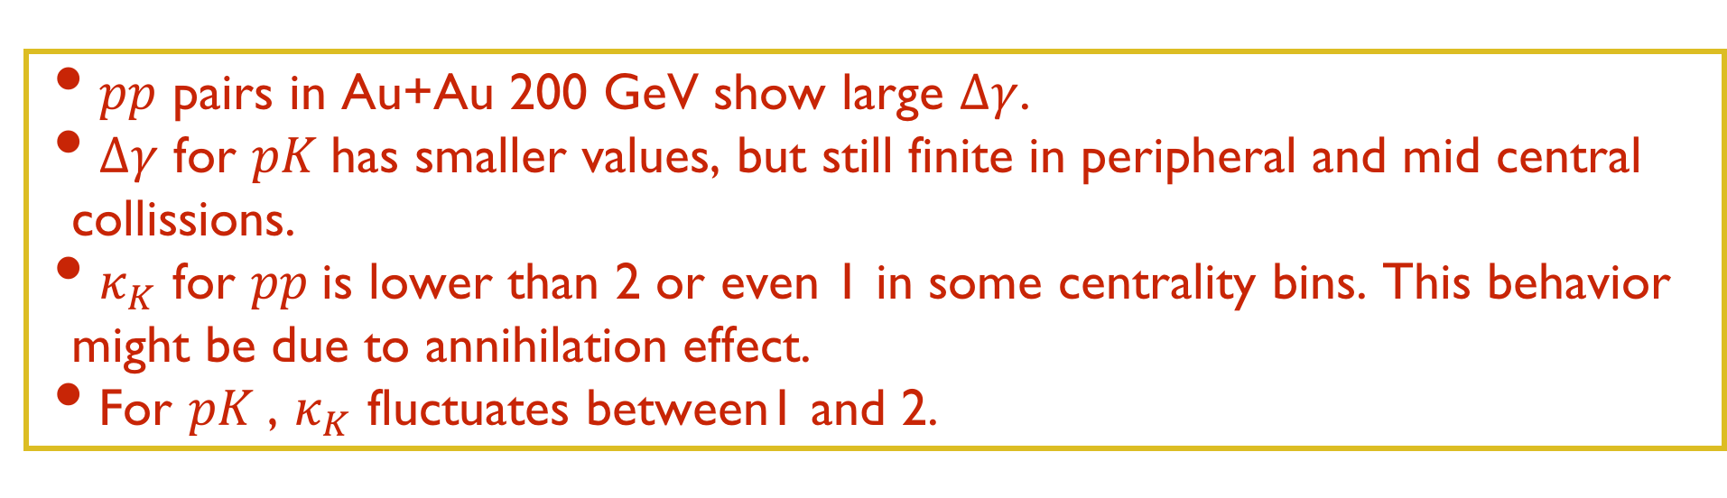
$pp$and $pK$correlation
STAR Preliminary
$pp$ pairs in Au+Au 200 GeV show large $Δγ$.
$Δγ$ for $pK$has smaller values, but still finite in peripheral and mid central collissions.
$κ_{K}$ for $pp$is lower than 2 or even 1 in some centrality bins. This behavior might be due to annihilation effect.
For $pK$, $κ_{K}$ fluctuates between1 and 2.
16

Slide 17
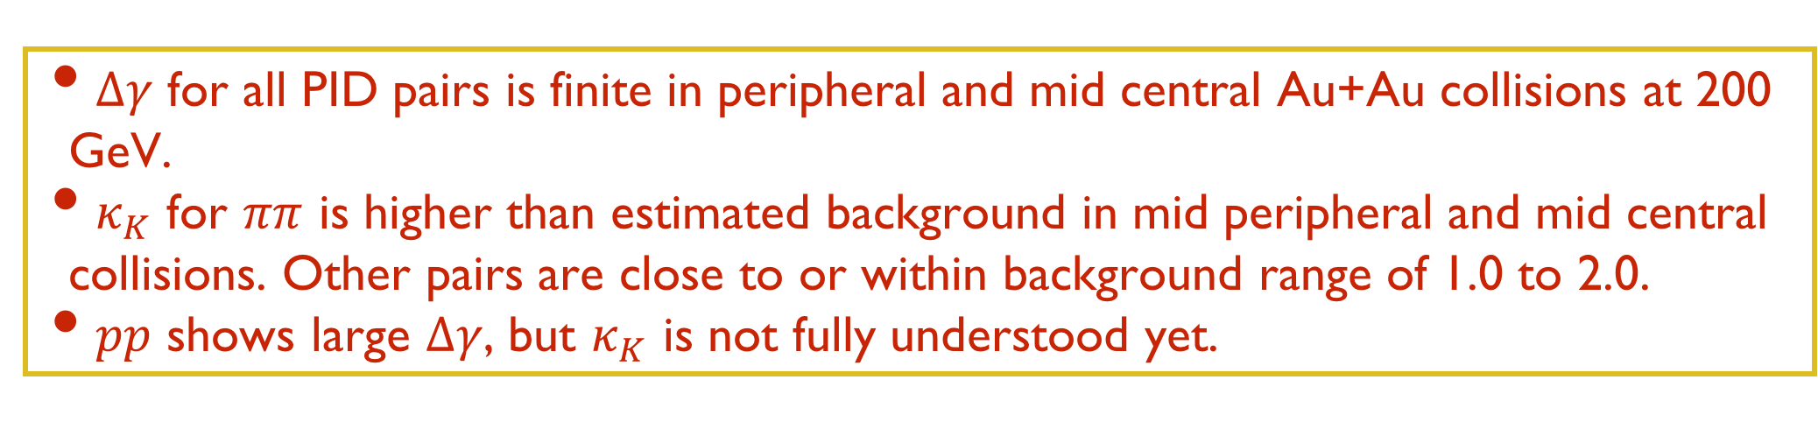
PID summary
STAR Preliminary
$Δγ$ for all PID pairs is finite in peripheral and mid central Au+Au collisions at 200 GeV.
$κ_{K}$ for $ππ$ is higher than estimated background in mid peripheral and mid central collisions. Other pairs are close to or within background range of 1.0 to 2.0.
$pp$ shows large $Δγ$, but $κ_{K}$ is not fully understood yet.
17

Slide 18
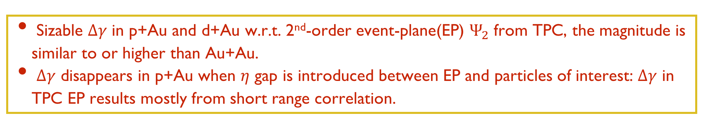

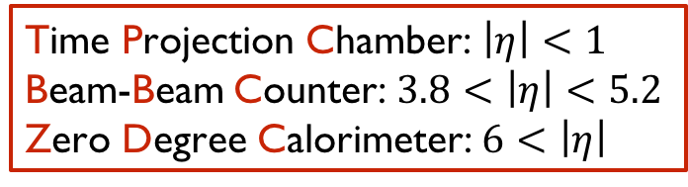
$γ$ correlation in p+Au and d+Au
Time Projection Chamber: $\left|η\right|<1$
Beam-Beam Counter: $3.8<\left|η\right|<5.2$
Zero Degree Calorimeter: $6<\left|η\right|$
HT (High Tower): trigger on electromagnetic energy
See J. Zhao’s poster(A12)
Sizable $Δγ$ in p+Au and d+Au w.r.t. 2nd-order event-plane(EP) $Ψ_{2}$ from TPC, the magnitude is similar to or higher than Au+Au.
$Δγ$ disappears in p+Au when $η$ gap is introduced between EP and particles of interest: $Δγ$ in TPC EP results mostly from short range correlation.
18

Slide 19
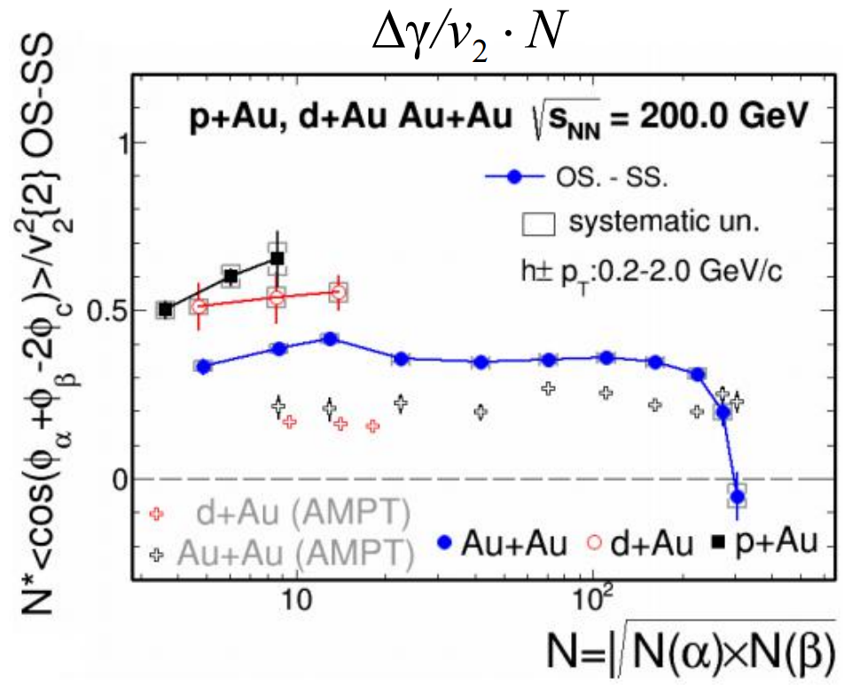
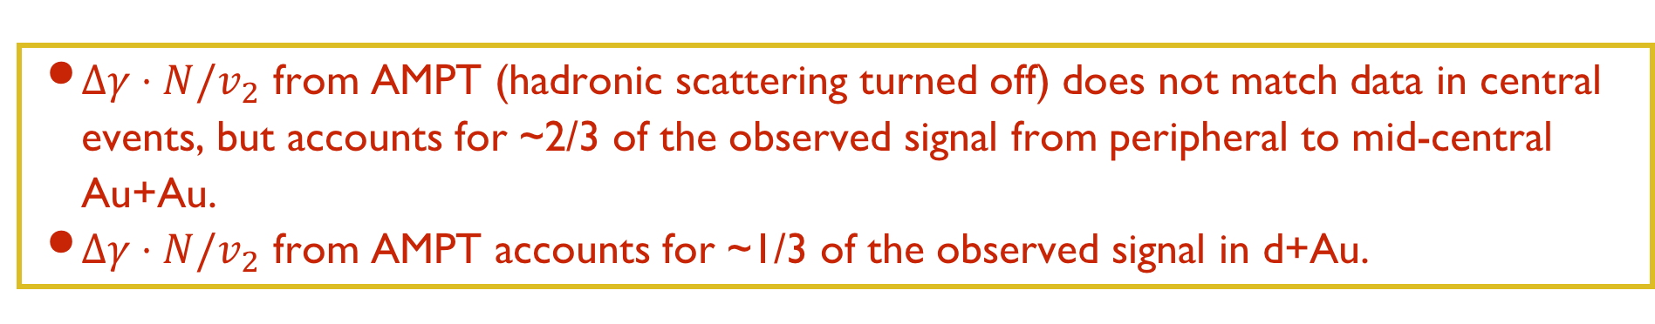
Another scaling scheme
$Δγ⋅N/v_{2}$ from AMPT (hadronic scattering turned off) does not match data in central events, but accounts for ~2/3 of the observed signal from peripheral to mid-central Au+Au.
$Δγ⋅N/v_{2}$ from AMPT accounts for ~1/3 of the observed signal in d+Au.
19

Slide 20
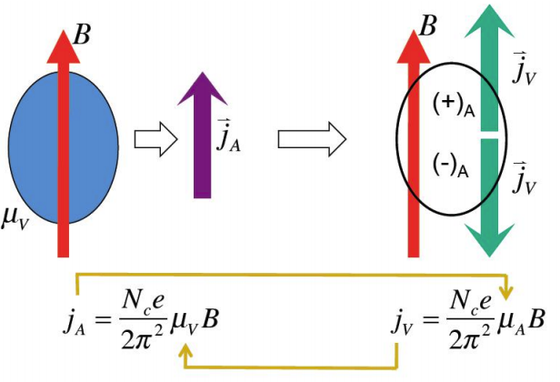
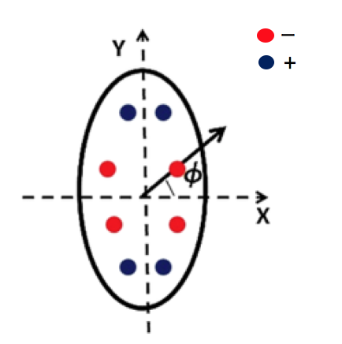
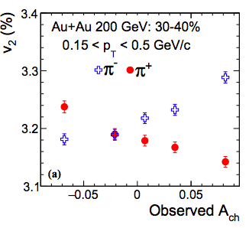
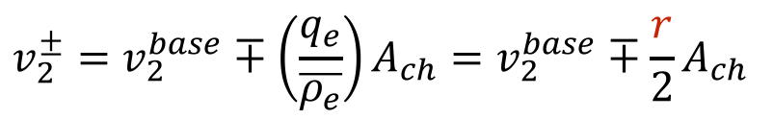
Chiral Magnetic Wave(CMW)
Y. Burnier, D. E. Kharzeev, J. Liao and H-U Yee, Phys. Rev. Lett. 107 (2011)052303
Chiral Separation Effect
Chiral Magnetic Effect
Chiral Magnetic Wave
Formation of electric quadrupole moment results from CMW: the “poles” of fireball acquire additional positive charges while the “equator” acquires additional negative charges.
Observable:
$$v_{2}^{±}=v_{2}^{base}∓\left(\frac{q_{e}}{\overline{ρ_{e}}}\right)A_{ch}=v_{2}^{base}∓\frac{r}{2}A_{ch}$$
STAR, Phys. Rev. Lett. 114 (2015) 252302
20

Slide 21
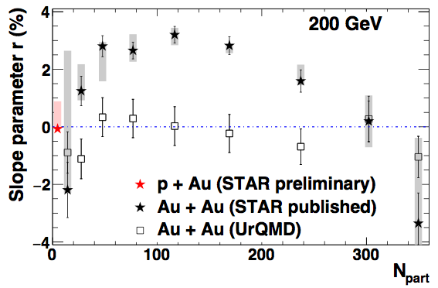
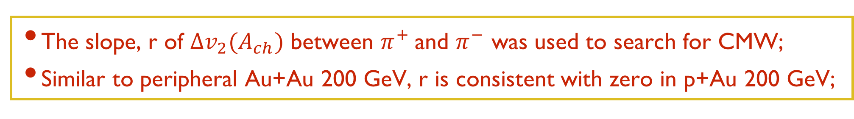
Chiral Magnetic Wave in p+Au?
STAR, Phys. Rev. Lett. 114 (2015) 252302
The slope, r of $Δv_{2}(A_{ch})$ between $π^{+}$and $π^{−}$ was used to search for CMW;
Similar to peripheral Au+Au 200 GeV, r is consistent with zero in p+Au 200 GeV;
21

Slide 22
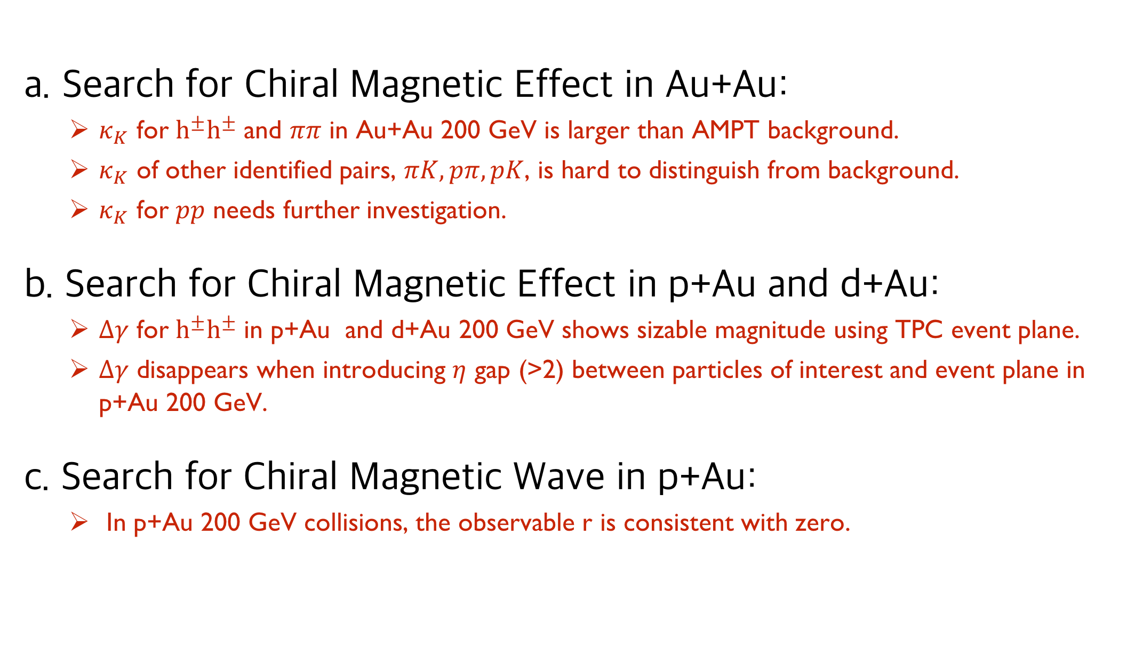
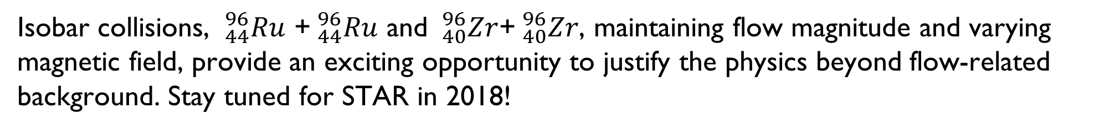
Summary and Outlook
a. Search for Chiral Magnetic Effect in Au+Au:
  $κ_{K}$ for $h^{±}h^{±}$ and $ππ$ in Au+Au 200 GeV is larger than AMPT background.
  $κ_{K}$ of other identified pairs, $πK, pπ, pK$, is hard to distinguish from background.
  $κ_{K}$ for $pp$ needs further investigation.
b. Search for Chiral Magnetic Effect in p+Au and d+Au:
  $Δγ$ for $h^{±}h^{±}$ in p+Au and d+Au 200 GeV shows sizable magnitude using TPC event plane.
  $Δγ$ disappears when introducing $η$ gap (>2) between particles of interest and event plane in p+Au 200 GeV.
c. Search for Chiral Magnetic Wave in p+Au:
  In p+Au 200 GeV collisions, the observable r is consistent with zero.
Summary:
Outlook:
Isobar collisions, $_{44}^{96}Ru$ +$_{44}^{96}Ru$ and $_{40}^{96}Zr$+$_{40}^{96}Zr$, maintaining flow magnitude and varying magnetic field, provide an exciting opportunity to justify the physics beyond flow-related background. Stay tuned for STAR in 2018!
22

Slide 23
Back up slides
23

Slide 24
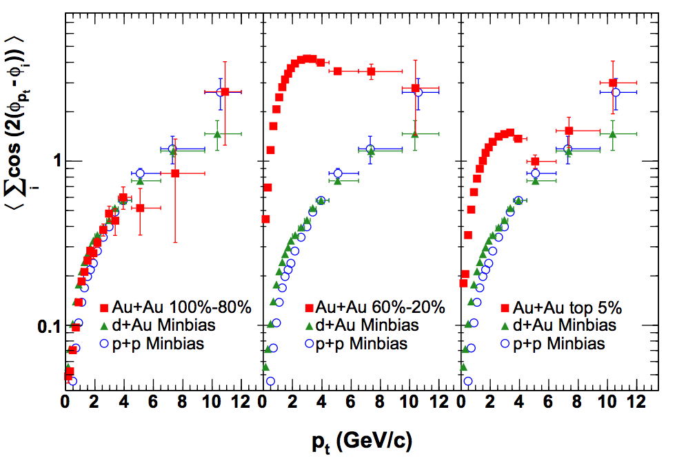
Non-flow in peripheral collisions
PHYSICAL REVIEW C 72, 014904 (2005)
Non-flow dominated in peripheral Au+Au collisions
24

Slide 25

Peripheral $κ_{K}$?
Phys. Rev. Lett. 113 (2014) 52302
25

