Slide 1





Measurement of the cumulants of net-proton multiplicity distribution in Au+Au collisions at
√s_{NN} = 7.7 - 200 GeV
Roli Esha
(for the STAR Collaboration)
Notes:
Hello, Thankyou for the opportunity to speak at the Quark Matter 2017. I will be talking about the measurement of the cumulants of the net-proton multiplicity distribution in Au+Au collisions from the STAR experiment.

Slide 2
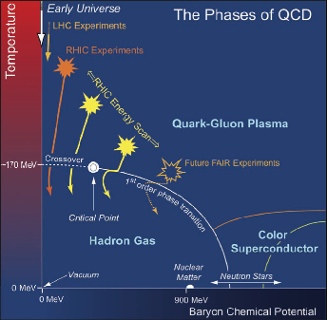
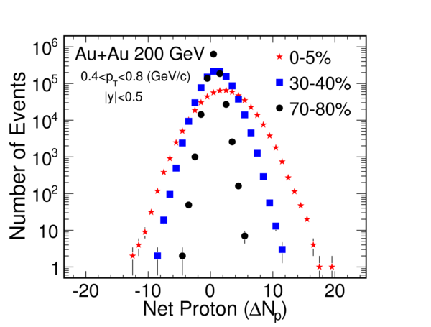




Fluctuation of Conserved Quantities
QCD critical point at large 𝜇_{B}
Connection to the susceptibility of the system (χ)
Higher order cumulants are more sensitive to the signatures of QCD phase transition
$$χ_{q}^{(n)}= \frac{1}{VT^{3}} × C_{n,q}= \frac{∂^{n}(p/T^{4})}{∂{(μ_{q}/T)}^{n}}$$
$$q=B,Q,S$$
Experimental evidence of smooth crossover at 𝜇_{B} = 0
$$\frac{{ χ}_{q}^{(4)}}{{ χ}_{q}^{(2)} } = \frac{C_{4,q}}{C_{2,q}}$$
$$\frac{{ χ}_{q}^{(6)}}{{ χ}_{q}^{(2)} } = \frac{C_{6,q}}{C_{2,q}}$$
STAR Collaboration, Phys.Rev.Lett. 105 (2010) 022302
M. A. Stephanov, Phys. Rev. Lett. 102, 032301 (2009).
M. Asakawa, S. Ejiri and M. Kitazawa, Phys. Rev. Lett. 103, 262301 (2009).
M. A. Stephanov, Phys. Rev. Lett. 107, 052301 (2011).
Notes:
Establishing the phase diagram of strong interaction has been one of the major goals of high energy heavy ion collisions. Spanned by Temperature on Y axis and Baryon chemical potential on X-axis, the distinct phases of Quark Gluon Plasma and Hadron Gas have been established experimentally. The transition is a crossover for low baryon chemical potential, with the crossover temperatures around 160 MeV. QCD based models suggest it to be a first order phase transition for large baryon chemical potential that ends in a second order critical point.
Susceptibility is defined as the derivative of free energy density or pressure of a thermodynamic system at a given temperature with respect to the chemical potential. In our case, it can be charge, strangeness and baryon chemical potential. The cumulants of net-charge, net-strangeness and net-baryon are related to the respective susceptibility. We construct the ratios of cumulants as the experimental observables, which cancel the volume dependence and can be directly compared with the ratios of susceptibilities from theoretical calculations.
The figure shows a typical distribution of net proton multiplicity distribution, which acts as a proxy for net baryon as we cannot measure neutrons in our detector, in Au+Au collision at 200 GeV in the STAR experiment for different centralities.
In this talk, we will concentrate on the efforts at STAR to find the elusive critical point in the QCD phase diagram at large muB and the search for experimental evidence for smooth crossover at muB = 0.

Slide 3

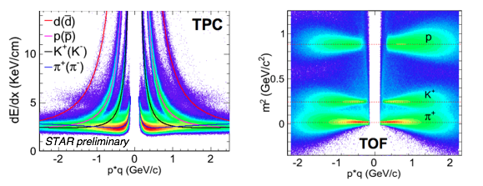
STAR Detector
EEMC
Magnet
MTD
BEMC
TPC
TOF
BBC
Notes:
STAR is a massive solenoid detector with full azimuthal coverage and excellent particle identification capabilities. For this analysis, we will be using the Time Projection Chamber and the Time of Flight for tracking and particle identification. We use energy loss mechanism to identify protons and anti-protons in TPC for transverse momentum less than 0.8 GeV/c and calculated mass-square from time of flight in TOF with TPC for transverse momentum between 0.8 to 2 GeV/c.

Slide 4
Analysis Technique
Centrality determination
  Use charged particles within |η| < 1, other than protons and anti-protons, to avoid auto-correlations
Centrality bin width correction
  Evaluate cumulants for each centrality bin to suppress volume fluctuations
STAR Preliminary
N_{ch} – N_{p} – N_{p}
X. Luo and N. Xu, arXiv:1701.02105
STAR Collaboration, Phys.Rev.Lett. 105 (2010) 022302.
STAR Collaboration, Phys.Rev.Lett. 113 (2014) 092301 .
Notes:
In the data analysis, we apply a series of analysis techniques to suppress backgrounds and make precise measurements of the event-by-event fluctuation analysis in heavy-ion collisions.
The definition of the collision centralities for two colliding nuclei is not unique and can be defined by different quantities. The centrality in heavy-ion collisions is usually determined by a comparison between experimental measured particle multiplicity and Glauber Monte-Carlo simulations. The auto-correlation effect is a background effect in the fluctuation analysis which suppress the magnitude of the signals. In net-proton fluctuation analysis, to avoid the auto-correlation, we should exclude the corresponding protons and anti-protons from the centrality definition. On the right is a typical charged particle multiplicity distribution minus protons and antiprotons for Au Au collisions at 200 GeV at mid rapidity.
The centrality bin width effect is caused by the volume variation within a wide centrality bin and results in an artificial centrality dependence for the fluctuation observables. In order to suppress volume fluctuations within a wide centrality bin, centrality bin width correction is applied.

Slide 5

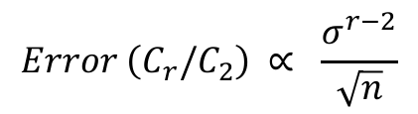
Analysis Technique
Error estimation
  Statistical errors are based on Bootstrap technique or the Delta Theorem.
Efficiency correction
  Express the cumulants in terms of the factorial moments or factorial cumulants, which can be easily efficiency corrected by assuming binomial response function for efficiency.
$$Error \left(C_{r}\right) ∝ \frac{σ^{r}}{\sqrt{n}}$$
$$Error \left(C_{r}/C_{2}\right) ∝ \frac{σ^{r−2}}{\sqrt{n}}$$
𝜎 : width of the distribution
n : Number of events
Based on factorial cumulants: T. Nonaka, M. Kitazawa and S. Esumi, In preparation.
Based on factorial moments: A. Bzdak and V. Koch, PRC91, 027901 (2015). X. Luo, PRC91, 034907(2015). X. Luo and N. Xu, 1701.02105
B. Efron et al. An Introduction to Bootstrap, Chapman & Hill (1993).
X. Luo, J. Xu, B. Mohanty, N. Xu, J. Phys. G 40, 105104 (2013)
Notes:
Error estimation is done either by Bootstrap technique, which is based on resampling or the Delta Theorem, which is an analytical technique. Both the methods give similar results.
The detector always have a finite particle detection efficiency. The observed event-by-event particle multiplicity distributions are the convolution between the original distributions and the efficiency response function. Efficiency corrections contains the net effects of tracking efficiency, detector acceptance, decays, and interaction losses. It is well know that the detection efficiency response function is binomial distribution for a detector with good performance. In order to efficiency correct the cumulants, the principle idea is to express the them in terms of the factorial moments, which can be easily corrected for efficiency effect. This method can be also applied to the phase space dependent efficiency case, where the efficiency of proton or anti-proton are not constant within studied phase space.

Slide 6
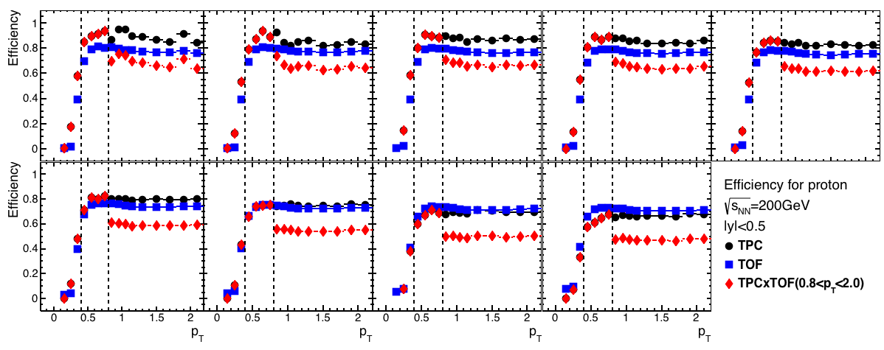
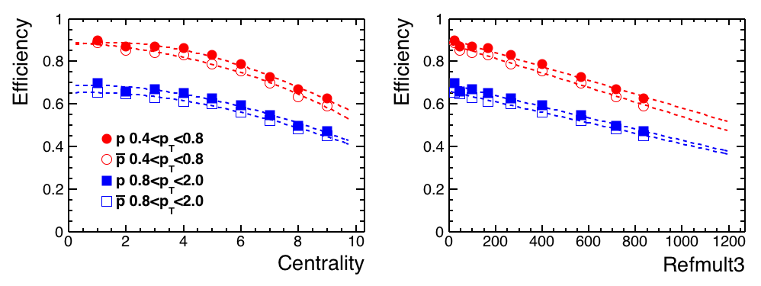
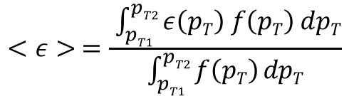
Detector Efficiency
0-5%
Au+Au @ √s_{NN} = 200 GeV
STAR Preliminary
p_{T} integrated efficiency
(0.4 < p_{T} (GeV/c) < 0.8)
TPC (0.4 < p_{T} (GeV/c) < 0.8)
(0.4 < p_{T} (GeV/c) < 0.8)
STAR Preliminary
(0.8 < p_{T} (GeV/c) < 2.0)
TPC+TOF (0.8 < p_{T} (GeV/c) < 2.0)
(0.8 < p_{T} (GeV/c) < 2.0)
(GeV/c)
N_{ch} – N_{p} – N_{p}
$$<ε> =\frac{ \int_{pT1}^{pT2}{ε\left(pT\right) f\left(pT\right) dpT}}{\int_{pT1}^{pT2}{f\left(pT\right) dpT}}$$
p_{T} – integrated efficiency is calculated as a function of multiplicity
Efficiency correction is applied at each multiplicity bin
Notes:
At this point I would like to throw some light on the efficiency of our detectors. The left plot shows the efficiency of particle identification on Y-axis and the transverse momentum on the X-axis for protons in AuAu collisions at 200 GeV within a rapidity window of 1 unit at midrapidity for 0-5% central collisions. The Black circles are points from TPC, the Blue squares are from Time of Flight and the red diamonds are combined efficiency for TPC and TOF. As a reminder, we use TPC only for transverse momentum between 0.4 to 0.8 GeV/c for protons and TPC and TOF combined for transverse momentum between 0.8 to 2.0 GeV/c. pT integrated efficiency is then calculated by weighting with the particle spectra to get efficiency as a function of reference multiplicity as shown in the right panel. The red points are for transverse momentum between 0.4 to 0.8 GeV/c, while the blue points are for transverse momentum between 0.8 to 2.0 GeV/c. The closed points are for protons while the open ones are for antiprotons. For AuAu collisions at 200 GeV, we find a slight dependence of the pt integrated efficiency on multiplicity. Let me reiterate that we should apply efficiency correction and error estimation at each multiplicity bin to get the corrected cumulants for a wide centrality bin.

Slide 7
Search for the QCD Critical Point
Notes:
Let us now move to the first part, which the the effort at STAR to search for the QCD critical point.

Slide 8
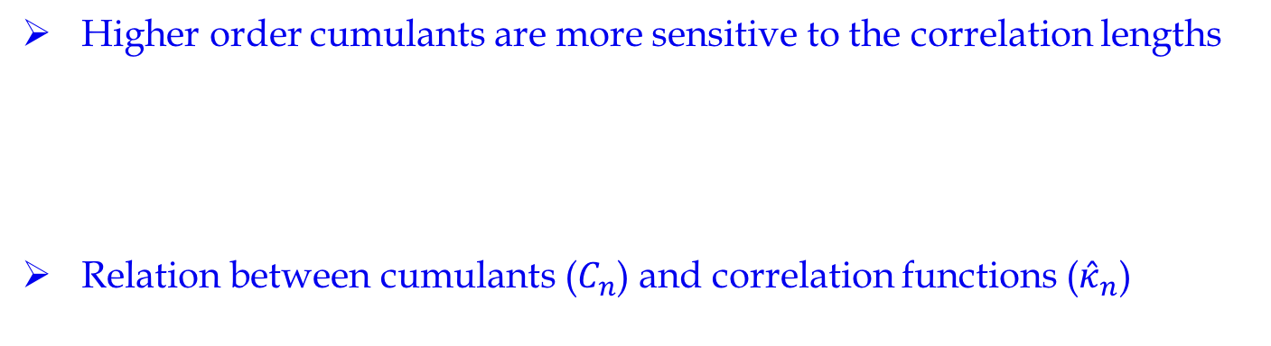
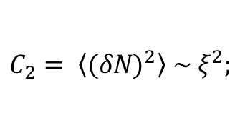
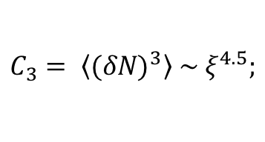
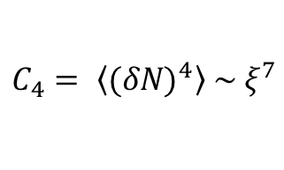

Cumulants and Correlation Function
Higher order cumulants are more sensitive to the correlation lengths
Relation between cumulants ($C_{n}$) and correlation functions (${\hat{κ}}_{n}$)
$$C_{2}= \left\langle {(δN)}^{2}\right\rangle \sim ξ^{2};$$
$$C_{3}= \left\langle {(δN)}^{3}\right\rangle \sim ξ^{4.5};$$
$$C_{4}= \left\langle {(δN)}^{4}\right\rangle \sim ξ^{7}$$
with
$$δN=N−\left\langle N\right\rangle$$
M. A. Stephanov, Phys. Rev. Lett. 102, 032301 (2009); M. A. Stephanov, Phys. Rev. Lett. 107, 052301 (2011).
M.Asakawa, S. Ejiri and M. Kitazawa, Phys. Rev. Lett. 103, 262301 (2009); Y. Hatta, M. Stephanov, Phys. Rev. Lett. 91, 102003 (2003).
B. Ling, M. Stephanov, Phys. Rev. C 93, 034915 (2016); A. Bzdak, V. Koch, N. Strodthoff, arXiv:1607.07375;
A. Bzdak, V. Koch, V. Skokov, arXiv:1612.05128
Notes:
Close to the critical point, the correlation lengths diverge. But due to finite size and finite time effects in heavy ion collisions, the correlations lengths are estimated to be 2-3 fm. Therefore, we would require higher sensitivity observables. It is proposed by theory calculations, the third and fourth order cumulants are proportional to 4th and 7th power of correlation lengths, thereby making them sensitive observables. We would like to extract the multiparticle correlation function from the cumulants using the relations shown here. Correlation functions have the same power dependence on correlation lengths as the cumulants.

Slide 9
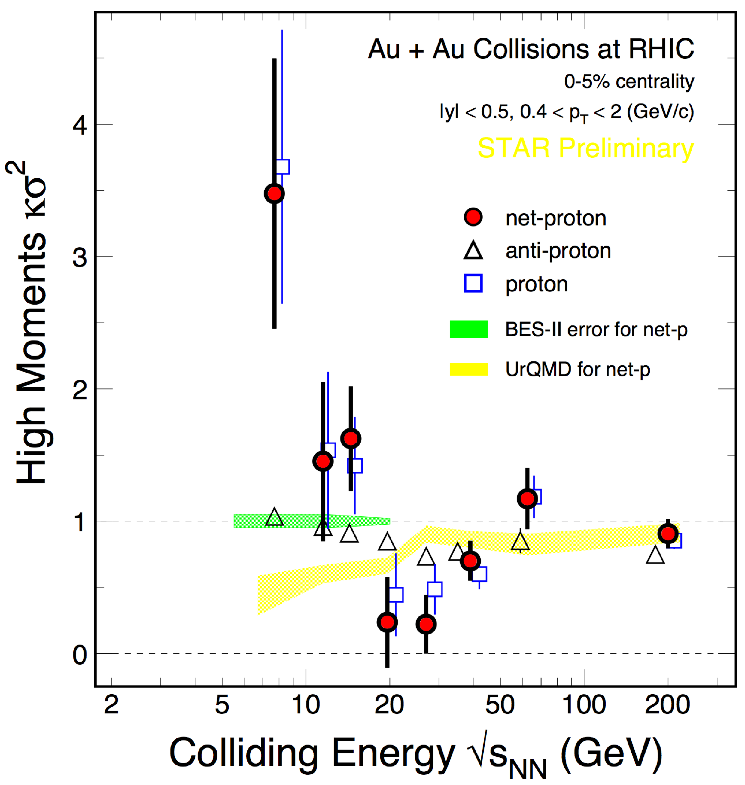

Fourth Order Net Proton Fluctuation
Non-monotonic energy dependence is observed for 4th order net-proton, proton fluctuations in most central Au+Au collisions.
UrQMD results show monotonic decrease with decreasing collision energy.
STAR Preliminary
$$κσ^{2}= \frac{C_{4}}{C_{2}}$$
Notes:
On the left is the plot for kurtosis times sigma squared, which is the ratio of fourth to the second cumulant with collision energy for 0-5 % central AuAu collisions at midrapidity and transverse momentum between 0.4 to 2 GeV/c for net protons in red, protons in blue squares, antiprotons in traingles. From experimental measurements, we find a non-monotonic energy dependence for net-protons. Protons also follow the similar trend. This is opposed to expectations from UrQMD, which does not manifest any critical phenomenon shown in yellow band. In order to better understand this trend, we will concentrate on protons for now.

Slide 10
Contributions from Four-Particle Correlations
Four-particle correlations contribute dominantly to the observed non-monotonicity.
Notes:
The first panel shows the energy dependence of the normalized fourth order cumulant of proton multiplicity distribution with beam energy for most central collisions. We the extract the four particle correlation function for protons in the second panel. We find that the four particle correlation functions contribute dominantly to the observed non-monotonicity. With four particle correlation function in the third panel, the observed non-monotonicity disappears. Further studies are underway to better understand this phenomenon.

Slide 11
Summary - I
Non-monotonic energy dependence of net-proton and proton C₄/C₂ is observed for 0–5% central Au+Au collisions.
Four-particle correlations contribute dominantly to the observed non-monotonicity.
More data will be
collected in BES-II
at √s_{NN} = 7.7 – 19.6 GeV
in 2019–2020 with detector
upgrades.
STAR Collaboration, https://drupal.star.bnl.gov/STAR/starnotes/public/sn0619
Notes:
To summarize this, non-monotonic energy dependence observed in net-proton and proton C4/C2 in most central AuAu collisions has a dominant contribution from four-particle correlations. With detector upgrades, more data with be collected in BES-II to give us a better insight into our efforts to pin down the QCD critical point. The plot here shows the estimated errors for BES-II with iTPC upgrades.

Slide 12
The measurement of net-proton sixth-order cumulant at small μ_{B} and its comparison to Lattice QCD
T. Nonaka
Poster ID 239
Notes:
Moving to the next part, which is the search for experimental signature for crossover at small baryon chemical potential by measurement of the sixth order cumulant of net proton multiplicity distribution and its comparison to estimates from Lattice QCD.

Slide 13
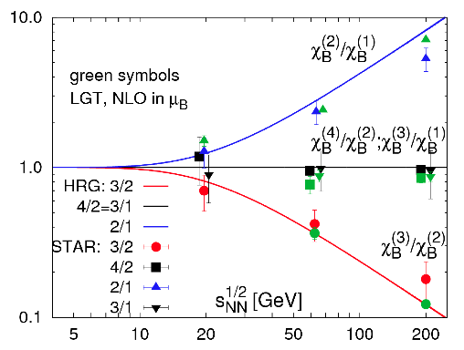
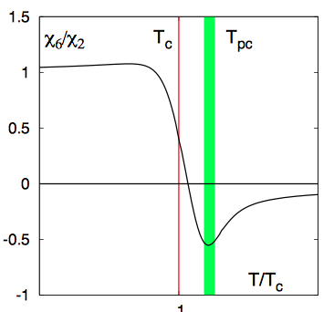
Connections with Lattice QCD
F. Karsch and K. Redlich, Phys. Lett. B 695, 136 (2011) STAR Collaboration, Phys.Rev.Lett. 112 (2014) 032302.
LQCD predicts a “crossover” for μ = 0
No established approach to do QCD calculations at finite baryon chemical potential
By putting μ_{Q} = μ_{S}= 0 and using Taylor expansion, the equation of state for finite μ_{B}:
The sixth order cumulants of baryon number is expected to be negative at chiral transition temperature
Y. Aoki, Nature 443, 675(2006)
B. Friman, F. Karsch, K. Redlich, V. Skokov Eur. Phys. J. C 71, 1694 (2011)
Notes:
Lattice QCD is a well-established non-perturbative approach to solve the theory of quarks and gluons exactly from first principles and without any assumptions. It can be used to study the thermodynamic properties of a strongly interacting system in thermal equilibrium. Most importantly, lattice QCD provides a framework for investigation of non-perturbative phenomena which are difficult to deal by means of analytic field theories. However, these calculations are exact at zero chemical potentials. In order to explore phenomenon at large baryon chemical potentials, next to leading order calculations are performed using the current best approach, which is Taylor expansion about mu = 0.
Up to fourth cumulant has been experimentally measured at the STAR experiment. The top plot shows the ratio of various order of susceptibility or cumulants with beam energy for Hadron Resonance Gas model in solid lines, next to leading order calculations from Lattice QCD, which is taking into account chi4/chi2 and STAR measurements in various colors. In order to have better constrain Lattice results, let us move to the next to next leading order, which is chi6/chi2.
In addition, It is expected from Lattice calculations that the sixth order cumulant of baryon number remain negative at the chiral transition temperature which is strikingly different from Hadron Resonance Gas model, which does not have any critical phenomenon in it and predicts the ratio to be 1.

Slide 14
Net-Proton Sixth Cumulant
0-10%
0-10%
0-5%
STAR Preliminary
STAR Preliminary
Combined data of Au+Au collisions at √s_{NN} = 200 GeV from year 2010 and 2011: 200 M (0 – 10 %) and 650 M (10 – 80 %) events
The C₆ and C₆/C₂ is negative for central collisions with large uncertainties
Notes:
Combining the data from Run 10 and Run 11 for Au Au collisions at 200 GeV, we have around 200 M events for 0-10% central collisions and around 650 M events for 10-80% central collisions. The left panel shows the values of the sixth cumulant of net proton multiplicity distribution as a function of number of participants. For transverse momentum between 0.4 to 2 GeV/c at midrapidity with a rapidity window of 1 unit. The dashed line is 0. The right panel shows the ratio of the sixth cumulant to the second cumulant of net proton multiplicity distribution on Y axis for different centrality. This point is for 0-10% central events. The magenta line is the binomial baseline and the dashed line is 1. We find the ratio to be less than 1, which is the prediction from Hadron Resonance Gas model, for all centralities. We find the measurements to be constrained by statistics.

Slide 15
Acceptance Dependence
STAR Preliminary
STAR Preliminary
Around 160 M events are analyzed for 0-10% central collisions for Au + Au at √s_{NN} = 200 GeV with central trigger from year 2010
Notes:
Next, we would look into the acceptance dependence of the ratio of the sixth cumulant to the second cumulant of net proton multiplicity distribution. This analysis has been done for Au Au collisions at 200 GeV with around 160 M events obtained from the central trigger, translating to 0 – 10% central collisions. The red points are for 0-5 % central collisions, while the blue points are for 5-10% central collisions. On the left panel, we show the transverse momentum dependence of the cumulant ratio for rapidity window of 1 unit at midrapidity. There is difference in trends for the two centralities.
On the right panel, we show the rapidity dependence of the cumulant ratio at midrapidity for transverse momentum between 0.4 to 2.0 GeV/c for Au Au collisions at 200 GeV. The trends are consistent with statistical errors.

Slide 16
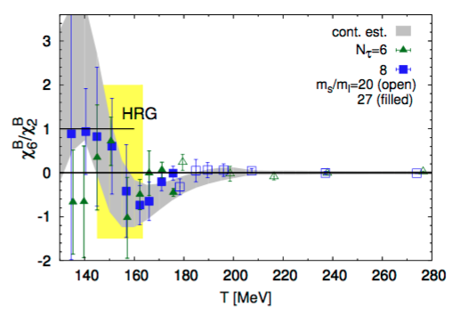
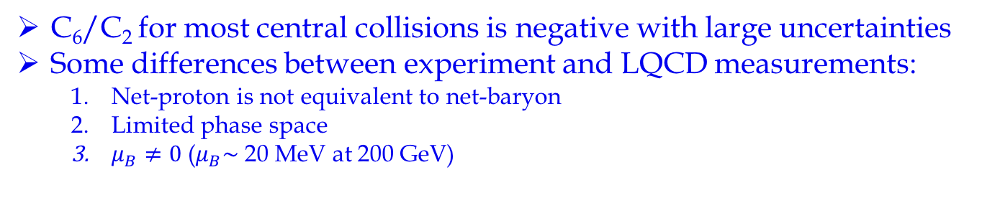
Comparison with LQCD
0-10%
0-5%
Region of interest for
√s_{NN} = 200 GeV
STAR Preliminary
A. Bazavov et al, arXiv:1701.04325.
C₆/C₂ for most central collisions is negative with large uncertainties
Some differences between experiment and LQCD measurements:
  Net-proton is not equivalent to net-baryon
  Limited phase space
  $μ_{B}≠0$($μ_{B}\sim$20 MeV at 200 GeV)
Notes:
Here, we compare our results with predictions from L-QCD for the ratio of the sixth cumulant to the second cumulant of net proton multiplicity distribution. The left panel is the centrality dependence of the ratio for combined events from Run 10 and Run 11 for transverse momentum between 0.4 to 2 GeV/c at midrapidity, within a rapidity window of 1 unit using the combined dataset. The red square is the value of 0-5 % central collisions as measured using central trigger for Run 10 only. The dashed line is 1. The right panel is the expectation from L-QCD calculations as a function of freezeout temperature. For Au Au collision at 200 GeV, this is around 160 MeV, which is in this region. The black line is expectation from Hadron Resonance Gas, which is 1.
With constraints from statistics, it is difficult to make direct comparison between experiment and L-QCD calculations. At this point, let me mention a caveat. Lattice calculations are done for net baryons which is not equivalent to the net proton analysis done in experiments. In addition, Lattice calculations are performed on the entire phase space, while in experiment, we restrict ourselves to a part of it. At 200 GeV, the baryons chemical potential is around 20 MeV, while Lattice calculations are performed for Taylor expansions about mu = 0. In addition, there are some remnant effects of volume fluctuation in data, which are difficult to deal with. With these in mind, we would suggest that the data from most central collisions are least biased and would make a good candidate when comparing with Lattice estimates. At this point, the value is negative but we have enormous error bars for that centrality.

Slide 17
Summary - II
We report the efficiency corrected sixth order cumulant of the net-proton multiplicity distribution for Au+Au collisions at √s_{NN} = 200 GeV.
Centrality, transverse momentum and rapidity dependence of the ratio C₆/C₂ are presented.
C₆ and C₆/C₂ are negative for central collisions with large statistical uncertainty.
Assessment of systematic errors is underway.
Combining the data taken in year 2014 and 2016, with more than 2 billion events, we can get a better control on the statistical errors for C₆/C₂.
Notes:
This brings us to the conclusion. Centrality, transverse momentum and rapidity dependent study of the ratio of the sixth cumulant to the second cumulant of net proton multiplicity distribution for Au Au collision at 200 GeV is presented. The measurements are constrained by large error bars. The measured ratio is found to be less than 1 for all centralities. In order to get better estimates by drastically reducing the error bars, we are working to combine the data taken in year 2014 and 2016 with the present analysis. This would make more than 2 billion events, which will give a better control on statistics.

Slide 18
Thank you !

Slide 19
Back-up

Slide 20
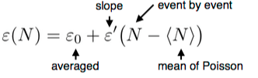
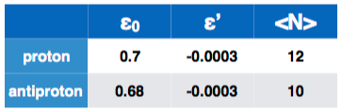
Multiplicity Dependent Efficiency
Au+Au @ √s_{NN} = 200 GeV
STAR Preliminary
p_{T} integrated efficiency
(0.4 < p_{T} (GeV/c) < 0.8)
(0.4 < p_{T} (GeV/c) < 0.8)
(0.8 < p_{T} (GeV/c) < 2.0)
(0.8 < p_{T} (GeV/c) < 2.0)
N_{ch} – N_{p} – N_{p}
Analyzed for 1B events
Protons and anti-protons are sampled from Poisson distribution with Binomial efficiency
Deviations for efficiency corrected higher order cumulants from the input Skellam are within statistical errors
A. Bzdak et al Phys.Rev. C94, 064907 (2016) .

