Slide 1
Kaon Femtoscopy in √s_{NN}=200 GeV Au+Au Collisions at STAR
Róbert Vértesi
robert.vertesi@ujf.cas.cz .
for the
collaboration
Nuclear Physics Institute
Czech Academy of Sciences

Slide 2
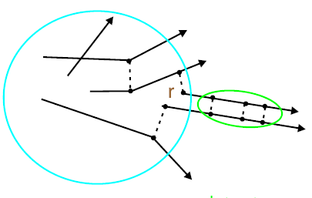
Femtoscopy
Boson emitting source:
Symmetric two-boson wave function
Bose-Einstein Correlation / Hanbury-Brown–Twiss effect
Correlation function:
Final state interactions
Compensating the Coulomb force
Strong FSI …
Solving for the source is difficult → assumptions
Correlation
Emitting source
Info about shape and evolution of the particle emitting source

Slide 3
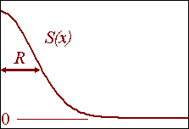
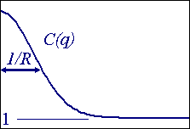
Source approximation w/ Gaussian
If the source is approximated with Gaussian:
Then the correlation function is also Gaussian:
These radii are the so-called HBT radii
Often specified in the LCMS system (not invariant)
Out: direction of the mean transverse momentum of the pair
Side: orthogonal to out
Long: beam direction
Do not necessarily reflect the geometrical size

Slide 4
Source imaging
Physics in shape: dynamics, resonance decays, rescattering…
Koonin-Pratt equation (1D)
Imaging: Obtain S(r) directly
No assumptions for the shape of source
Kernel includes all interactions (QM, FSI)
Numerical inversion of the equation
No analytical solution, hence some limitations and approximations (integral cutoff, finite resolution … )
Assumptions (e.g. weak dependence in single particle sources)
Needs statistics, stability is a question
D. A. Brown, P. Danielewicz, nucl-th/9701010
Interactions
Emitting source

Slide 5
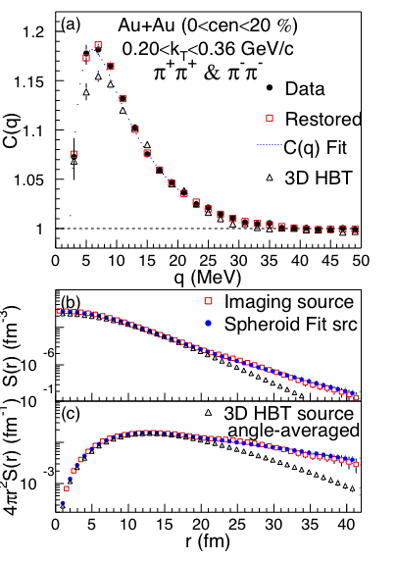
Why Kaons?
PHENIX, PRL 98:132301,2007
Pion source shows a heavy, non-Gaussian tail
Interpretation is problematic
Tail attributed to decays of long-lived resonances and/or non-zero emission duration
Kaons: cleaner probe
less contribution from resonances

Slide 6
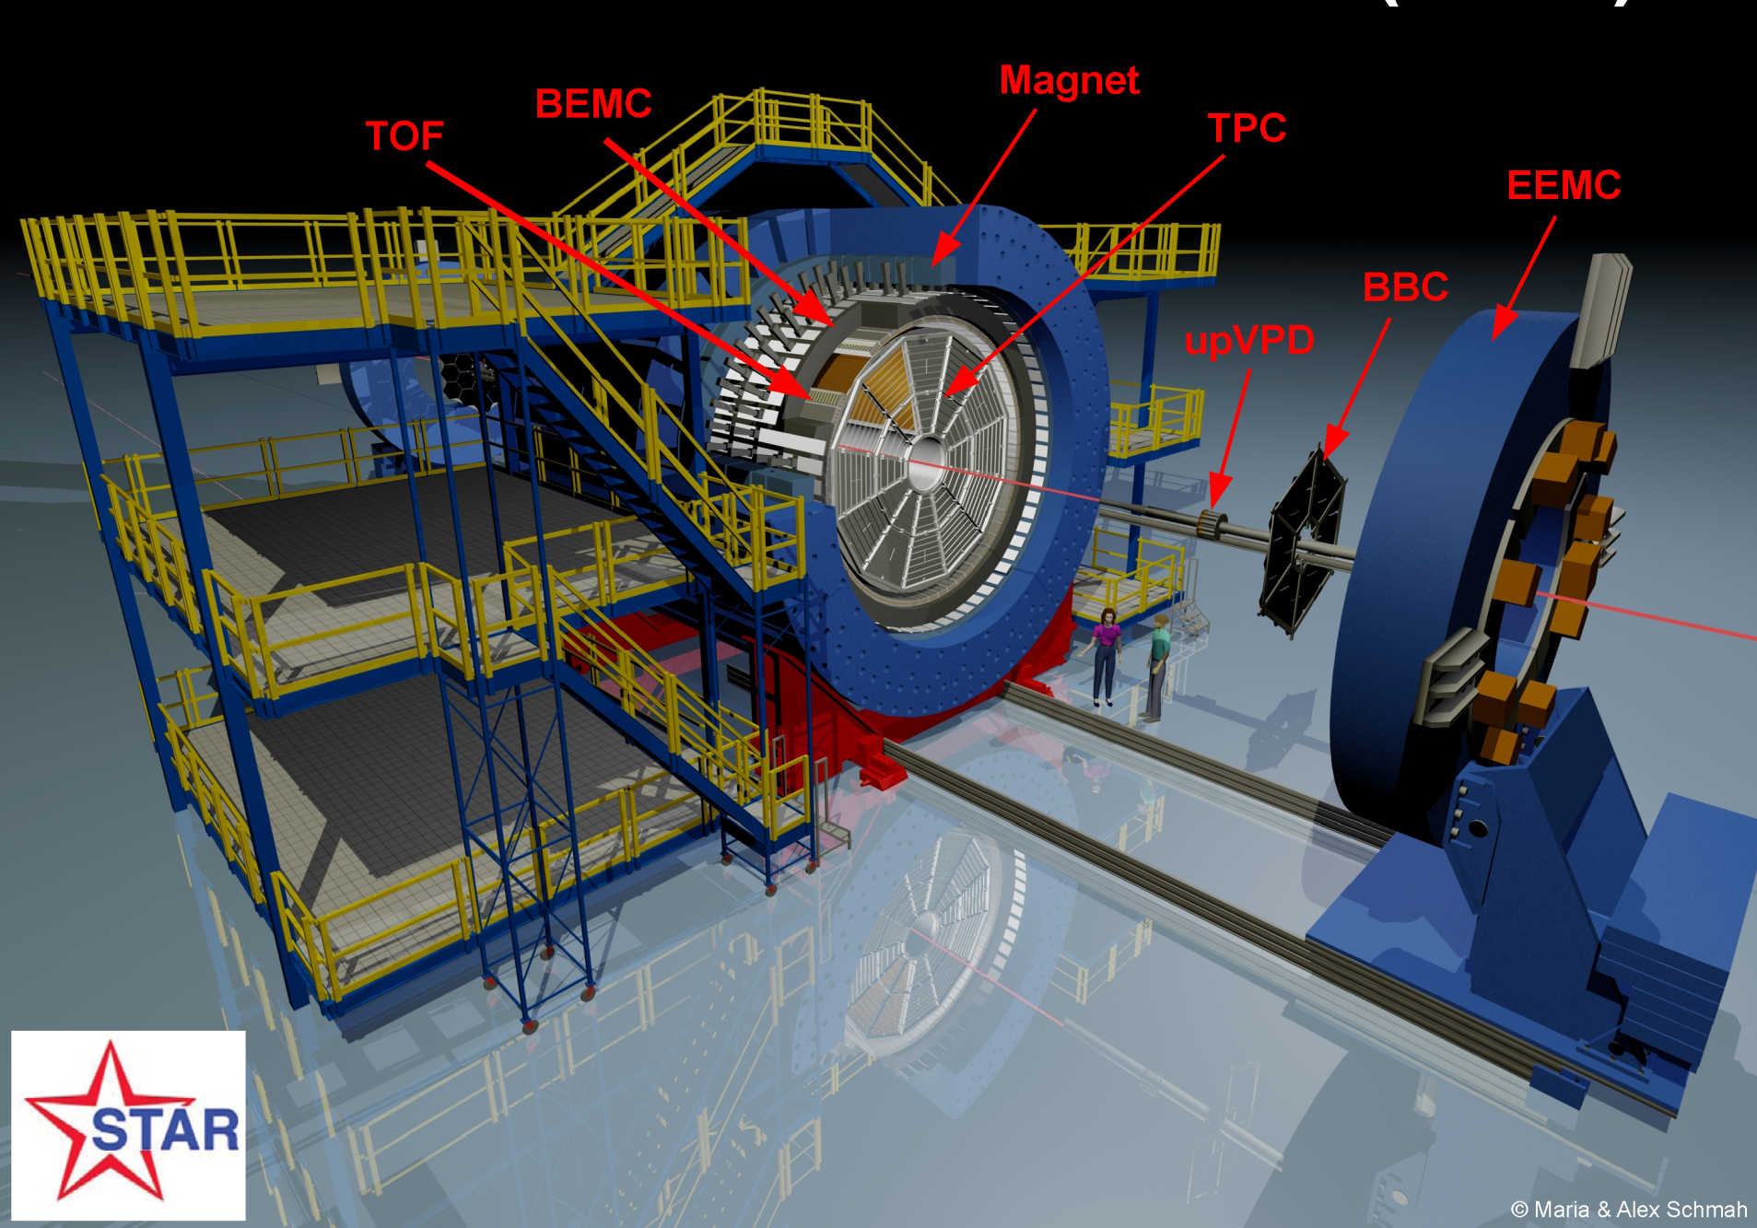
The STAR Experiment
Time Projection Chamber
ID via energy loss (dE/dx)
Momentum (p)
Full azimuth coverage
Uniform acceptance
for different energies and particles
The Solenoidal Tracker At RHIC
Notes:
6

Slide 7
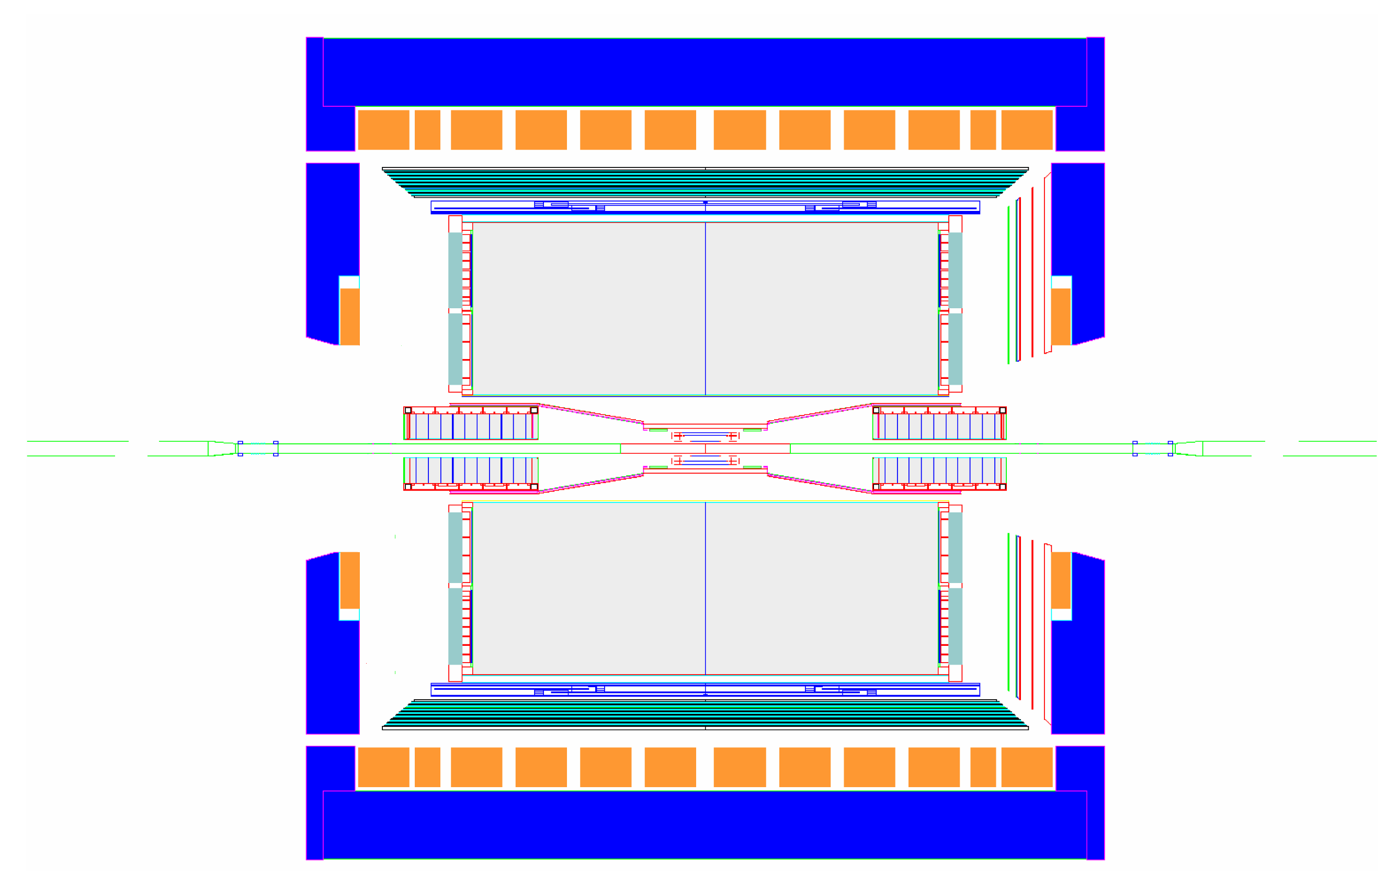
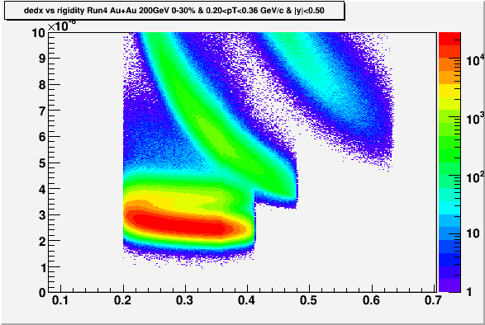
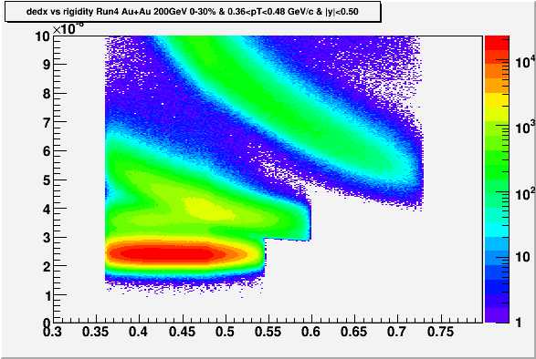
Kaon femtoscopy analyses
Au+Au @ √s_{NN}=200 GeV
Mid-rapidity |y|<0.5
Source shape: 20% most central
Run 4: 4.6 Mevts, Run 7: 16 Mevts
m_{T}-dependence: 30% most central
Run 4: 6.6 Mevts
TPC
0.2<k_{T}<0.36 GeV/c
0.36<k_{T}<0.48 GeV/c
dE/dx (keV/cm)
dE/dx (keV/cm)
dE/dx
dE/dx
Rigidity (GeV/c)
Rigidity (GeV/c)
Notes:
Motivate next slide!

Slide 8
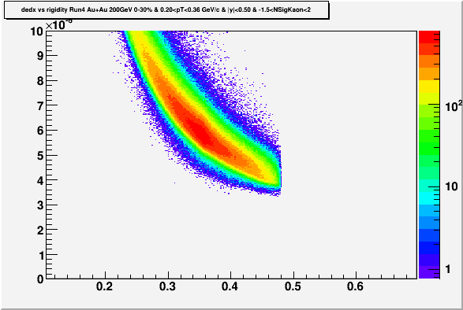
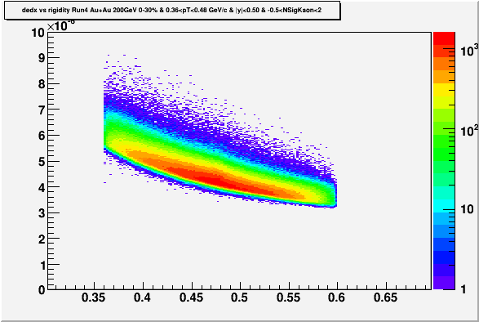
PID cut applied
Source shape analysis
dE/dx: nσ(Kaon)<2.0 and nσ(Pion)>3.0 and nσ(electron)>2.0 nσ(X) :deviation of the candidate dE/dx from the normalized distribution of partice type X at a given momentum
0.2 < p_{T} < 0.4 GeV/c
m_{T}-dependent analysis
-1.5< nσ(Kaon)<2.0
-0.5< nσ(Kaon)<2.0
0.2<k_{T}<0.36 GeV/c
0.36<k_{T}<0.48 GeV/c
dE/dx (keV/cm)
dE/dx (keV/cm)
dE/dx
dE/dx
Rigidity (GeV/c)
Rigidity (GeV/c)

Slide 9
3D source shapes
Expansion of R(q) and S(r) in Cartesian Harmonic basis
Danielewicz and Pratt, Phys.Lett. B618:60, 2005
α_{i} = x, y or z
x = out-direction
y = side-direction
z = long-direction
3D Koonin-Pratt:
Plug (1) and (2) into (3)
⇒
Invert (1)
⇒
Invert (2)
⇒
Notes:
9

Slide 10
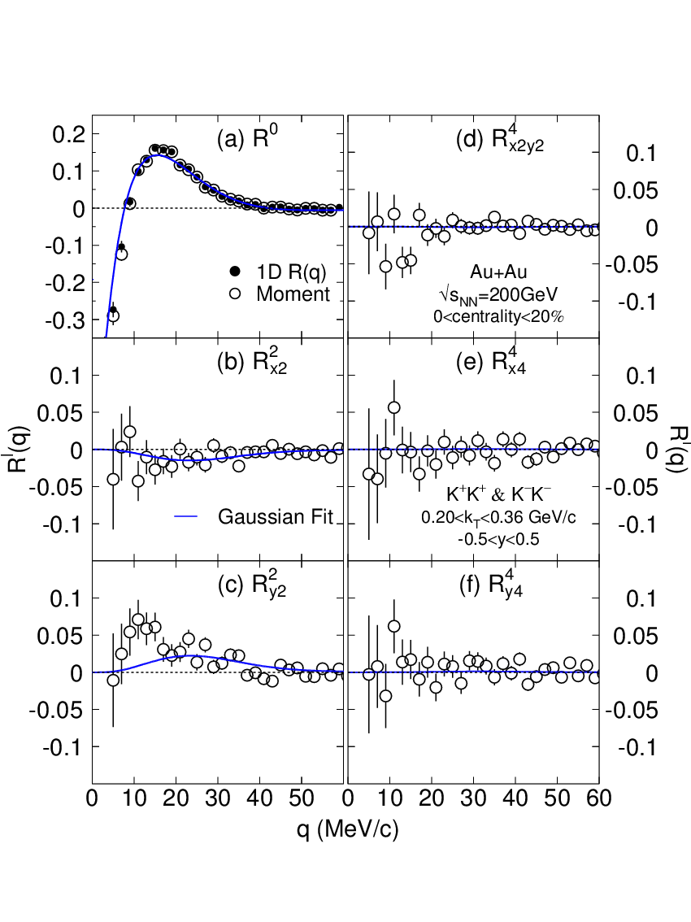
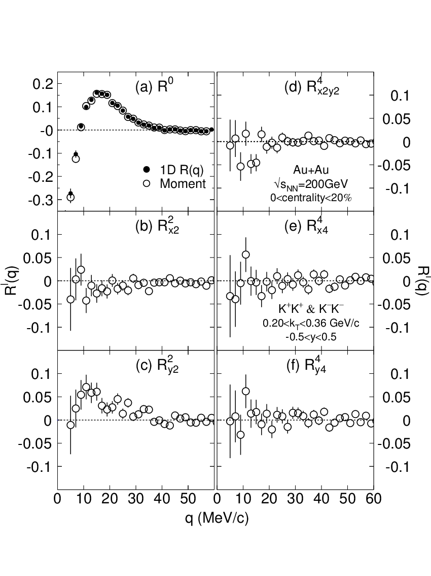
Shape analysis
l=0 moment agrees 1D C(q)
Higher moments relatively small
Trial funcional form for S(r): 4-parameter ellipsoid (3D Gauss)
Fit to C(q): technically a simultaneous fit on 6 independent moments R^{l}_{α1…αl} , 0≤l≤4
Result: statistically good fit
λ = 0.48 ± 0.01
r_{x} = (4.8 ± 0.1) fm
r_{y} = (4.3 ± 0.1) fm
r_{z} = (4.7 ± 0.1) fm
Run4+Run7 200 GeV Au+Au
Centrality<20%
0.2 < k_{T} < 0.36 GeV/c
arXiv:1302.3168

Slide 11
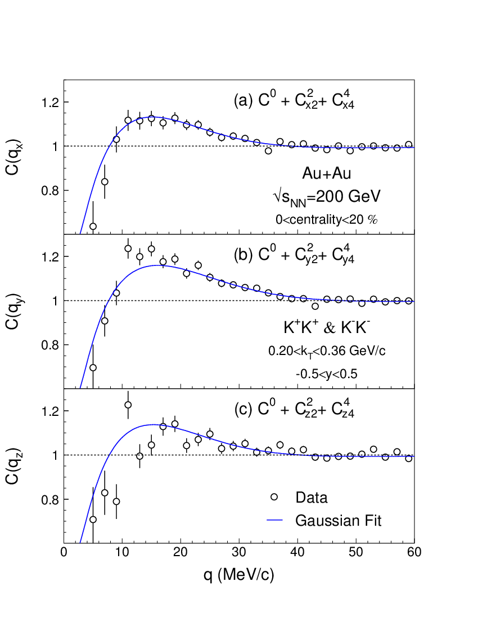
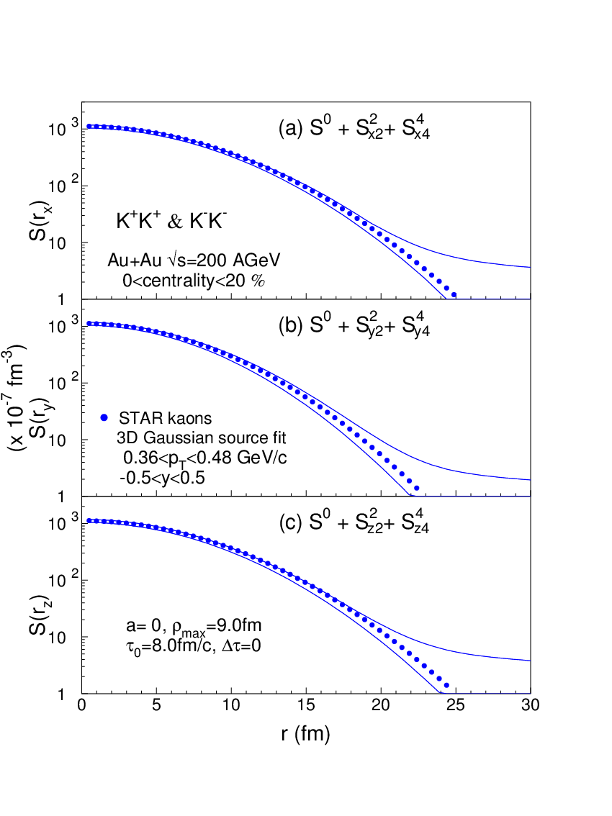
Correlation profiles and source
arXiv:1302.3168
arXiv:1302.3168
Correlation profiles
C(q_{x}) ≡ C(q_{x},0,0)
C(q_{y}) ≡ C(0,q_{y},0)
C(q_{z}) ≡ C(0,0,q_{z})
Gaussian source fit with error band
Note: Low statistics shows up as systematic uncertainty on shape assumption
Notes:
11

Slide 12
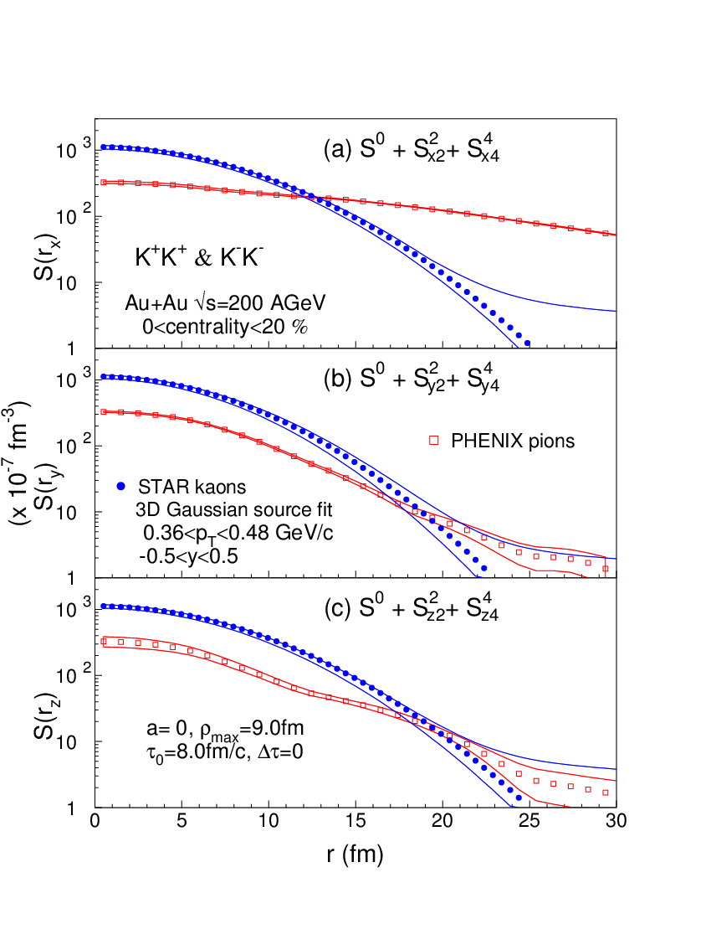
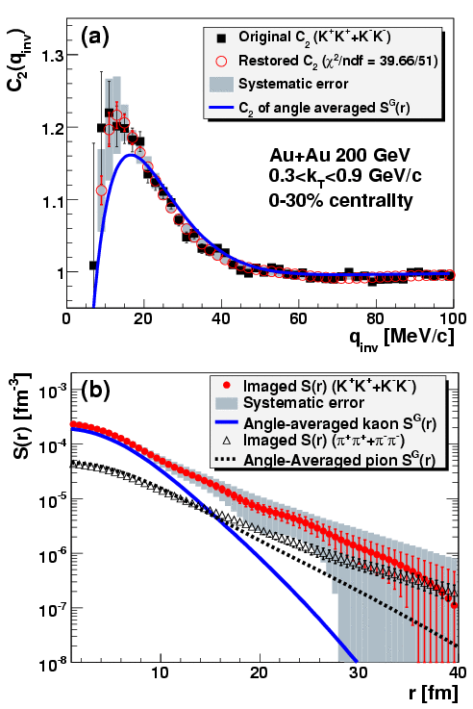
Source: Data comparison
1D PHENIX kaon:
Observed long tail, possibly due to wide k_{T} bin
(0.3<k_{T}<0.9 GeV)
PRL100, 232301 (2008)
arXiv:1302.3168
Kaon vs. Pion: different shape
Long pion tail caused by resonances?
Sign of different freeze-out dynamics?
PHENIX, PRL 103, 142301 (2009)
Notes:
12

Slide 13
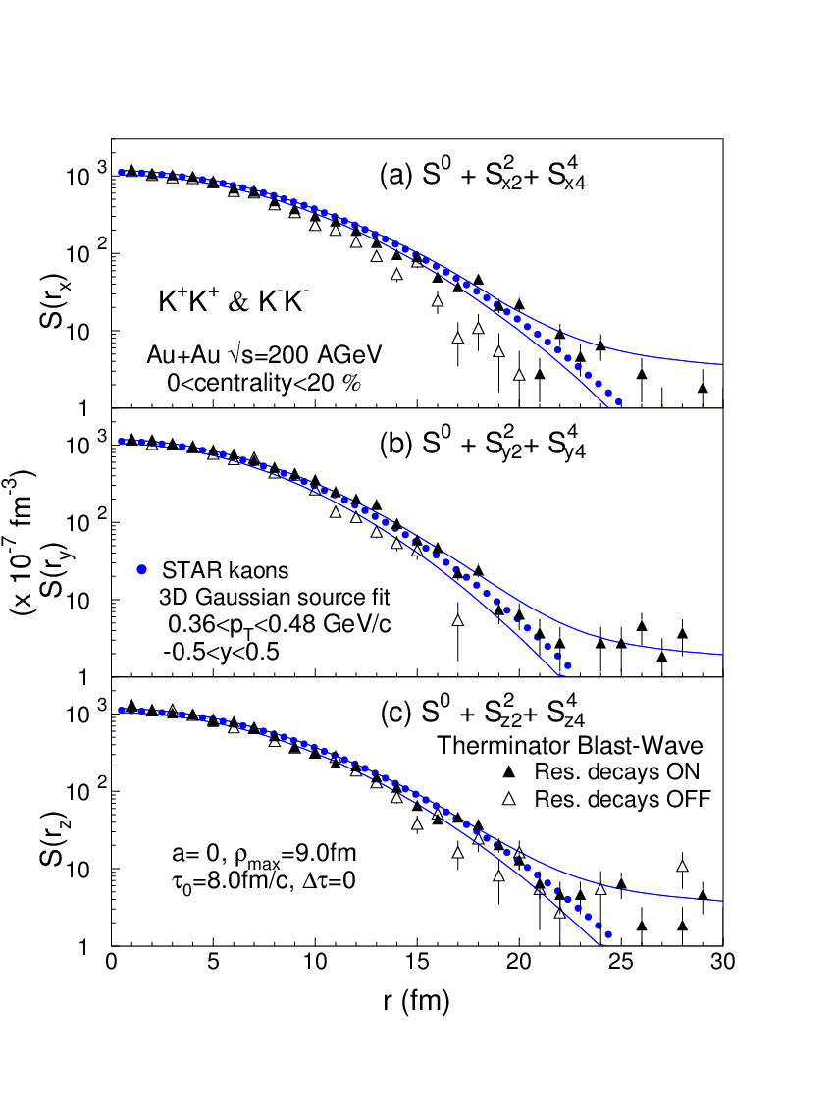
Source: Model comparison
Therminator
Blast-wave model (STAR tune):
Expansion: v_{t}(ρ)=(ρ/ρ_{max})/(ρ/ρ_{max}+v_{t})
Freeze-out occurs at τ = τ₀ +aρ.
Finite emission time Δτ in lab frame
Kaons: Instant freeze-out (Δτ = 0, compare to Δτ~2 fm/c of pions) at τ₀ = 0.8 fm/c
Resonances are needed for proper description
Hydrokinetic model
Hybrid model
Glauber initial+Hydro+uRQMD
Consistent in “side”
Slightly more tail (r>15fm) in “out” and “long”
arXiv:1302.3168
Therminator: Kisiel, Taluc, Broniowski, Florkowski, Comput. Phys. Commun. 174 (2006) 669.
HKM: PRC81, 054903 (2010)
data from Shapoval, Sinyukov, private communication
Notes:
13

Slide 14
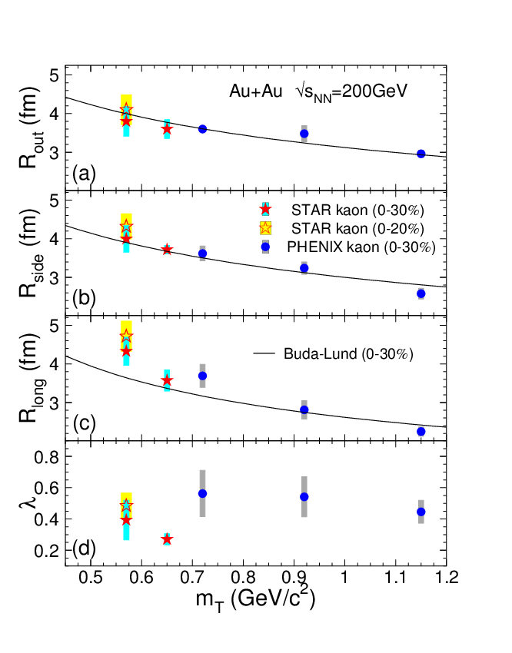
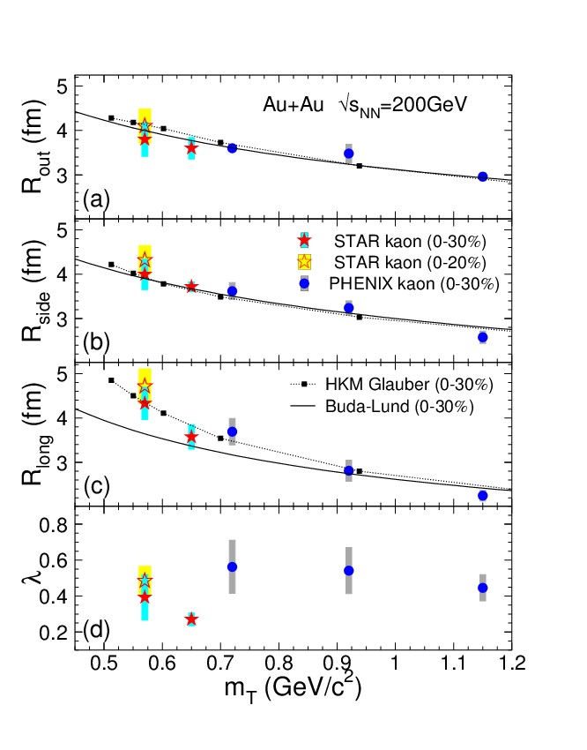
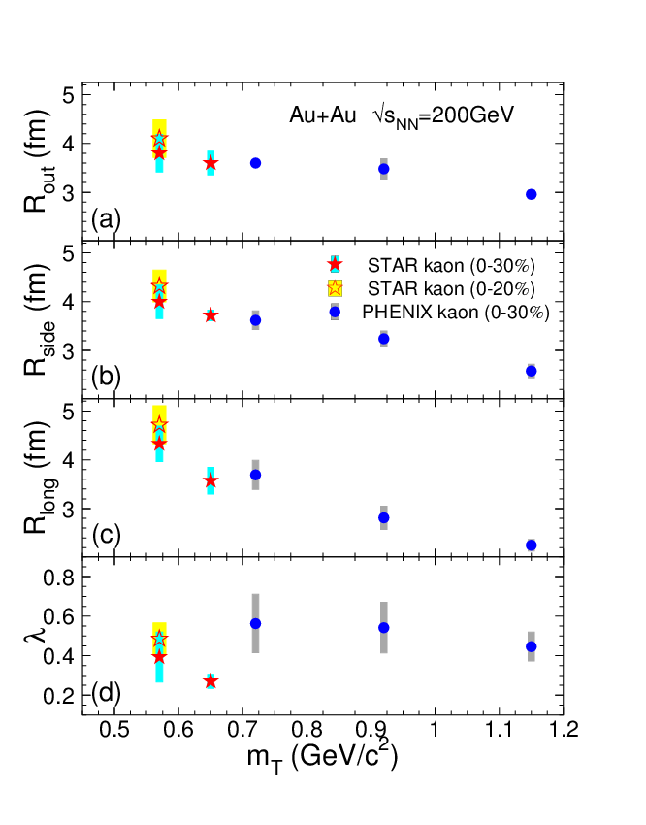
Transverse mass dependence
Radii: rising trend at low m_{T}
Strongest in “long”
Buda-Lund model
Perfect hydrodynamics, inherent m_{T}-scaling
Works perfectly for pions
Deviates from kaons in the “long” direction in the lowest m_{T} bin
HKM (Hydro-kinetic model)
Describes all trends
Some deviation in the “out” direction
Note the different centrality definition
arXiv:1302.3168
Buda-Lund: M. Csanád, arXiv:0801.4434v2
HKM: PRC81, 054903 (2010)

Slide 15
Summary
First model-independent extraction of kaon 3D source shape presented
No significant non-Gaussian tail is observed in RHIC √s_{NN}=200 GeV central Au+Au data
Model comparison indicates that kaons and pions may be subject to different dynamics
The m_{T}-dependence of the Gaussian radii indicates that m_{T}-scaling is broken in the “long” direction

Slide 16
Thank You!
Argonne National Laboratory, Argonne, Illinois 60439
Brookhaven National Laboratory, Upton, New York 11973
University of California, Berkeley, California 94720
University of California, Davis, California 95616
University of California, Los Angeles, California 90095
Universidade Estadual de Campinas, Sao Paulo, Brazil
University of Illinois at Chicago, Chicago, Illinois 60607
Creighton University, Omaha, Nebraska 68178
Czech Technical University in Prague, FNSPE, Prague, 115 19, Czech Republic
Nuclear Physics Institute AS CR, 250 68 Řež/Prague, Czech Republic
University of Frankfurt, Frankfurt, Germany
Institute of Physics, Bhubaneswar 751005, India
Indian Institute of Technology, Mumbai, India
Indiana University, Bloomington, Indiana 47408
Alikhanov Institute for Theoretical and Experimental Physics, Moscow, Russia
University of Jammu, Jammu 180001, India
Joint Institute for Nuclear Research, Dubna, 141 980, Russia
Kent State University, Kent, Ohio 44242
University of Kentucky, Lexington, Kentucky, 40506-0055
Institute of Modern Physics, Lanzhou, China
Lawrence Berkeley National Laboratory, Berkeley, California 94720
Massachusetts Institute of Technology, Cambridge, MA
Max-Planck-Institut f\"ur Physik, Munich, Germany
Michigan State University, East Lansing, Michigan 48824
Moscow Engineering Physics Institute, Moscow Russia
NIKHEF and Utrecht University, Amsterdam, The Netherlands
Ohio State University, Columbus, Ohio 43210
Old Dominion University, Norfolk, VA, 23529
Panjab University, Chandigarh 160014, India
Pennsylvania State University, University Park, Pennsylvania 16802
Institute of High Energy Physics, Protvino, Russia
Purdue University, West Lafayette, Indiana 47907
Pusan National University, Pusan, Republic of Korea
University of Rajasthan, Jaipur 302004, India
Rice University, Houston, Texas 77251
Universidade de Sao Paulo, Sao Paulo, Brazil
University of Science \& Technology of China, Hefei 230026, China
Shandong University, Jinan, Shandong 250100, China
Shanghai Institute of Applied Physics, Shanghai 201800, China
SUBATECH, Nantes, France
Texas A\&M University, College Station, Texas 77843
University of Texas, Austin, Texas 78712
University of Houston, Houston, TX, 77204
Tsinghua University, Beijing 100084, China
United States Naval Academy, Annapolis, MD 21402
Valparaiso University, Valparaiso, Indiana 46383
Variable Energy Cyclotron Centre, Kolkata 700064, India
Warsaw University of Technology, Warsaw, Poland
University of Washington, Seattle, Washington 98195
Wayne State University, Detroit, Michigan 48201
Institute of Particle Physics, CCNU (HZNU), Wuhan 430079, China
Yale University, New Haven, Connecticut 06520
University of Zagreb, Zagreb, HR-10002, Croatia
STAR Collaboration

Slide 17
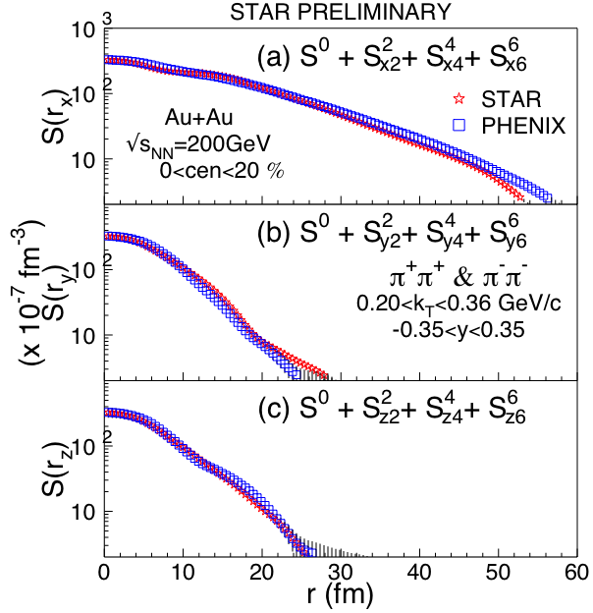
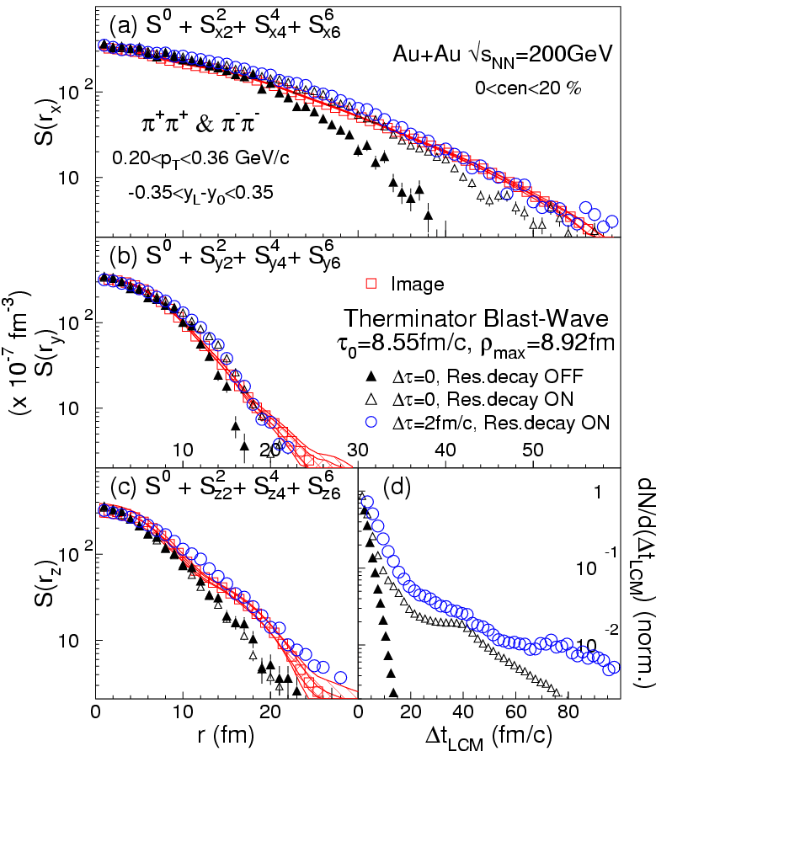
3D pions, PHENIX and STAR
PHENIX, PRL100, 232301 (2008)
P. Chung (STAR), arXiv:1012.5674 [nucl-ex]
STAR PRELIMINARY
Elongated source in “out” direction
Therminator Blast Wave model suggests non-zero emission duration
Very good agreement of PHENIX and STAR 3D pion source images

Slide 18
STAR 1D kaons
34M+83M=117M
K⁺K⁺ & K⁻K⁻ pairs
STAR data are
well described
by Gaussian,
contrary to
PHENIX no
non-gaussian
tails are observed.
May be due
to a different
k_{T}-range:
STAR bin is
4x narrower.
STAR PRELIMINARY
STAR PRELIMINARY

Slide 19
Fit to correlation moments #2
0.2<kT<0.36 GeV/c
0.36<kT<0.48 GeV/c
STAR PRELIMINARY
STAR PRELIMINARY
Dataset #2
Run4 Cent<30%

Slide 20
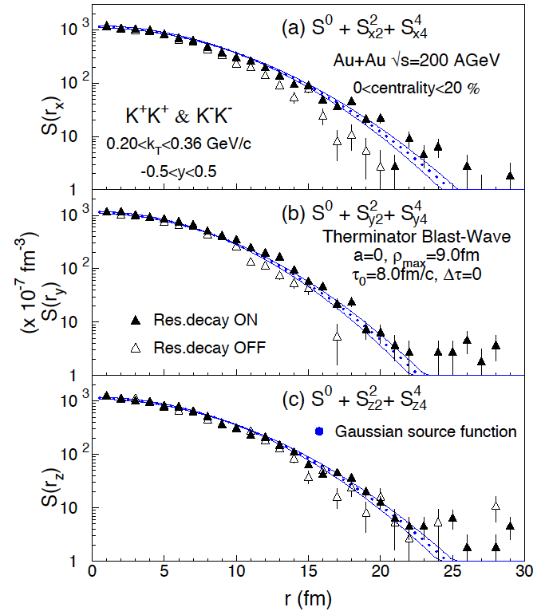
Model comparison: thermal BW
Therminator
(A Thermal Heavy Ion Generator)
A. Kisiel et al., Phys. Rev. C 73:064902 2006
Longitudinal boost invariance
Blast-wave expansion: transverse velocity profile semi-linear in transverse radius ρ: v_{t}(ρ)=(ρ/ρ_{max})/(ρ/ρ_{max}+v_{t}) ; v_{t} =0.445 from BW fits to particle spectra
Thermal emission at proper time τ, from an infinite cylinder radius ρ_{max}
Freeze-out occurs at τ = τ₀ +aρ.
Particles which are emitted at (z, ρ) have LAB emission time τ² = (τ0 +aρ)²+z² .
Finite emission duration Δτ
STAR PRELIMINARY
Source consistent with BW and resonances
Instant freeze-out at τ₀ = 0.8 fm/c
Zero emission duration
Notes:
20

Slide 21
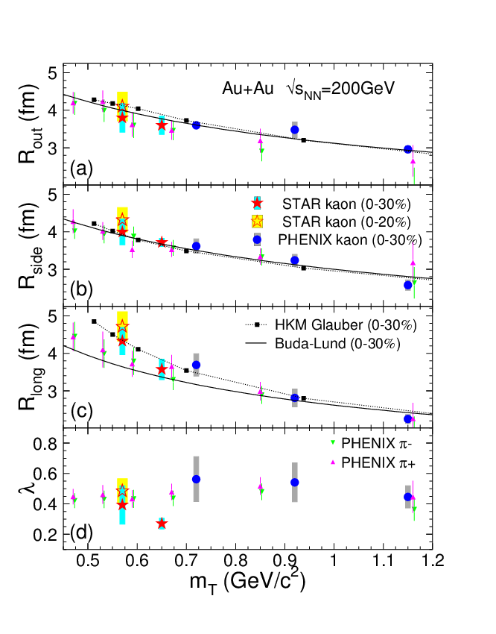
Radii vs. mT, pion, kaon
STAR kaons
PHENIX pions +,–
Buda-Lund
HKM
Buda-Lund: M. Csanád, arXiv:0801.4434v2
HKM: PRC81, 054903 (2010)

Slide 22
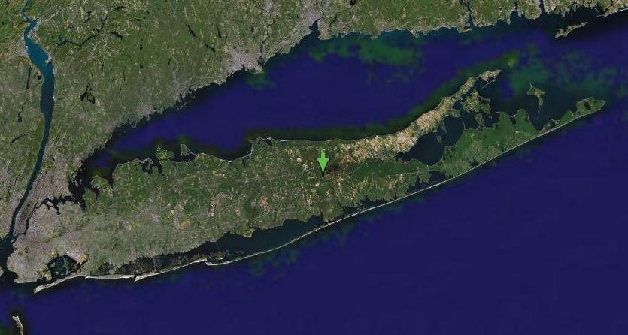
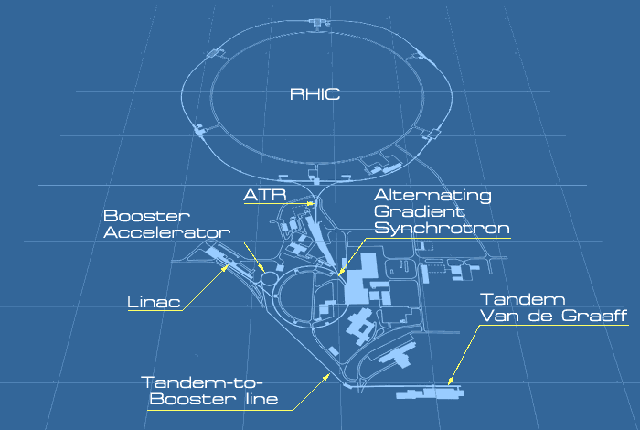
The RHIC facility
Two independent rings
3,9 km long each
Collides heavy ions...
Au+Au, Cu+Cu, U+U...
√s_{NN}= 7,7 – 200 GeV
...and protons
p+p up to √s = 500 GeV
Different polarization patterns
Asymmetric setups
d+Au, Cu+Au …
4 experiments
All different capabilities
PHENIX, STAR (the „large” ones)
PHOBOS, BRAHMS (completed)
RHIC, BNL
PHOBOS
BRAHMS
PHENIX
STAR
Notes:
22

Slide 23
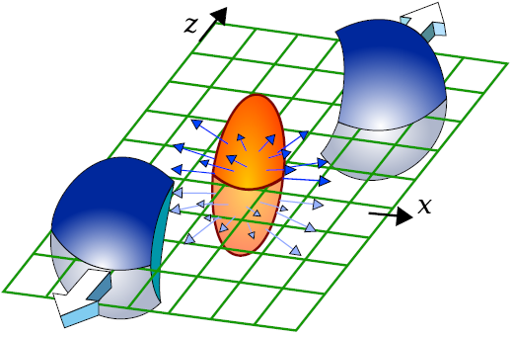
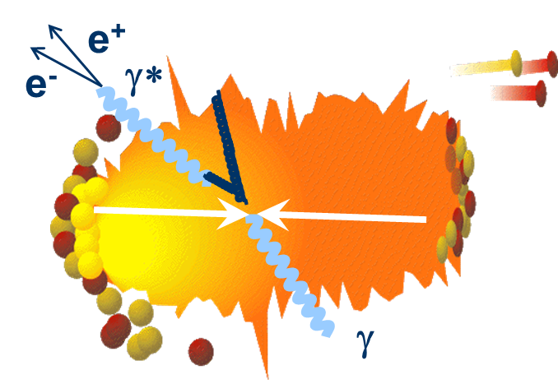
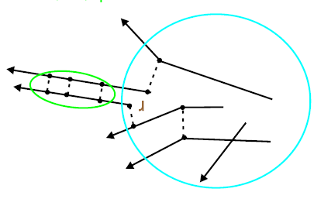
Hot nuclear matter
Nucl. Phys. A 757 (2005) p1 ; p28; p102 ; p184 [white papers]
Extremely dense
Au+Au: jet suppression No effect in d+Au
Strongly interacting, new state of matter
λ ~ 3 fm (5 GeV jet)
Perfect fluid of quarks
Contradicts expectations
Degrees of freedom: quarks
Viscosity consistent with theoretical limit
η/s ~ ħ/4π , c_{s} = 0.35c
Quark Gluon Plasma (sQGP)
Phys.Rev.Lett. 104, 132301 (2010)
Thermal radiation, T_{init}~4 x 10¹² K
T_{init}>300 MeV>>T_{Hagedorn}, ε_{init}~15 GeV/fm³ ,p_{init} ≥ 1.5 GeV/fm³
Evolution of the particle source?
Dynamics, space-time extent ←correlations
Notes:
23

