Slide 1
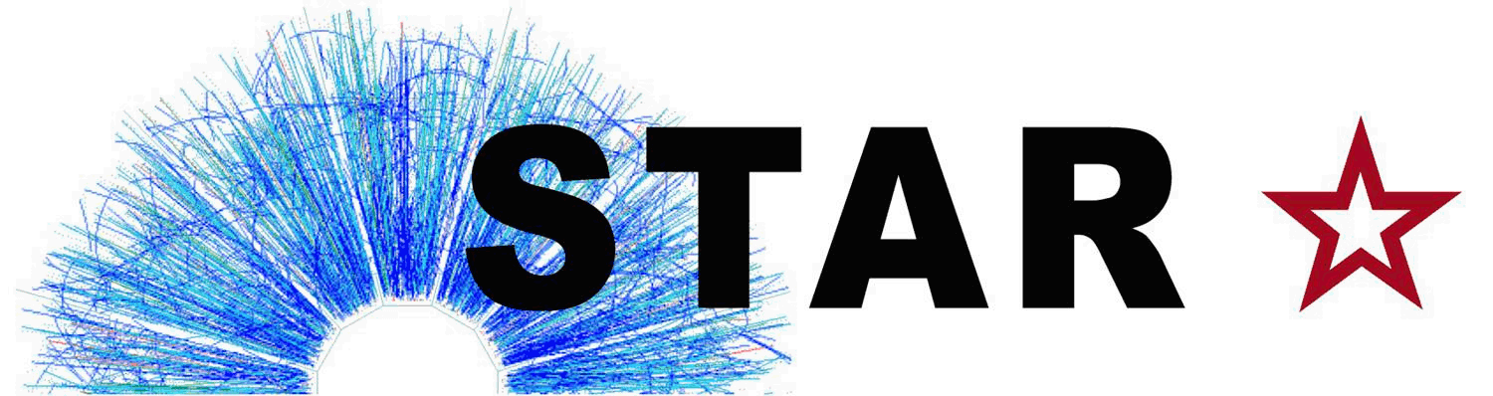


STAR detector Capabilities and Forward Upgrade Plans
Zhangbu Xu

Slide 2
STAR detectors
Present and in the plans
  STAR capabilities for 2016-2020
BES-II iTPC, eTOF, EPD
  Low energy long range correlations
2020+
  Configuration as BES-II for top energy
  Additional Upgrades Not part of RHIC plans at present, but intriguing possibilities

Slide 3


STAR Detector System
15 fully functioning detector systems
EEMC
ESMD
Magnet
MTD
BEMC
BSMD
TPC
TOF
BBC
FMS
FPS
DAQ
Trigger
RP
ZDC
NSAC 2015 RECOMMENDATION #I:
The upgraded RHIC facility provides unique capabilities that must be utilized to explore the properties and phases of quark and gluon matter in the high temperatures of the early universe and to explore the spin structure of the proton.
HFT
Excellent PID at mid-rapidity, X10³ increases in DAQ rate since 2000, most precise Silicon Detector (HFT)

Slide 4
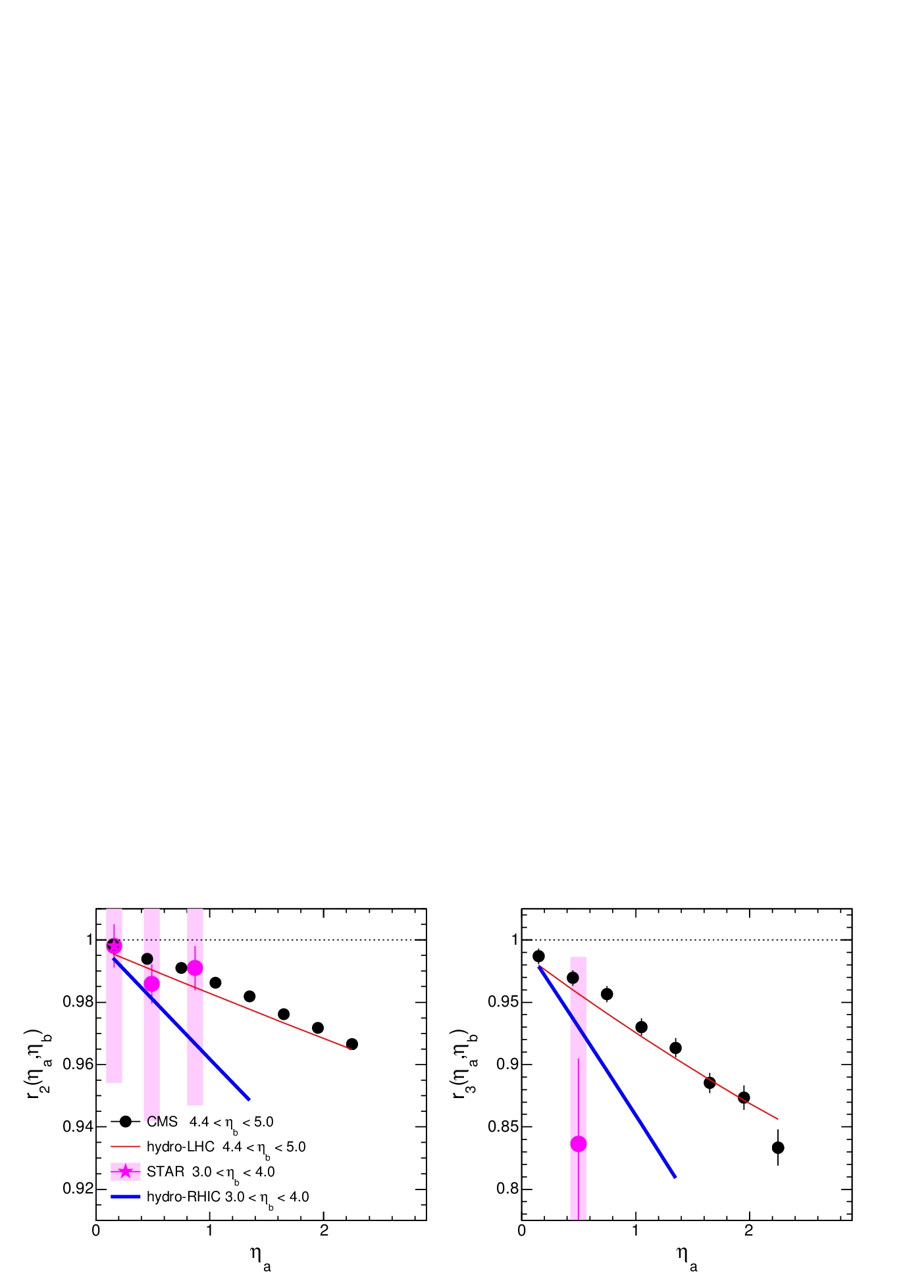
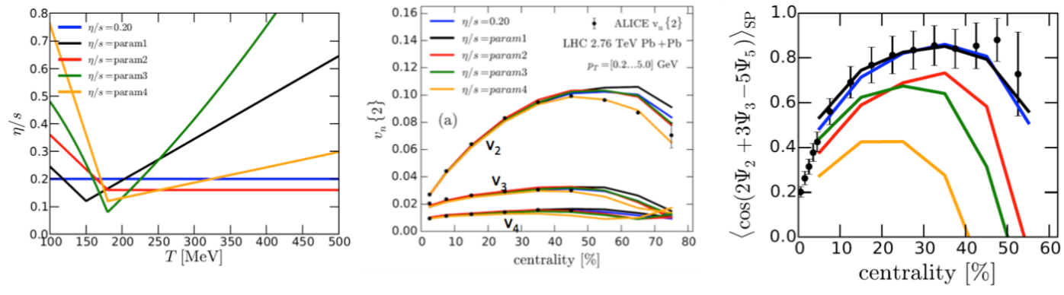
η/s and 3+1D hydrodynamics
Uncertainties in the correct physics of the initial state are still problematic:
gluon saturation or Glauber?
To what extent do thermal fluctuations during the expansion phase contribute to the correlations observed in the data?
Both of these pressing uncertainties can be addressed by extending the longitudinal acceptance of the STAR detector.

Slide 5
What is our present longitudinal capability?
Zero Degree Calorimeter (ZDC |η|>5.5)
Forward Meson Spectrometer (FMS 2.6<η<4)
Beam-Beam Counter (BBC 3.3<|η|<5)
Time-Projection Chamber (TPC |η|<1)
+Time-of-Flight (TOF |η|<0.9)
+Electromagnetic Calorimeter (EMC -1<η<2)

Slide 6
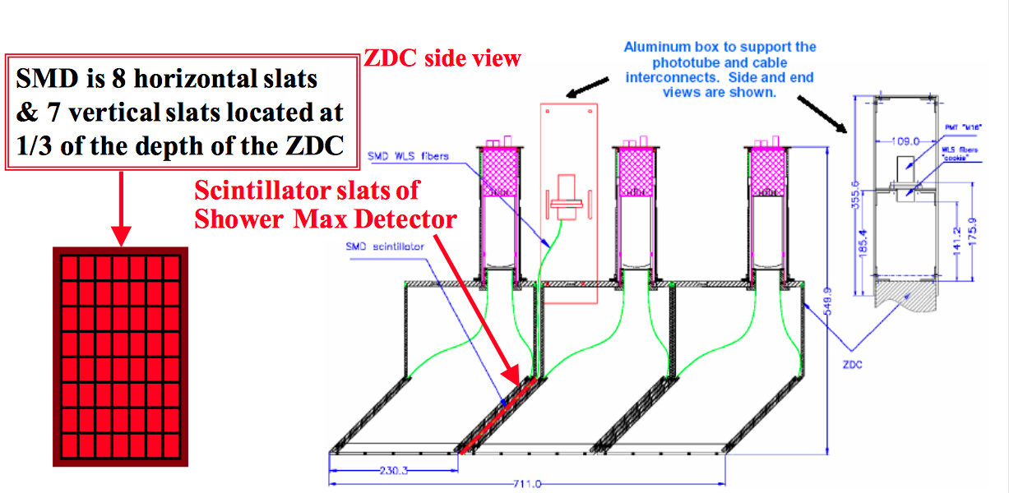
Longitudinal fluctuation using ZDC
Talks by Yang Wu’s talk at this workshop, measure directed flow v₁ using ZDC
Prospects to correlate e.g. with p,p-bar at mid-rapidity , forward-backward correlations vs. beam energy
Useful also in future high energy running

Slide 7
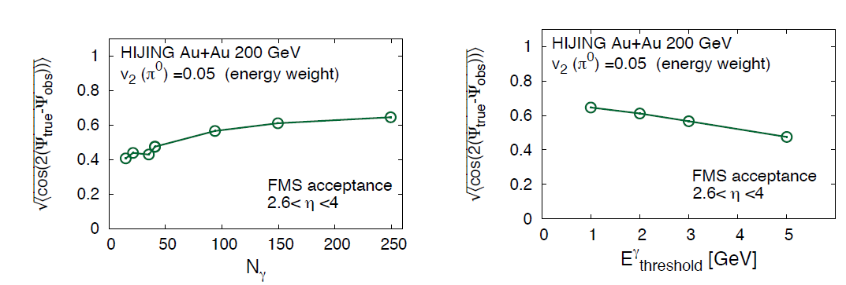
Mid-rapidity + FMS
In run-16 STAR will utilize the FMS
Prithwish Tribedy

Slide 8
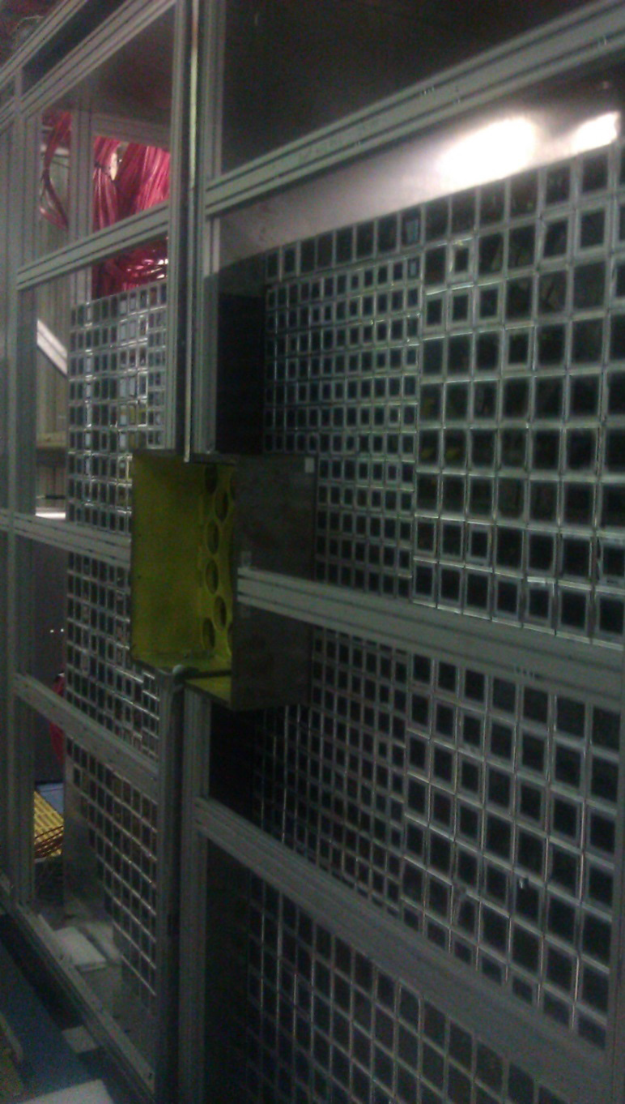
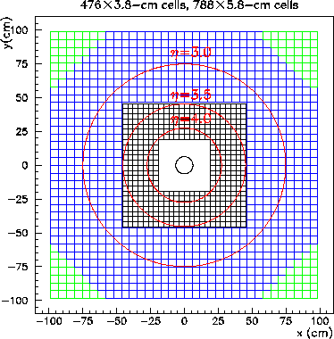
STAR Forward Meson Spectrometer (FMS)
Schematic of the FMS as seen from the interaction point. The small-cell inner calorimeter has 476 detectors and the large cell outer calorimeter has 788 detectors.
Detectors are stacked on the west platform in two movable halves.

Slide 9
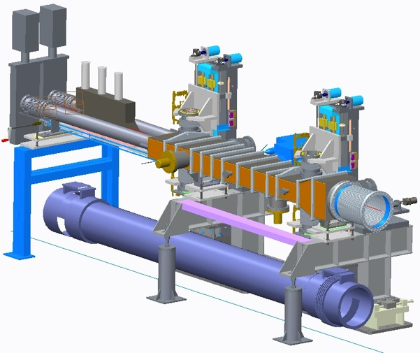
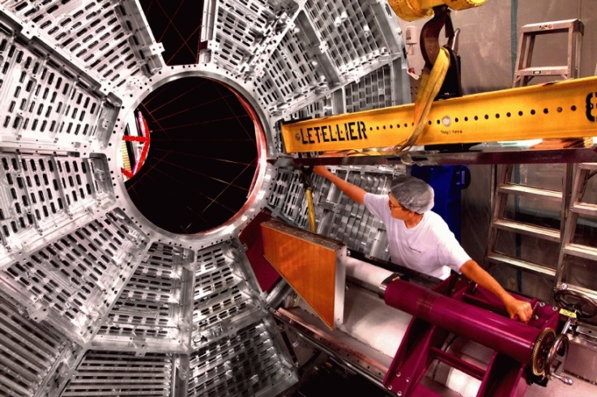
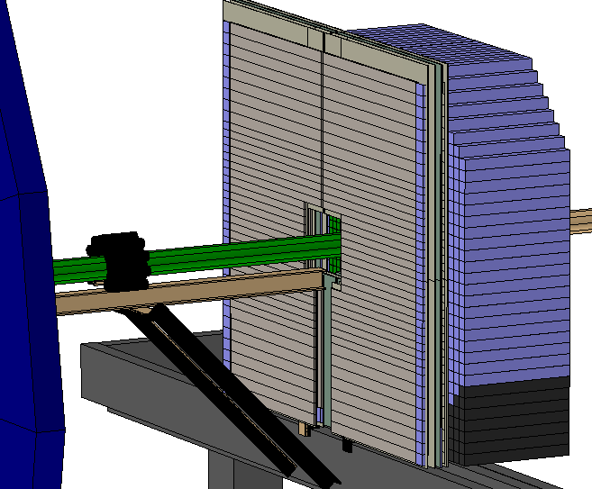
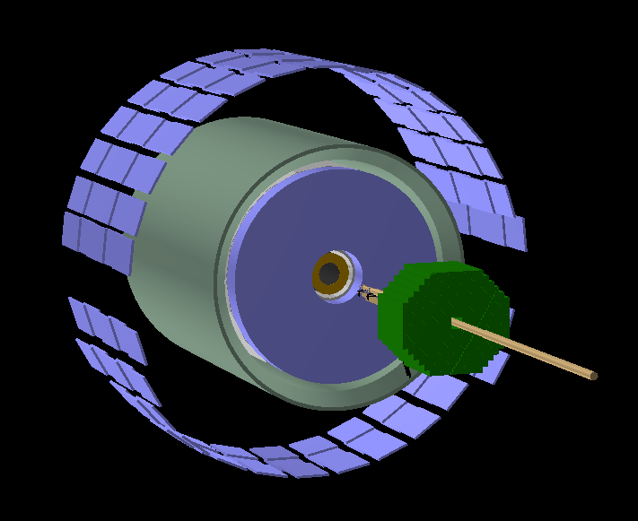
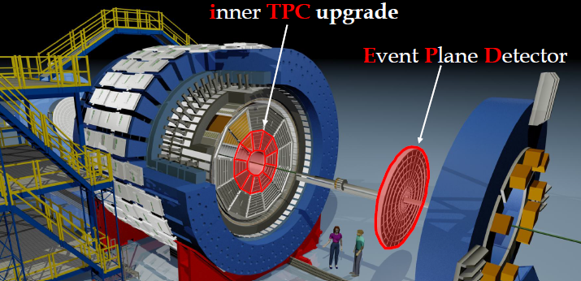
Detector Upgrades and Performance Improvements
Incremental upgrades/improvements, big impacts
Run15,16,17, 19, 20 (Year2015—2020)
Trigger/DAQ x2 throughput
iTPC upgrade (2018)
replace inner TPC Sectors
Extend rapidity coverage
Better particle ID; Low p_{T} coverage
Proposal: public STAR Note 0619
Roman Pots (2015)
Tag diffractive protons
FMS+FPS
HCAL
Event Plane Detector (2018):
Greatly improved Event Plane Info
Centrality definition
Better trigger
Background rejection
Forward calorimeter instrumentation (2015—2020)
FMS + pre-shower (2015), +post-shower (2017)
A_{N} photon, jets, Drell-Yan; ridge, fluctuation, spectators
refurbished HCAL (--2020, forward spectator)
CBM TOF for STAR Endcap East

Slide 10
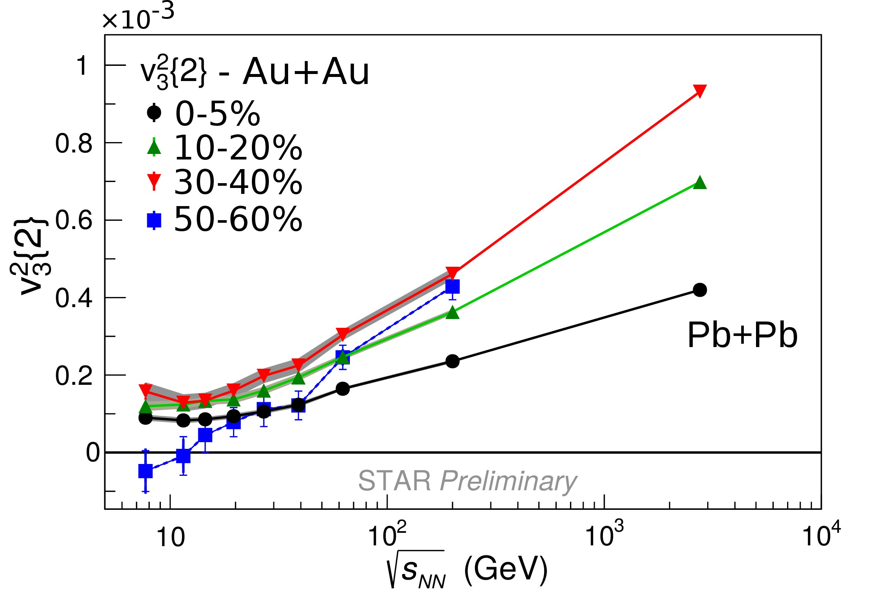
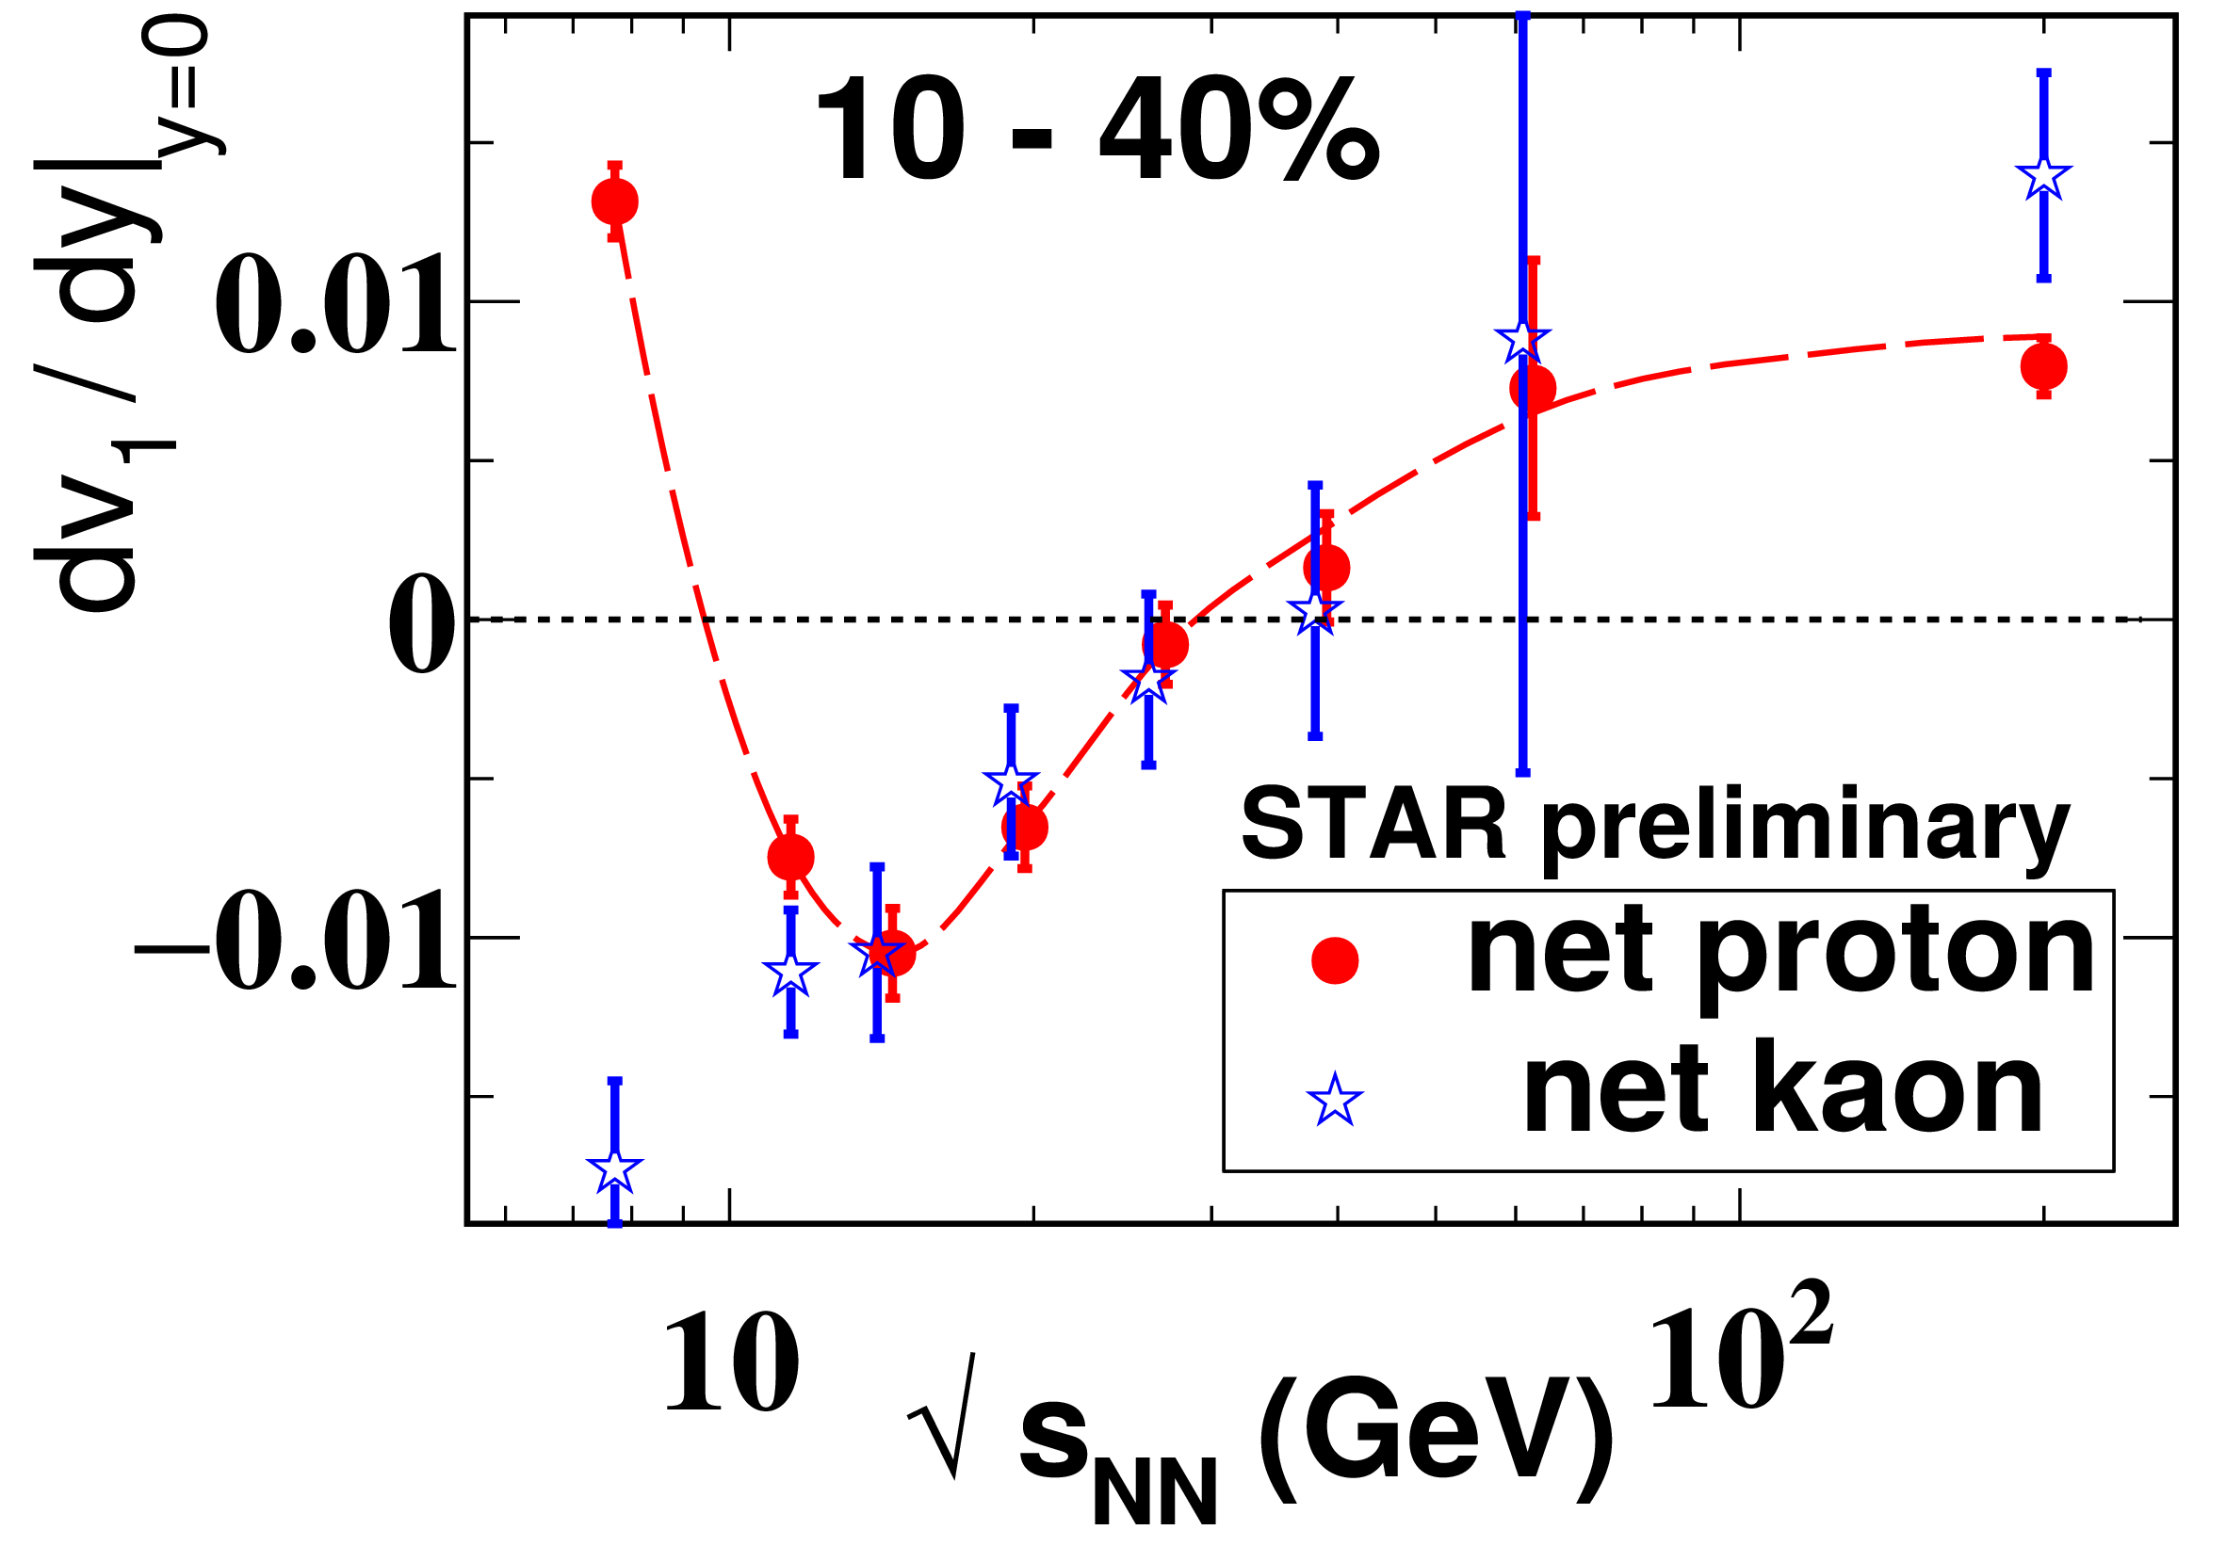
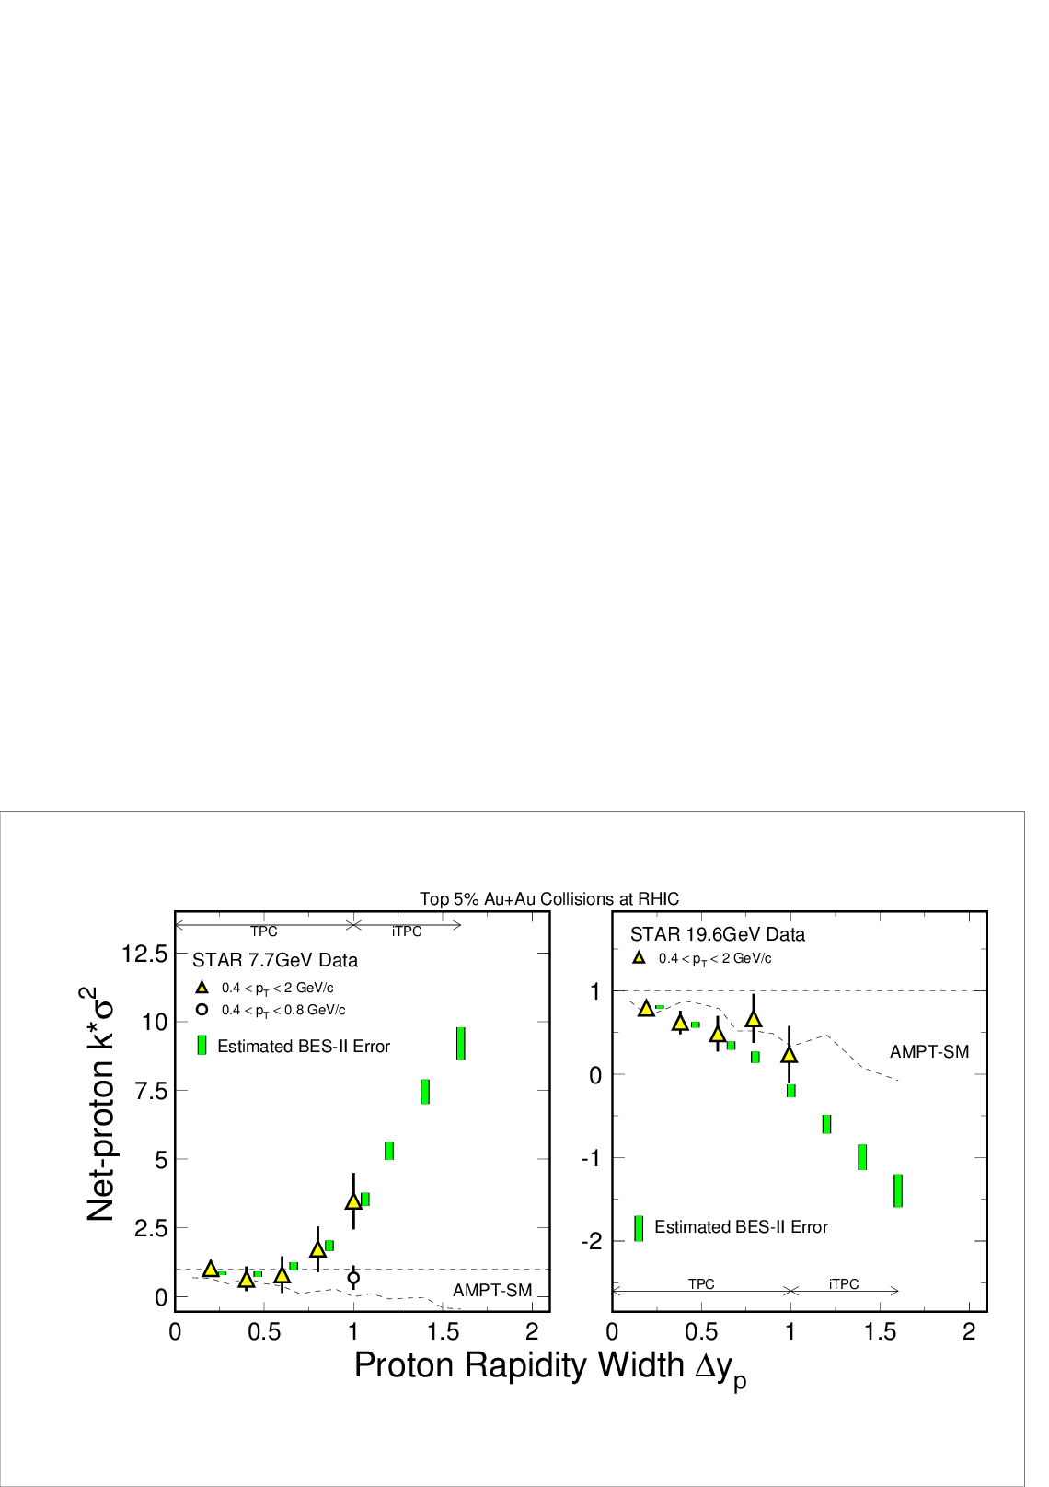
(QM15) Map QCD phase diagram
Beam Energy Scan Program:
Turn off QGP Signatures
triangle flow (v₃) in peripheral at low energy
consistent with zero
Search for first-order phase transition
minimum net-proton v1 slope from
interplay between baryon stopping and soft EOS
Search for critical point
net-proton Kurtosis possibly not Poissonian and
grow with accepted rapidity window
Rapidity Width

Slide 11
Upgrade Plans for BES II
i
TPC
E
P
D
iTPC upgrade:
Sparse pads cover full area;
better dE/dx;
-1 < η < 1 -1.5 < η < 1.5;
p_{T} >125 MeV/c p_{T} > 60 MeV/c.
EPD upgrade:
1.8 < eta < 4.2
Greatly improved Event Plane info (esp. 1st-order EP);
Better trigger & b/g reduction.

Slide 12
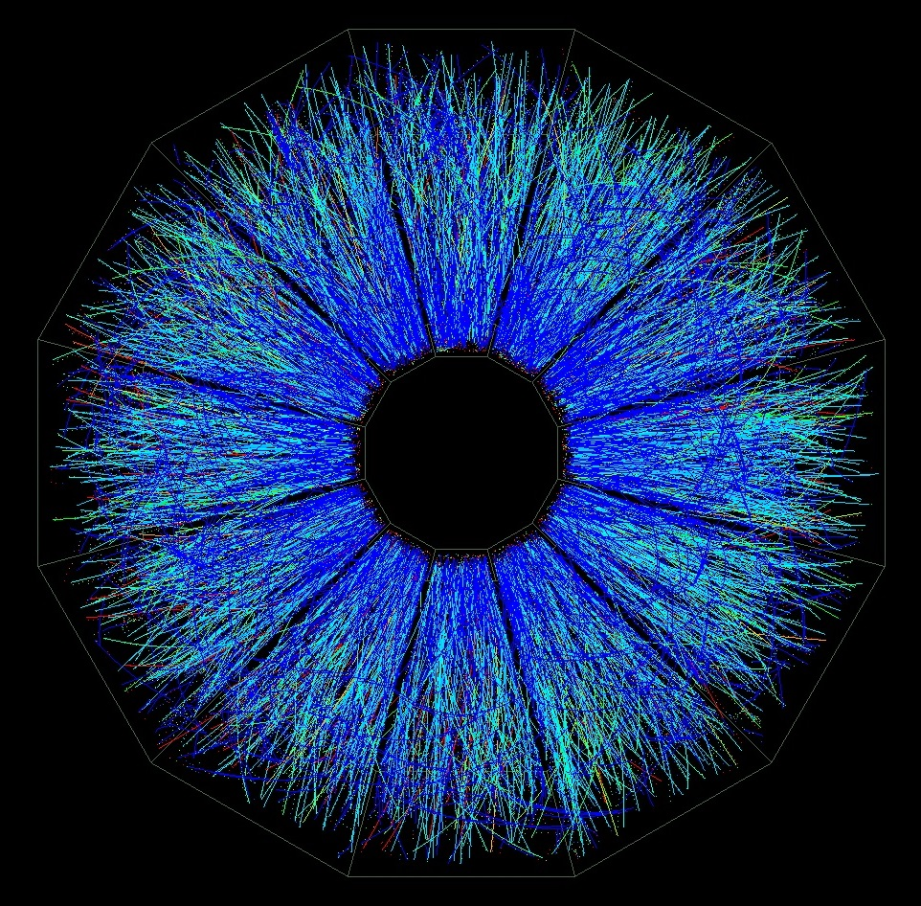
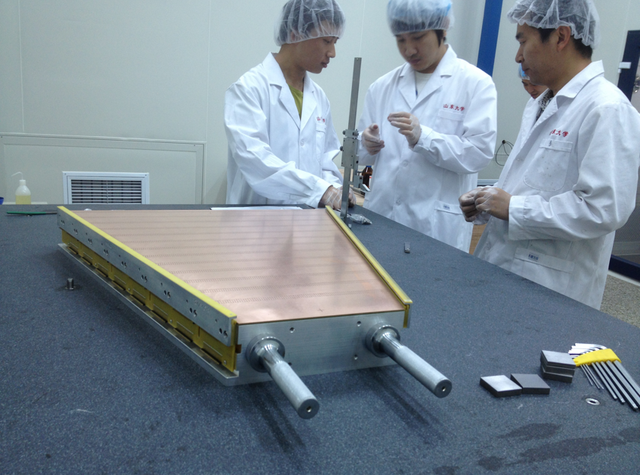
iTPC project
Sparse pads(20%) cover full area;
better dE/dx;
-1 < η < 1 -1.5 < η < 1.5;
p_{T} >125 MeV/c p_{T} > 60 MeV/c.
https://drupal.star.bnl.gov/STAR/starnotes/public/sn0644

Slide 13
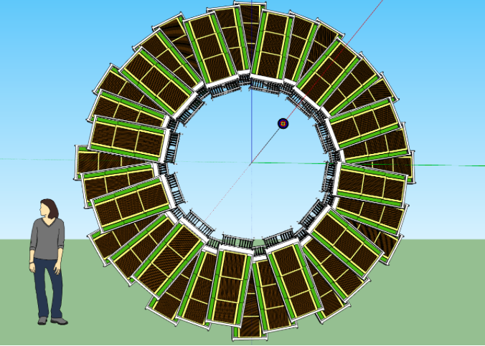
Endcap Time-of-Flight from CBM
eTOF will be positioned at the east end of STAR
~5% occupancy for central Au+Au
-2<eta<-1
Almost Hermetic coverage (iTPC+eTOF+EPD)
https://drupal.star.bnl.gov/STAR/starnotes/public/sn0639

Slide 14
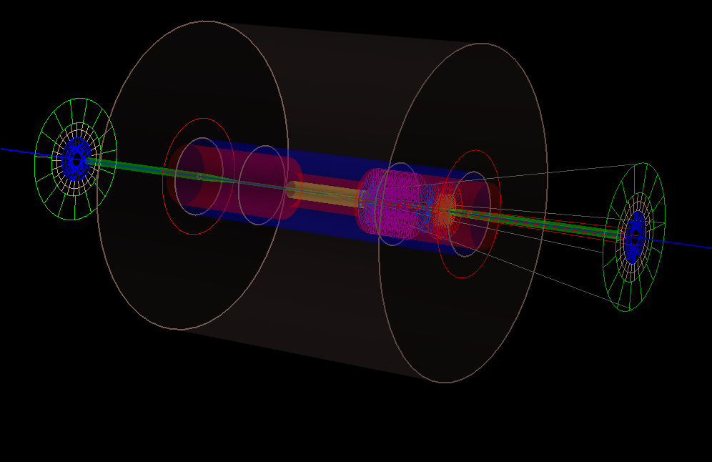
Event Plane Detector

Slide 15
Design Criteria
Large rapidity gap relative to the TPC to minimize non-flow effects and physics correlations
Significant radial (16) segmentation to reduce (EP) biases
• Large acceptance to maximize the EP resolution
Symmetric in pseudo rapidity (east and west side) to determine an unbiased EP resolution and to measure as many particles as possible
• Fine granularity (single hit determination) for
good EP and centrality resolution

Slide 16
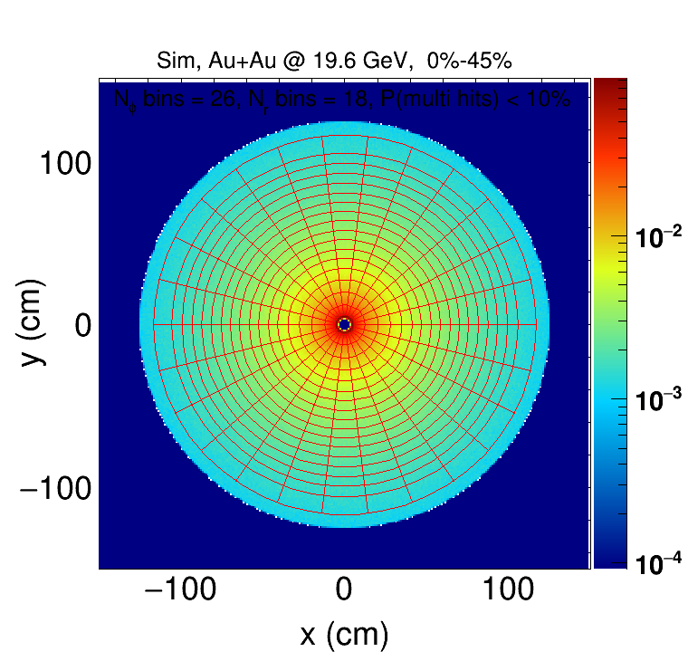
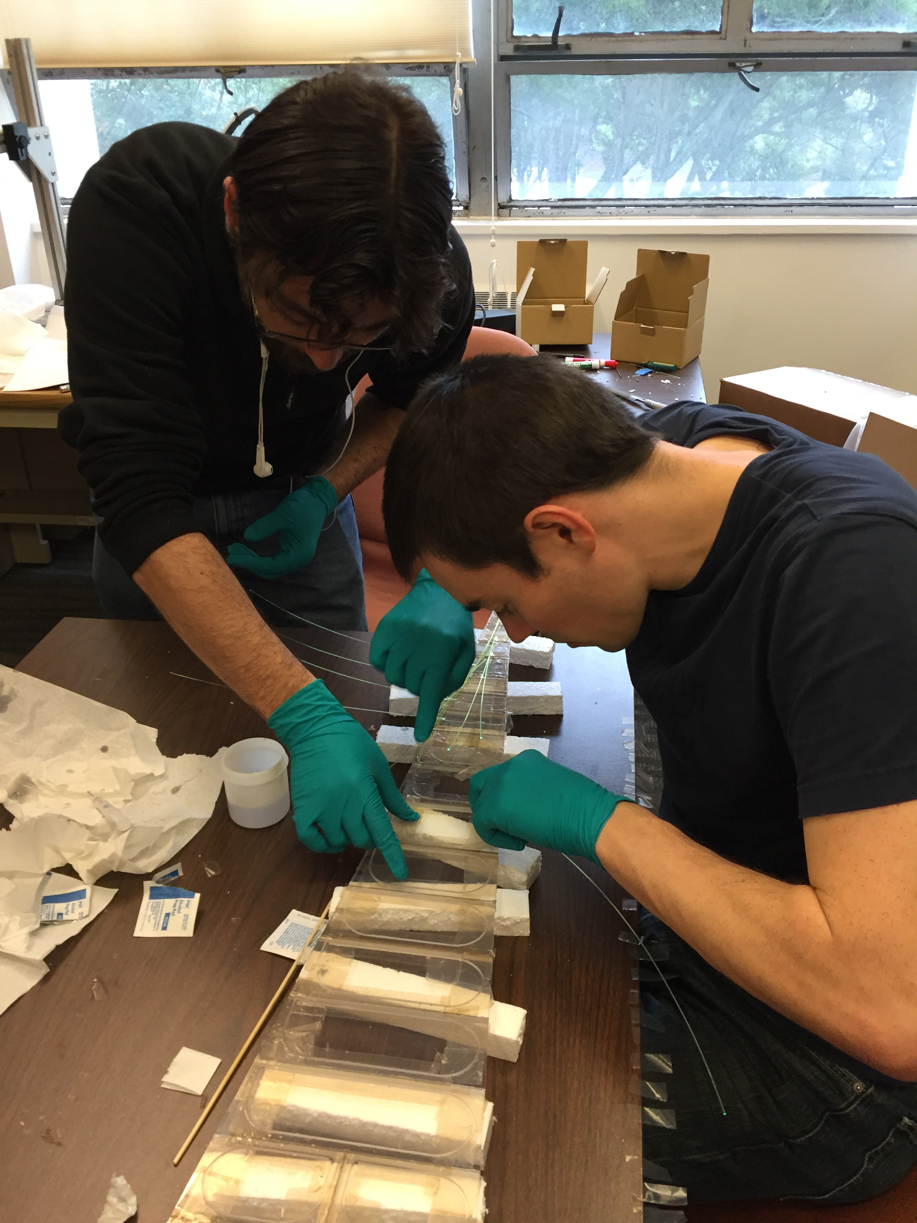
Event-Plane Detector Coverage
24 sector design
16 channels per sector
Optimal pad sizes determined through simulation
2.3<η<5.0

Slide 17
Rapidity Coverage (<=2017)
TPC+FMS (2016-2017)
TPC-FMS
FMS-FMS
TPC-FMS

Slide 18
Rapidity Coverage (BES-II)
TPC+iTPC+EPD+FMS (2019--)
TPC-FMS
FMS-FMS
TPC-FMS

Slide 19
STAR 2020+
Over the year in e.g. decal plan and subsequent document STAR developed plans for running in the period after the BES-II and concurrent with sPHENIX.
These plans have not, yet, been approved by ALD and PAC but it is worthwhile to review what opportunities there are continue running with the STAR detector in 2020+.
https://drupal.star.bnl.gov/STAR/starnotes/public/sn0640

Slide 20
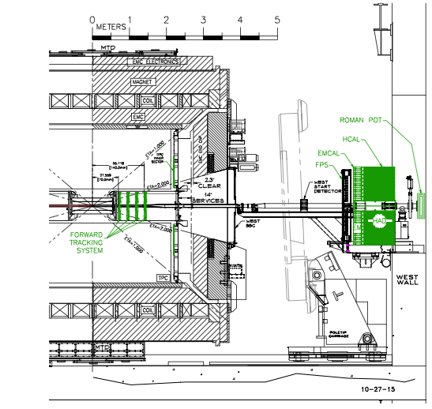
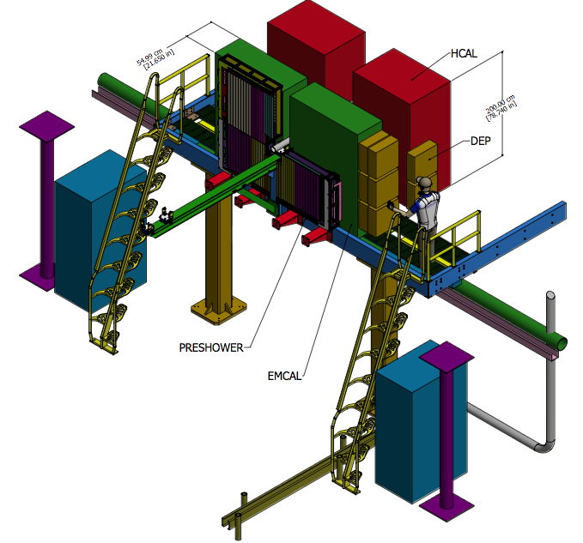
Possible Implementation
Forward Electromagnetic calorimeter and hadronic calorimeter
Complete energy measurement with high granularity.
https://drupal.star.bnl.gov/STAR/starnotes/public/sn0648
And
The RHIC Cold QCD Plan from 2017 to 2023: A portal to the EIC - Jan. 2016

Slide 21
Rapidity Coverage (beyond BES-II)
TPC+iTPC+EPD+FCS (2019--)
TPC-FCS
FCS-FCS
TPC-FCS

Slide 22
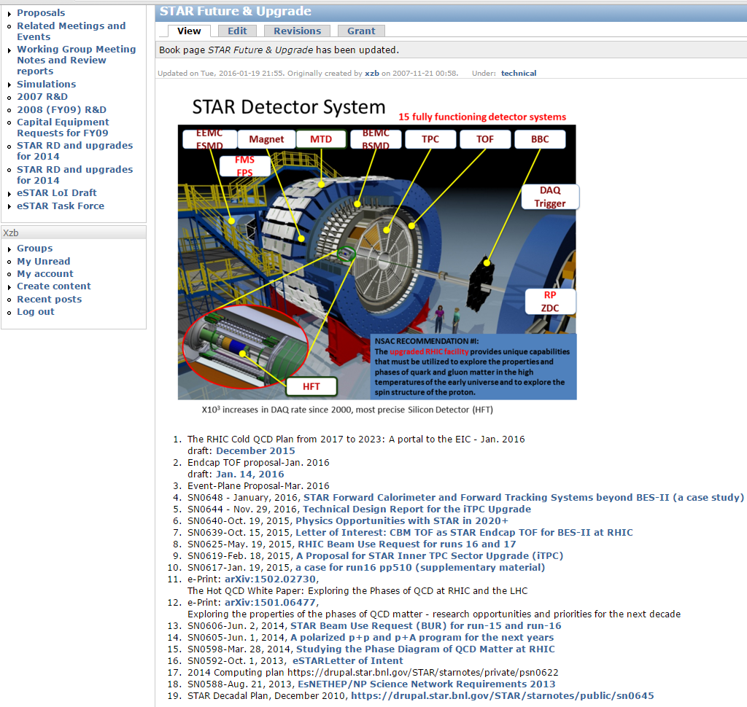
“The Future”
documents

Slide 23
Summary
STAR has been at the frontier of flow and correlation analyses
Continue to develop its capability by improving Particle Identification at mid-rapidity and extending acceptance in the forward rapidity; increasing data-taking and online processing capacity.
With a few modest upgrades (300K—3M$)
  facilitate the determination of QGP properties in A+A collisions through improved measurements of the initial density fluctuations as well as the collective flow seeded by these fluctuations.
  further quantify η/s through improved understanding of initial conditions via measurements of longitudinal flow de-correlation, multiple harmonics and event-shape engineering in A+A collisions
  allow studies of the possible existence of and limits on hydrodynamics and jet-medium interaction in small systems at RHIC energies.
Looking forward to more exciting programs at RHIC

Slide 24
The RHIC Cold QCD Plan from 2017 to 2023: A portal to the EIC - Jan. 2016
draft: December 2015
Endcap TOF proposal-Jan. 2016
draft: Jan. 14, 2016
Event-Plane Proposal-Mar. 2016
SN0648 - January, 2016, STAR Forward Calorimeter and Forward Tracking Systems beyond BES-II (a case study)
SN0644 - Nov. 29, 2016, Technical Design Report for the iTPC Upgrade
SN0640-Oct. 19, 2015, Physics Opportunities with STAR in 2020+
SN0639-Oct. 15, 2015, Letter of Interest: CBM TOF as STAR Endcap TOF for BES-II at RHIC
SN0625-May. 19, 2015, RHIC Beam Use Request for runs 16 and 17
SN0619-Feb. 18, 2015, A Proposal for STAR Inner TPC Sector Upgrade (iTPC)
SN0617-Jan. 19, 2015, a case for run16 pp510 (supplementary material)
e-Print: arXiv:1502.02730,
The Hot QCD White Paper: Exploring the Phases of QCD at RHIC and the LHC
e-Print: arXiv:1501.06477,
Exploring the properties of the phases of QCD matter - research opportunities and priorities for the next decade
SN0606-Jun. 2, 2014, STAR Beam Use Request (BUR) for run-15 and run-16
SN0605-Jun. 1, 2014, A polarized p+p and p+A program for the next years
SN0598-Mar. 28, 2014, Studying the Phase Diagram of QCD Matter at RHIC
SN0592-Oct. 1, 2013, eSTARLetter of Intent
2014 Computing plan https://drupal.star.bnl.gov/STAR/starnotes/private/psn0622
SN0588-Aug. 21, 2013, EsNETHEP/NP Science Network Requirements 2013
STAR Decadal Plan, December 2010, https://drupal.star.bnl.gov/STAR/starnotes/public/sn0645

