Slide 1
STAR-Heavy Flavor Production and Heavy Flavor Induced Correlations at RHIC
W. Xie for the STAR Collaboration
(Purdue University, West Lafayette)
Outline:
Heavy quarkonia Measurements in
  p+p, d+Au and Au+Au collisions
Open Heavy Flavor Measurements
  Non-photonic electron in p+p
  Separating B/D→e through e-h correlation
  Non-photonic electron triggered azimuthal correlation in A+A collisions.

Slide 2
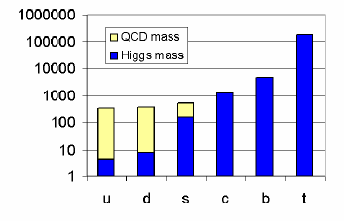
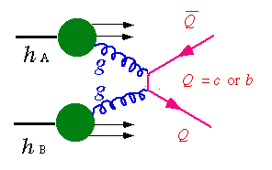
Motivation for Studying Heavy Quarks
Heavy quark mass are external parameter to QCD.
Sensitive to initial gluon density and gluon distribution.
Interact with the medium differently from light quarks.
Suppression or enhancement pattern of heavy quarkonium production reveals critical features of the medium.
Cold Nuclear effect (CNM):
  Different scaling properties in central and forward rapidity region CGC.
  Gluon shadowing, etc
K⁺
e⁻/μ⁻
ν_{l}
K⁻
Non-photonic electron
D⁰
π
Open heavy flavor
e⁻/μ⁻
e⁺/μ⁺
Heavy quarkonia

Slide 3

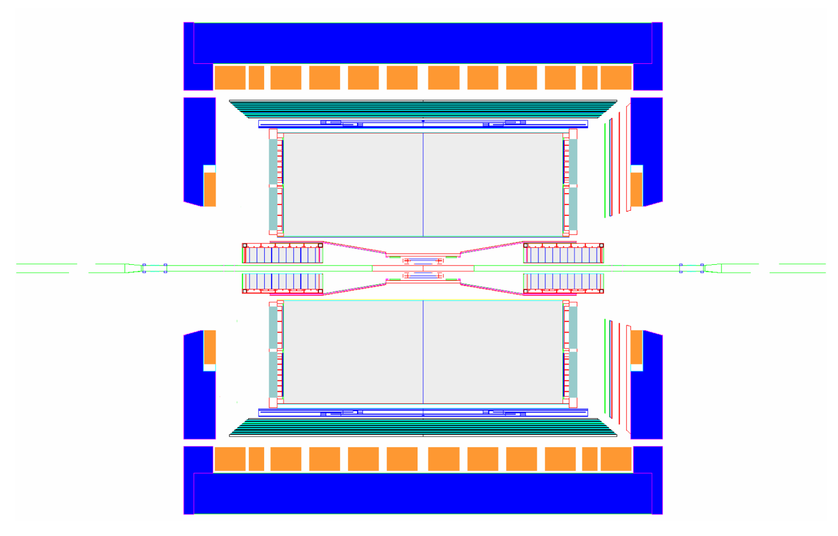
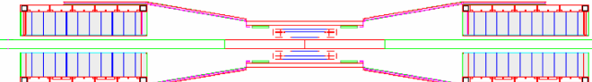
The STAR Detector
MRPC ToF barrel
MTD
EMC barrel
EMC End Cap
FMS
BBC
FPD
TPC
FHC
PMD
DAQ1000
Completed
FTPC
HFT
FGT
Ongoing
R&D
HLT

Slide 4
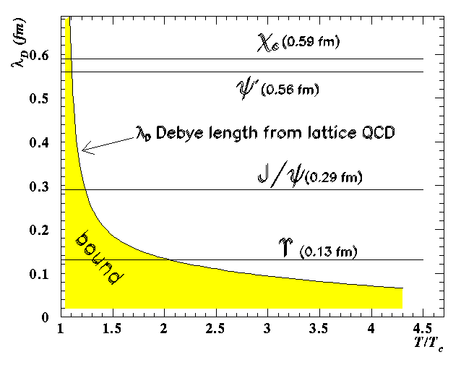
Quarkonia Suppression: “smoking gun” for QGP
Physics Letter B Vol.178, no.4 1986
c
c
Low temperature
Vacuum
J/ψ
High temperature
High density
(screening effect take place)
d
d
D⁺
D⁻
The melting sequence: χ_{c} -> Ψ’ -> J/ψ -> Upsilon

Slide 5
The life of Quarkonia in the Medium can be Complicated
Observed J/ψ is a mixture of direct production+feeddown (R. Vogt: Phys. Rep. 310, 197 (1999)).
  All J/ψ ~ 0.6J/ψ(Direct) + ~0.3 χ_{c} + ~0.1ψ’
    Important to disentangle different component
Suppression and enhancement in the “cold” nuclear medium
  Nuclear Absorption, Gluon shadowing, initial state energy loss, Cronin effect and gluon saturation (CGC)
Hot/dense medium effect
  J/ψ, ϒ dissociation, i.e. suppression
  Recombination from uncorrelated charm pairs
  Survival (or not) in the hot/dense medium from lattice calculation
c
J/ψ
c
c
D⁺

Slide 6
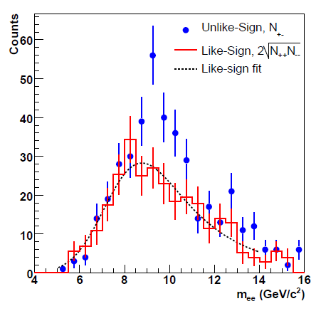
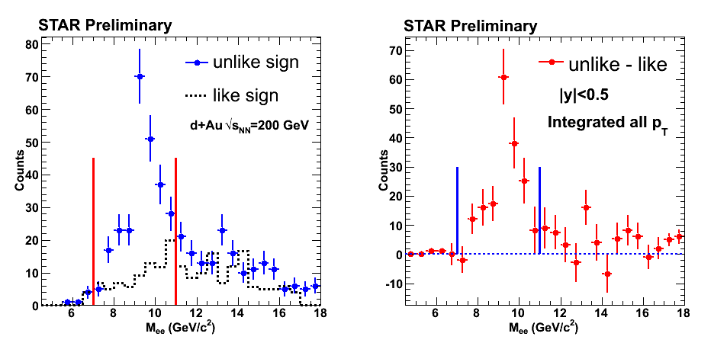

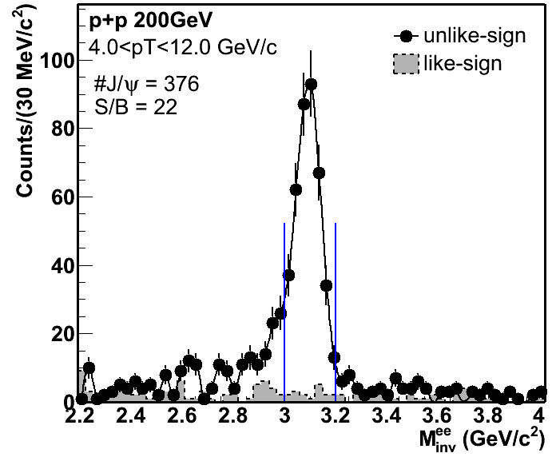
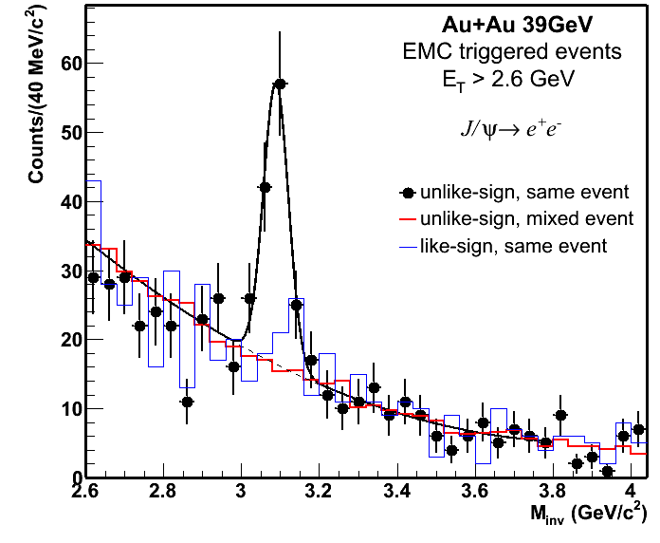
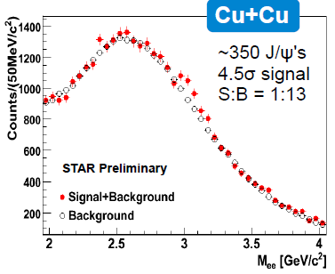
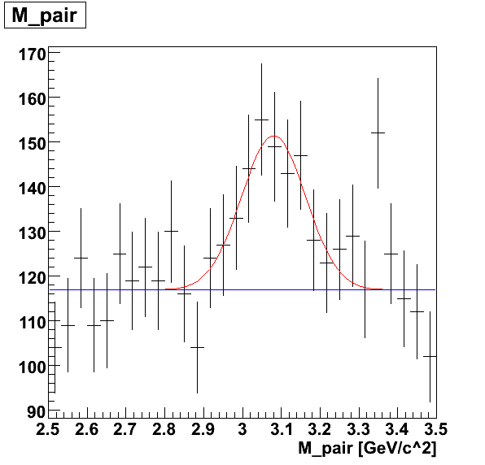
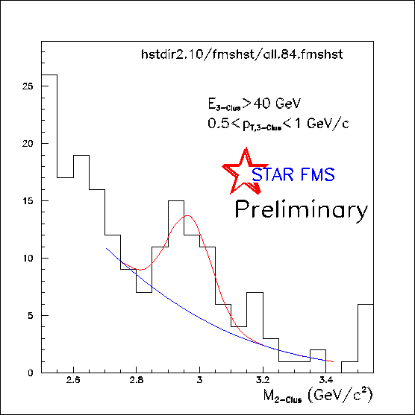

Quarkonia Signals in STAR
PRD 82 (2010) 012004
STAR Preliminary
STAR Preliminary
STAR Preliminary
STAR can measure Quarkonia
  of all different kind (ϒ, J/ψ, χ_{c}, …)
  in broad pT range.
  at both mid and forward rapidity
  in all collision species.
forward J/ψ
J/ψ from χ_{c} enriched

Slide 7
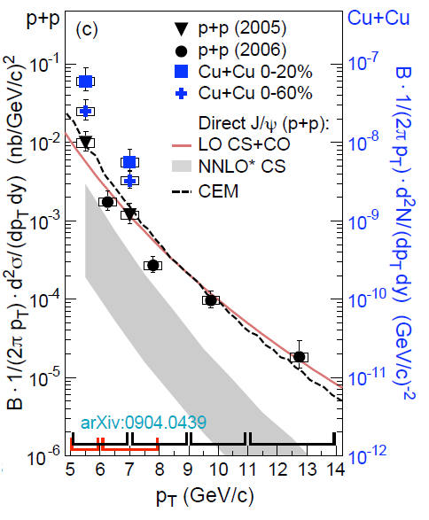
J/ψ Production in 200GeV p+p Collisions
Color singlet model (NNLO*CS):
P. Artoisenet et al., PRL. 101, 152001 (2008), and J.P. Lansberg private communication.
Include no feeddown from higher mass state.
LO CS+ color octet (CO):
  G. C. Nayak et al., PRD 68, 034003 (2003), and private communication.
Include no feeddown from higher mass state.
Agree with the data
Color Evaporation Model:
M. Bedjidian et al., hep-ph/0311048; R. Vogt private communication
Include feeddown from Xc and ψ’
Agree with the data
Phys.Rev.C80:041902,2009
See Z.B. Tang’s talk for Details

Slide 8
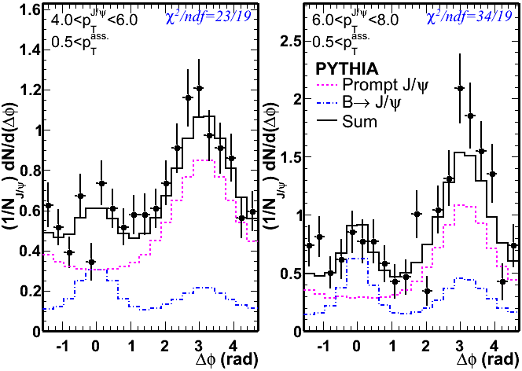
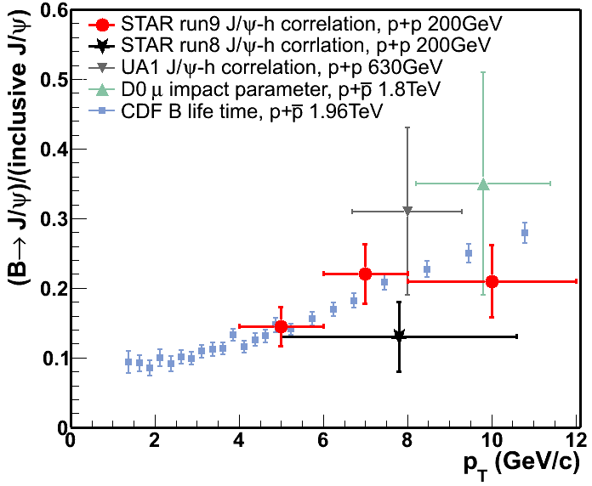
J/ψ-hadron Azimuthal Correlation in 200GeV p+p Collisions
STAR Preliminary
B→J/ψ: 10-20% of total J/ψ (pT > 4GeV/c) at RHIC
The ratio has no significant dependence on collisions energy.
Constrain J/ψ Production mechanisms in p+p:
  J/ψ+c, J/ψ+D or J/ψ+e
  S. Brodsky, J.-P. Lansberg, arXiv:0908.0754
See Z.B. Tang’s talk for Details

Slide 9
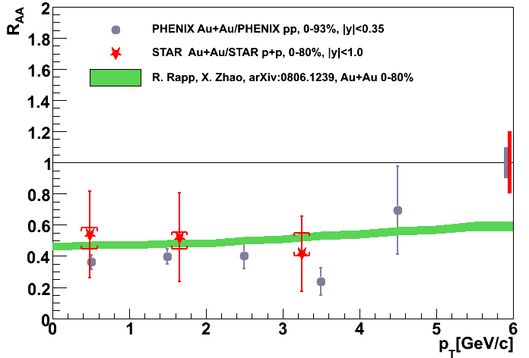
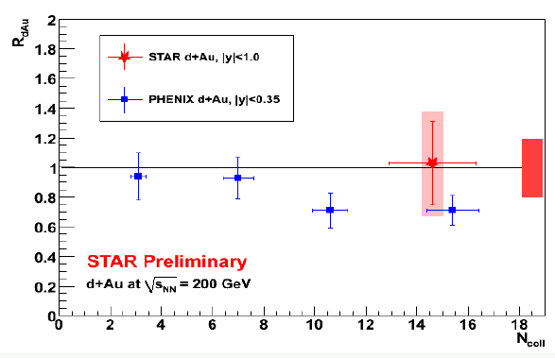
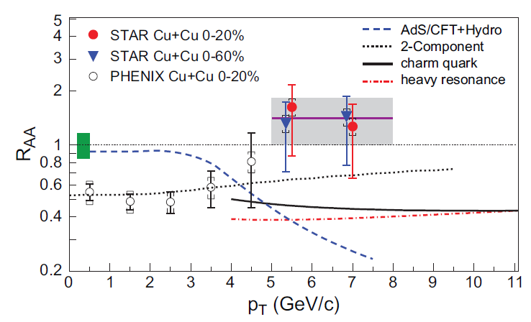
J/ψ Suppression/Enhancement in 200GeV d+A and A+A and Collisions
d+Au and Au+Au Collisions:
Nice consistenty with PHENIX
Cu+Cu Collisions:
R_{AA}(p⊥>5 GeV/c) = 1.4± 0.4±0.2
R_{AA} seems larger at higher pT.
Model favored by data:
  2-component: nucl-th/0806.1239
  Incl. color screening, hadron phase dissociation, coalescence, B feeddown.
Model unfavored by the data:
  AdS/CFT+Hydro: JPG35,104137(2008)
Comparison with open charm:
  Charm quark & Heavy resonance : NPA784, 426(2007); PLB649, 139 (2007), and private communication
Star preliminary
Au+Au: 0-80%
Phys.Rev.C80:041902,2009
See Z.B. Tang’s talk for Details

Slide 10
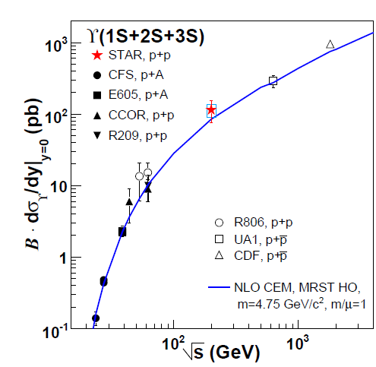
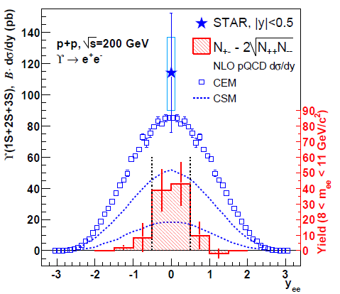
ϒ Production in 200GeV p+p Collisions
PRD 82 (2010) 012004
arXiv:1001.2745
PRD 82 (2010) 12004
pb
See R. Reed’s talk for Details

Slide 11
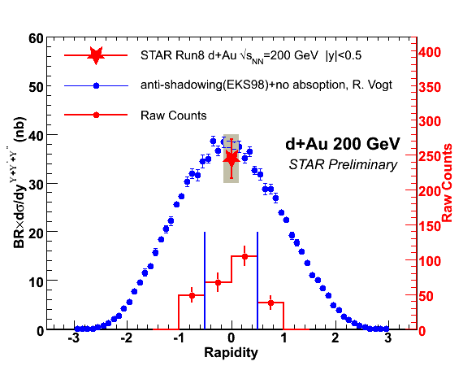
R_{dAu} (ϒ ) in 200GeV d+Au Collisions
NPA830(2009)235c
NPA830(2009)235c
nb
See R. Reed’s talk for Details

Slide 12
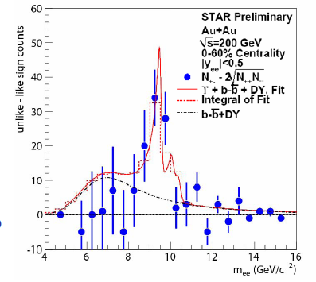
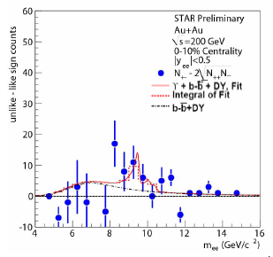
R_{AA} (ϒ ) in 200GeV Au+Au Collisions
Upsilon yield is obtained through a combined fit using the line shape from
  the simulated Upsilon and
  The calculated DY/bbar (PRD 82 (2010) 12004)
From 2007 Au+Au run:
R_{AA} (0-60%)= 0.78±0.32(stat) ± 0.22(sys,DY+bb) ±0.09(sys,p+p lum)
R_{AA} (0-10%)= 0.63±0.44(stat) ± 0.29(sys,DY+bb) ±0.07(sys,p+p lum)
See R. Reed’s talk for Details

Slide 13
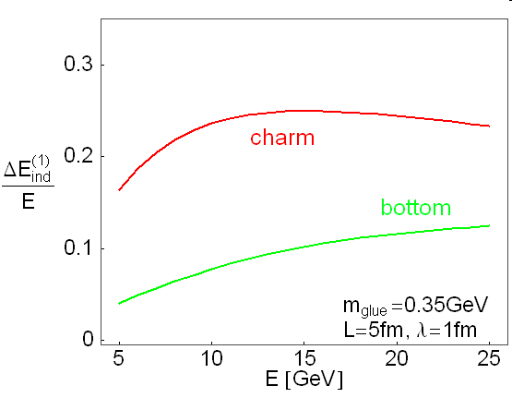
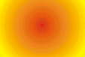
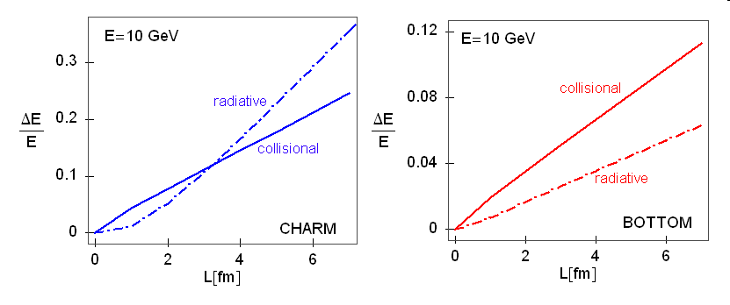
The Large Suppression of Non-photonic Electron Production was a Surprise
Hot/Dense Medium
K⁺
u
“dead cone effect”:
gluon radiation suppressed at θ < m_{Q}/E_{Q}
c quark
e⁻/μ⁻
light
c
ν_{l}
D⁰
radiative energy loss
(D. kharzeev, M.Djordjevic et al. )
Hot/Dense Medium
K⁺
c quark
u
e⁻/μ⁻
c
ν_{l}
D⁰
collision energy loss
(Teany, Ralf, Denes et al.)
Hot/Dense Medium
K⁺
c quark
u
e⁻/μ⁻
c
ν_{l}
D⁰
D⁰
meson energy loss
Ivan, et al

Slide 14
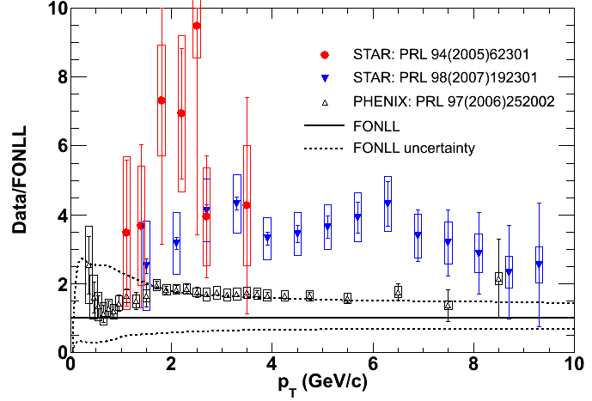
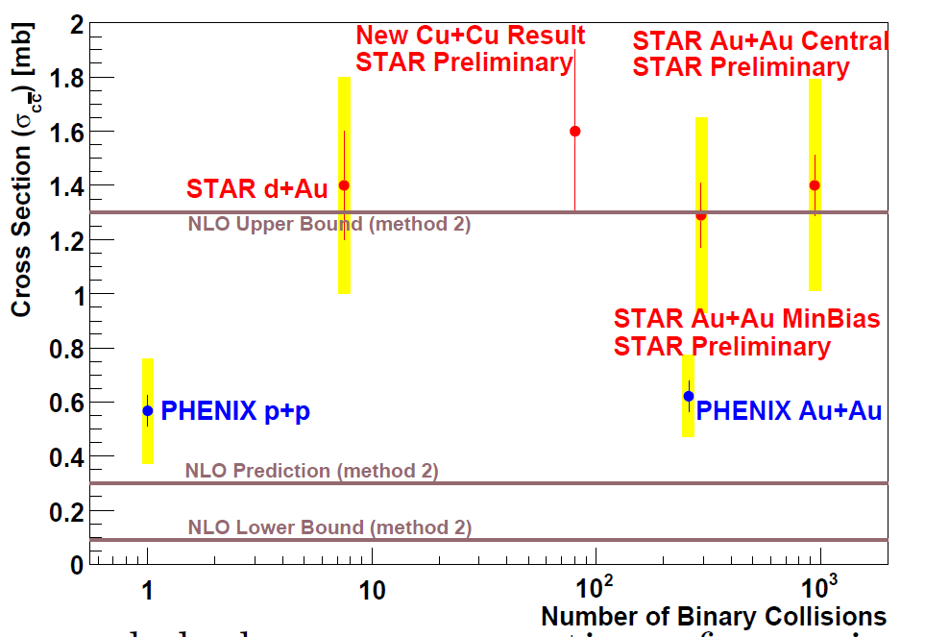
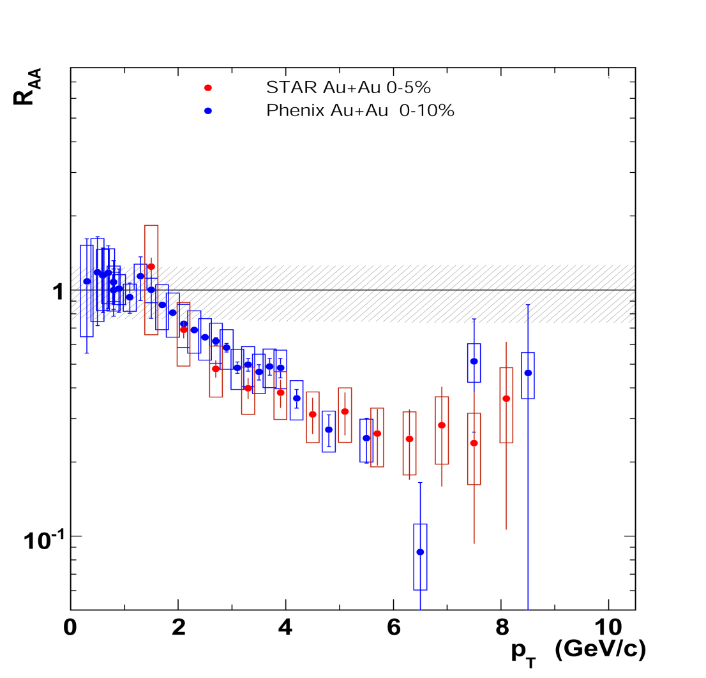
The Long Standing Issue on RHIC NPE Measurement
STAR
STAR d+Au
PRL 94(2005)62301
PRL 97(2006)252002
PRL 94(2005)082301
STAR PRL 97(2007)192301
Results differ by a factor of two in
pT spectra
Total cross section
p+p collisions
Au+Au collisions
Investigation is underway
PHENIX PRL 98(2007)172301

Slide 15
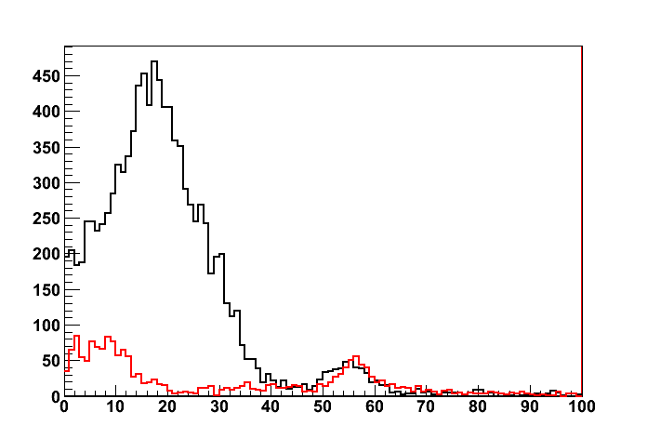
STAR Solution
Significantly Increase the S/B of this analysis (2008-present)
Cross check NPE measurements with early runs.
STAR preliminary
Beam pipe +
SVT +
SSD+
Dalitz
γ conversion
Count
R
Beam pipe +
Dalitz
TPC Inner Field cage
R(cm)
Yield of conversion electrons at different radial location

Slide 16
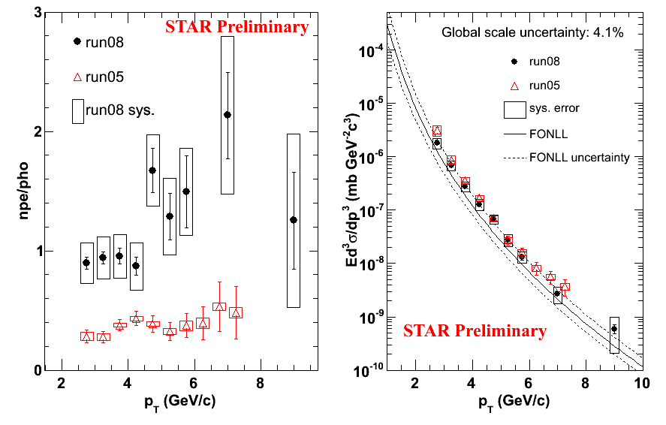
STAR high pT NPE Measurements in 200GeV p+p collisions
8.1%
Measurement done using TPC+EMC using run08 and run05 data.
pT>2.5GeV/c NPE measurement with dramatically different background agree with each very well
Combined using “Best Linear Unbiased Estimate”. χ²/ndf = 4.81/7 = 0.69

Slide 17
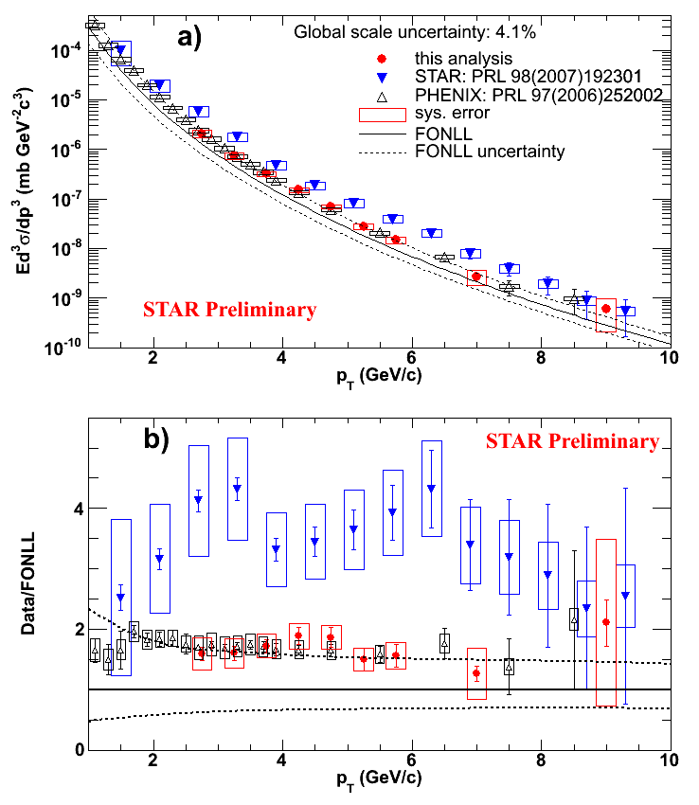
Comparison with the Published NPE Results
8.1%
STAR and PHENIX NPE result in 200GeV p+p collisions
Are consistent within errors at pt > 2.5 GeV/c
STAR High pT NPE results are consistent with FONLL in 200GeV p+p collisions

Slide 18
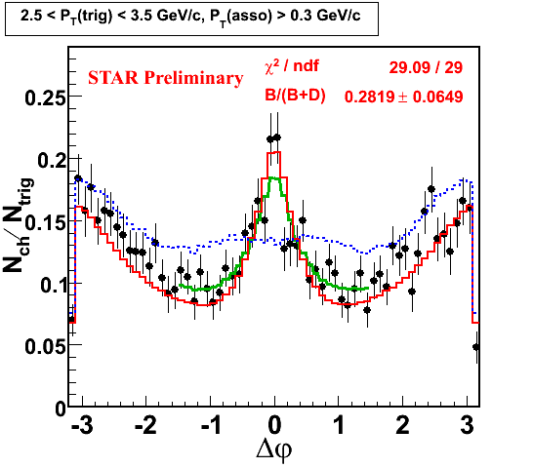
Disentangle Charm and Bottom Production
B
Wider Δφ distribution for B meson because of the larger mass.
Combined fit on data to obtain the B meson contribution to non-photonic electron.
D
hep-ph/0602067
See G. Wang talk for Details

Slide 19
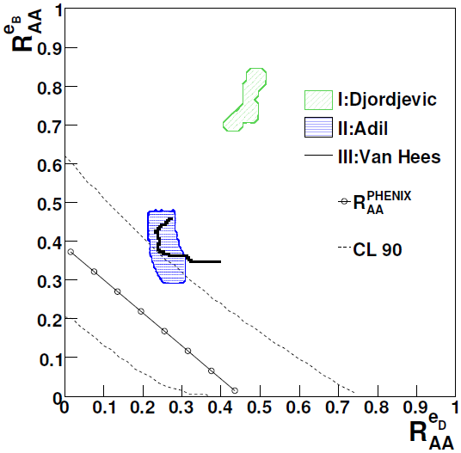
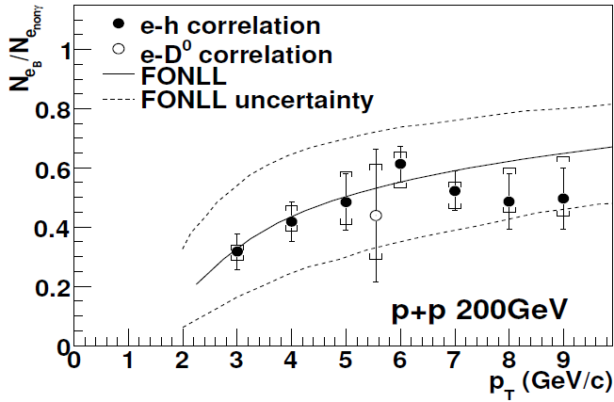
B Meson is Suppressed in 200 GeV Au+Au collisions
arXiv:1007.1200
~30-60% of non-photonic electron come from B meson in 200GeV p+p collisions.
Assume the same fraction in Au+Au collisions, results indicate B meson is suppressed
See G. Wang talk for Details

Slide 20
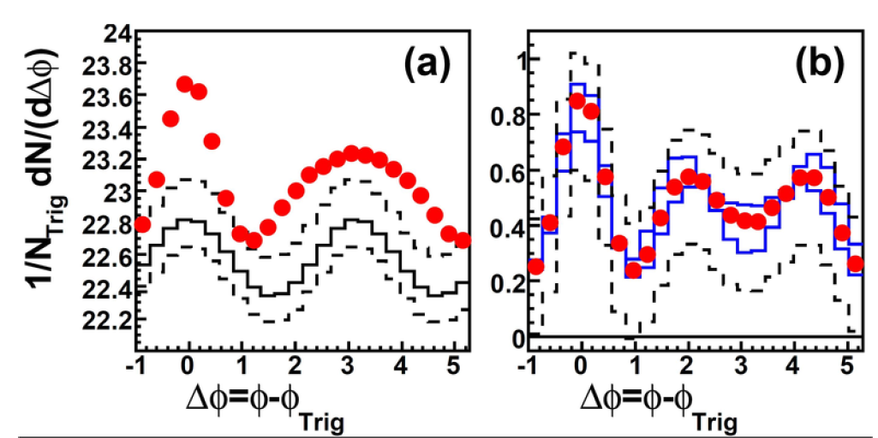
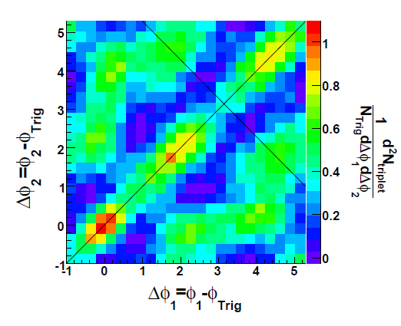
Study Conical Emission from Azimuthal Correlation
PRL102, 52302(2009)
3-hadron correlation indicate conical emission on the away-side.
Same analysis using heavy quark allow measuring velocity dependence of the emission angle.

Slide 21
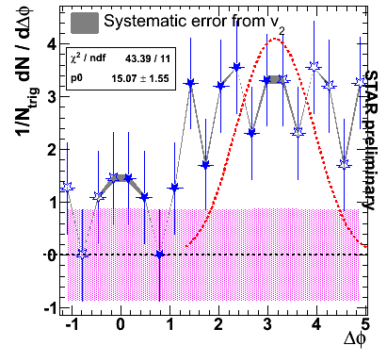
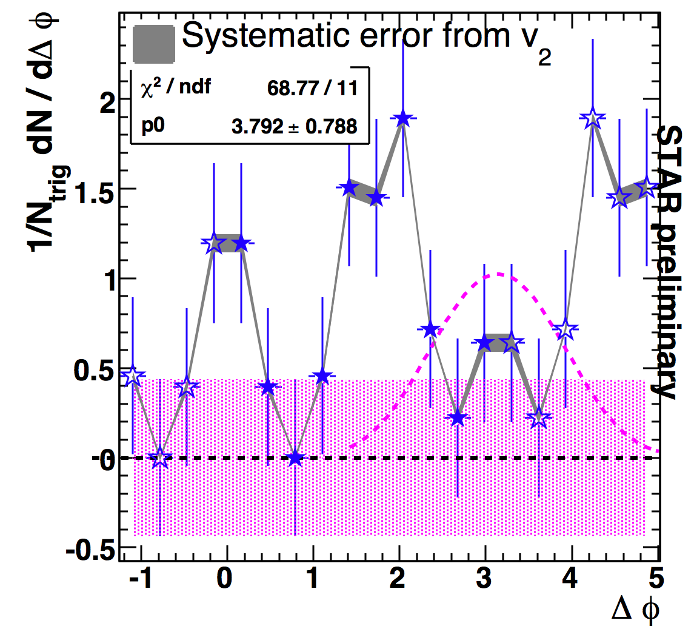
Broadened Awayside in the Non-photonic Electron e-h Correlations
AuAu
B. Biritz (QM2009)
CuCu
0 – 20%: 3 < p_{T}^{trig} < 6 GeV/c & 0.15 < p_{T}^{asso} < 0.5 GeV/c
Away side broadened, beyond PYHTIA fit, in both the Au+Au and the Cu+Cu collisions
See G. Wang talk for Detail

Slide 22
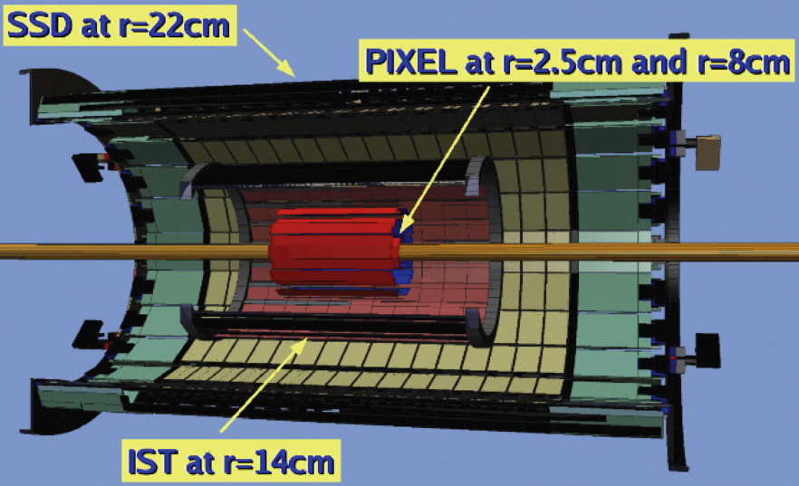
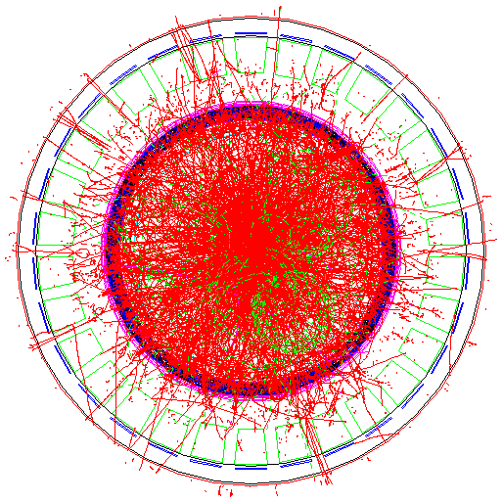
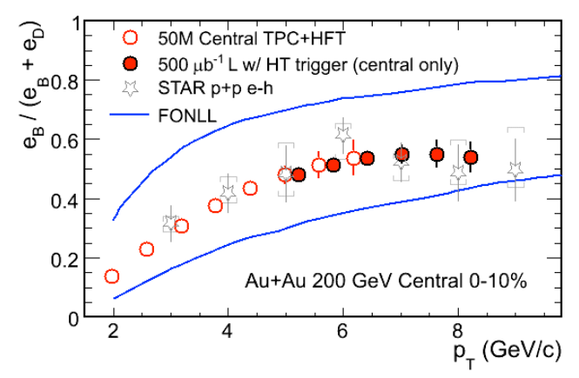
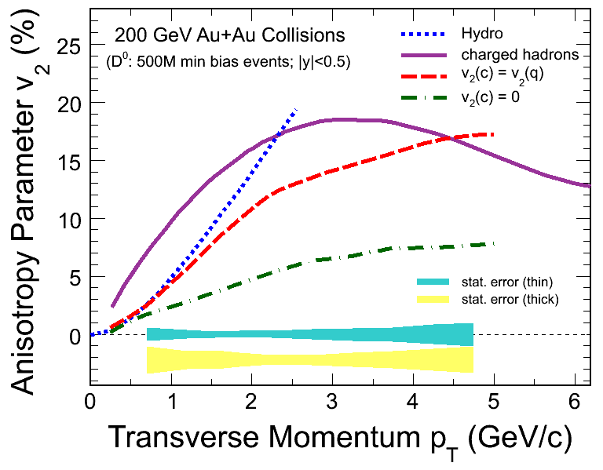
Future of Heavy Flavor Measurement at STAR
MTD (MRPC)

Slide 23
Summary and Perspective
Heavy Quarkonia
J/psi spectra shape at high p_{T} (up to 14GeV/c) favors COM
B→J/psi at pT>4GeV/c is about 10-20% of the total J/psi yield at RHIC.
Upsilon measurements in p+p agrees with the World’s data.
R_{dA} = 0.98 +/- 0.32(stat) +/- 0.28 (sys)
R_{AA} (0-60%)= 0.78±0.32(stat) ± 0.22(sys,DY+bb) ±0.09(sys,p+p lum)
R_{AA} (0-10%)= 0.63±0.44(stat) ± 0.29(sys,DY+bb) ±0.07(sys,p+p lum)
Open Heavy Flavor
STAR NPE results and PHENIX published result are consistent within errors at pt > 2.5 GeV/c in 200GeV p+p Collisions.
e-h correlation indicate B meson suppressed in central Au+Au collisions.
Broadened away-side azimuthal correlation trigger by non-photonc electron.
Looking forward to the precision measurement heavy quark production with the upgraded detectors and luminosity.

Slide 24
List of STAR Heavy Flavor Talks
Gang Wang , Monday 17:10 in Big Blue Hall - B
  “B/D contribution to non-photonic electrons and status of non- photonic electron v2 at RHIC”
Zebo Tang, Tuesday 15:00 in Coral A
  “J/psi production at high pT at STAR”
Rosi Reed, Thursday 14:40 Big Blue Hall - B
  Upsilon production in p+p, d+Au, Au+Au collisions at sqrt(S_NN ) = 200 GeV in STAR
J. Dunlop, Tuesday 15:00 Big Blue Hall - B
  “The next decade of physics with STAR”
Lijuan Ruan, Monday 14:40 in coral A
  Di-lepton production in p+p collisions at sqrt(S_NN ) =200 GeV

Slide 25
backup

Slide 26
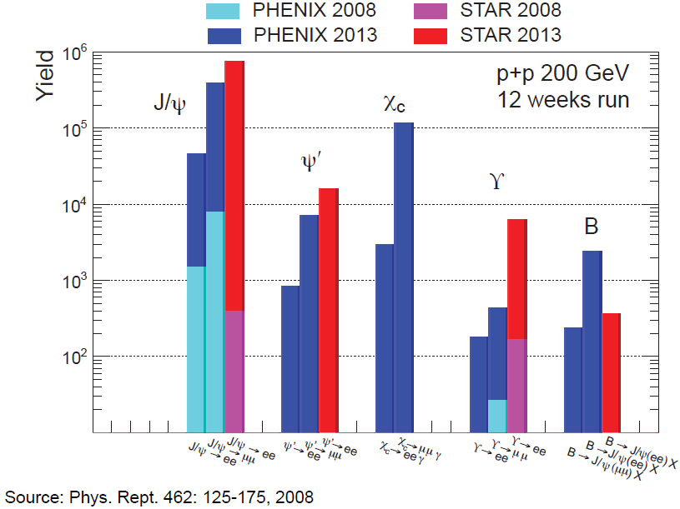
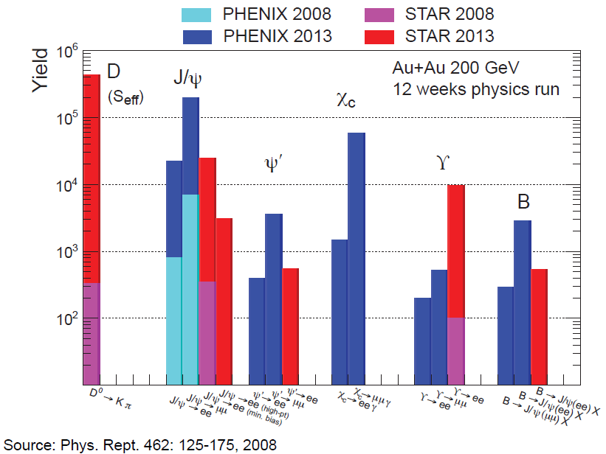
Future of Heavy Flavor Measurement at STAR
Courtesy of T. Ullirich

Slide 27
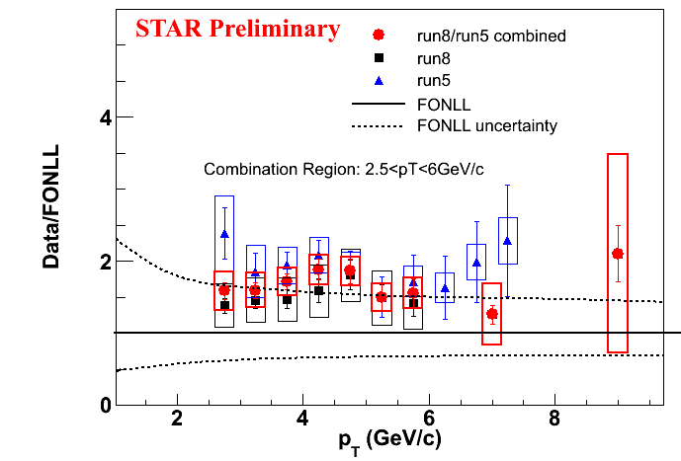
Combining run5 and run8 results
Using “Best Linear Unbiased Estimate” NIM A500(2003)391,
χ²/ndf = 4.8/7 = 0.69
Run05 and run08 are consistent with each other.

Slide 28
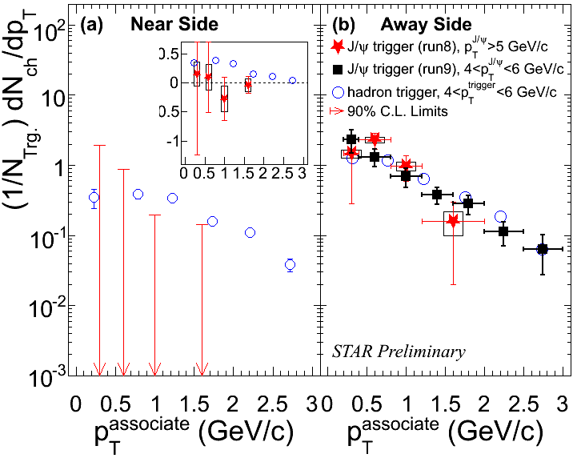
Associated hadron p_{T} spectra
Near side: Consistent with no associated hadron production
Away side: Consistent with h-h correlation
➔away-side from gluon or light quark fragmentation

Slide 29
Projection for BES
constrain CNM
Beam Energy (GeV) |  | # MB (Central) events (M) | #J/ψ¹ | Significance² | EMC sampled luminosity
Run 10 (Completed) | 39 | 250 | 1000 | 13σ | 62 μb⁻¹
 | 62 | 143 (33) | 1200 (900) |  | 175 μb⁻¹
 | 200 | 355 (265) | 12000 (28000) |  | 2600 μb⁻¹
Run 11 (Proposed) | 27 | 150 | 300 | 7σ | NA
 | 18 | 150 | 100 | 4σ | NA
420 signals
13 σ
¹ Assuming same suppression and same <N_{bin}>
² Assuming same signal-to-background ratio

Slide 30
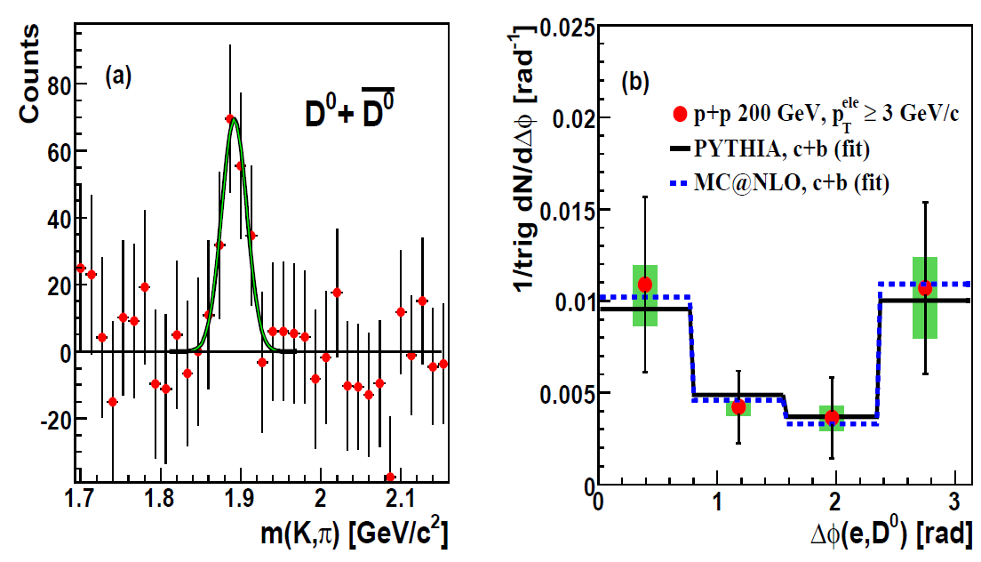
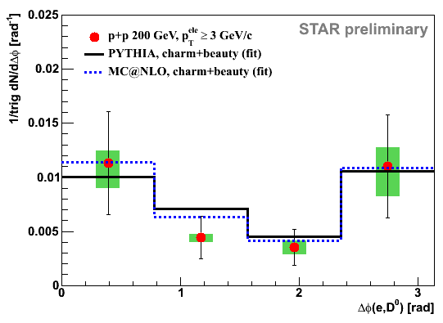
Disentangle Charm and Bottom Production
STAR preliminary
JPG35(2008)104117
JPG35(2008)104117
Near side: mostly from B mesons
Away side: charm (~75%), Bottom (~25%)

Slide 31
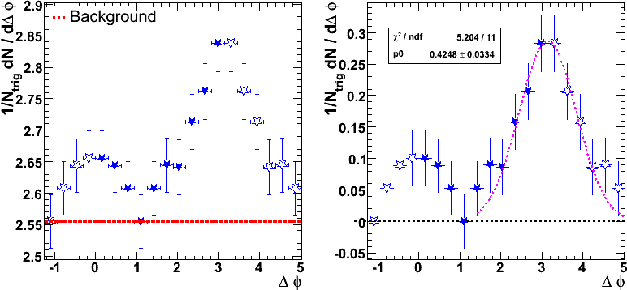
Non-photonic e-h correlations in d+Au 200 GeV
3 < p_{T}^{trig} < 6 GeV/c & 0.15 < p_{T}^{asso} < 0.5 GeV/c
STAR Preliminary
Non-photonic e-h azimuthal correlation is measured in one π range,
and open markers are reflections. The away-side correlation can be well described by PYTHIA calculations for p+p. No medium effects seen here.
Notes:
Eff = 70%

Slide 32




