Slide 1
Anisotropic flow measurements - highlights from STAR BES program
2025 RHIC/AGS Annual Users' Meeting
Brookhaven National Laboratory, USA
Sharang Rav Sharma (for the STAR Collaboration)
Indian Institute of Science Education and Research (IISER) Tirupati, India
Date: May 21, 2025

Slide 2
Outline
Introduction
STAR Experiment
Results and Discussion
Directed flow (v₁)
Elliptic flow (v₂)
Triangular flow (v₃)
Summary and Outlook
Sharang Rav Sharma RHIC/AGS AUM 2025

Slide 3
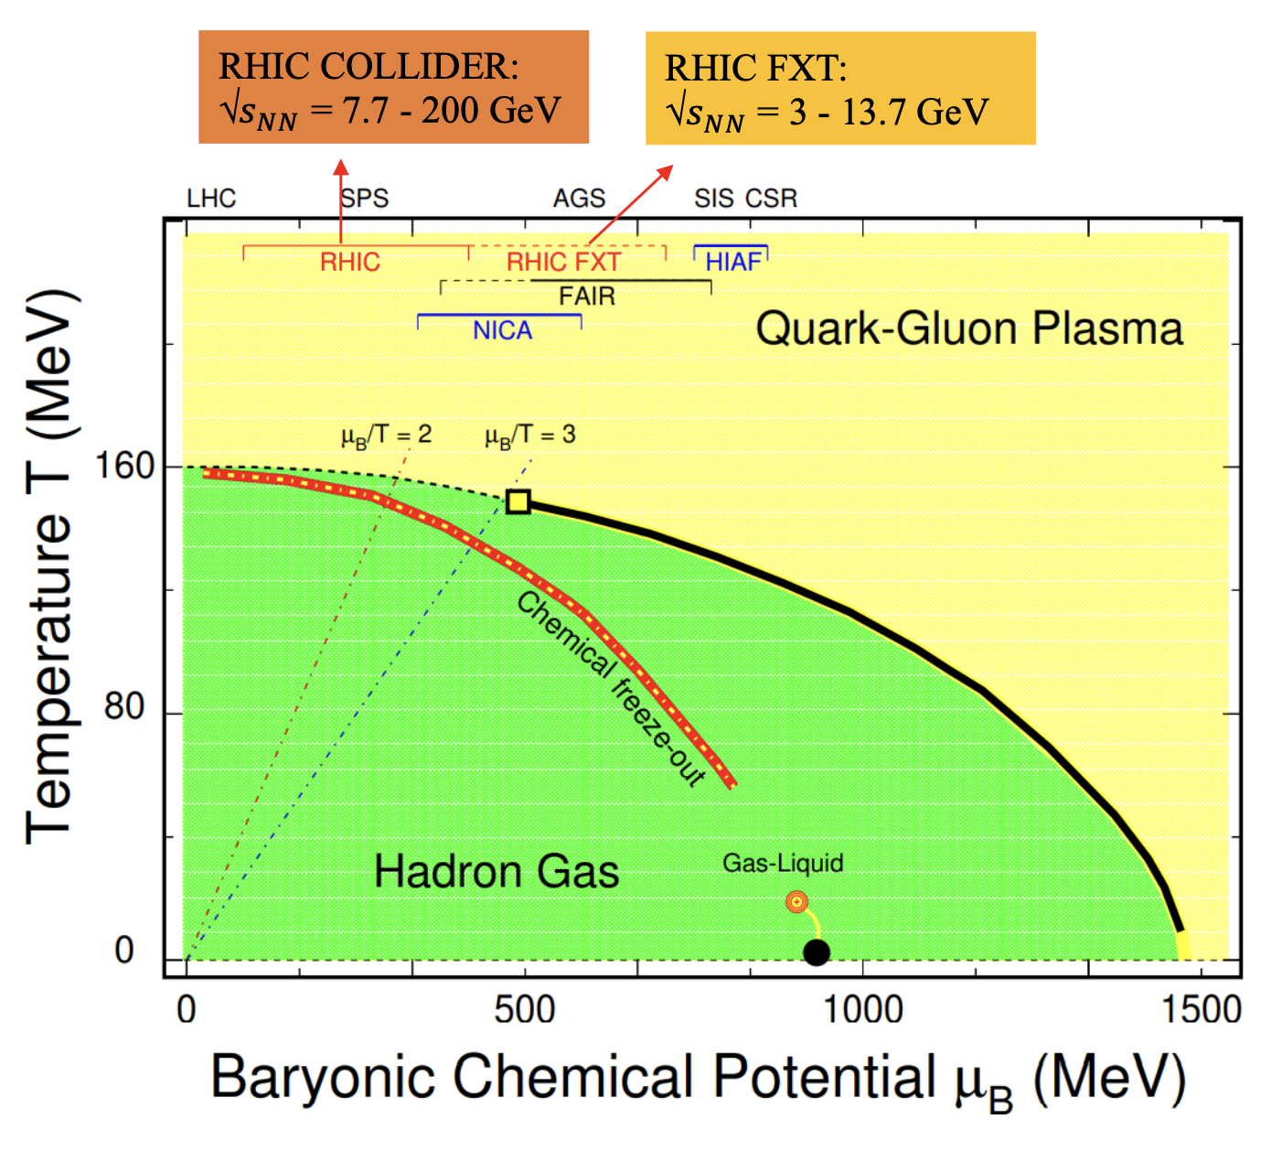
Introduction
At very high temperature/energy density a deconfined phase of quarks and gluons is expected to form ➔ Quark-Gluon Plasma (QGP)
RHIC BES Program:
First-order phase transition
QCD critical end point
Turn-off of QGP signatures
Phase-I
√s_{NN} = 7.7, 11.5, 14.5, 19.6, 27, 39, 62.4, and 200 GeV (COL)
Phase-II
√s_{NN} = 7.7, 9.2, 11.5, 14.6, 19.6, 27 and 54. 4 GeV (COL)
√s_{NN} = 3.0, 3.2, 3.5, 3.9, 4.5, 5.2, 6.2, 7.7, 9.1, 11.5, and 13.7 GeV (FXT)
X.Luo, S.Shi, Nu Xu et al. Particle 3, 278 (2020)
Sharang Rav Sharma RHIC/AGS AUM 2025

Slide 4
STAR Beam Energy Scan
Extensive exploration of the QCD phase diagram
Covers a wide range of collision energies: √s_{NN} = 3 - 200 GeV
Probes from low to high baryon densities: μ_{B}: 25 - 760 MeV
Sharang Rav Sharma RHIC/AGS AUM 2025

Slide 5
STAR Detector System
Major Upgrades in BES-II
iTPC:
Improves dE/dx
Extends η coverage from ±1.0 to ±1.5
Lowers p_{T} cut from 125 to 60 MeV/c
Ready in 2019
eTOF:
Forward rapidity coverage
PID at η = -1.1 to -1.6
Ready in 2019
EPD:
Improves trigger
Event plane measurements
Ready in 2018
Extended pseudorapidity acceptance
Improved particle identification
Enhanced event plane resolution
[1] iTPC: https://drupal.star.bnl.gov/STAR/starnotes/. public/sn0619.
[2] eTOF: STAR and CBM eTOF group, arXiv: 1609.05102.
[3] EPD: J. Adams, et al. NIM A968, 163970 (2020)
Sharang Rav Sharma RHIC/AGS AUM 2025
Sharang Rav Sharma RHIC/AGS AUM 2025

Slide 6
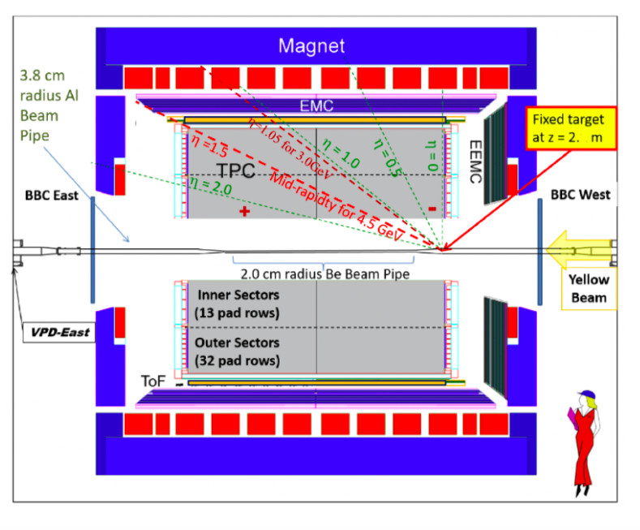
STAR Fixed-Target Setup
Fixed-target mode
√s_{NN} (GeV) | 𝝁_{B} (MeV) ≈
3.2 | 699
3.5 | 670
3.9 | 633
4.5 . . . | 590 . . .
Nuclear Phy A 808-811 (2017)
Fixed-Target (FXT) program at Solenoidal Tracker At RHIC (STAR) → low center-of-mass energies and high baryon density region
Target located at z = 200 cm
Target is 0.25 mm thick (1% interaction probability) and held 2 cm below center of beam axis
Sharang Rav Sharma RHIC/AGS AUM 2025
Sharang Rav Sharma RHIC/AGS AUM 2025

Slide 7
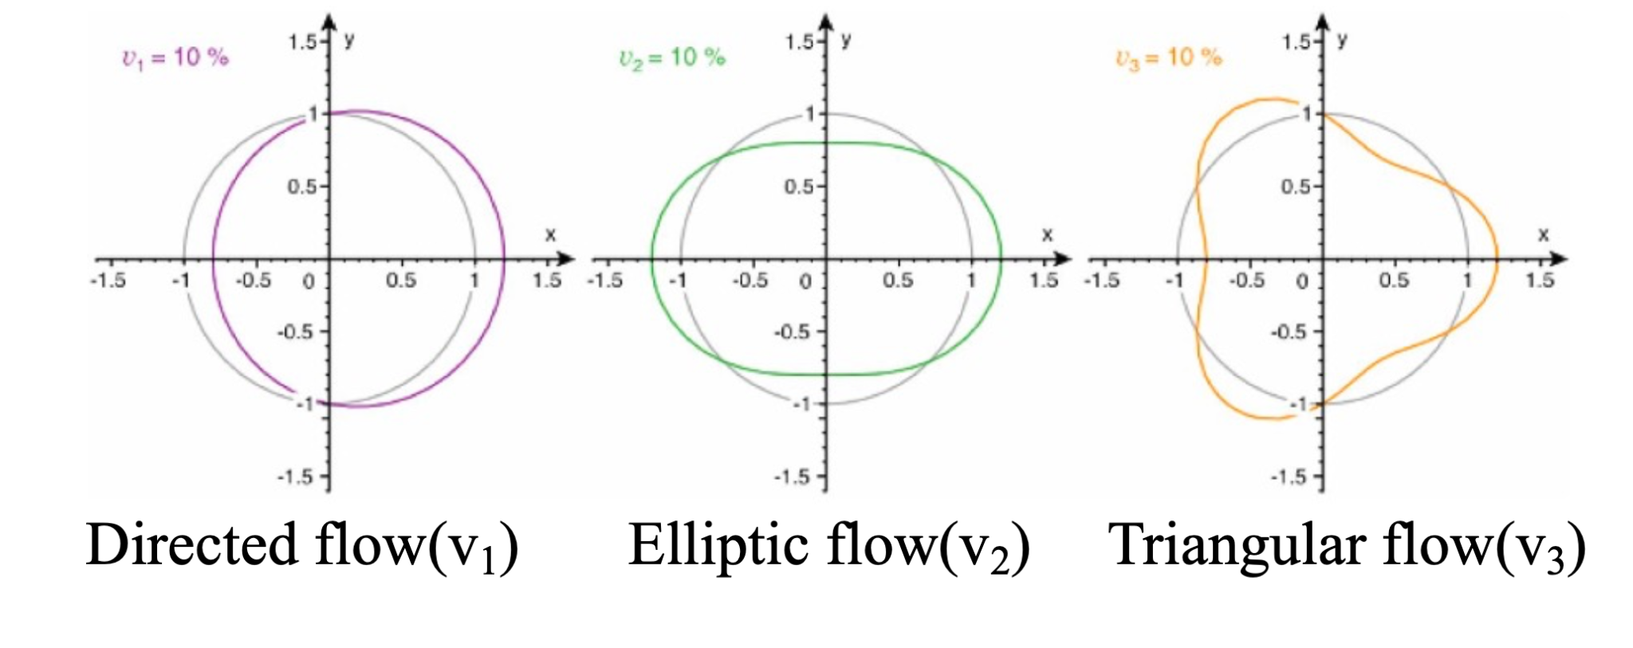
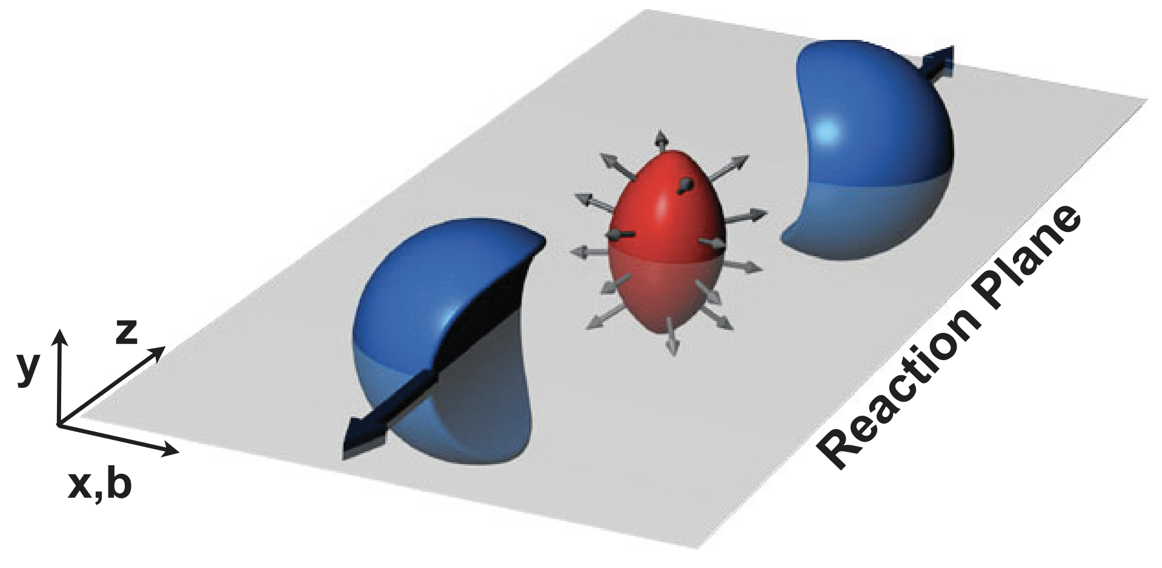
Anisotropic Flow
Flow is the measure of azimuthal anisotropy of particles
Azimuthal distribution of particles
Directed flow
Elliptic flow
Sideward motion of emitted hadrons with respect to collision reaction plane
2
Driven by the initial spatial asymmetry of the overlap region
Triangular flow
Why is v_{n} an important observable?
Sensitive to the equation of state
Sensitive to early times in the evolution of the system
Driven by the shape of the initial collision geometry at low collision energies
Sharang Rav Sharma RHIC/AGS AUM 2025
Sharang Rav Sharma RHIC/AGS AUM 2025

Slide 8
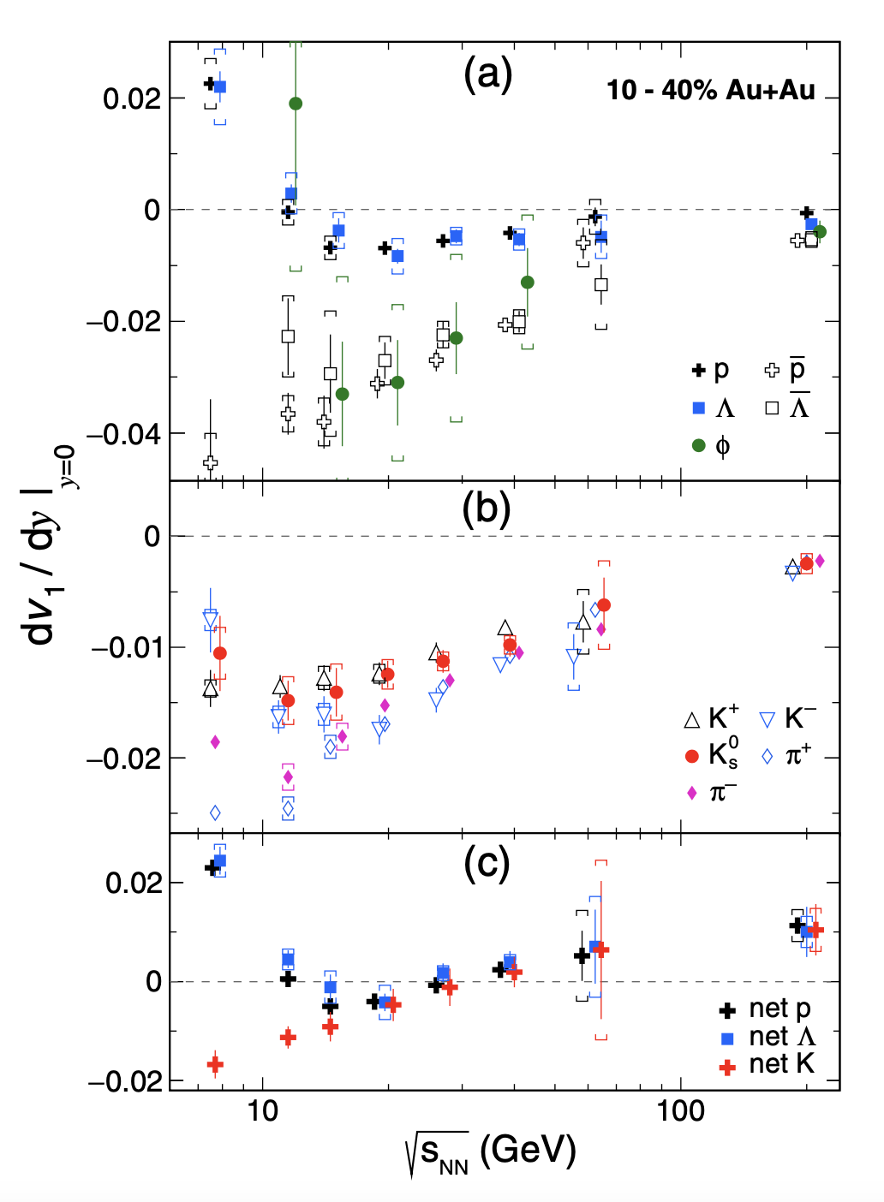
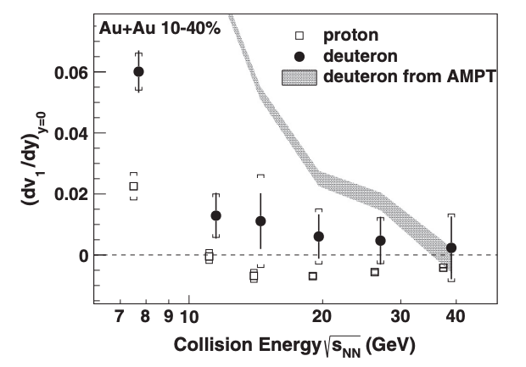
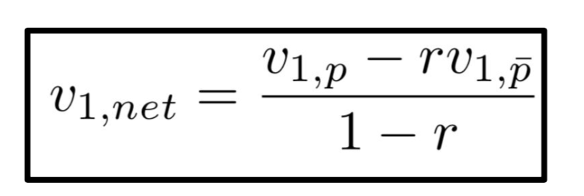
Motivation: Directed flow
Net particle v₁ is defined as
where v_{1,p}, v_{1,p̄}→ particle and antiparticle v₁ and r is the ratio of anti-particles to particles
dv₁/dy for proton contrary to mesons showed a non-monotonic trend as function of collision energy ➡ Change of sign
Net particle (the excess of a particle over antiparticle) gives contribution of transported quarks w.r.t produced
Observed minima in v₁ slope of net-p and net-𝚲 between 11.5 and 19.6 GeV, no minima observed for net-K
Light nuclei d(v₁/A)/dy within systematic and statistical uncertainties ➡ test for nucleon coalescence mechanism
STAR: Phys. Rev. Lett. 120, 062301 (2018);
STAR: Phys. Rev. C 102, 044906 (2020)
Sharang Rav Sharma RHIC/AGS AUM 2025

Slide 9
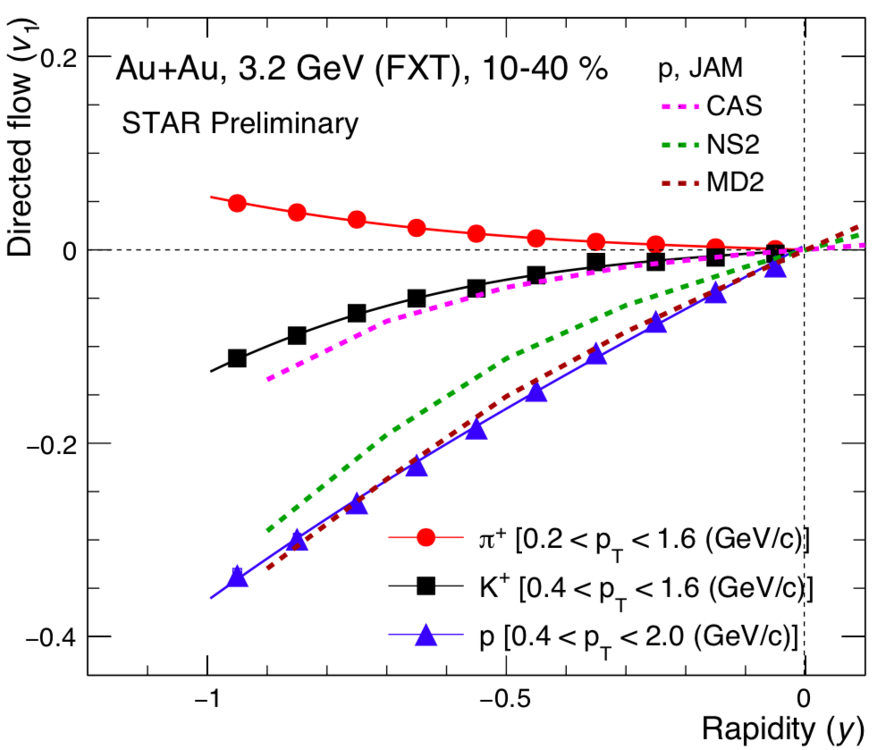
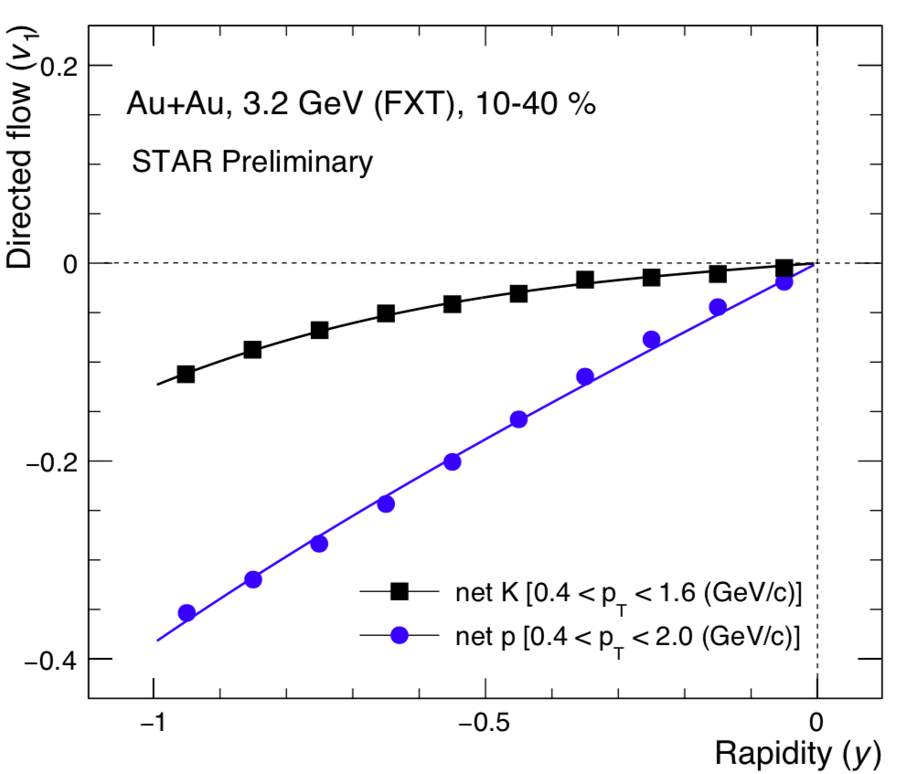
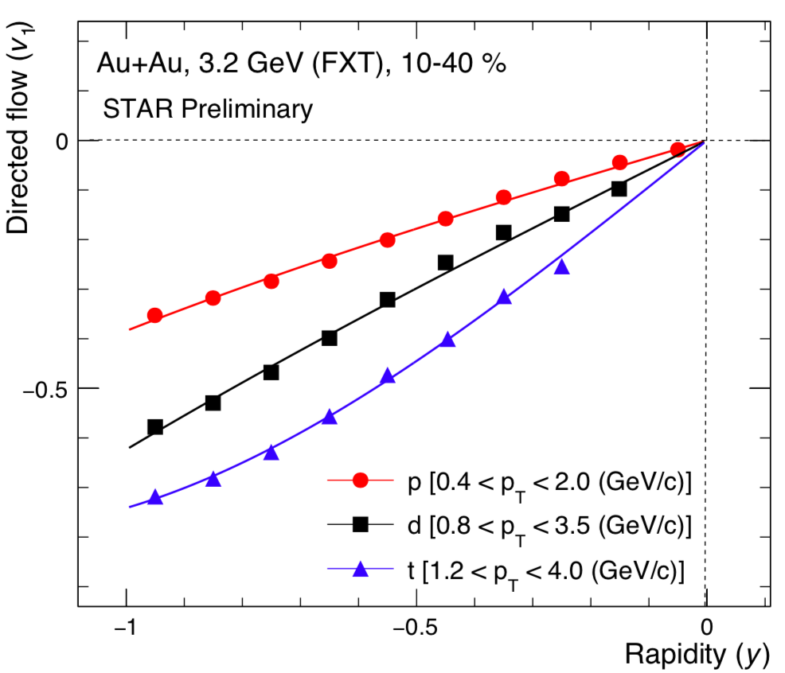
Directed Flow at 3.2 GeV
Identified hadrons
Net-particle
Light nuclei
JET AA Microscopic Transportation Model (JAM2)
Cas: no interactions among particles
NS2: mean-field potential
Incompressibility constant: κ = 210 MeV
MD2: momentum dependent mean-field potential
Incompressibility constant: κ = 380 MeV
Magnitude of v₁ increases with increasing rapidity
Magnitude of v₁ increases with increasing mass of the particle
JAM MD2 gives better description to the experimental data for baryons
Phys. Rev. C. 105, 014911(2022)
Sharang Rav Sharma RHIC/AGS AUM 2025

Slide 10
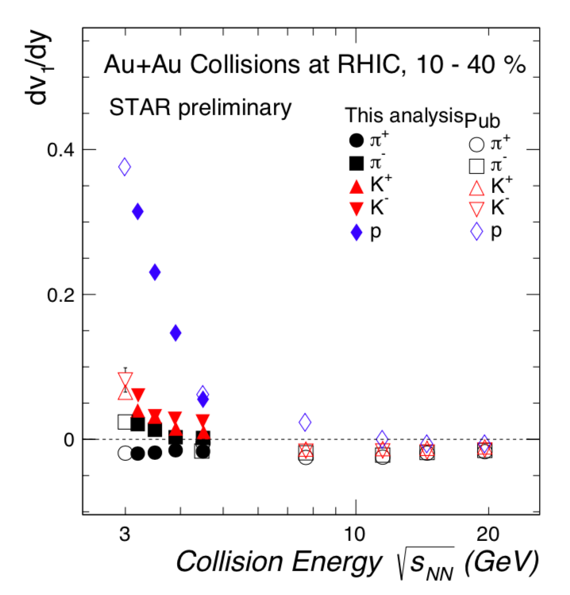
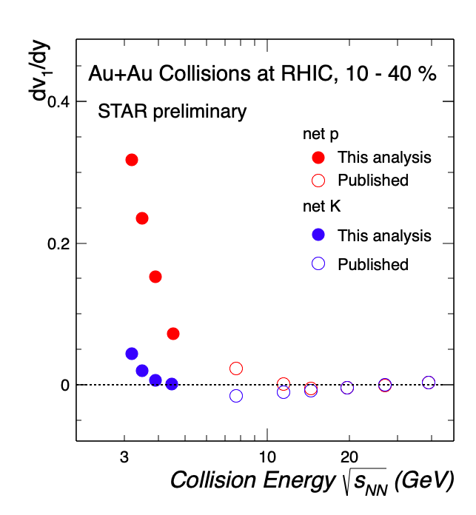
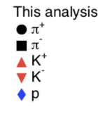
Slope of Directed Flow
Identified hadrons
Net-particle
Increasing collision energy → decreasing v₁ slope for the measured energies
dv₁/dy|_{𝞹+} is negative whereas dv₁/dy|_{𝞹-} is positive → Spectator shadowing (3.0 - 4.5 GeV)
Net-K changes sign at lower collision energy (4.5 - 7.7 GeV) compared to Net-p (11.5 - 14.5 GeV)
Sharang Rav Sharma RHIC/AGS AUM 2025

Slide 11
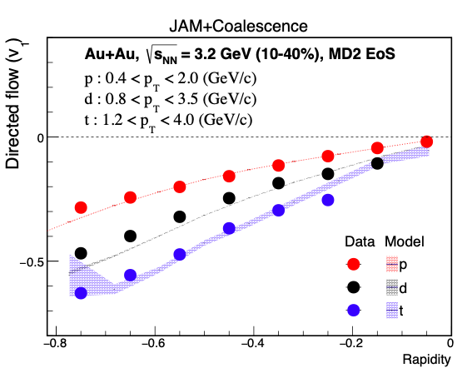
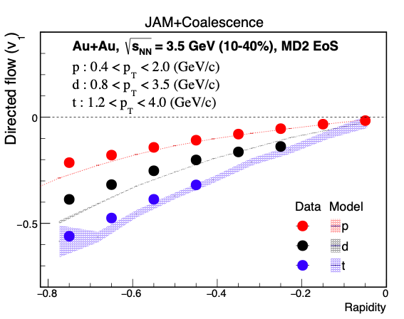
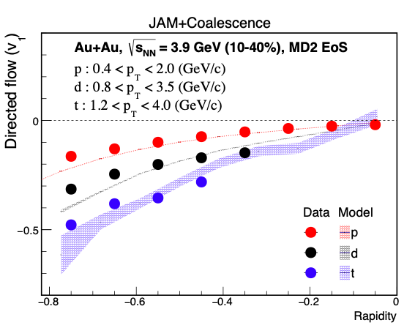
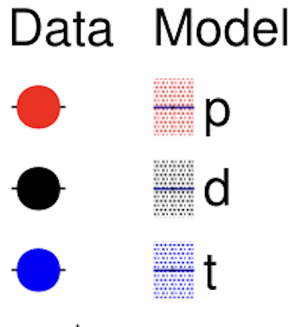
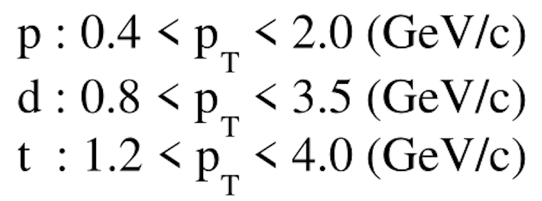
Directed Flow of Light Nuclei
STAR preliminary
STAR preliminary
JET AA Microscopic Transportation Model (JAM2)
MD2: momentum dependent mean-field potential
Incompressibility constant: κ = 380 MeV
Magnitude of v₁ increases with increasing rapidity
JAM MD2 with coalescence provides good description of the data
Phys. Rev. C. 105, 014911(2022)
Sharang Rav Sharma RHIC/AGS AUM 2025

Slide 12
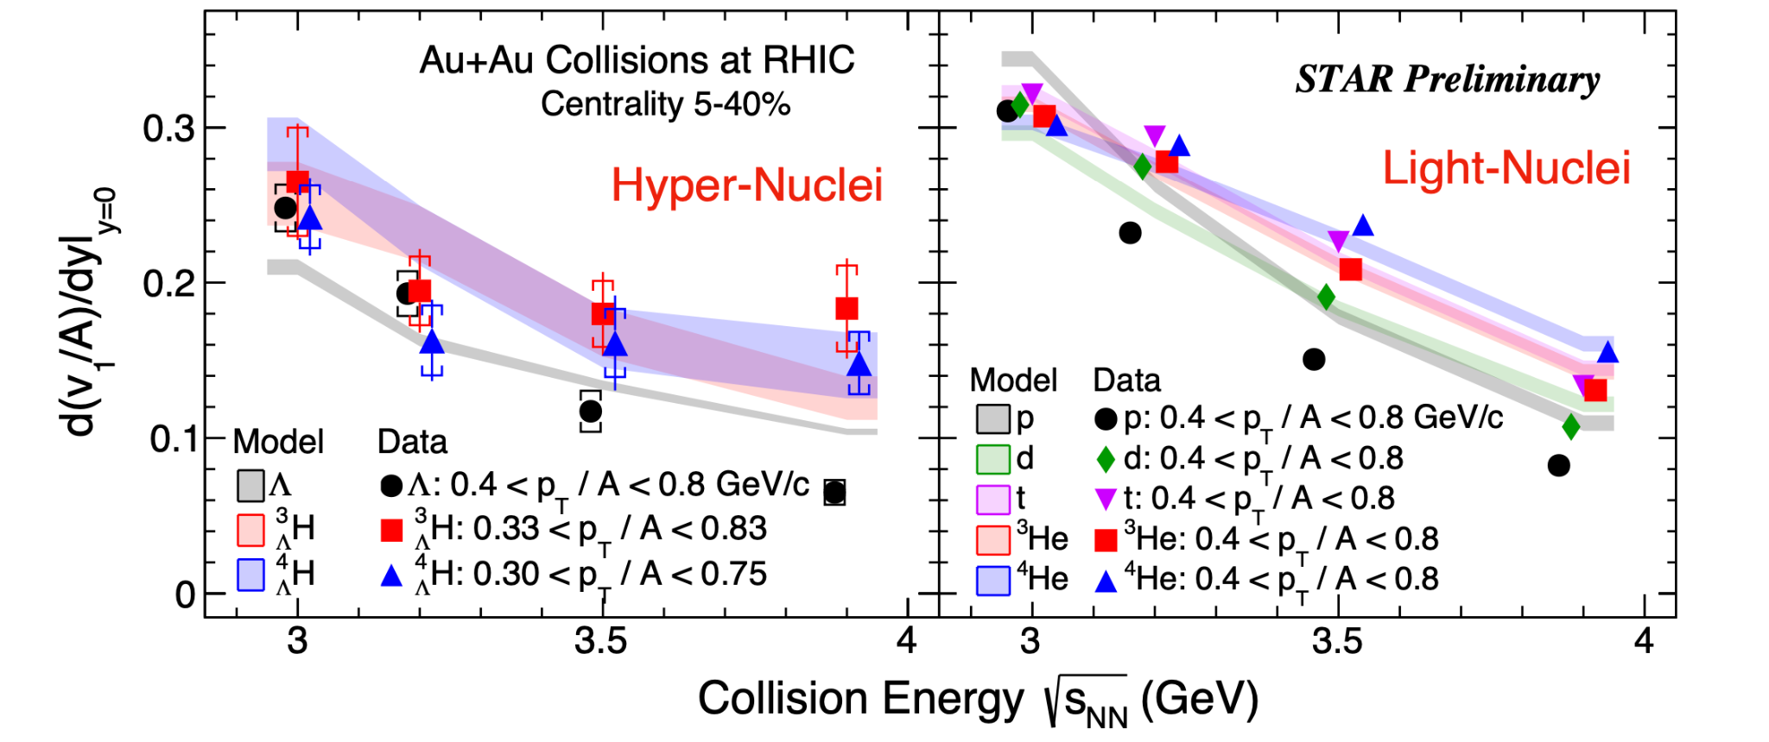
Directed Flow of Light- And Hyper-Nuclei
As the collision energy increases, the v₁ slope of light- and hyper-nuclei decreases
At given energy, for both light- and hyper-nuclei, it seems that the slopes of mid-rapidity v₁ are scaled with atomic mass number (A)
Hadronic transport model (JAM2 mean field + Coalescence) calculations are consistent with observed energy dependence
The results for light- and hyper-nuclei v₁ favor coalescence as their production mechanism
STAR: Phys. Lett. B 827, 136941 (2022); STAR: Phys. Rev. Lett. 130, 211301(2023); Phys. Rev. C. 105, 014911(2022)
Sharang Rav Sharma RHIC/AGS AUM 2025

Slide 13
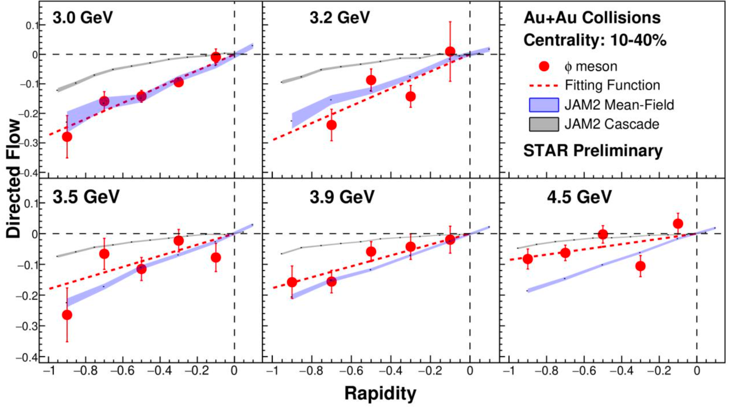
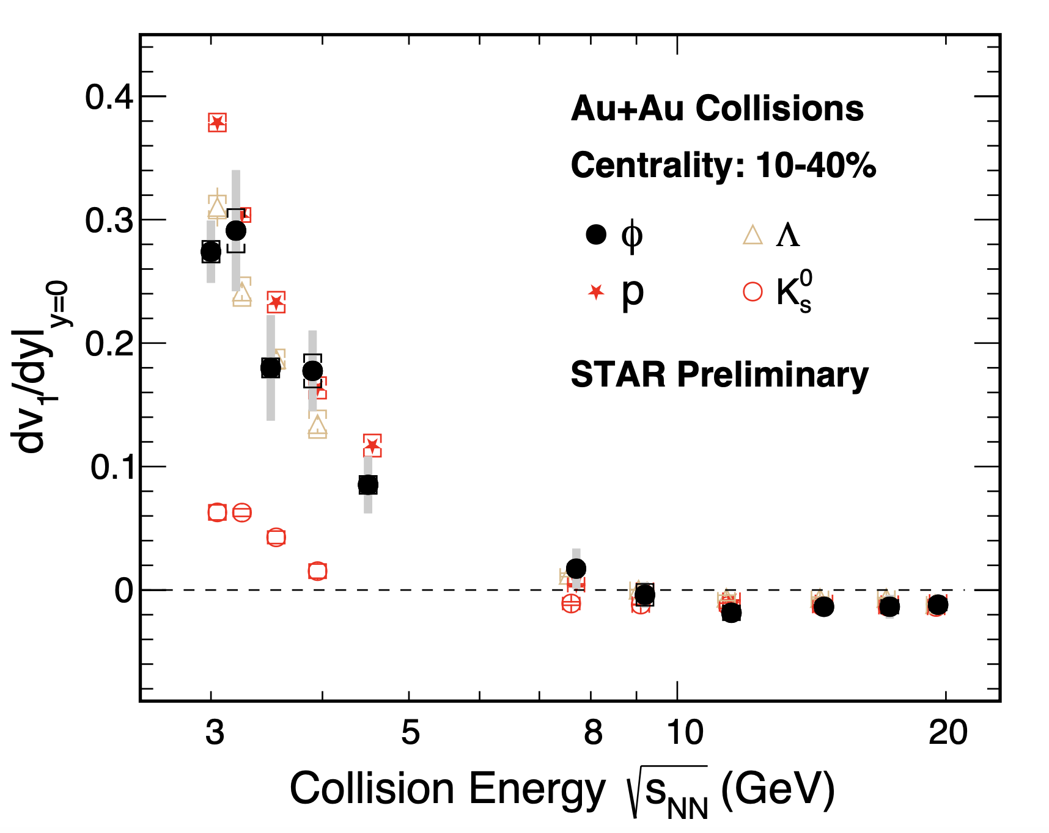
Directed Flow of ϕ Meson
ϕ(ss̄) is a unique particle as it is a meson with mass (1020 MeV) close to baryons
The v₁ slope of ϕ meson shows similar trends to that of p and Λ.
Sharang Rav Sharma RHIC/AGS AUM 2025

Slide 14
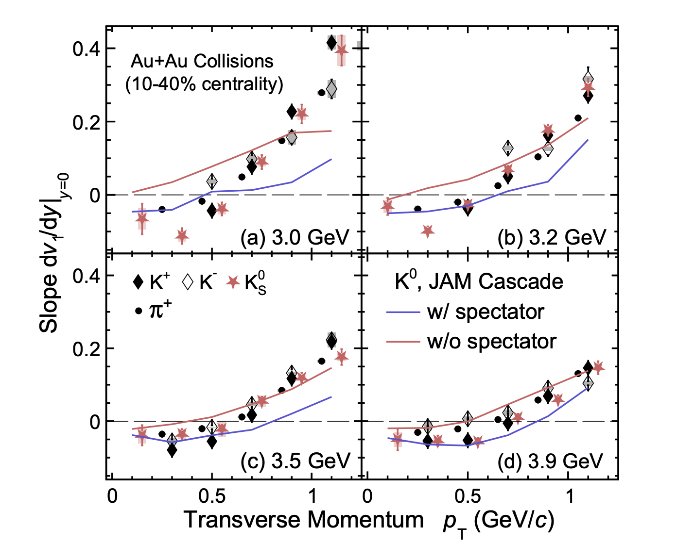
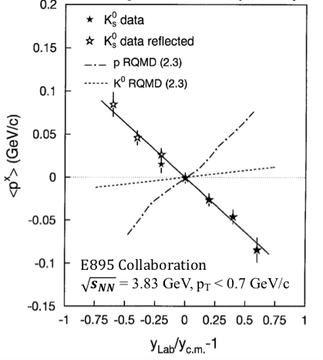
Anti-flow of Mesons at Low p_{T}
Phys. Rev. Lett. 85, 940 (2000)
Negative dv₁/dy at low p_{T} for mesons → Anti-flow at low energies (3.0 - 4.5 GeV)
JAM Cascade model → with spectators able to reproduce the anti-flow at low p_{T} ➡ Kaon potential is not necessary
E895: anti-flow of kaon at low p_{T} ➡ Kaon potential?
STAR: arXiv:2503.23665
Sharang Rav Sharma RHIC/AGS AUM 2025

Slide 15
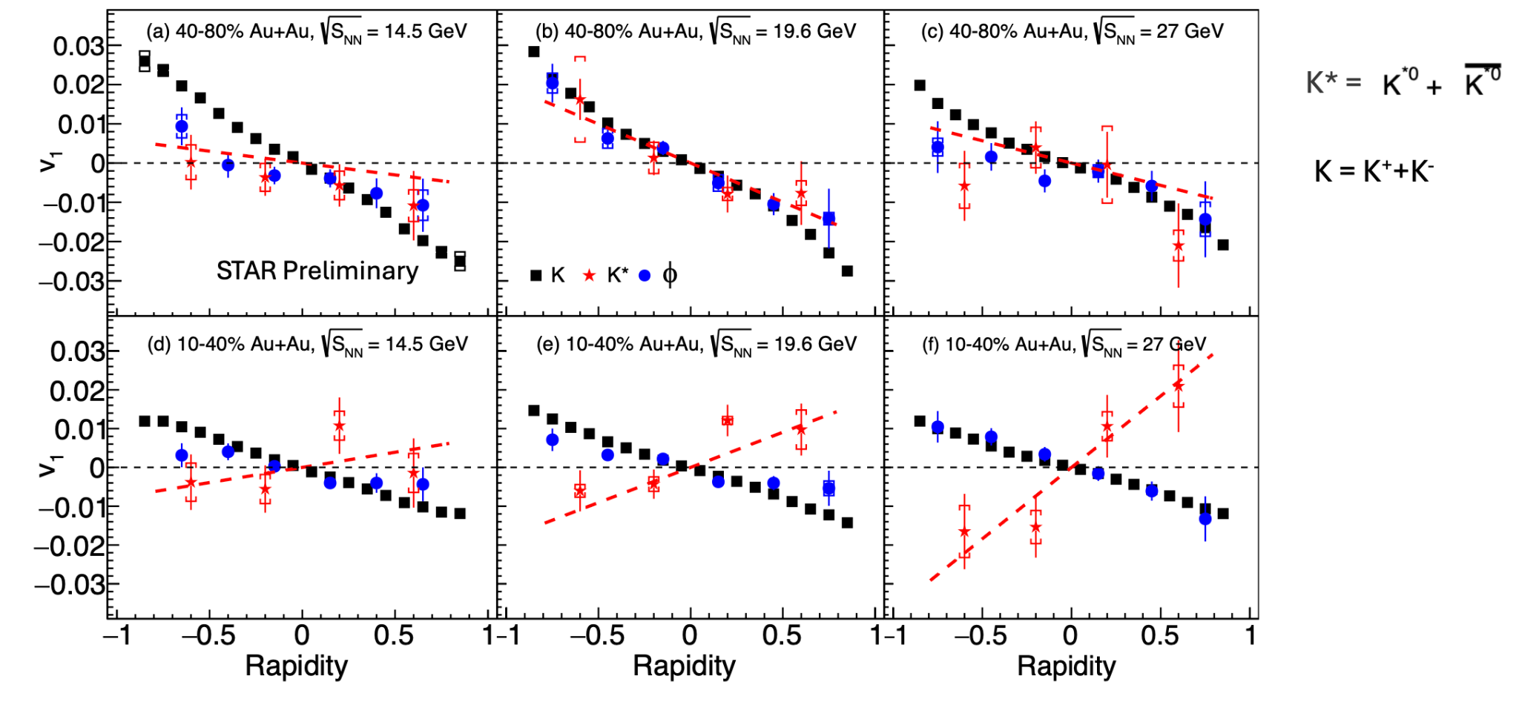
Directed Flow of K^{*0} and ϕ Resonances
Asymmetric loss of K^{*0} yield in different sides of the p_{x} axis may lead slope change for K^{*0} v₁ as a function of rapidity
Au+Au collisions [40-80%]: Negative v₁ slope for charged Kaon, ϕ and K^{*0} resonances
Au+Au collisions [10-40%] : Opposite v₁ slope for K^{*0} resonances compared to peripheral
Sharang Rav Sharma RHIC/AGS AUM 2025

Slide 16
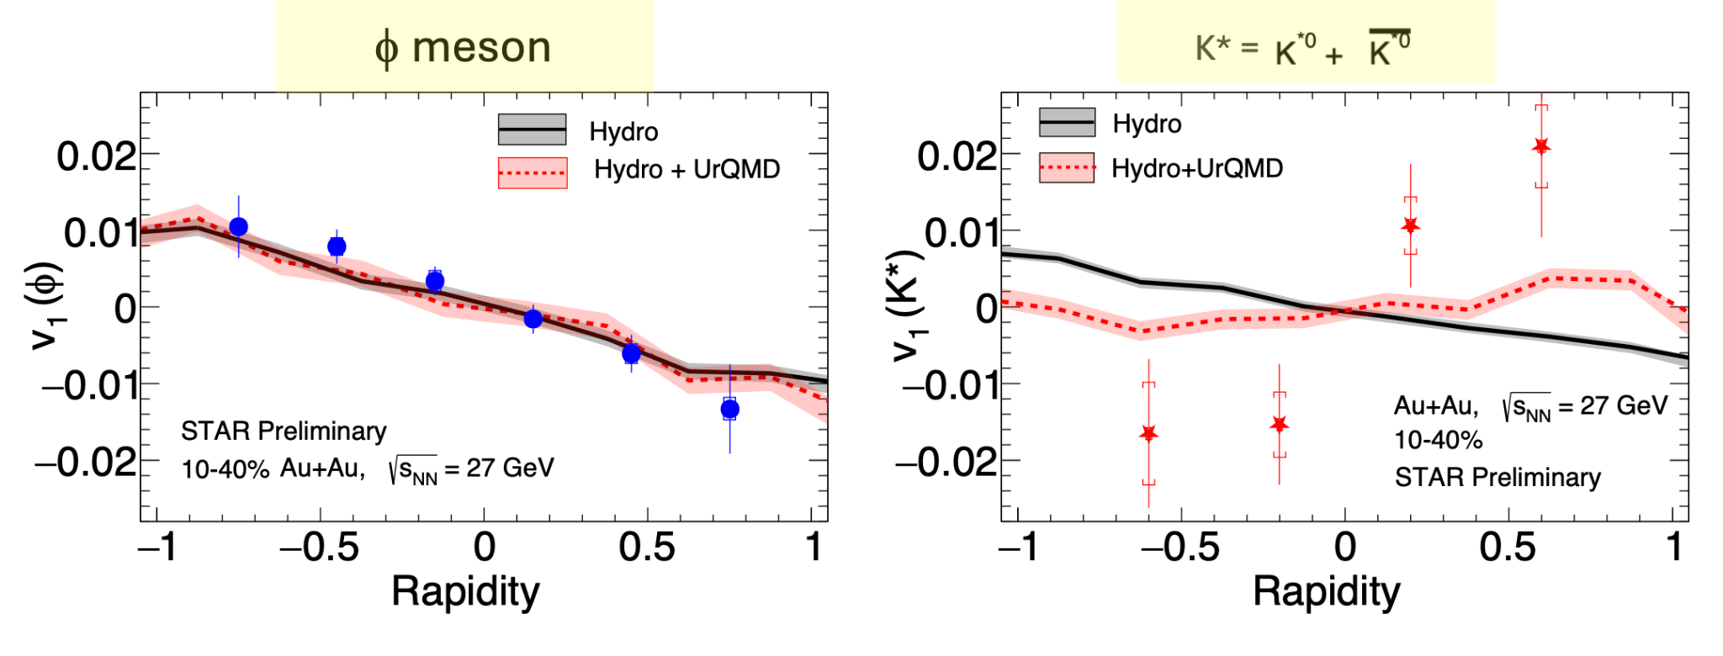
Directed Flow of K^{*0} and ϕ Resonances
Model calculation successfully reproduces measured f meson v₁ for ɸ
Hydro model calculation shows opposite slope compared to data for K*
Hydro+Hadronic afterburner qualitatively explain the data.
Model: Phys. Rev. C 109, 044905 (2024)
Sharang Rav Sharma RHIC/AGS AUM 2025

Slide 17
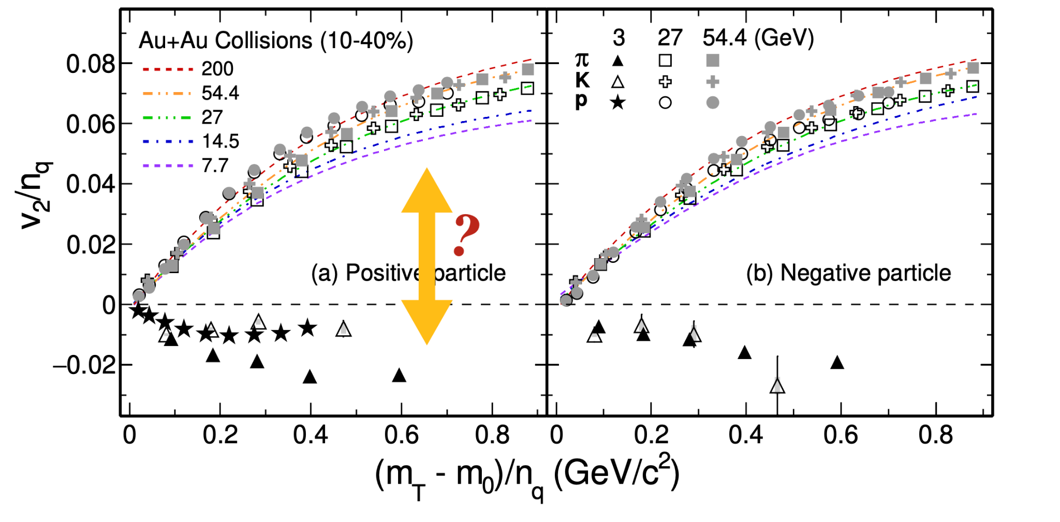
Motivation: Elliptic flow (v₂)
At high energies, data follows NCQ scaling, indicating partonic collectivity
At 3 GeV, anti-flow from shadowing breaks NCQ scaling
STAR: Phys. Rev. C 93, 14907 (2016), STAR: Phys. Lett. B 827, 137003 (2022)
Sharang Rav Sharma RHIC/AGS AUM 2025

Slide 18
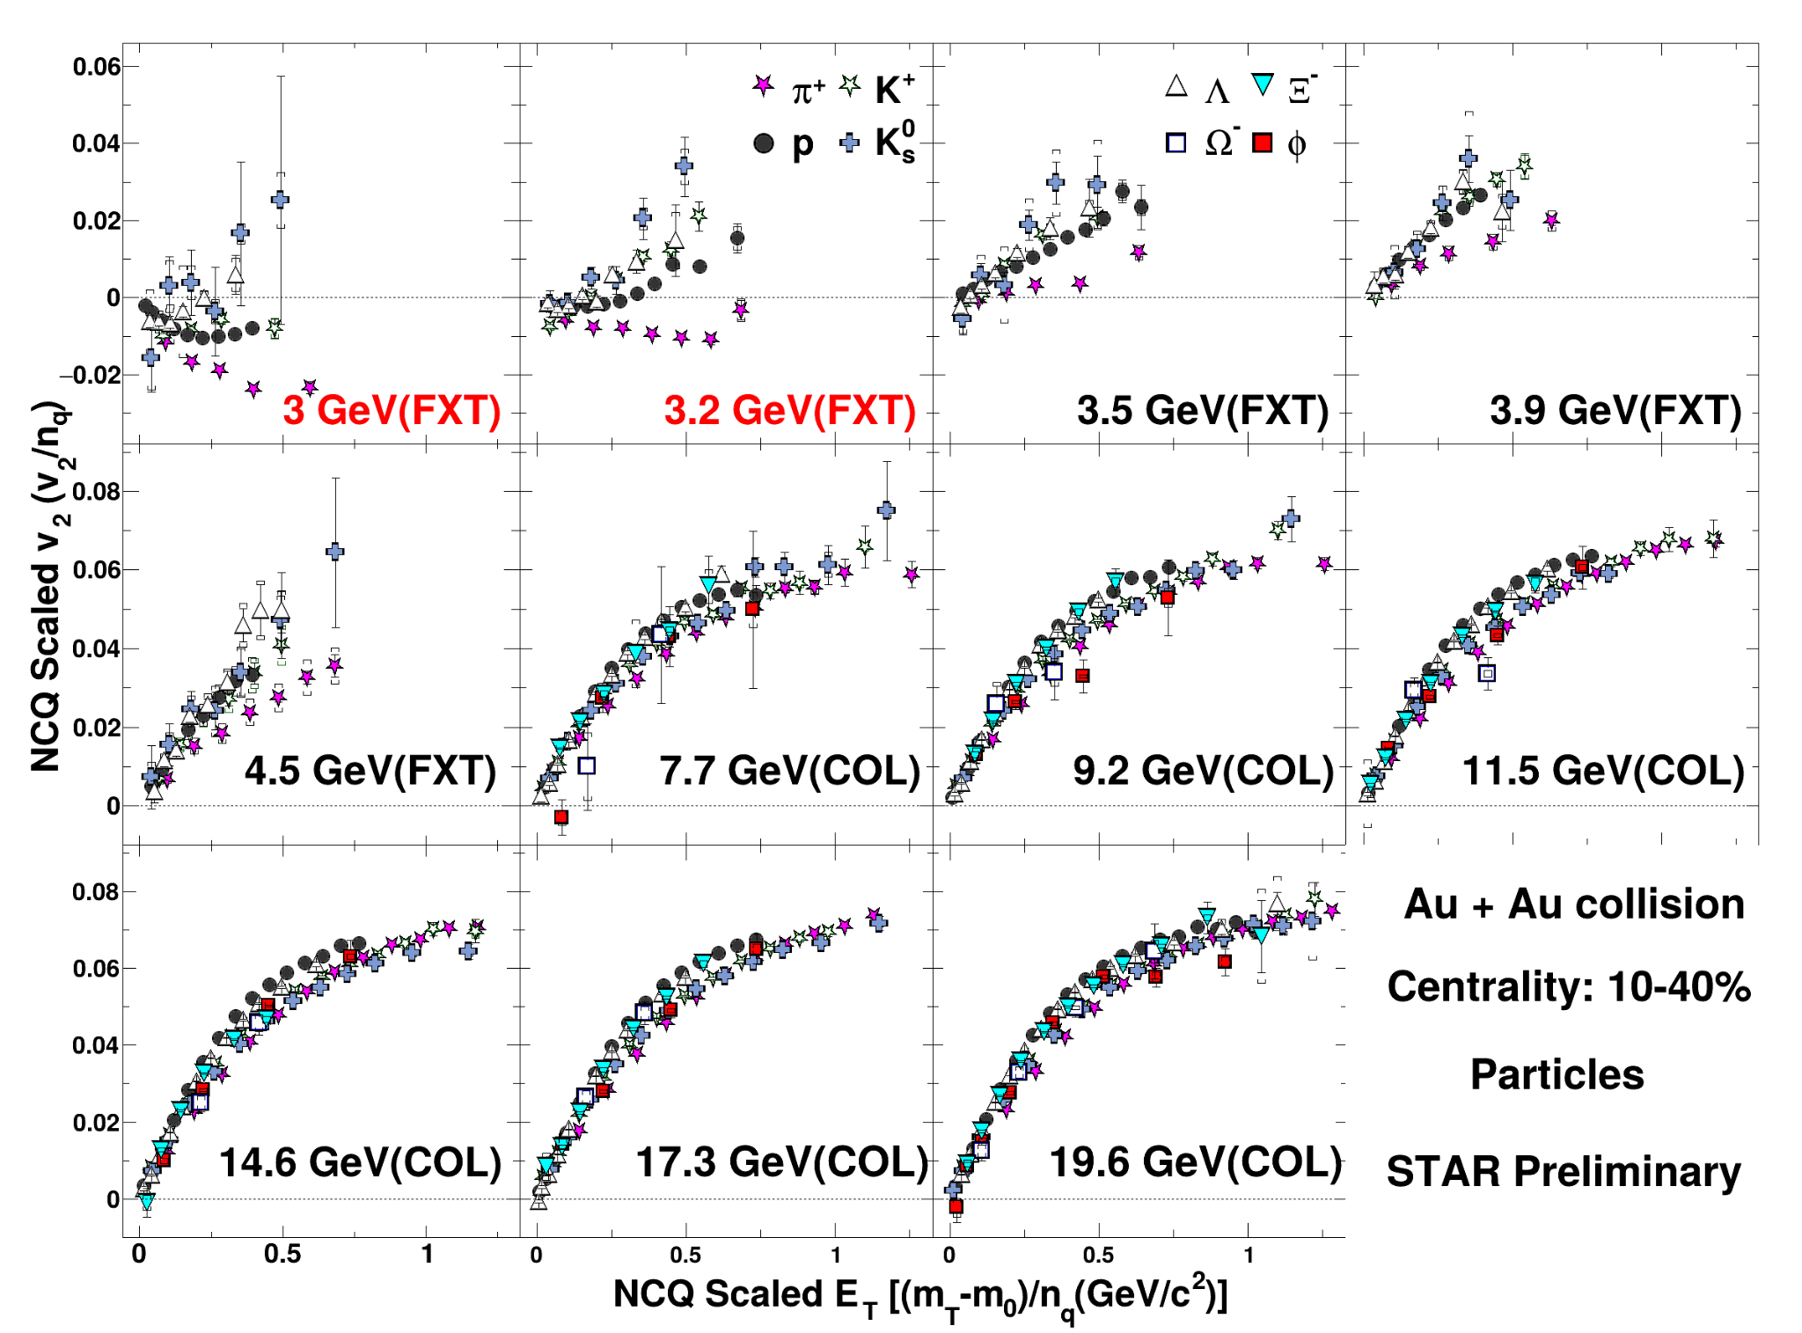
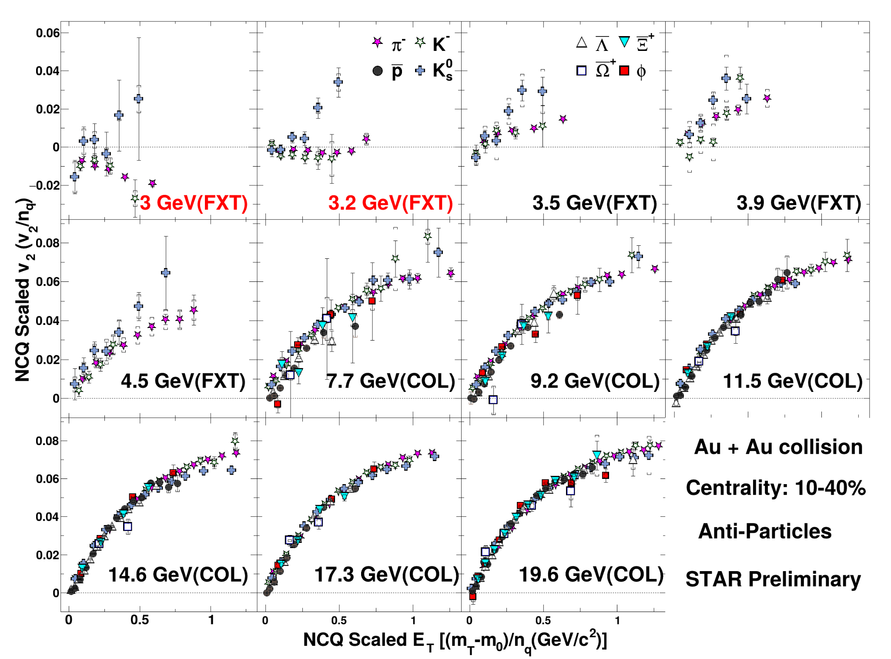
NCQ Scaling of Elliptic Flow
Particles
Anti-particles
NCQ scaling completely breaks below 3.2 GeV
NCQ scaling becomes better gradually with increasing collision energy after 4.5 GeV
Change of degree of freedom: 4.5 → 7.7 GeV ?
Sharang Rav Sharma RHIC/AGS AUM 2025

Slide 19
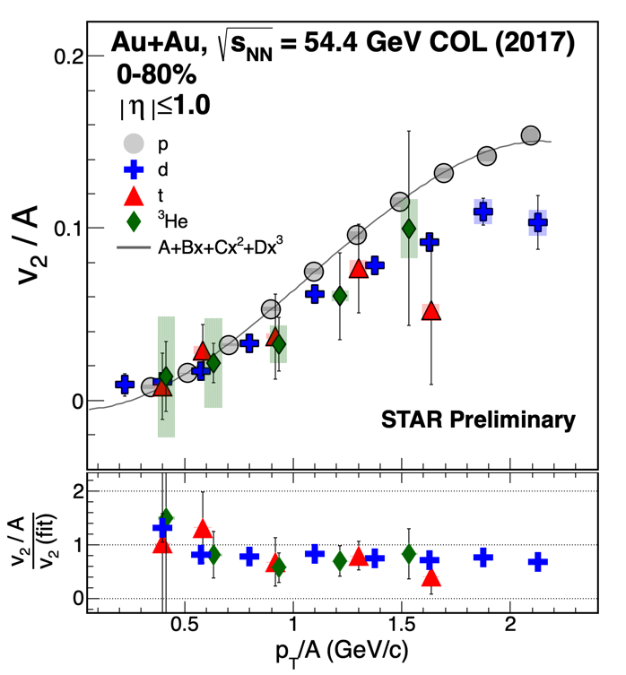
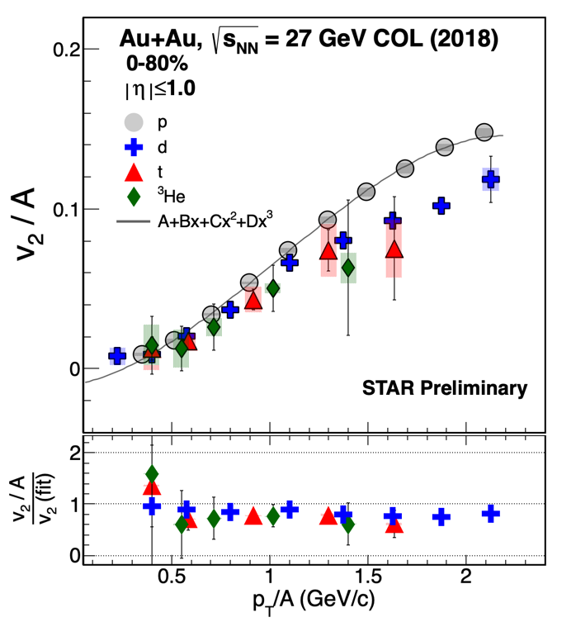
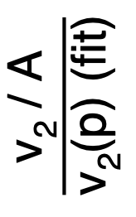
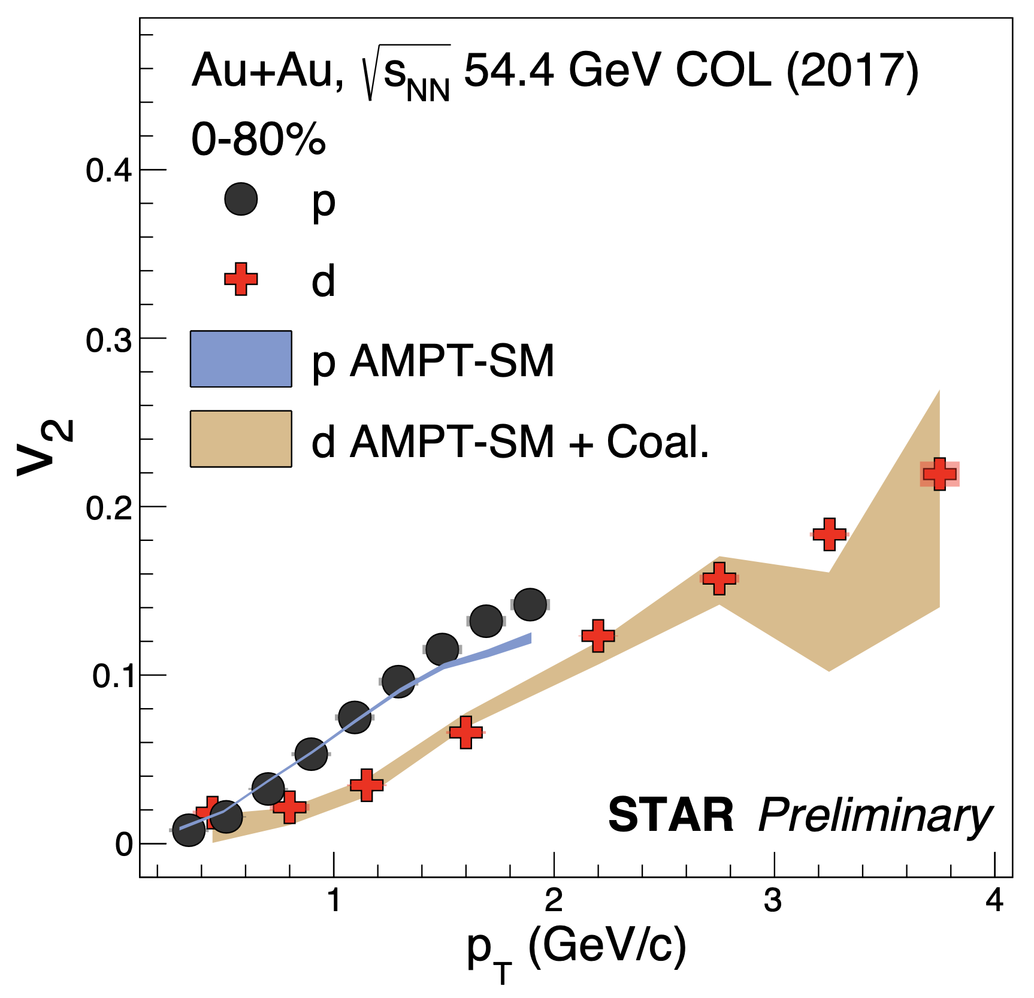
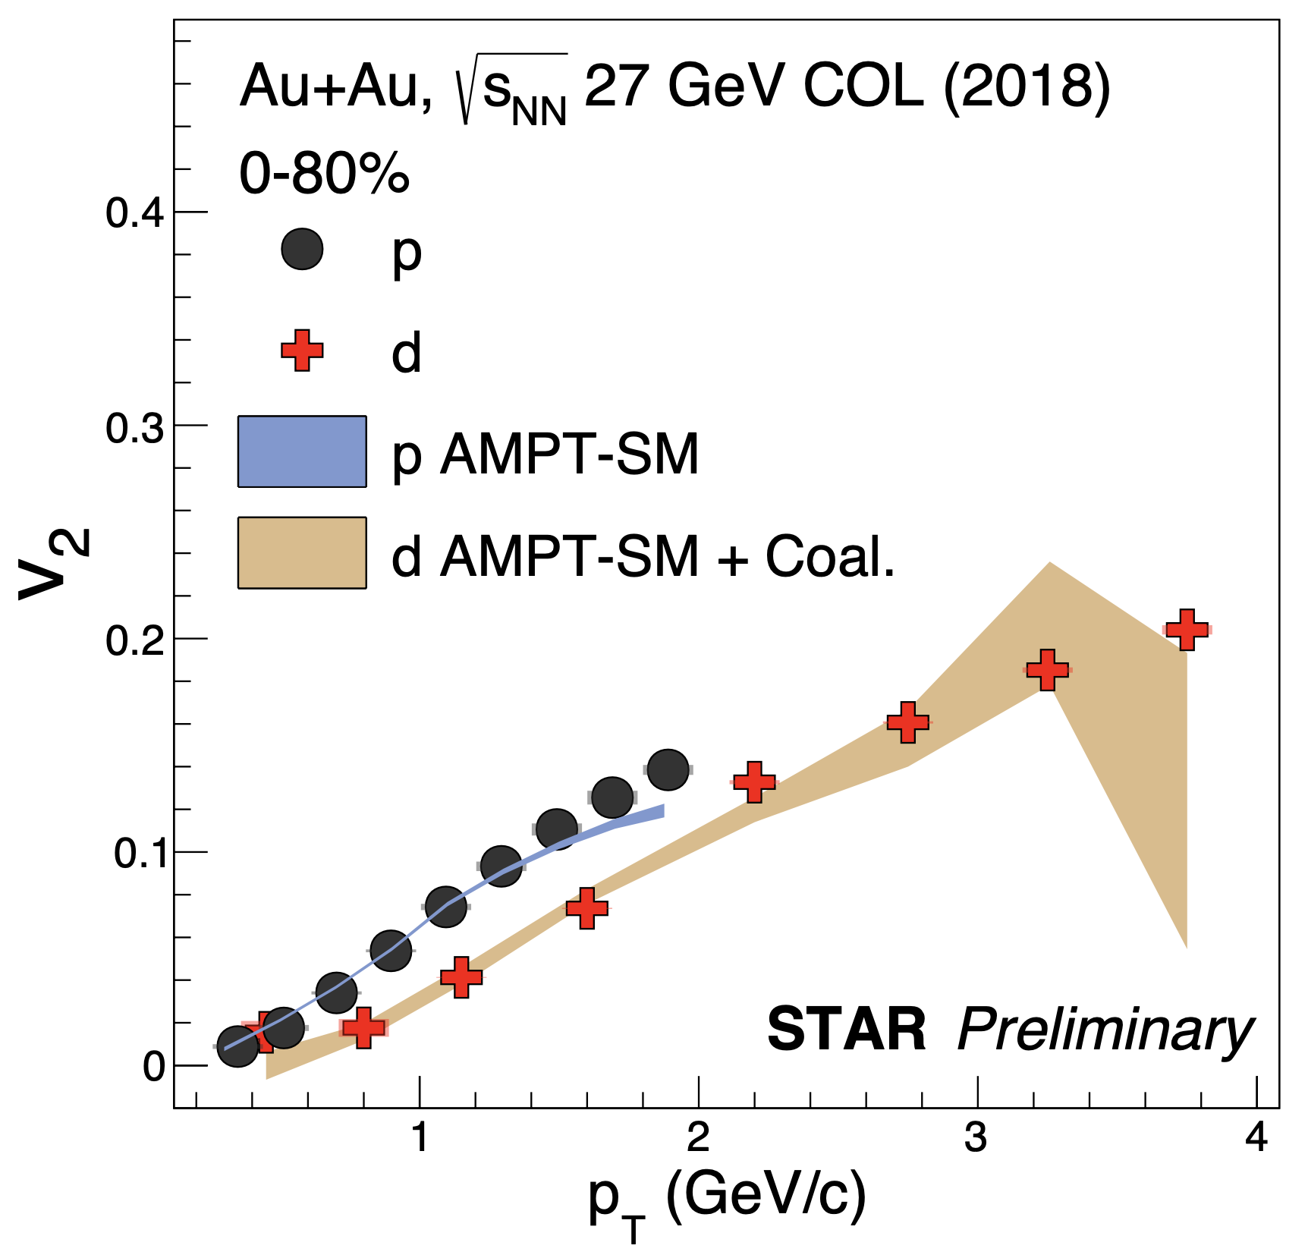
Elliptic Flow of Light Nuclei
Systematic deviation of around 20-30% from mass number scaling is observed for all light nuclei in measured energies
AMPT-SM model with a coalescence afterburner is in good agreement with v₂(p_{T}) of d
(BES-II)
(BES-II)
Phys. Rev. C 72, 064901 (2005)
Nucl. Phys. A 729 (2003) 809–834
Proton v₂: Phys. Rev. C 93, 014907 (2016); Phys. Rev. C 88, 014902 (2013); Phys. Lett. B 827, 137003 (2022)
Sharang Rav Sharma RHIC/AGS AUM 2025
Sharang Rav Sharma RHIC/AGS AUM 2025

Slide 20
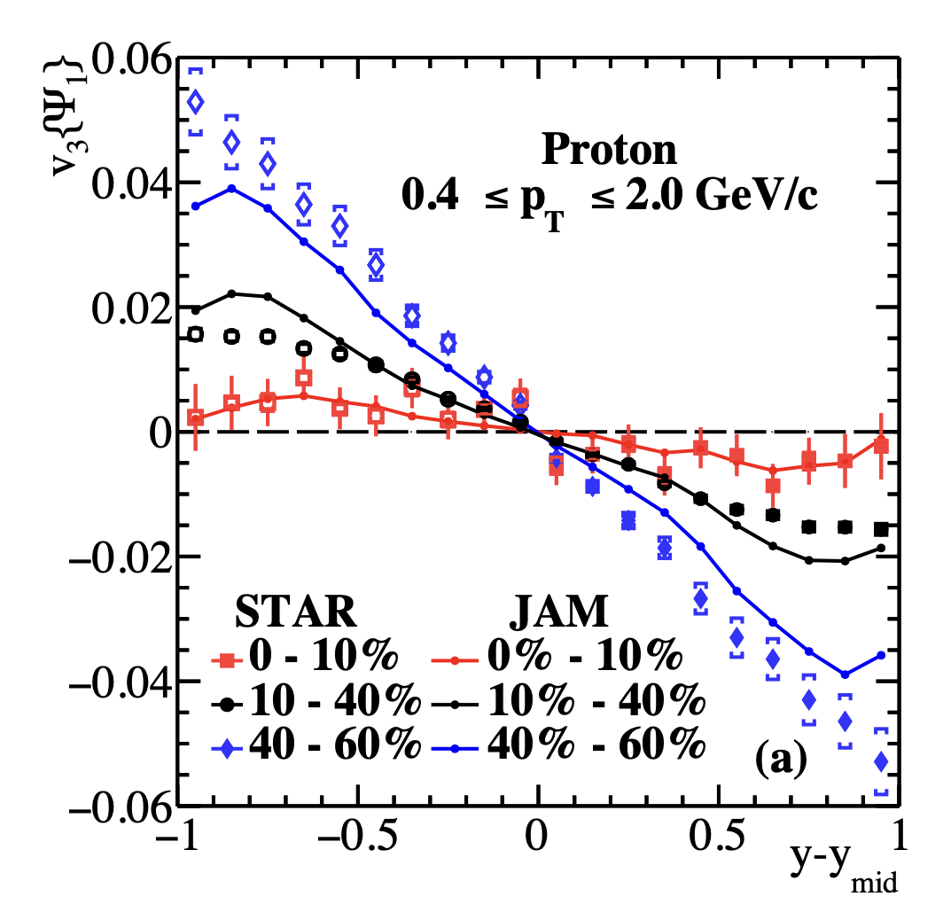
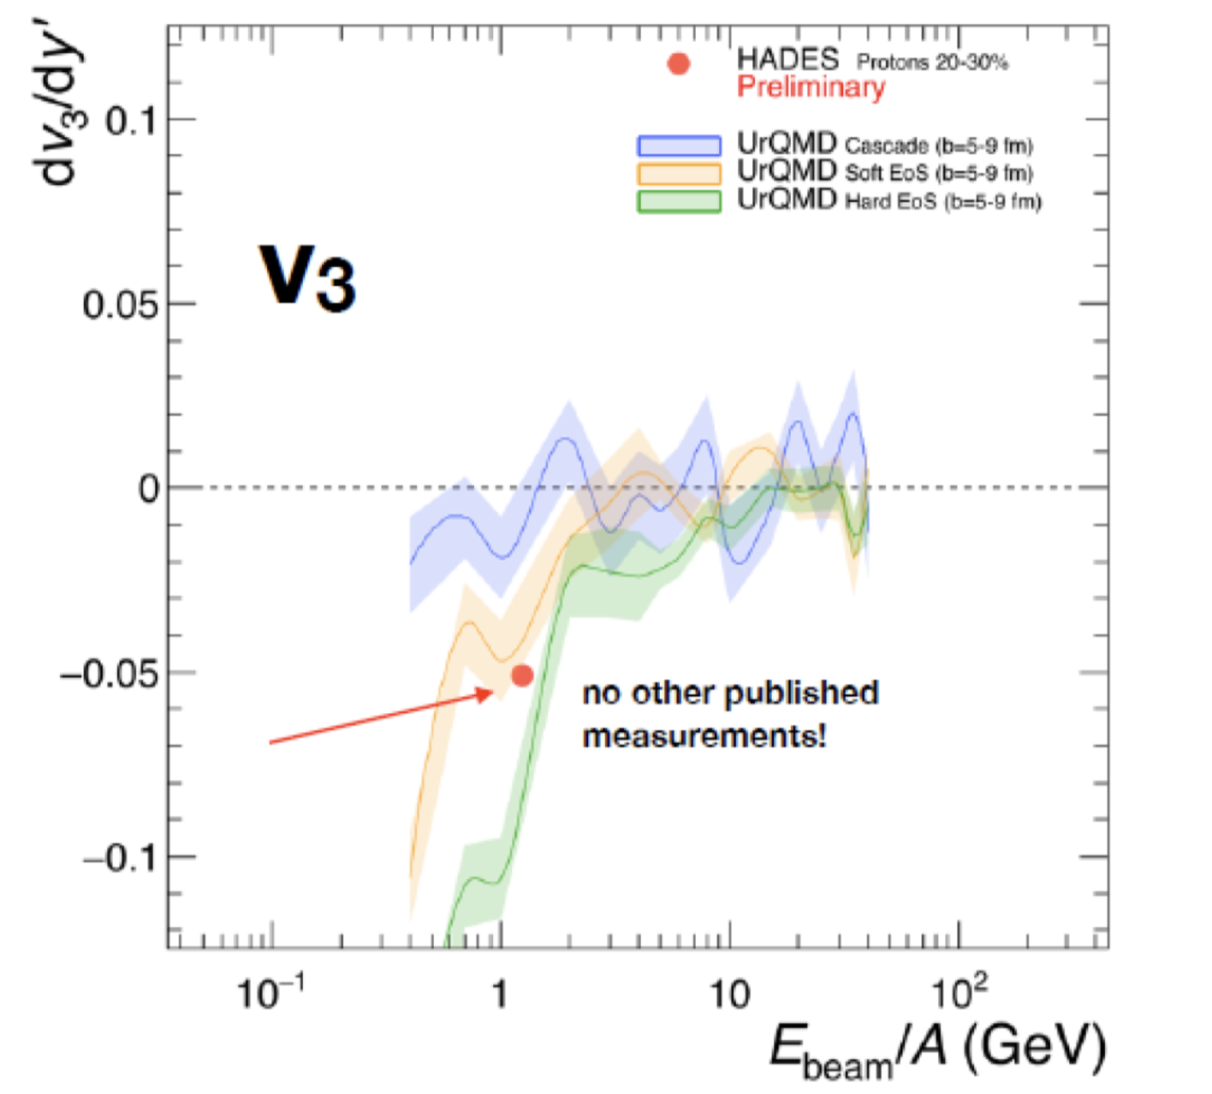
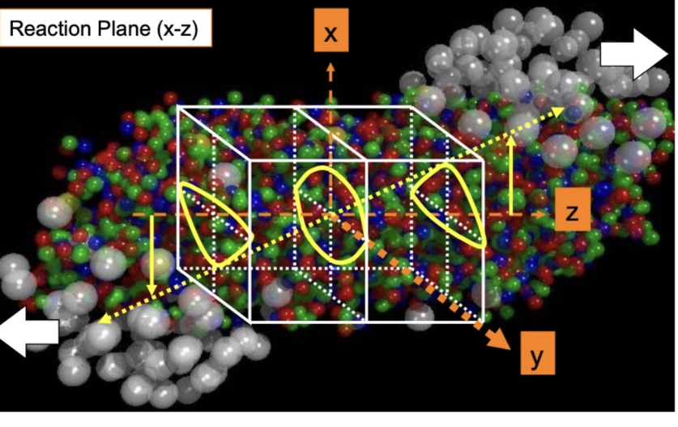
Motivation: Triangular flow (v₃)
At high energies, v₃ → uncorrelated with the 1st order event plane, contrary to observation at 2.4 GeV by (HADES) and at 3 GeV (STAR).
Collision Geometry
v₃{𝛹₁}
Potential
HADES: Eur. Phys .J. A 59 4, 80 (2023), STAR: Phys. Rev. C 109, 044914 (2024), J. Phys. G: Nucl. Part. Phys. 45 085101 (2018)
Sharang Rav Sharma RHIC/AGS AUM 2025

Slide 21
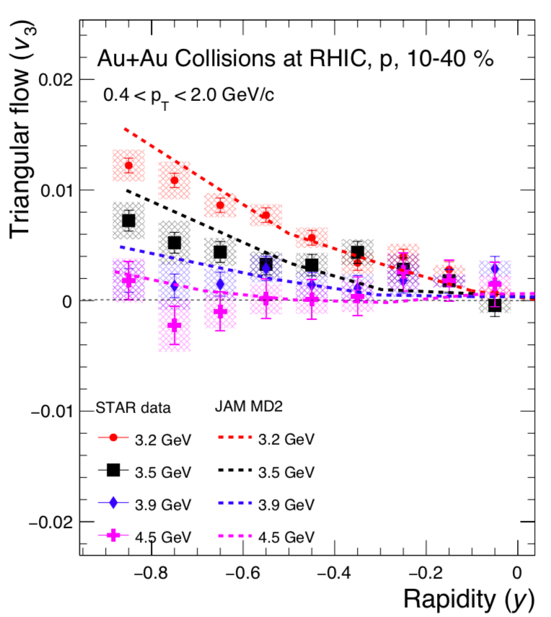
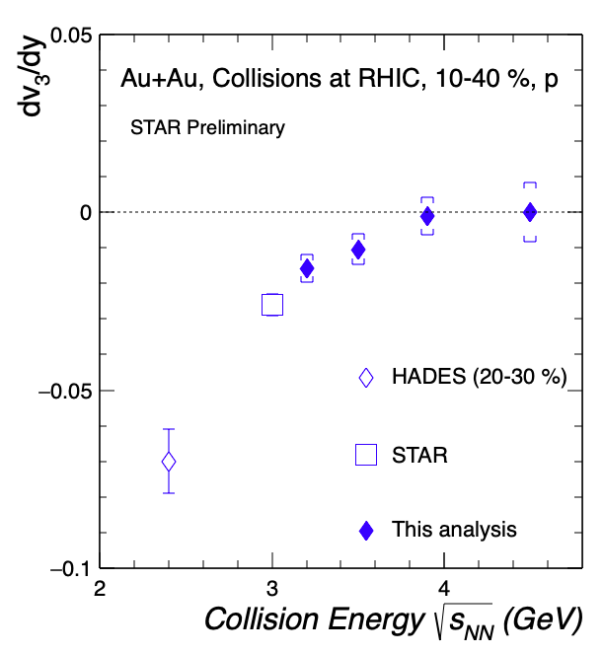
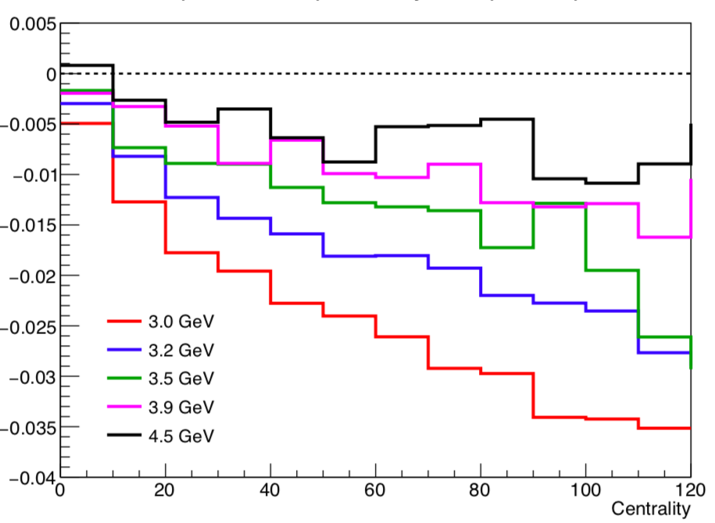
Triangular flow (v₃{𝛹₁})
√s_{NN}
STAR preliminary
Increasing collision energy → decreasing magnitude of 𝑣₃{Ψ₁} slope
JAM model with mean-field (MD2) describes the data ➡ Nuclear potential is essential for the development of |𝑣₃{Ψ₁}| ✅
Triangularity (ϵ₃) decreases with increasing collision energy ➡ Strong geometric effect ✅
HADES: Eur. Phys .J. A 59 4, 80 (2023), STAR: Phys. Rev. C 109, 044914 (2024)
Sharang Rav Sharma RHIC/AGS AUM 2025

Slide 22
Summary
Approximate mass no. scaling is observed in the v₁ slope for light nuclei ➡ Nucleon coalescence
The v₁ slope of ϕ meson shows similar trends to that of baryons in 'in the high μ_{B} region
In peripheral collisions, K^{∗0} v₁(y) shows a negative slope like ϕ and kaons, but a positive slope in mid-central collisions.
NCQ scaling breaks at 3.0 and 3.2 GeV, and gradually restores from 3.2 to 4.5 GeV
Shadowing effect diminishes with increasing energy
Dominance of partonic interactions at 4.5 GeV and above
AMPT-SM+Coal. seems to well describe the v₂ of d
Magnitude of d(𝑣₃{Ψ₁})/dy decreases with increasing energy and approaches zero at 4.5 GeV
JAM model with momentum dependent mean-field (κ = 380 MeV) describes the 𝑣₃{Ψ₁} data
Sharang Rav Sharma RHIC/AGS AUM 2025

Slide 23
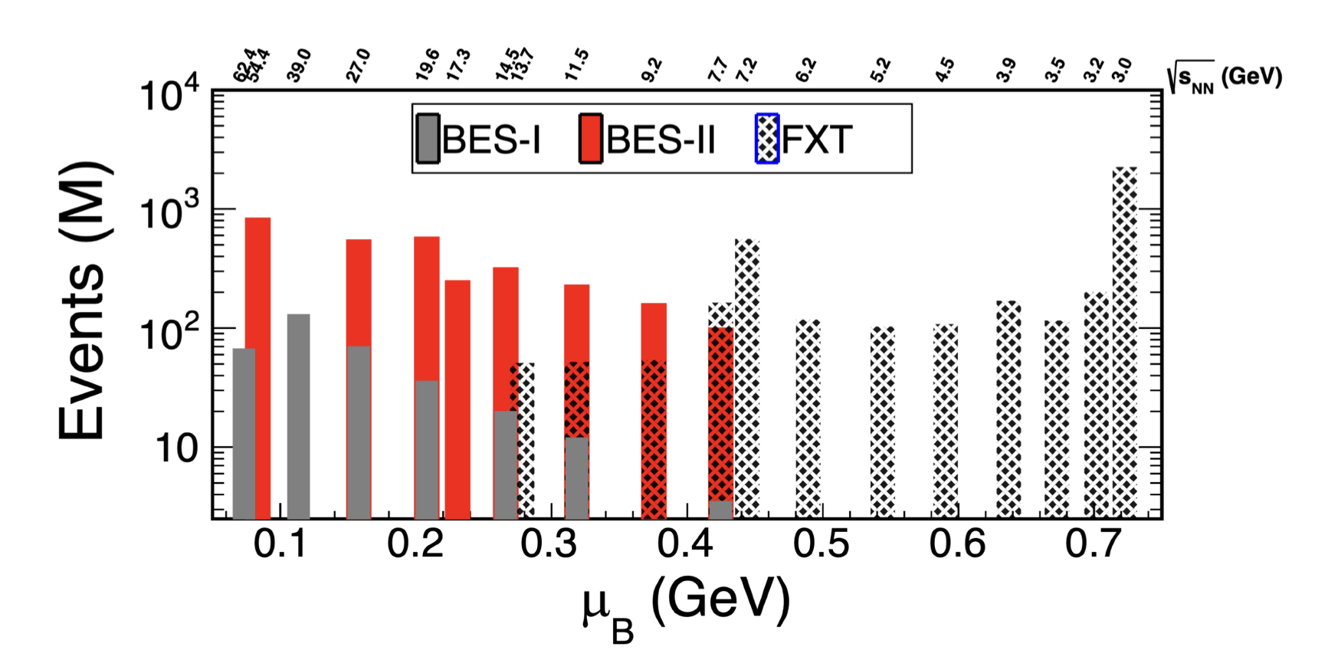
Outlook
High-precision measurements enabled by BES-II with improved statistics and upgraded detectors.
Deeper exploration of the QCD phase diagram, targeting critical phenomena and phase transitions.
Stay tuned for more exciting results from BES-II and FXT runs at STAR!
"With precision as our tool and curiosity as our guide, we move closer to unveiling the mysteries of the QCD phase diagram."
Thank you for your attention!
Sharang Rav Sharma RHIC/AGS AUM 2025

Slide 24
Backup slides
Sharang Rav Sharma RHIC/AGS AUM 2025

Slide 25
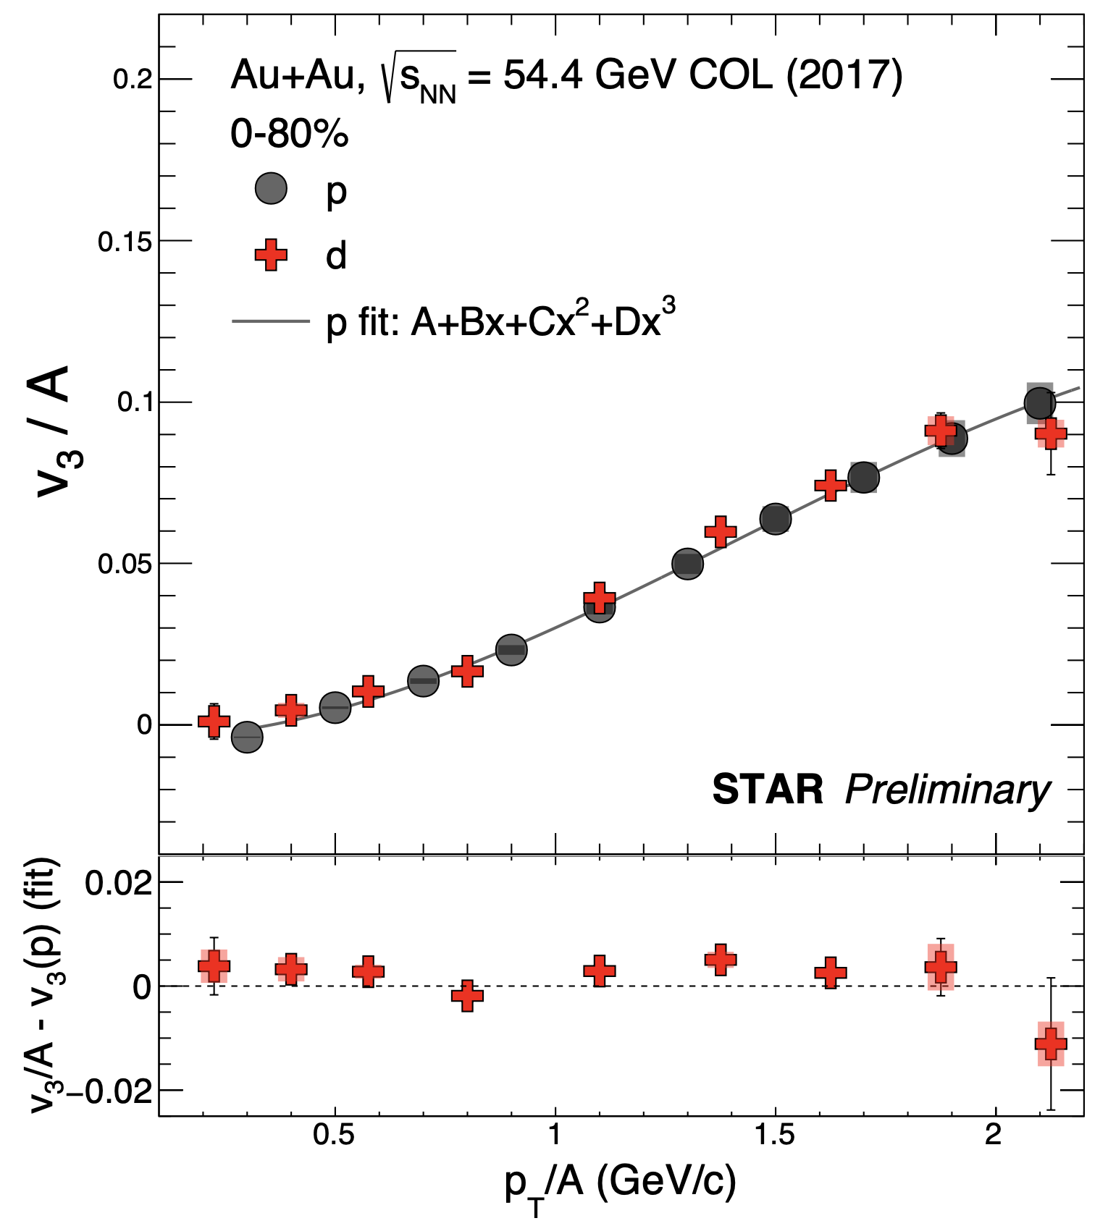
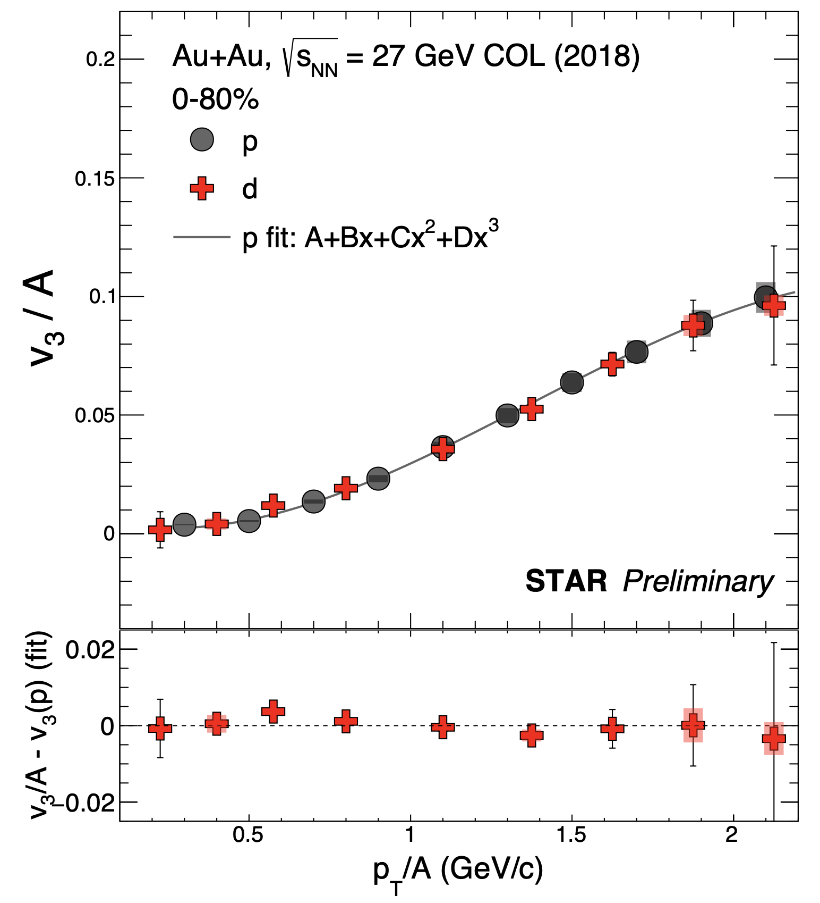
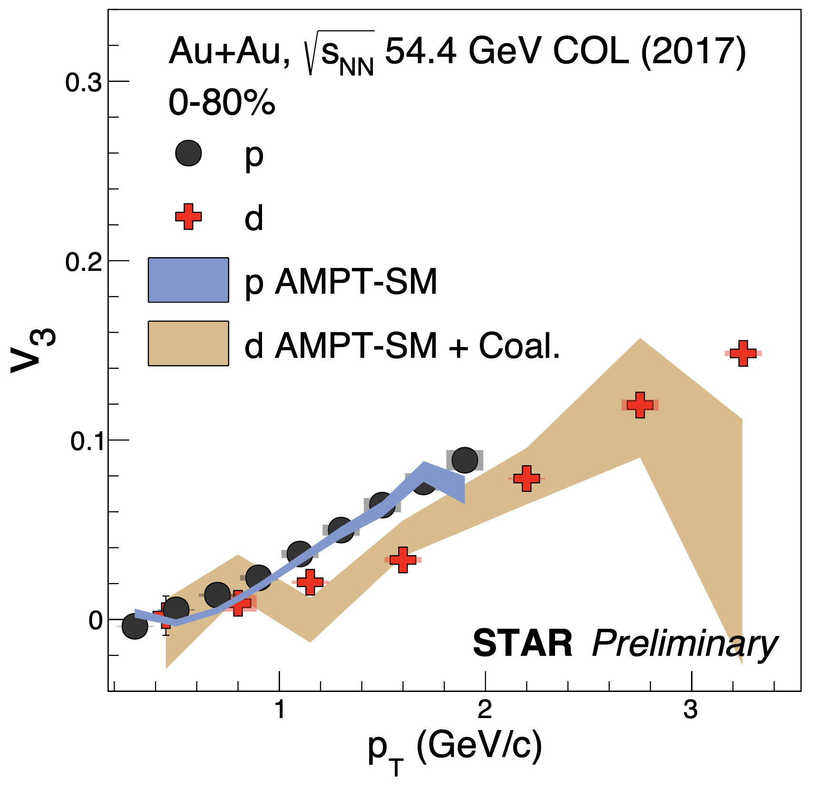
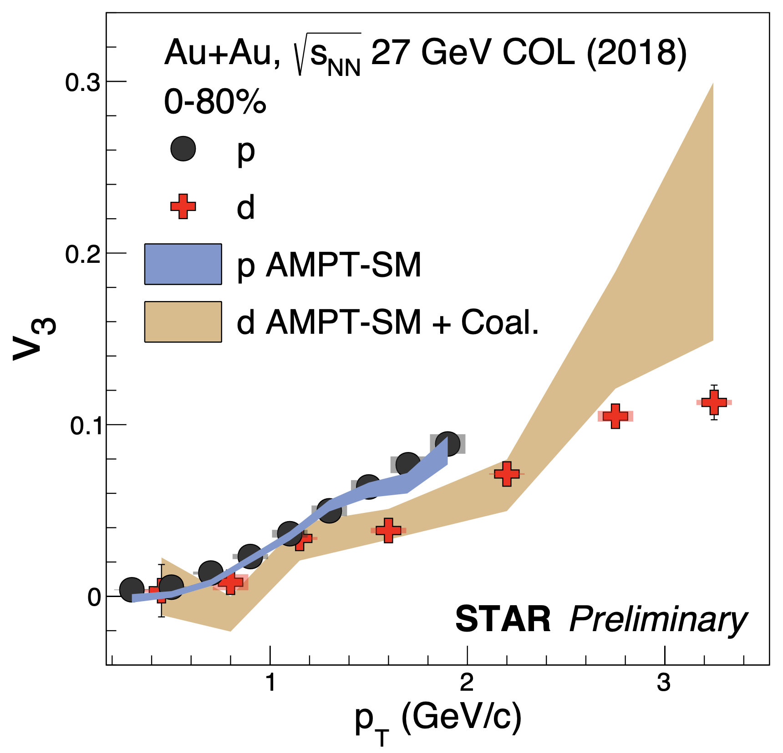
Triangular Flow of Light Nuclei
v₃(p_{T}) of d shows a good agreement with mass number scaling within ~10%
AMPT-SM model with a coalescence afterburner is in good agreement with v₃(p_{T}) of d
Sharang Rav Sharma RHIC/AGS AUM 2025
Sharang Rav Sharma RHIC/AGS AUM 2025

Slide 26
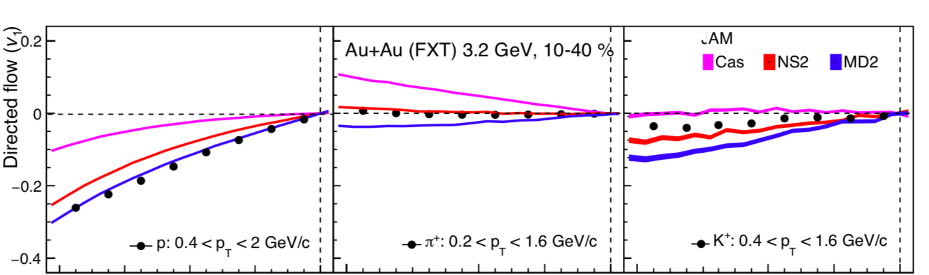
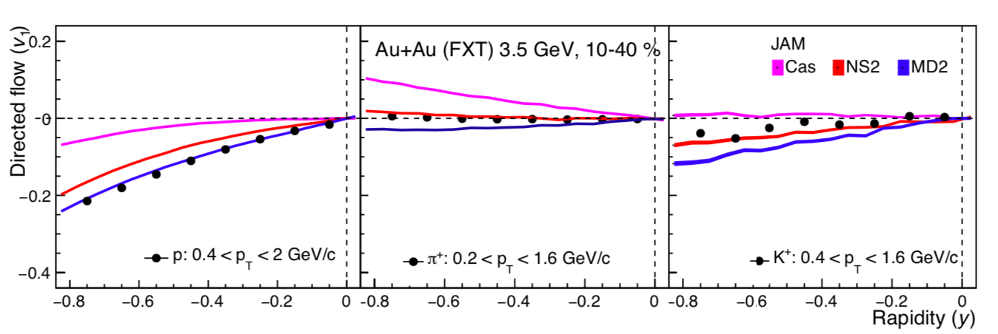
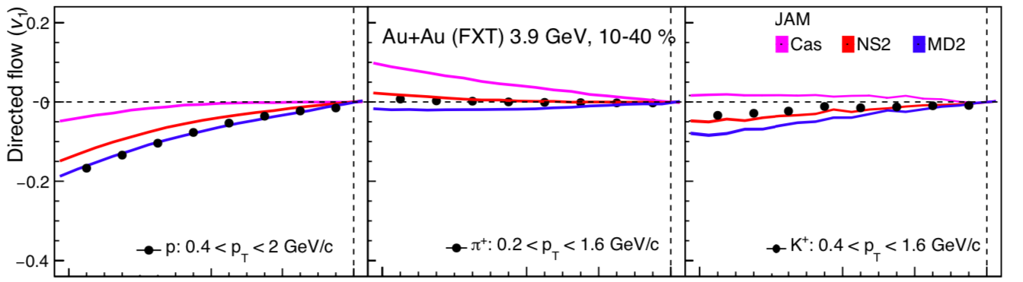
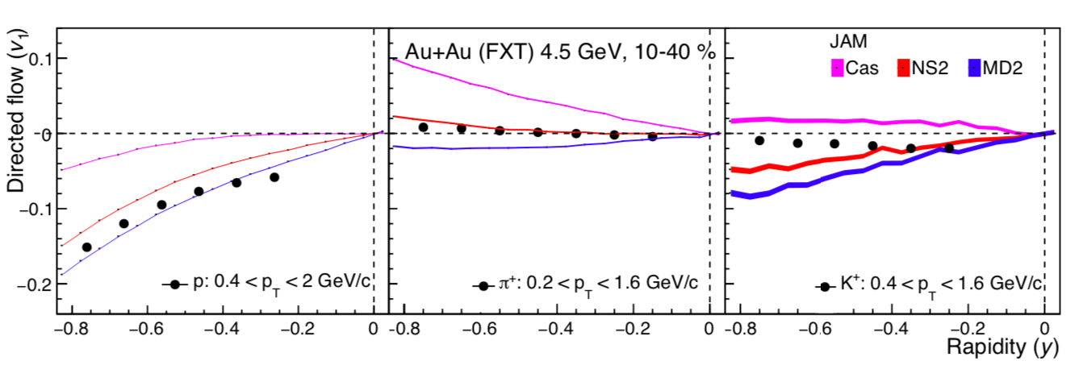
JAM Model Comparison
p
0.4 < p_{T} < 2 GeV/c
𝞹⁺
0.2 < p_{T} < 1.6 GeV/c
K⁺
0.4 < p_{T} < 1.6 GeV/c
Sharang Rav Sharma RHIC/AGS AUM 2025

Slide 27
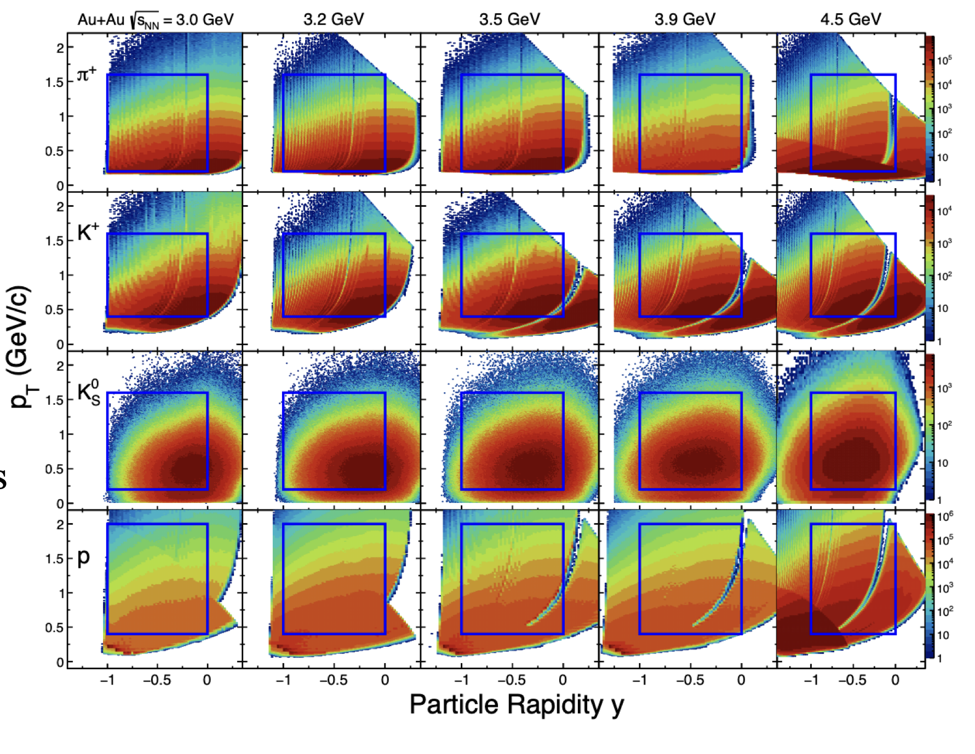
Phase Space Distribution
Sharang Rav Sharma RHIC/AGS AUM 2025

Slide 28
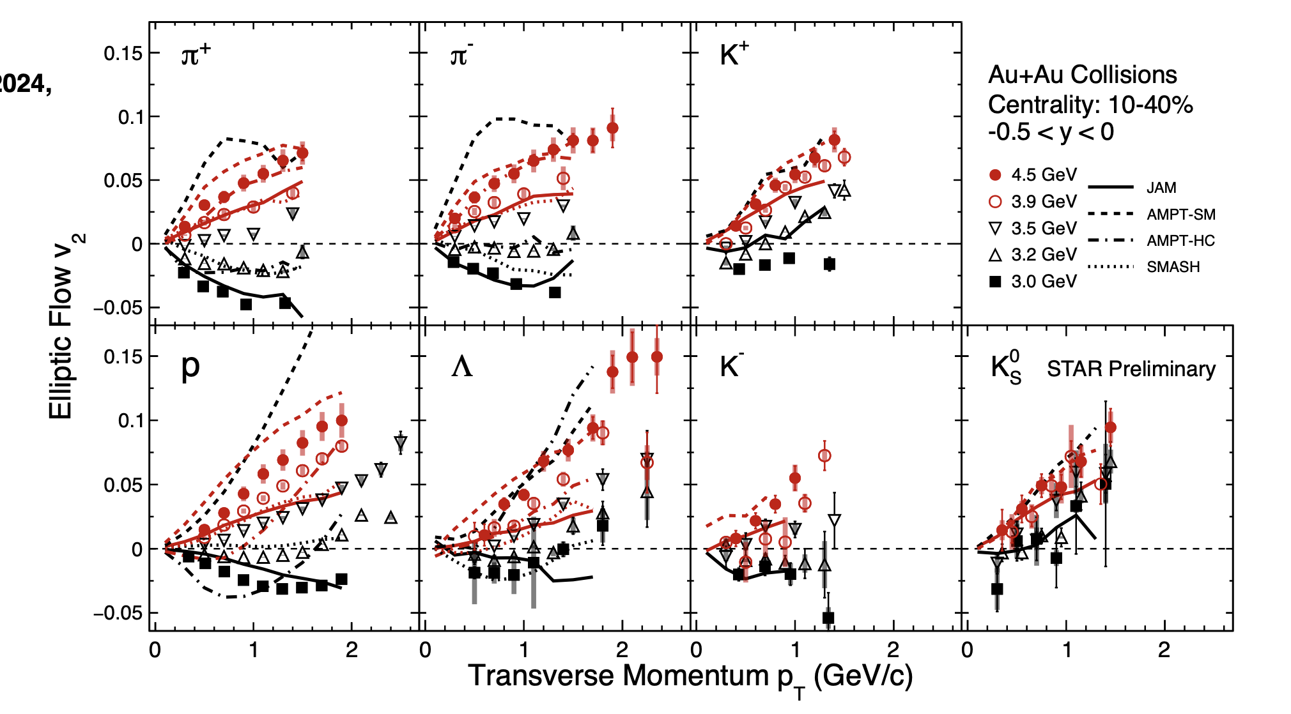
Elliptic flow (v₂)
As the collision energy increases, the passing time between nuclei decreases→ spectator shadowing is reduced.
Hadronic models fit the experimental data well at 3.0 GeV, but the AMPT-SM model does not.
At 4.5 GeV, the AMPT-SM model matches the data better, while hadronic models tend to underestimate the results.
Sharang Rav Sharma RHIC/AGS AUM 2025

Slide 29
Triangular flow
STAR preliminary
STAR preliminary
STAR preliminary
Sharang Rav Sharma RHIC/AGS AUM 2025

Slide 30
AMPT Model
Au+Au
Initial Conditions
Obtained from Heavy-Ion Jet INteraction Generator (HIJING)
We have used the AMPT-SM ampt-v1.26t9b-v2.26t9b version
String fragmentation parameters used:
a = 0.55
b = 0.15 GeV/c²
Parton Interactions
Scatterings among partons are modeled by Zhang’s Parton Cascade (ZPC)
Hadronization
AMPT with string melting (AMPT-SM) uses quark coalescence to combine partons into hadrons
Hadron Cascade
Dynamics of the hadronic matter is described by
A Relativistic Transport (ART) model
Final Particle Spectra
Sharang Rav Sharma RHIC/AGS AUM 2025
Sharang Rav Sharma RHIC/AGS AUM 2025

