Slide 1
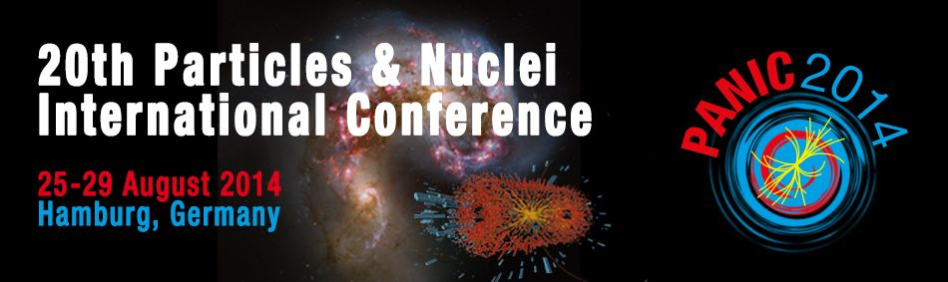



STAR
○ production at the STAR experiment
with a focus on new U+U results
Róbert Vértesi
robert.vertesi@ujf.cas.cz
for the STAR collaboration
.
Nuclear Physics Institute Academy of Sciences
of the Czech Republic

Slide 2
Outline
Quarkonia in heavy ion collisions
○ measurements with the STAR experiment
Results (√s_{NN}=193..200 GeV, mid-rapidity)
  p+p → pQCD baseline
  d+Au → CNM effects
  Au+Au and U+U → sQGP modification
Outlook
  New high-statistics measurements, √s=500 GeV p+p
  Muon Telescope Detector (MTD)

Slide 3
Quarkonia in the sQGP
Debye screening of heavy quark potential
→ Quarkonium states are expected to dissociate
T. Matsui, H. Satz, Phys.Lett. B178, 416 (1986)
Charmonia: J/Ψ, Ψ’, χ_{c} Bottomonia: ϒ(1S), ϒ(2S), ϒ(3S),χ_{B}

Slide 4
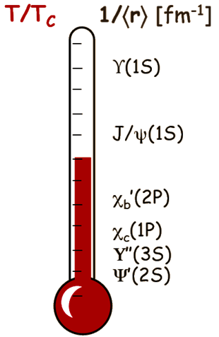
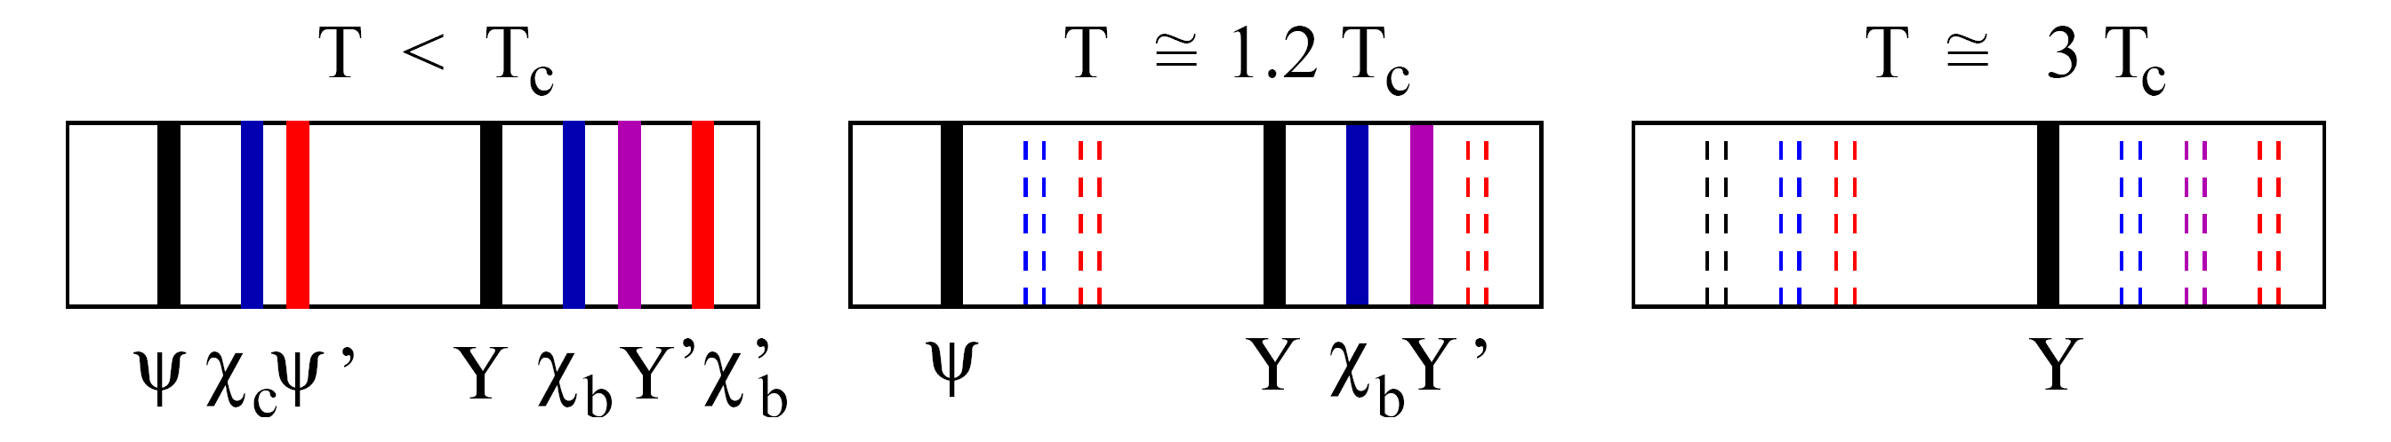
Quarkonia in the sQGP
Debye screening of heavy quark potential
→ Quarkonium states are expected to dissociate
T. Matsui, H. Satz, Phys.Lett. B178, 416 (1986)
Sequential melting: Different states are
expected to melt at different temperatures
Á. Mócsy, P. Petreczky, Phys. Rev. D77, 014501 (2008)
Charmonia: J/Ψ, Ψ’, χ_{c} Bottomonia: ϒ(1S), ϒ(2S), ϒ(3S),χ_{B}
Quarkonia may serve as sQGP thermometer

Slide 5
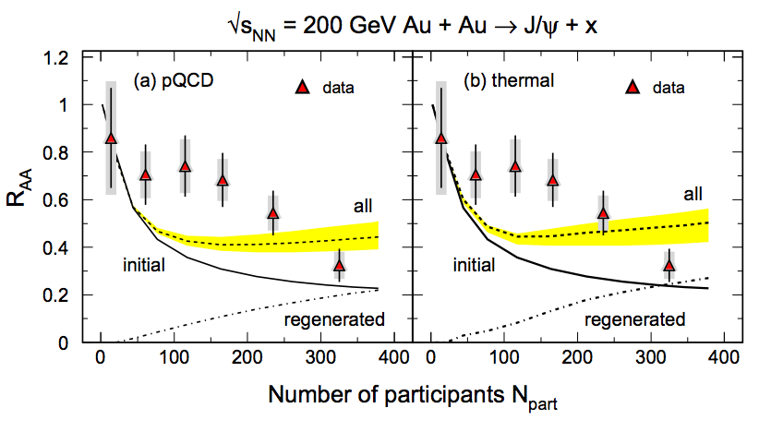
○ measurements at RHIC
J/ψ yield is strongly affected by recombination,
feed-down, co-mover absorption
→ P. Chaloupka’s talk
Model:
R. Rapp et al., Prog.Part.Nucl.Phys.
65 (2010) 209
Data:
PHENIX, Nucl.Phys. A 774 (2006) 747

Slide 6
○ measurements at RHIC
J/ψ yield is strongly affected by recombination,
feed-down, co-mover absorption
○ recombination and co-mover absorption are negligible at RHIC energies
However: Low production rate makes it a difficult measurement
Requires good acceptance and specific triggering
→ P. Chaloupka’s talk
Model:
R. Rapp et al., Prog.Part.Nucl.Phys.
65 (2010) 209
Data:
PHENIX, Nucl.Phys. A 774 (2006) 747
○ states provide a cleaner probe at RHIC

Slide 7
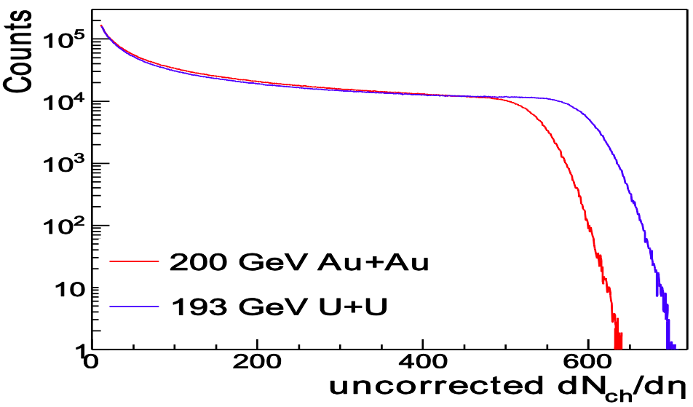
U+U: Higher energy densities
STAR preliminary
RHIC √s_{NN}=193 GeV U+U data (2012)
Reach higher N_{part} than in Au+Au

Slide 8
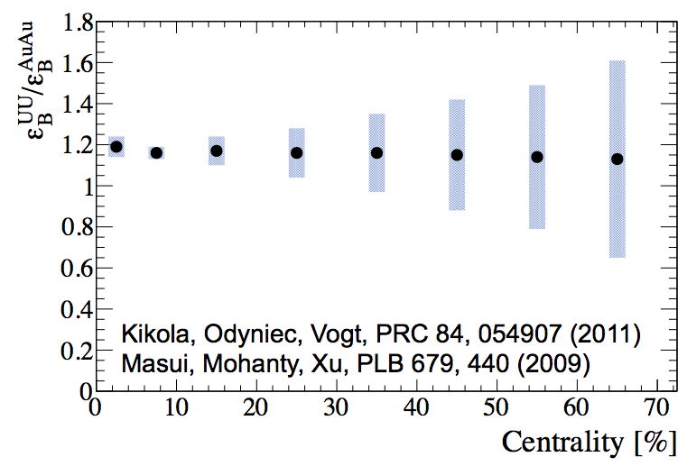
U+U: Higher energy densities
STAR preliminary
RHIC √s_{NN}=193 GeV U+U data (2012)
Reach higher N_{part} than in Au+Au
Provide higher energy density
Way to test the sequential melting hypothesis

Slide 9
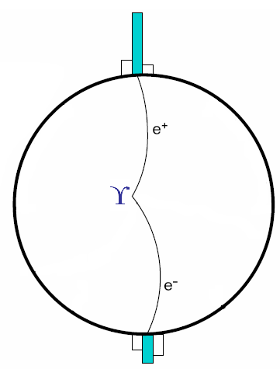
ϒ measurements in RHIC/STAR
ϒ → e⁺e– (BR ~ 2%)
  Large invariant mass (m_{ee}~10 GeV/c²)
  Back-to-back electron-positron pair
  Rather energetic electrons (typically >3 GeV)

Slide 10
ϒ measurements in RHIC/STAR
ϒ → e⁺e– (BR ~ 2%)
  Large invariant mass (m_{ee}~10 GeV/c²)
  Back-to-back electron-positron pair
  Rather energetic electrons (typically >3 GeV)
a central Au+Au event in STAR

Slide 11
1. Triggering on ϒ events
L0,L2
1. Trigger on energetic hits in the BEMC
L2
L0: ‘High tower trigger’ saves events with high energy hit
in the Barrel Electromagnetic Calorimeter (BEMC) tower
L2 in p+p and d+Au only – software trigger:
coarse reconstruction of cluster energy, opening angle, invariant mass

Slide 12
2. Finding electron tracks
1. Trigger on energetic hits in the BEMC
2. Find electron tracks in the TPC
Find tracks in the Time Expansion Chamber (TPC)
based on Fractional energy loss dE/dx
-1.2<nσ_{e}<3 (A+A analyses)

Slide 13
3. Matching
1. Trigger on energetic hits in the BEMC
2. Find electron tracks in the TPC
3. Match BEMC clusters
and TPC tracks
Clusterize energy in the BEMC
Cluster: 3 adjacent towers with most of the energy deposit
Project TPC tracks onto clusters to match them
ΔR_{match} = √(Δη²+Δφ²) < 0.04

Slide 14
4. ID in the calorimeter
1. Trigger on energetic hits in the BEMC
2. Find electron tracks in the TPC
3. Match BEMC clusters
and TPC tracks
4. ID cuts in the BEMC
Cluster energy matches track momentum
0.75<E/p<1.4 (U+U analysis)
Energy deposit is compact, mostly in a single tower
triggered e±: E_{tower}/E>0.7, associated e±: E_{tower}/E>0.5 (U+U analysis)

Slide 15
Peak extraction (U+U example)
e⁺e⁻ pair invariant mass
  Combinatorial background is fitted with exponential, then subtracted
U+U √s_{NN}=193 GeV 0-60%
STAR preliminary

Slide 16
Peak extraction (U+U example)
comb. bg subtracted
e⁺e⁻ pair invariant mass
  Combinatorial background is fitted with exponential, then subtracted
  Shape of Drell-Yan is from pQCD calculations;
  open bb contribution is from PYTHIA
  ○ peak shape is from embedded MC simulation
  Normalization of ○ peak and Drell-Yan+bb is fitted simultaneously
  Note: log-likelihood method applied in the fits
U+U
√s_{NN}=193 GeV
0-60%
_
_
STAR preliminary

Slide 17
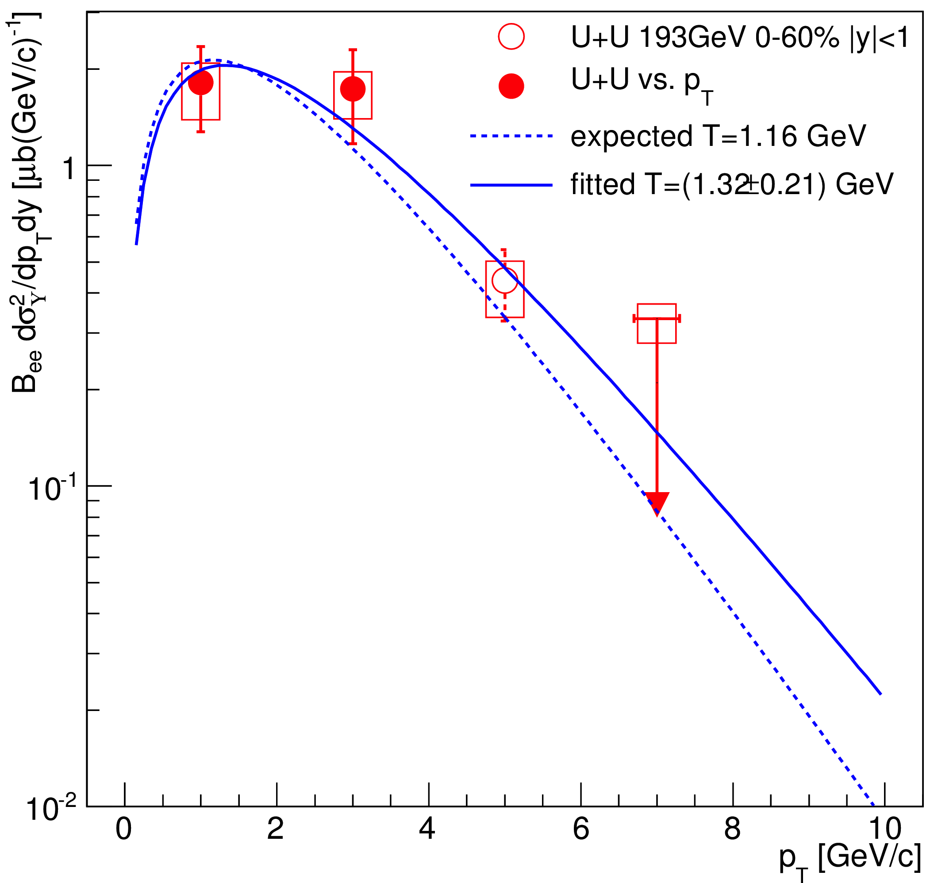

ϒ x-section and p_{T}-spectrum in U+U
ϒ cross section (STAR preliminary)
U+U 193 GeV, 0-60% centrality stat. syst
Major systematic uncertainties (%) (STAR preliminary)
Geometrical acceptance | +1.7 -3.0
Trigger efficiency | +1.1 -3.6
Tracking efficiency | 11.8
TPC electron identification | +4.0 -6.4
TPC-BEMC matching | 5.4
BEMC electron identification | 5.9
Embedding p_{T} and y shapes | 2.1
Signal extraction | +4.8 -18
STAR preliminary
Expected T is extrapolated
from ISR, CDF and CMS
pp (pp) results
PLB91, 481 (1980).
PRL88, 161802 (2002).
PRD83, 112004 (2011)
_

Slide 18
ϒ in p+p and d+Au
Phys.Lett. B735 (2014) 127
ϒ in p+p 200 GeV, |y|<0.5, L0 & L2
∫L dt = 20.0 pb⁻¹ N_{ϒ}(total)= 152 ± 23 (stat. + fit)
ϒ in d+Au 200 GeV, |y|<0.5, L0 & L2
∫L dt = 28.1 nb⁻¹ N_{ϒ}(total)= 46 ± 13 (stat. + fit)

Slide 19
ϒ in Au+Au
Phys.Lett. B735 (2014) 127
mid-peripheral
(30-60%)
ϒ in Au+Au 200 GeV, |y|<1
∫L dt = 1075 µb⁻¹ N_{ϒ} = 254 ± 29
mid-central
(10-30%)
centrality bins
central
(0-10%)

Slide 20
ϒ in p+p – QCD baseline
p+p ϒ cross section vs. y, compared to pQCD predictions
R. Vogt, Phys. Rep. 462125, 2008
Phys.Lett. B735 (2014) 127

Slide 21
ϒ in p+p – QCD baseline
p+p ϒ cross section vs. y, compared to pQCD predictions
R. Vogt, Phys. Rep. 462125, 2008
Phys.Lett. B735 (2014) 127
STAR Preliminary
p+p ϒ cross section, compared to world data trend

Slide 22
ϒ R_{dAu} – CNM effects
Models include
  Gluon nPDF (Anti)shadowing
  Initial parton energy loss
Indication of suppression at mid-rapidity beyond models
Phys.Lett. B735 (2014) 127
R_{dAu}=0.48 ± 0.14(stat) ± 0.07(syst) ± 0.02 (pp stat) ± 0.06 (pp syst)
|y|<0.5

Slide 23
ϒ R_{dAu} – CNM effects
Models include
  Gluon nPDF (Anti)shadowing
  Initial parton energy loss
Indication of suppression at mid-rapidity beyond models
Phys.Lett. B735 (2014) 127
Phys.Lett. B735 (2014) 127
STAR data consistent with E772

Slide 24
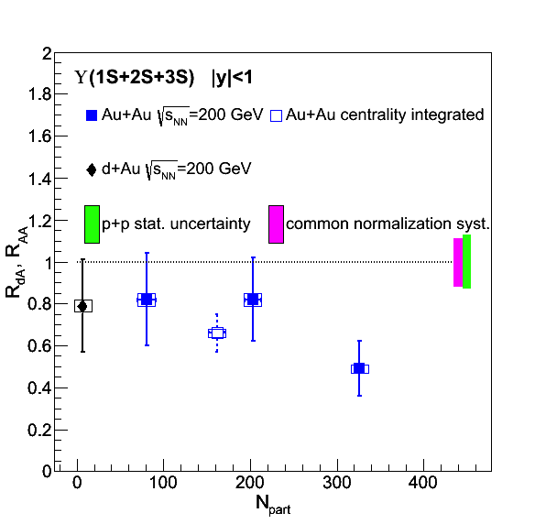
ϒ R_{AA}
Au+Au, d+Au: Phys.Lett. B735 (2014) 127
Au+Au data
Peripheral data and d+Au (|y|<1) is consistent with no suppression
Significant suppression
in central data

Slide 25
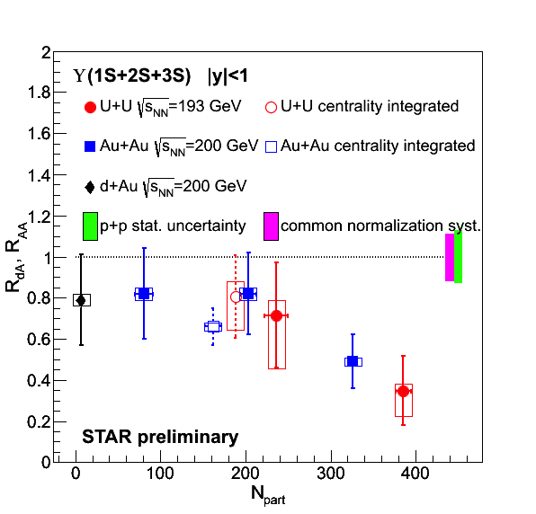
ϒ R_{AA}
Au+Au, d+Au: Phys.Lett. B735 (2014) 127
Au+Au and U+U data
Peripheral data and d+Au (|y|<1) is consistent with no suppression
Significant suppression
in central data
Trend in U+U follows and extends trend in Au+Au

Slide 26
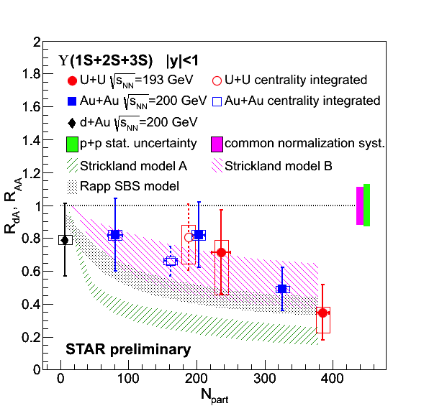
ϒ R_{AA} – data vs. models
Au+Au, d+Au: Phys.Lett. B735 (2014) 127
Model calculations:
Strong binding scenario,
CNM effects included
Emerick, Zhao, Rapp, Eur. Phys. J A48, 72 (2012)
Potential model based on heavy quark internal energy ‘B’
assumes 428 < T < 443 MeV
Strickland, Bazov, Nucl. Phys. A879, 25 (2012)
Potential model based on heavy quark free energy ‘A’ disfavored
ϒ suppression indicates color deconfinement
However: CNM effects need further study
→ Planned p+Au run at RHIC for 2015

Slide 27
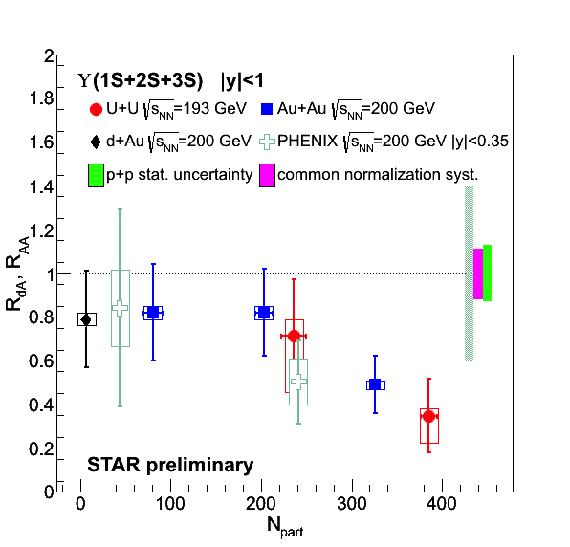
ϒ R_{AA} – RHIC comparison
Au+Au, d+Au: Phys.Lett. B735 (2014) 127
STAR vs. PHENIX:
data are consistent
PHENIX Collaboration, arXiv:1404.2246

Slide 28
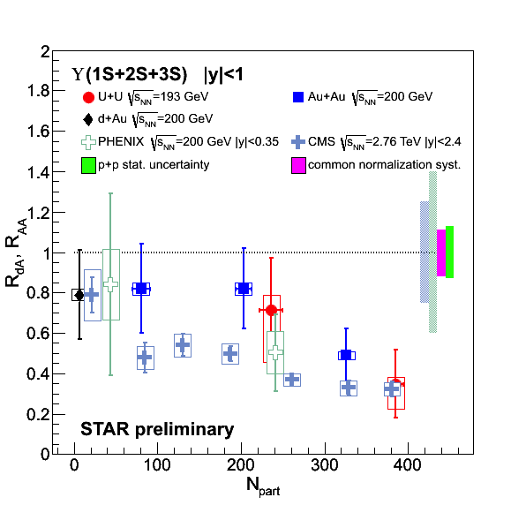
ϒ R_{AA} – RHIC & LHC comparison
Au+Au, d+Au: Phys.Lett. B735 (2014) 127
STAR vs. PHENIX:
data are consistent
RHIC vs. LHC:
  High-N_{part} suppression comparable at LHC and RHIC
  Suppression of ϒ appears to be ~flat at LHC
  → is suppression driven
  by the energy density?
Note the uncertainties, however
PHENIX Collaboration, arXiv:1404.2246
CMS Collaboration, PRL 109 (2012) 222301

Slide 29
ϒ(1S) R_{AA} in Au+Au
Phys.Lett. B735 (2014) 127
Model calculations
Strickland-Bazov model B:
Hot and cold effects
Nucl. Phys. A879, 25 (2012)
Liu-Chen model:
Dissociation of Quarkonium
No CNM effects
Phys. Lett. B697 (2011) 32
B
ϒ(1S) R_{AA} is consistent with unity in d+Au and peripheral and mid-central Au+Au
Indication of suppression consistent with model calculation in central Au+Au

Slide 30
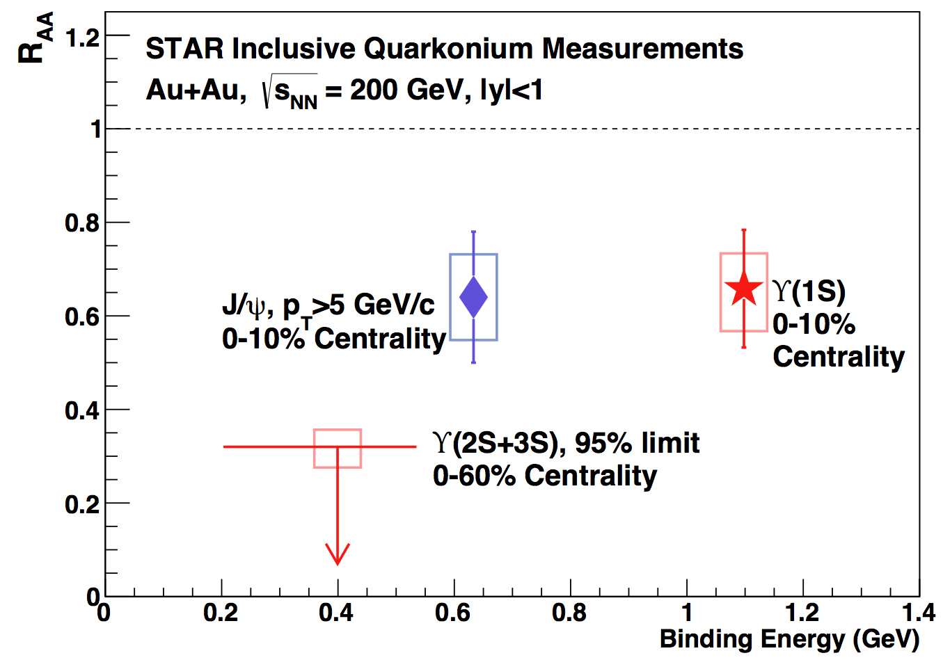
Excited ϒ states in Au+Au
Phys.Lett. B735 (2014) 127
Central Au+Au:
Excited states ϒ(2S) and ϒ(3S) consistent with complete melting
ϒ(1S) suppression is similar to high-p_{T} J/ψ
Au+Au

Slide 31
Excited ϒ states in Au+Au
Phys.Lett. B735 (2014) 127
Central Au+Au:
Excited states ϒ(2S) and ϒ(3S) consistent with complete melting
ϒ(1S) suppression is similar to high-p_{T} J/ψ
Au+Au
ϒ suppression pattern supports sequential melting

Slide 32
Excited ϒ states – LHC comparison
Phys.Lett. B735 (2014) 127
Au+Au
RHIC √s_{NN}=200 GeV Au+Au and
LHC √s_{NN}=2.76 TeV Pb+Pb collisions:
Similar suppression of central ϒ(1S)

Slide 33
Outlook: analyses underway
p+p √s=500 GeV, 2011
~ 22 pb⁻¹
Double x-section, L0-only
p_{T} spectrum
Excited-to-ground ratio
Au+Au √s_{NN}=200 GeV, 2011
~ 2800 ub⁻¹
same setup as in 2010

Slide 34
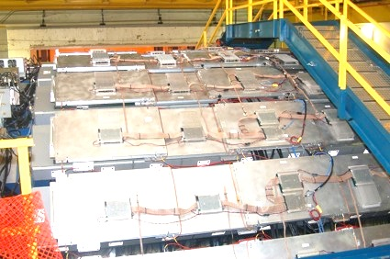
Outlook: Muon Telescope Detector
Outermost, gas detector
Physics goal: Precision measurement of heavy quarkonia through the muon channel
Acceptance:
45% in azimuth, |y|<0.5
R_{AA}
ϒ projection
<N_{part}>

Slide 35
Outlook: Muon Telescope Detector
Outermost, gas detector
Physics goal: Precision measurement of heavy quarkonia through the muon channel
Acceptance:
45% in azimuth, |y|<0.5
Complete in 2014, sampled ~13.8 nb⁻¹ in Au+Au data
R_{AA}
ϒ projection
<N_{part}>

Slide 36
Summary
Strong ○ suppression in √s_{NN}=200 GeV central Au+Au data
New √s_{NN}=193 GeV U+U measurement confirms Au+Au trend and extends it to higher N_{part}
Similar R_{AA} at RHIC and LHC in most central collisions
Sequential melting: ground state is suppressed, no evidence for surviving excited states in central Au+Au collisions
Unexpected suppression in mid-rapidity d+Au
CNM effects need further studies → upcoming p+A run

Slide 37
Summary
Strong ○ suppression in √s_{NN}=200 GeV central Au+Au data
New √s_{NN}=193 GeV U+U measurement confirms Au+Au trend and extends it to higher N_{part}
Similar R_{AA} at RHIC and LHC in most central collisions
Sequential melting: ground state is suppressed, no evidence for surviving excited states in central Au+Au collisions
Unexpected suppression in mid-rapidity d+Au
CNM effects need further studies → upcoming p+A run
Stay tuned for new ○→μ⁺μ– results with MTD

Slide 38
Thank You!
AGH University of Science and Technology
Alikhanov Institute for Theoretical and Experimental Physics
Argonne National Laboratory
Brookhaven National Laboratory
Central China Normal University
Cracow University of Technology
Creighton University
Czech Technical University in Prague
Frankfurt Institute for Advanced Studies (FIAS)
Indian Institute of Technology. Mumbai
Indiana University, CEEM
Institute of High Energy Physics - Beijing
Institute of High Energy Physics - Protvino
Institute of Modern Physics, Lanzhou
Institute of Nuclear Physics PAS
Institute of Physics. Bhubaneswar
Instituto de Fisica da Universidade de Sao Paulo
Joint Institute for Nuclear Research
Kent State University
Korea Institute of Science and Technology Information
Lawrence Berkeley National Laboratory
Massachusetts Institute of Technology
Max-Planck-Institut fuer Physics
Michigan State University
Moscow Engineering Physics Institute
National Institute of Science Education and Research
Nuclear Physics Inst., Academy of Sciences - Prague
Ohio State University
Panjab University
Pennsylvania State University
Purdue University
Pusan National University
Rice University
Shandong University
Shanghai Institue of Applied Physics
Temple University
Texas A&M University
Tsinghua University
United States Naval Academy
Universidade Estadual de Campinas
University of California - Davis
University of California - Los Angeles
University of California, Berkeley
University of Houston
University of Illinois at Chicago
University of Jammu
University of Kentucky
University of Rajasthan
University of Science and Technology of China (USTC)
University of Texas - Austin
University of Washington
University of Zagreb
Valparaiso University
Variable Energy Cyclotron Centre. Kolkata
Warsaw University of Technology
Wayne State University
World Laboratory for Cosmology and Particle Physics (WLCAPP)
Yale University
STAR Collaboration

Slide 39
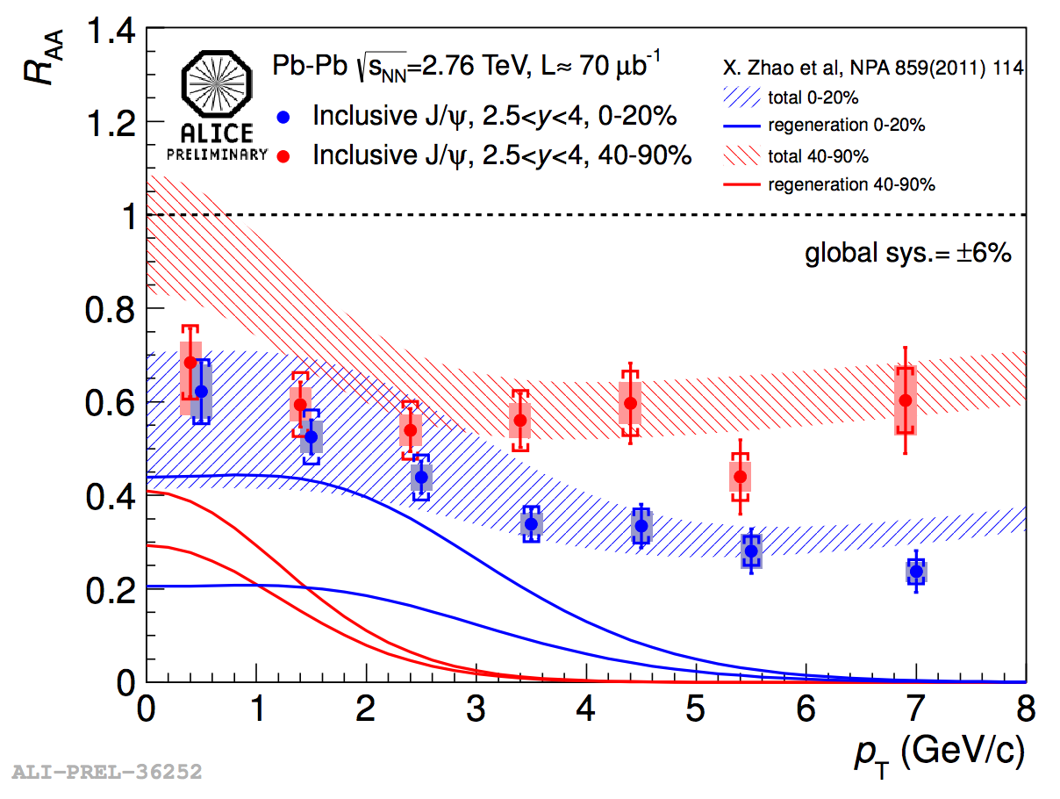
High-pT J/ψ – motivation
R_{dAu} ~ 1 at high P_{T}
→ CNM effects do not play a strong role
Less regeneration at high P_{T}
PHENIX data: Phys. Rev. C 87, 034904 (2013)
^{Model: Eskola, Paukkuenna,} Salgado, Nucl.Phys.A830, 599 (2009)

Slide 40
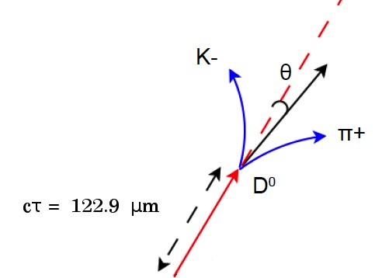
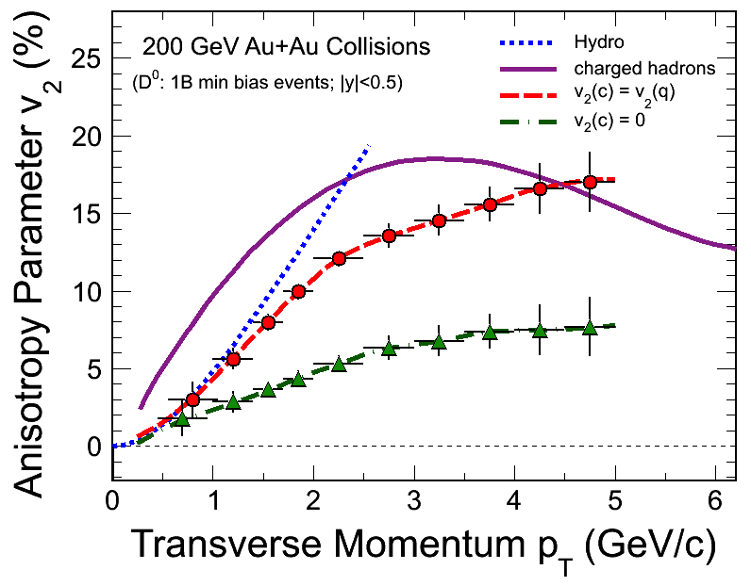
Outlook: Heavy Flavor Tracker
Innermost, silicon detectors (3 subsystems)
Resolves secondary vertex
Physics goal: Precision measurement of heavy quark production
Complete and taking data in Run14
IST at 14 cm
PXL at 2.9 and 8.2 cm
D⁰ v₂ projection
SSD at 22 cm

Slide 41
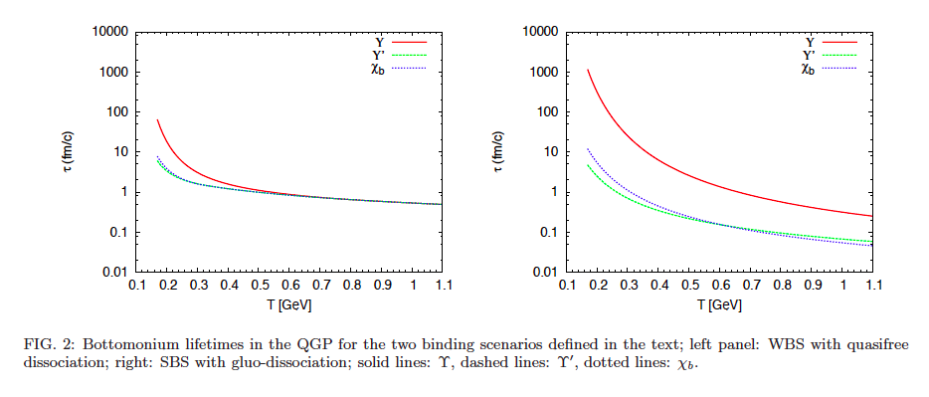
Rapp WBS & SBS
Emerick, Zhao, Rapp, Eur. Phys. J A48, 72 (2012)

Slide 42
CMS
CMS Collaboration, PRL 109 (2012) 222301
CMS
2.76 TeV
Pb+Pb

Slide 43
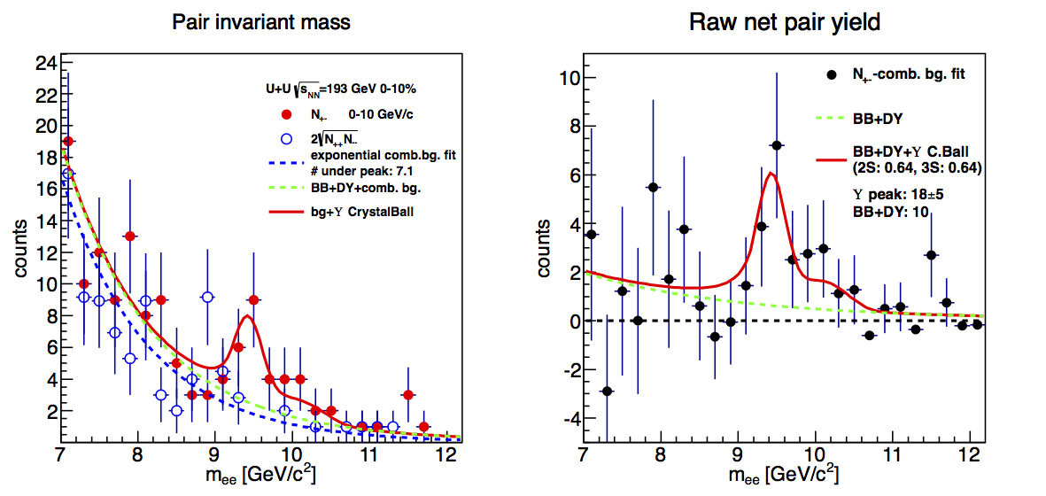
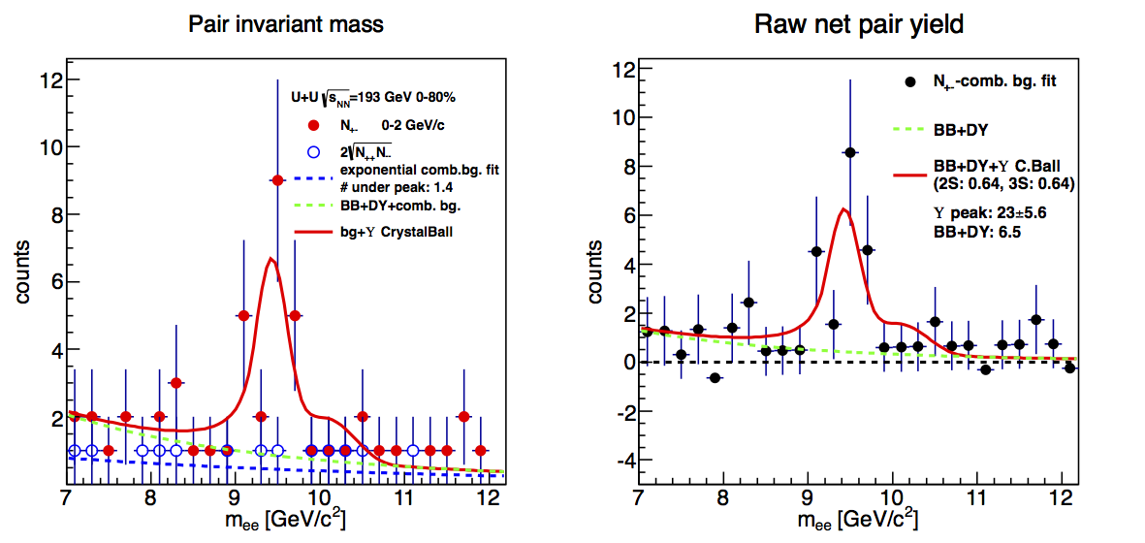
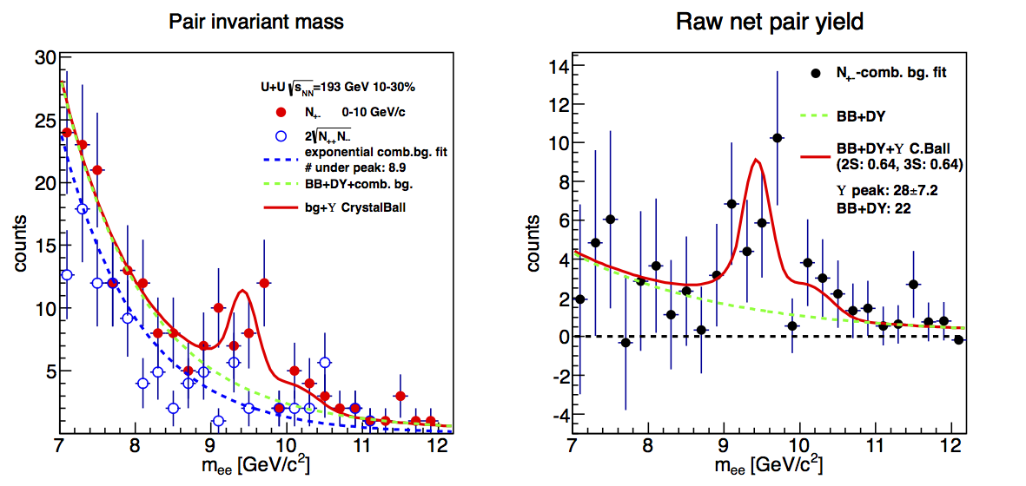
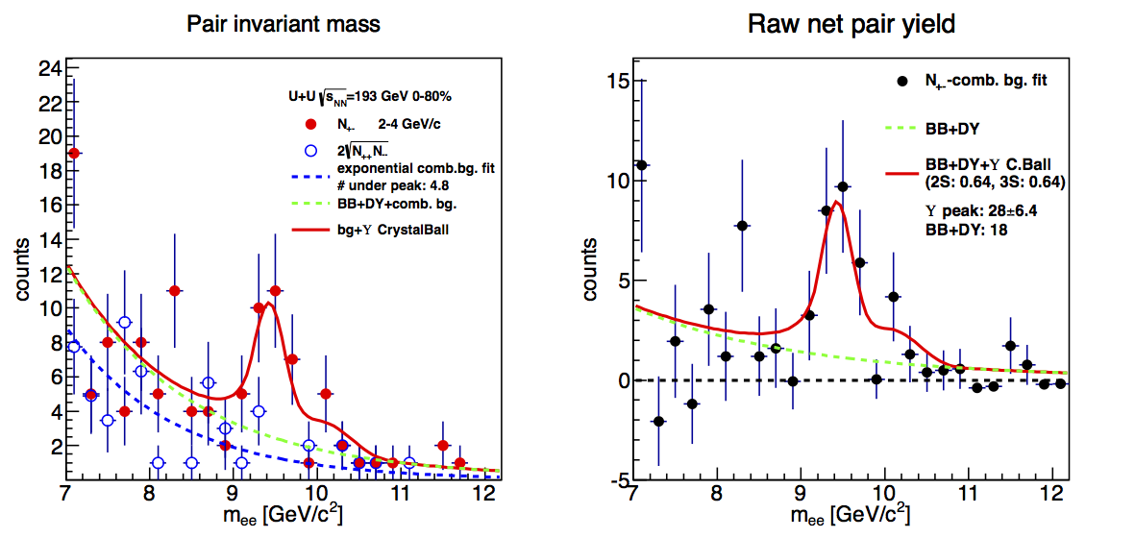
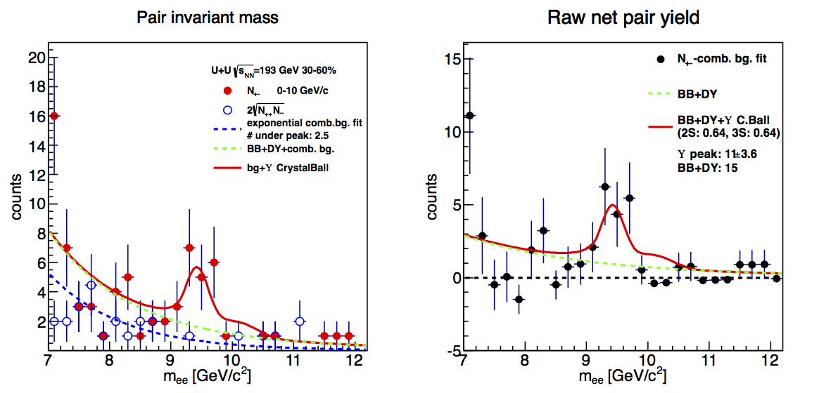
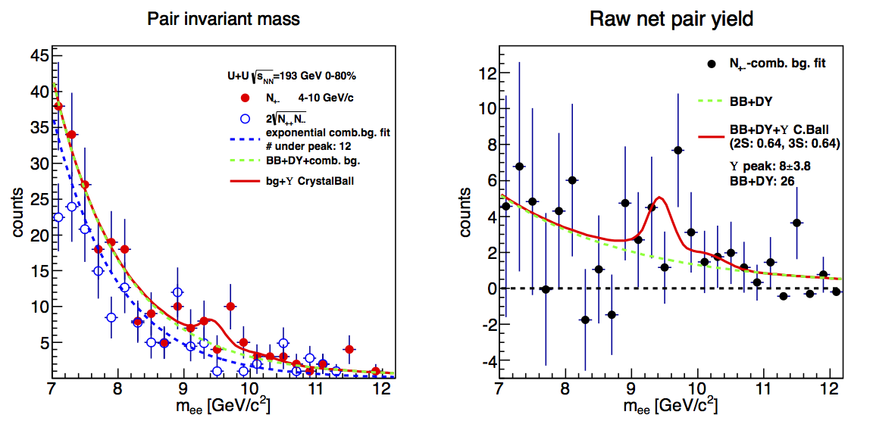
Peak extraction
← 0-10%
pT<2GeV →
←10-30%
2<pT<4GeV→
← 30-60%
pT>4GeV→

Slide 44
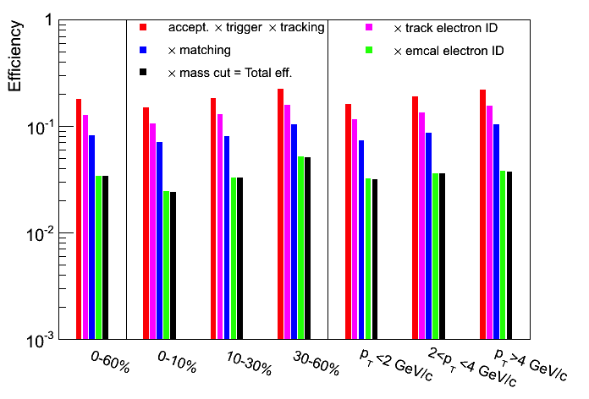
U+U acceptance and efficiency
    15M high-tower-triggered U+U 193 GeV events (263 μb⁻¹)
    Divided into 3
    centrality bins:
      0 – 10 %
      10 – 30 %
      30 – 60 %
    or… 3 bins in p_{T}^{ϒ}:
      0 – 2 GeV/c
      2 – 4 GeV/c
      4< GeV/c
    Total acceptance & efficiency for ϒ→ e⁺e– reconstruction:
    ~ 2-3%
STAR preliminary

Slide 45
Nuclear modification
p+p : pQCD baseline
Nuclear modification factor (R_{dA,AA})
d+Au: generally considered as proxy for CNM
A+A: hot nuclear matter effects – sQGP
R_{AA}=1 if no modification by the medium

