Slide 1




Bottomonium production in heavy ion collisions at STAR
Róbert Vértesi
robert.vertesi@ujf.cas.cz .
for the
collaboration
Nuclear Physics Institute Academy of Sciences
of the Czech Republic

Slide 2
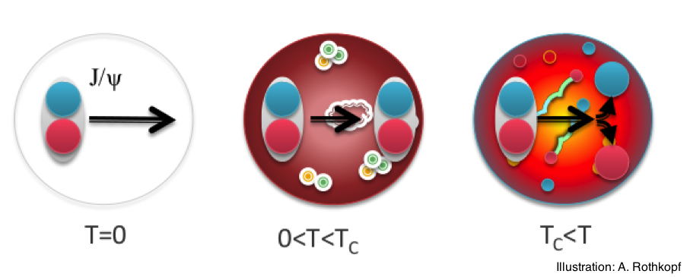
Quarkonia in the sQGP
Debye screening of heavy quark potential
→ Quarkonia are expected to dissociate
T. Matsui, H. Satz, Phys.Lett. B178, 416 (1986)
_
Charmonia (cc):
J/Ψ, Ψ’, χ_{c}
Bottomonia (bb):
ϒ(1S), ϒ(2S), ϒ(3S),χ_{B}
_

Slide 3
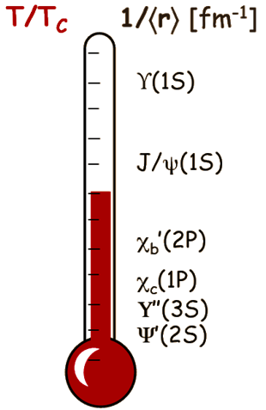
Quarkonia in the sQGP
Debye screening of heavy quark potential
→ Quarkonia are expected to dissociate
T. Matsui, H. Satz, Phys.Lett. B178, 416 (1986)
Sequential melting: Different states
dissociate at different temperatures
Á. Mócsy, P. Petreczky, Phys. Rev. D77, 014501 (2008)
_
Charmonia (cc):
J/Ψ, Ψ’, χ_{c}
Bottomonia (bb):
ϒ(1S), ϒ(2S), ϒ(3S),χ_{B}
_
Quarkonia may serve as sQGP thermometer

Slide 4
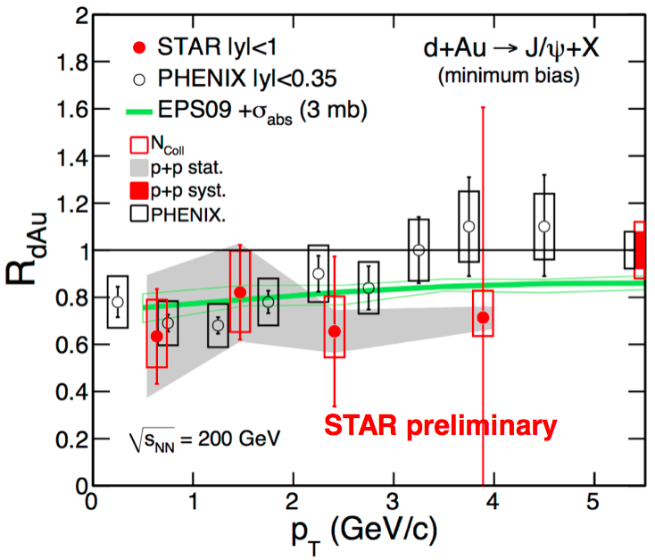
Lessons from J/ψ
Cold nuclear matter effects
  Nuclear shadowing
  (PDF modification in the nucleus)
  Initial state energy loss
  Co-mover absorption

Slide 5
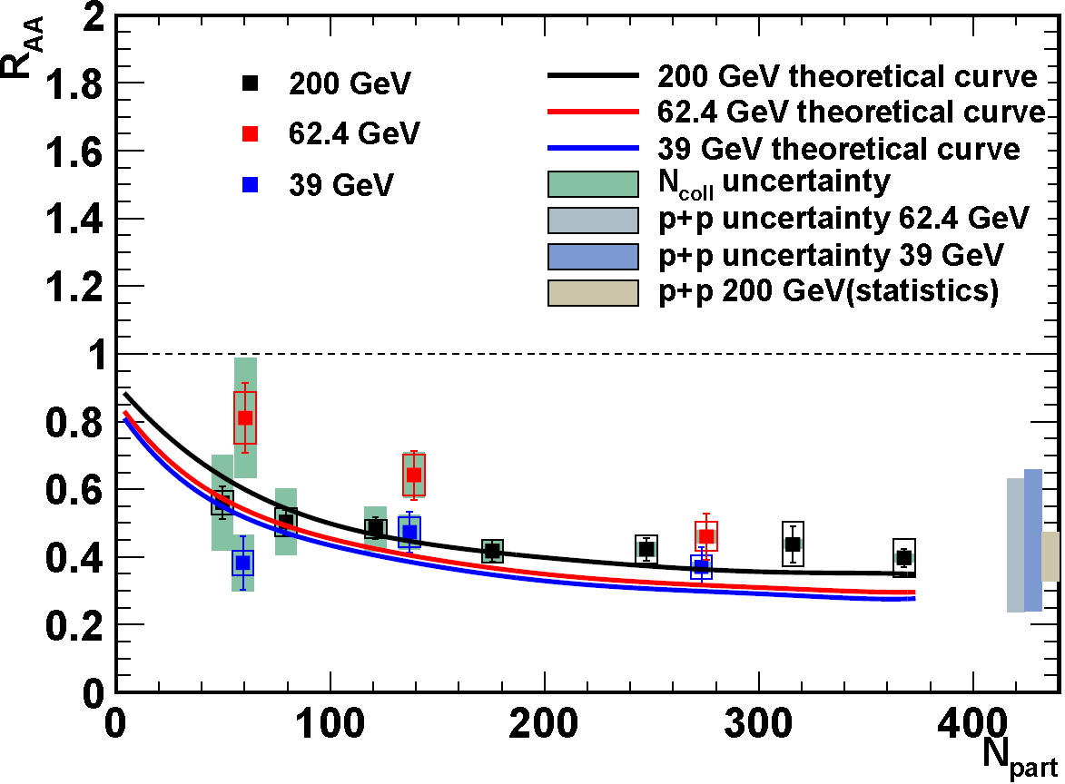
Lessons from J/ψ
Cold nuclear matter effects
  Nuclear shadowing
  (PDF modification in the nucleus)
  Initial state energy loss
  Co-mover absorption
Hot/dense medium effects
  Coalescence of uncorrelated
  charm and bottom pairs.
Au+Au
STAR preliminary

Slide 6
Lessons from J/ψ
Cold nuclear matter effects
  Nuclear shadowing
  (PDF modification in the nucleus)
  Initial state energy loss
  Co-mover absorption
Hot/dense medium effects
  Coalescence of uncorrelated
  charm and bottom pairs.
Feed-down
  χ_{c}, ψ’, B-meson decay to J/ψ
Au+Au
STAR preliminary

Slide 7
Lessons from J/ψ
Cold nuclear matter effects
  Nuclear shadowing
  (PDF modification in the nucleus)
  Initial state energy loss
  Co-mover absorption
Hot/dense medium effects
  Coalescence of uncorrelated
  charm and bottom pairs.
Feed-down
  χ_{c}, ψ’, B-meson decay to J/ψ
Au+Au
STAR preliminary
Contribution of different effects is not well understood

Slide 8
○ measurements at RHIC
○ co-mover absorption is negligible at RHIC energies
  ○(1S) is tightly bound, larger kinematic threshold.
  5-10 times smaller than for J/ψ (σ~0.2 mb)
  Lin & Ko, PLB 503 (2001) 104
○ recombination → negligible at RHIC:
  σ_{cc} ~800 μb >> σ_{bb} ~ (1-2) μb
○ excited states: test sequential suppression

Slide 9
○ measurements at RHIC
○ co-mover absorption is negligible at RHIC energies
  ○(1S) is tightly bound, larger kinematic threshold.
  5-10 times smaller than for J/ψ (σ~0.2 mb)
  Lin & Ko, PLB 503 (2001) 104
○ recombination → negligible at RHIC:
  σ_{cc} ~800 μb >> σ_{bb} ~ (1-2) μb
○ excited states: test sequential suppression
  ○ measurements : a challenge
  Low production rate
  Large acceptance, specific trigger needed
  Feed-down still present: χ_{b}, ϒ(2S), ϒ(3S) to ϒ(1S) …
○ states provide a cleaner probe at RHIC

Slide 10
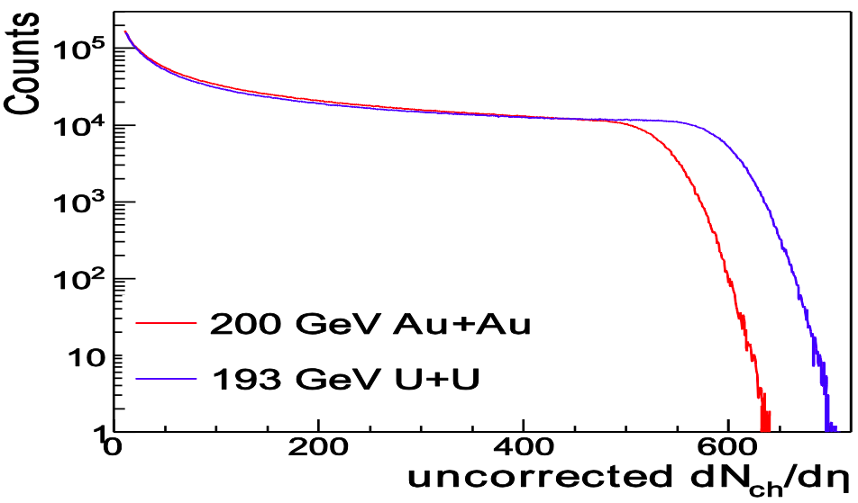
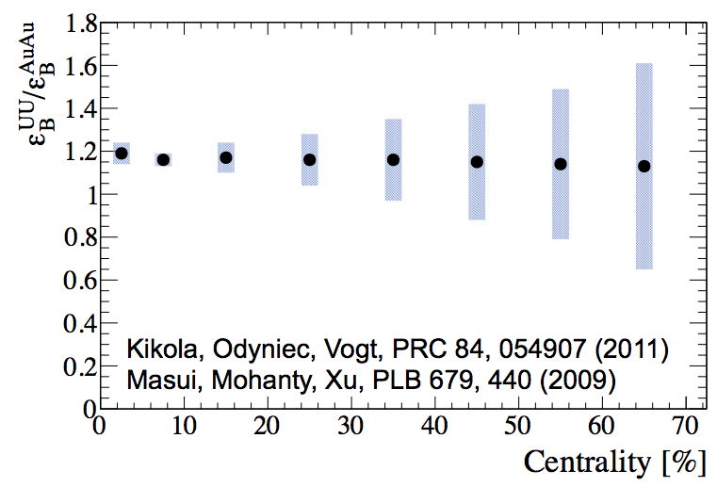
U+U: Higher energy densities
STAR preliminary
RHIC √s_{NN}=193 GeV U+U data (2012)
Reach higher N_{part} than in Au+Au
Provide higher energy density:
~20% more in central collisions!
Further test of dissociation-coalescence interplay

Slide 11
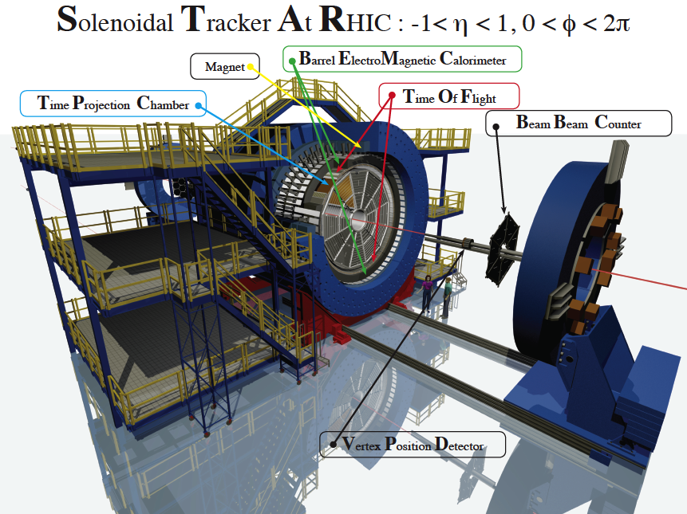
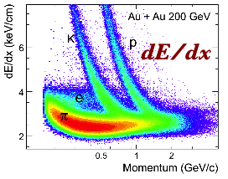
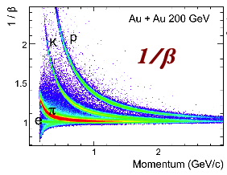
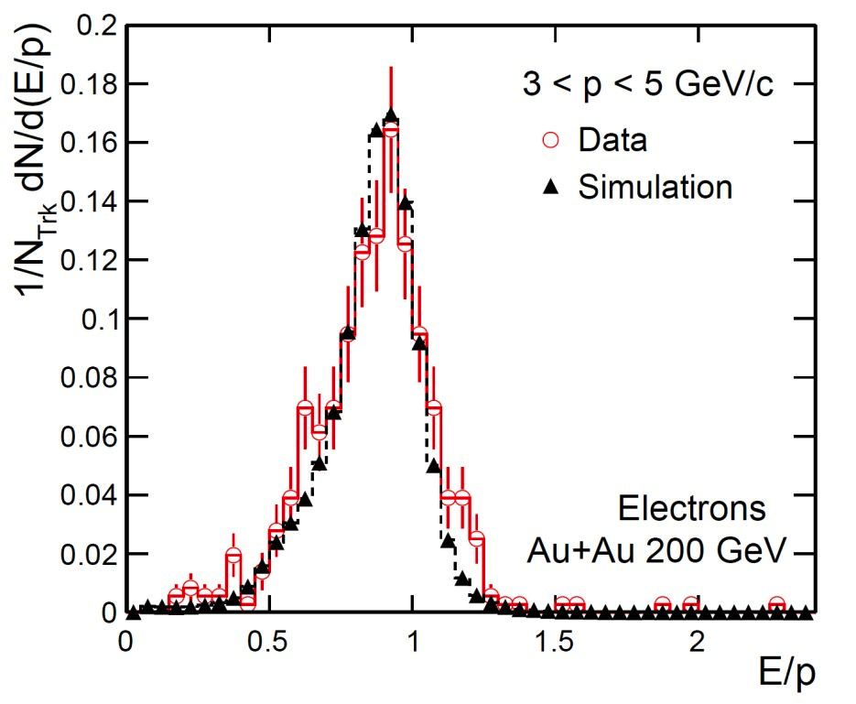
RHIC/STAR
Reconstruction:
  J/ψ → e⁺e– (B_{ee} ~ 6%)
  ϒ → e⁺e– (B_{ee} ~ 2.4%)
TPC
  dE/dx PID
  Large acceptance,
  uniform in a wide
  energy range
TOF
  PID using flight time
BEMC
  High-p_{T} trigger
  PID using E/p
  and shower shape
VPD
  Minimum
  bias events
TPC
E/p
TOF
BEMC
Notes:
11

Slide 12
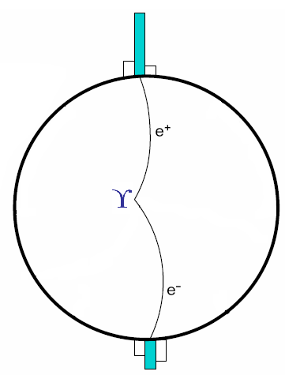
1. Triggering on ϒ events
L0,L2
1. Trigger on energetic hits in the BEMC
L2
L0: ‘High tower trigger’ saves events with a high energy hit
in a Barrel Electromagnetic Calorimeter (BEMC) tower
L2 in p+p and d+Au only – software trigger:
coarse reconstruction of cluster energy, opening angle, invariant mass

Slide 13
2. Finding electron tracks
1. Trigger on energetic hits in the BEMC
2. Find electron tracks in the TPC
Find tracks in the Time Projection Chamber (TPC)
based on specific energy loss dE/dx
-1.2<nσ_{e}<3 (A+A analyses)

Slide 14
3. Matching tracks
1. Trigger on energetic hits in the BEMC
2. Find electron tracks in the TPC
3. Match BEMC clusters
and TPC tracks
Clusterize energy deposit in the BEMC
Cluster: 3 adjacent towers with most of the energy deposit
Project TPC tracks onto clusters to match them
ΔR_{match} = √(Δη²+Δφ²) < 0.04

Slide 15
4. ID in the calorimeter
1. Trigger on energetic hits in the BEMC
2. Find electron tracks in the TPC
3. Match BEMC clusters
and TPC tracks
4. ID cuts in the BEMC
Cluster energy matches track momentum
0.75 < E/(pc) < 1.4 (U+U analysis)
Energy deposit is compact, mostly in a single tower
triggered e±: E_{tower}/E>0.7, associated e±: E_{tower}/E>0.5 (U+U analysis)

Slide 16
STAR ○ measurements – summary
Phys.Lett. B735 (2014) 127
  p+p @ 200 GeV
  p+p @ 500 GeV
    pQCD benchmark
    Reference for A+A

Slide 17
STAR ○ measurements – summary
Phys.Lett. B735 (2014) 127
  p+p @ 200 GeV
  p+p @ 500 GeV
    pQCD benchmark
    Reference for A+A
  d+Au @ 200 GeV
    CNM effects
Phys.Lett. B735 (2014) 127

Slide 18
STAR ○ measurements – summary
Phys.Lett. B735 (2014) 127
  p+p @ 200 GeV
  p+p @ 500 GeV
    pQCD benchmark
    Reference for A+A
  d+Au @ 200 GeV
    CNM effects
  Au+Au
    Hot nuclear matter effects
    Sequential suppression
Phys.Lett. B735 (2014) 127
Phys.Lett. B735 (2014) 127

Slide 19
STAR ○ measurements – summary
Phys.Lett. B735 (2014) 127
  p+p @ 200 GeV
  p+p @ 500 GeV
    pQCD benchmark
    Reference for A+A
  d+Au @ 200 GeV
    CNM effects
  Au+Au
    Hot nuclear matter effects
    Sequential suppression
  U+U
    Further tests of sequential melting
    N_{part} dependence
Phys.Lett. B735 (2014) 127
Phys.Lett. B735 (2014) 127
U+U √s_{NN}=193 GeV 0-60%
STAR preliminary
STAR preliminary

Slide 20
ϒ in p+p – baseline
p+p ϒ cross section vs. y, compared to pQCD predictions
R. Vogt, Phys. Rep. 462125, 2008
Phys.Lett. B735 (2014) 127
ϒ in p+p 200 GeV, |y|<0.5, L0 & L2
∫L dt = 20.0 pb⁻¹ N_{ϒ}(total)= 152 ± 23 (stat. + fit)

Slide 21
ϒ in p+p – baseline and pQCD test
p+p ϒ cross section vs. y, compared to pQCD predictions
R. Vogt, Phys. Rep. 462125, 2008
Phys.Lett. B735 (2014) 127
STAR Preliminary
p+p ϒ cross section, compared to world data trend

Slide 22
ϒ R_{dAu} – CNM effects
Indication of suppression at mid-rapidity beyond models
Phys.Lett. B735 (2014) 127
ϒ in d+Au 200 GeV, |y|<0.5, L0 & L2
∫L dt = 28.1 nb⁻¹ N_{ϒ}(total)= 46 ± 13 (stat. + fit) R_{dAu} = 0.48 ± 0.14(stat) ± 0.07(syst) ± 0.02(pp stat) ± 0.06(pp syst)

Slide 23
ϒ R_{dAu} – CNM effects
Indication of suppression at mid-rapidity beyond models
Phys.Lett. B735 (2014) 127
Phys.Lett. B735 (2014) 127
STAR data consistent with E772 despite difference in energy

Slide 24
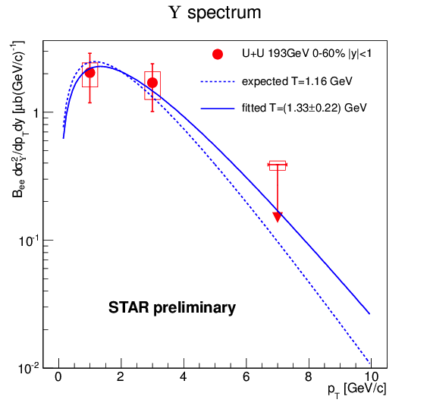

ϒ x-section and p_{T}-spectrum in U+U
ϒ cross section (STAR preliminary)
U+U 193 GeV, 0-60% centrality stat. syst
“expected” line:
T: interpolation of pp (pp) results
from ISR, CDF and CMS
_
PLB91, 481 (1980).
PRL88, 161802 (2002).
PRD83, 112004 (2011)

Slide 25
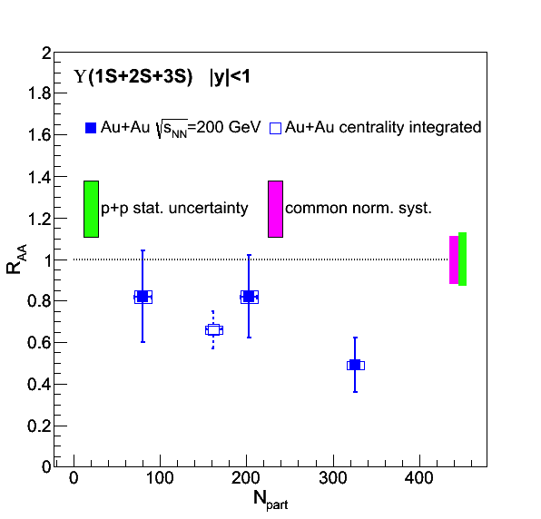
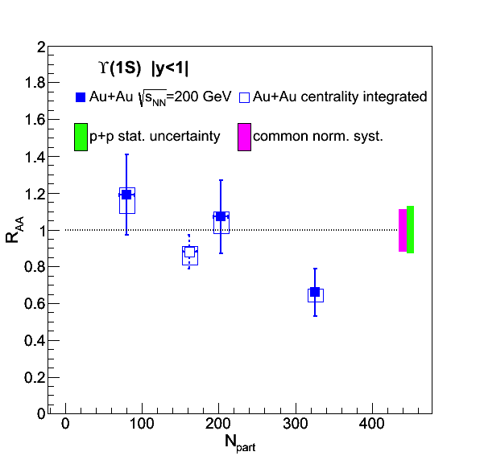
R_{AA} : ϒ(1S+2S+3S) and ϒ(1S)
Au+Au: Phys.Lett. B735 (2014) 127
Phys.Lett. B735 (2014) 127
Phys.Lett. B735 (2014) 127
Peripheral ○:
consistent with no suppression
Central ○:
significant suppression
Central ○(1S):
indication of a suppression

Slide 26
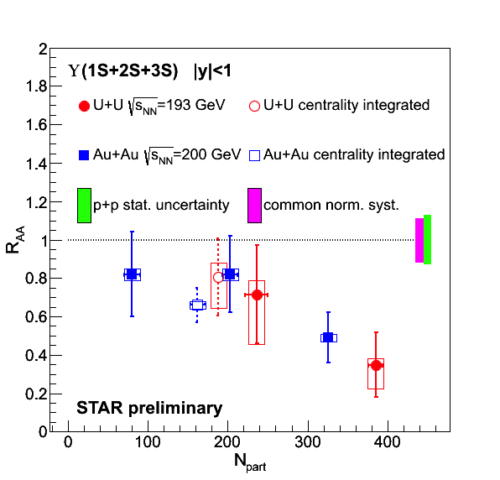
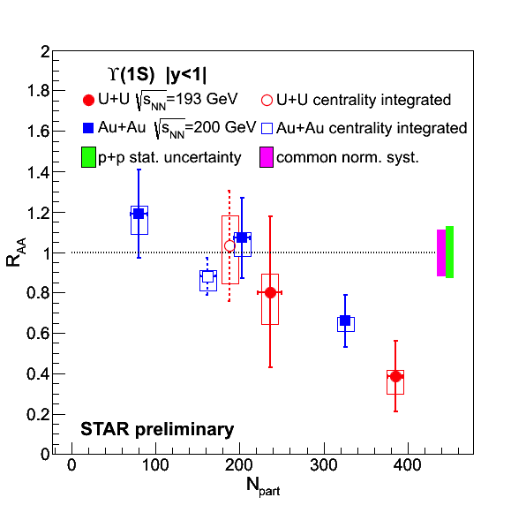
ϒ R_{AA} : Au+Au vs. U+U
Peripheral ○:
consistent with no suppression
Central ○:
significant suppression
Central ○(1S):
significant suppression
New U+U data confirms and extends Au+Au trend

Slide 27
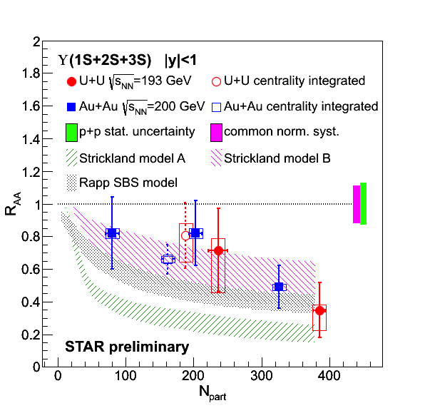
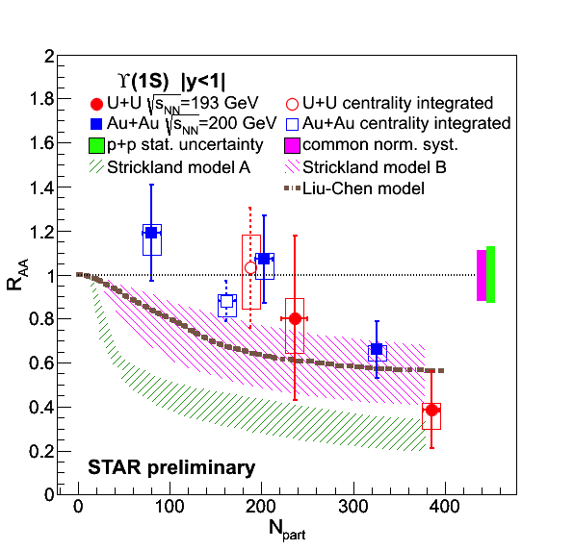
ϒ R_{AA} : data vs. models
Strickland, Bazov, Nucl.Phys.A 879, 25 (2012)
No CNM effects, 428<T<443 MeV
Potential model ‘B’ based on
heavy quark internal energy
Potential model ‘A’ based on
heavy quark free energy (disfavored)
Liu, Chen, Xu, Zhuang, Phys.Lett.B 697, 32 (2011)
Potential model, no CNM effects
T=340 MeV, only excited states dissociate
Emerick, Zhao, Rapp, Eur.Phys.J A48, 72 (2012)
CNM effects included
Strong binding scenario

Slide 28
ϒ R_{AA} : data vs. models
Suppression indicates ϒ melting in a deconfined medium
However: CNM effects have to be understood
→ RHIC 2015 p+Au run

Slide 29
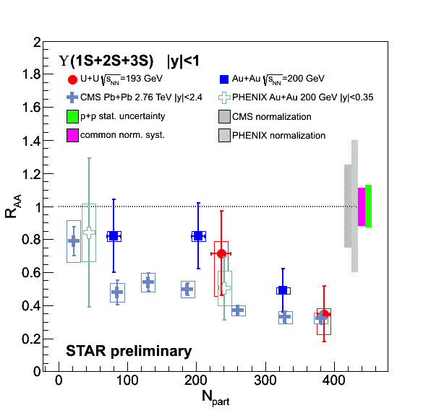
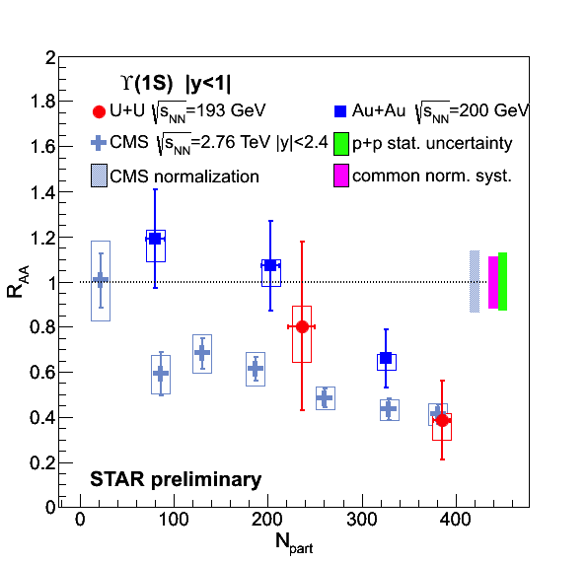
ϒ R_{AA} : RHIC & LHC comparison
PHENIX, Phys.Rev. C87 (2013)
CMS, Phys. Rev. Lett 109 (2012) 222301
LHC and RHIC suppressions are comparable at high N_{part}
N_{part} dependence of ϒ suppression appears weaker at the LHC
    Note the uncertainties, however
Is suppression driven by energy density?

Slide 30
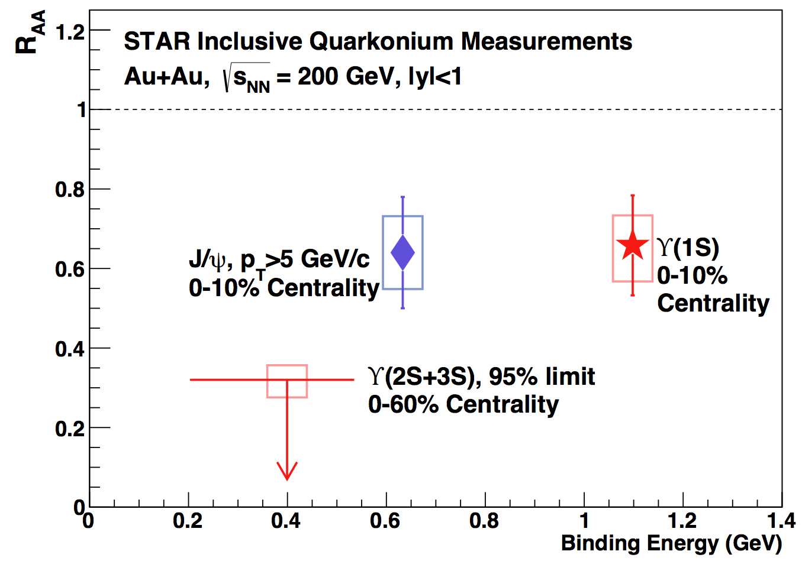
Excited ϒ states in Au+Au
Phys.Lett. B735 (2014) 127
Central Au+Au:
Excited states ϒ(2S) and ϒ(3S) consistent with complete melting
ϒ(1S) suppression is similar to high-p_{T} J/ψ
Au+Au

Slide 31
Excited ϒ states in Au+Au
Phys.Lett. B735 (2014) 127
Central Au+Au:
Excited states ϒ(2S) and ϒ(3S) consistent with complete melting
ϒ(1S) suppression is similar to high-p_{T} J/ψ
Au+Au
ϒ suppression pattern supports sequential melting

Slide 32
Excited ϒ states – LHC comparison
Phys.Lett. B735 (2014) 127
Au+Au
RHIC √s_{NN}=200 GeV Au+Au and
LHC √s_{NN}=2.76 TeV Pb+Pb collisions:
Similar suppression of central ϒ(1S)

Slide 33
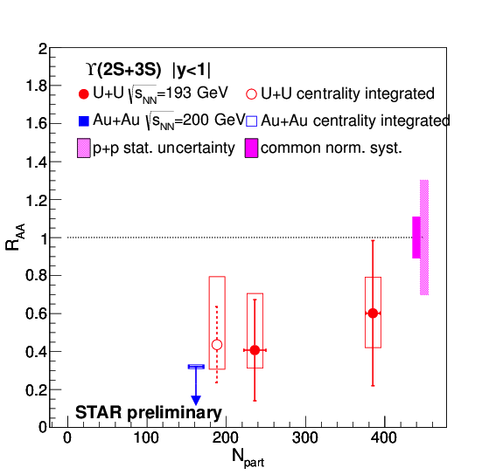
Excited ϒ states, U+U
U+U consistent with Au+Au limit, but…
0-60% centrality: R_{AA}(2S+3S)>0 at the 1.8σ level

Slide 34
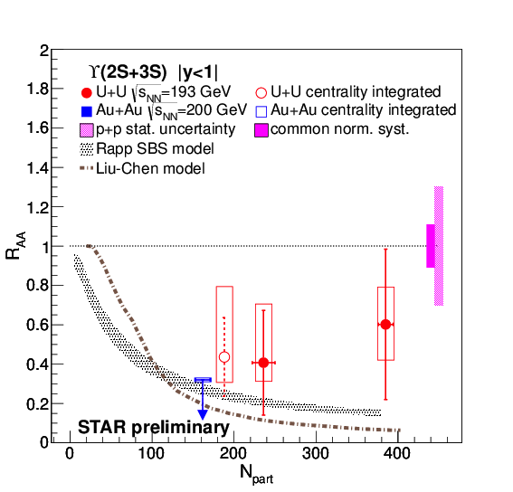
Excited ϒ states, comparison
U+U consistent with Au+Au limit, but…
0-60% centrality: R_{AA}(2S+3S)>0 at the 1.8σ level
Consistent with 2S model trend and LHC measurement
Is U+U different?

Slide 35
Summary
  CNM effects: ○ suppression in d+Au has to be understood
  Hot medium effects: Significant suppression of ○ states
  in central A+A collisions
    ○(1S) is similarly suppressed as high-p_{T} J/ψ
    ○(2S) and ○(3S) suppression is stronger than ○(1S)
    → clear signal of melting in a deconfined medium
    ○ suppression in most central collisions similar to LHC
  U+U measurements: extends the Au+Au observations
    Similar patterns in ○(1S) and ○(1S+2S+3S)
    Suppression of central ○(1S) confirmed
    Indication of ○(2S+3S) presence in 0-60% data (1.8σ effect)

Slide 36
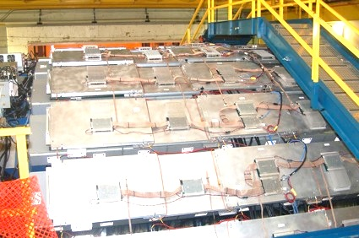
Outlook: Muon Telescope Detector
Outermost, gas detector
Physics goal: Precision measurement of heavy quarkonia through the muon channel
Acceptance:
45% in azimuth, |y|<0.5
R_{AA}
ϒ projection
<N_{part}>

Slide 37
Outlook: Muon Telescope Detector
Outermost, gas detector
Physics goal: Precision measurement of heavy quarkonia through the muon channel
Acceptance:
45% in azimuth, |y|<0.5
~13.8 nb⁻¹ Au+Au data from 2014 – being analyzed
R_{AA}
ϒ projection
<N_{part}>

Slide 38

Thank You!
AGH University of Science and Technology
Argonne National Laboratory, Argonne, Illinois 60439
Brookhaven National Laboratory, Upton, New York 11973
University of California, Berkeley, California 94720
University of California, Davis, California 95616
University of California, Los Angeles, California 90095
Universidade Estadual de Campinas, Sao Paulo 13131, Brazil
Central China Normal University (HZNU), Wuhan 430079, China
University of Illinois at Chicago, Chicago, Illinois 60607
Creighton University, Omaha, Nebraska 68178
Czech Technical University in Prague, FNSPE, Prague, 115 19, Czech Republic
Nuclear Physics Institute AS CR, 250 68 Rez/Prague, Czech Republic
Frankfurt Institute for Advanced Studies FIAS, Frankfurt 60438, Germany
Institute of Physics, Bhubaneswar 751005, India
Indian Institute of Technology, Mumbai 400076, India
Indiana University, Bloomington, Indiana 47408
Alikhanov Institute for Theoretical and Experimental Physics, Moscow 117218, Russia
University of Jammu, Jammu 180001, India
Joint Institute for Nuclear Research, Dubna, 141 980, Russia
Kent State University, Kent, Ohio 44242
University of Kentucky, Lexington, Kentucky, 40506-0055
Korea Institute of Science and Technology Information, Daejeon 305-701, Korea
Institute of Modern Physics, Lanzhou 730000, China
Lawrence Berkeley National Laboratory, Berkeley, California 94720
Massachusetts Institute of Technology, Cambridge, Massachusetts 02139-4307
Max-Planck-Institut fur Physik, Munich 80805, Germany
Michigan State University, East Lansing, Michigan 48824
Moscow Engineering Physics Institute, Moscow 115409, Russia
National Institute of Science Education and Research, Bhubaneswar 751005, India
Ohio State University, Columbus, Ohio 43210
Institute of Nuclear Physics PAN, Cracow 31-342, Poland
Panjab University, Chandigarh 160014, India
Pennsylvania State University, University Park, Pennsylvania 16802
Institute of High Energy Physics, Protvino 142281, Russia
Purdue University, West Lafayette, Indiana 47907
Pusan National University, Pusan 609735, Republic of Korea
University of Rajasthan, Jaipur 302004, India
Rice University, Houston, Texas 77251
University of Science and Technology of China, Hefei 230026, China
Shandong University, Jinan, Shandong 250100, China
Shanghai Institute of Applied Physics, Shanghai 201800, China
Temple University, Philadelphia, Pennsylvania 19122
Texas A&M University, College Station, Texas 77843
University of Texas, Austin, Texas 78712
University of Houston, Houston, Texas 77204
Tsinghua University, Beijing 100084, China
United States Naval Academy, Annapolis, Maryland, 21402
Valparaiso University, Valparaiso, Indiana 46383
Variable Energy Cyclotron Centre, Kolkata 700064, India
Warsaw University of Technology, Warsaw 00-661, Poland
University of Washington, Seattle, Washington 98195
Wayne State University, Detroit, Michigan 48201
World Laboratory for Cosmology and Particle Physics (WLCAPP), Cairo 11571, Egypt
Yale University, New Haven, Connecticut 06520
University of Zagreb, Zagreb, HR-10002, Croatia
STAR Collaboration

Slide 39
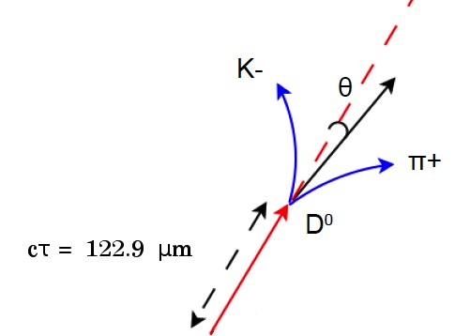
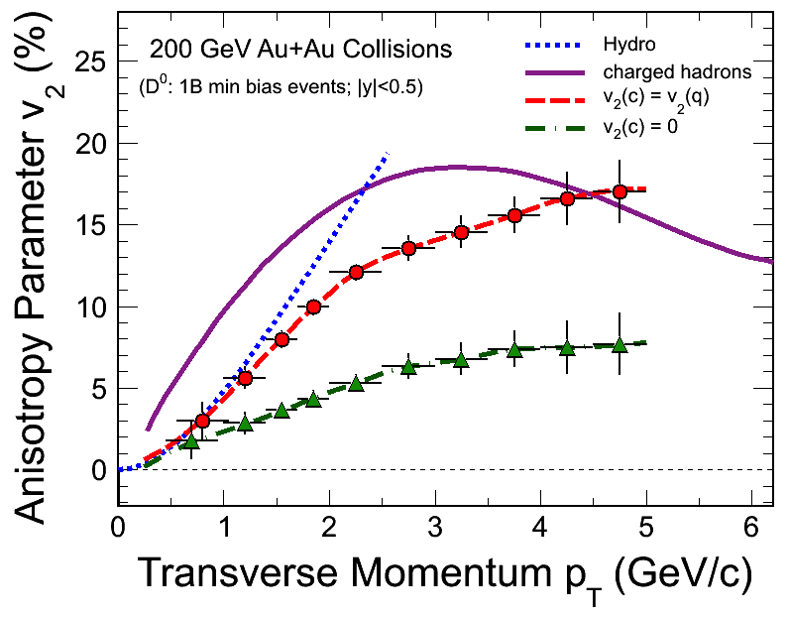
Outlook: Heavy Flavor Tracker
Innermost, silicon detectors (3 subsystems)
Resolves secondary vertex
Physics goal: Precision measurement of heavy quark production
Complete and taking data in Run14
IST at 14 cm
PXL at 2.9 and 8.2 cm
D⁰ v₂ projection
SSD at 22 cm

Slide 40
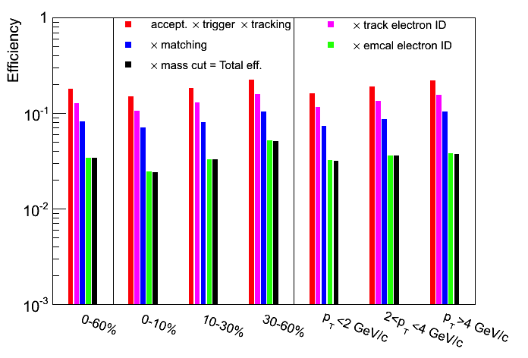
U+U acceptance and efficiency
    15M high-tower-triggered U+U 193 GeV events (263 μb⁻¹)
    Divided into 3
    centrality bins:
      0 – 10 %
      10 – 30 %
      30 – 60 %
    or… 3 bins in p_{T}^{ϒ}:
      0 – 2 GeV/c
      2 – 4 GeV/c
      4< GeV/c
    Total acceptance & efficiency for ϒ→ e⁺e– reconstruction:
    ~ 2-3%
STAR preliminary

Slide 41
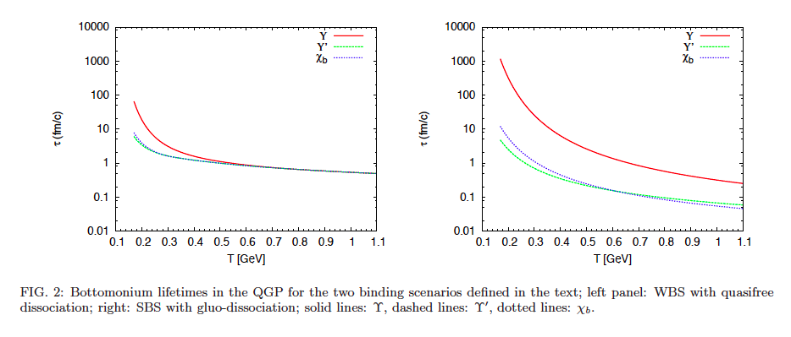
Rapp WBS & SBS
Emerick, Zhao, Rapp, Eur. Phys. J A48, 72 (2012)

Slide 42
ϒ x-section and p_{T}-spectrum in U+U
ϒ cross section (STAR preliminary)
U+U 193 GeV, 0-60% centrality stat. syst
Major systematic uncertainties (%) (STAR preliminary)
Geometrical acceptance | +1.7 -3.0
Trigger efficiency | +1.1 -3.6
Tracking efficiency | 11.8
TPC electron identification | +4.0 -6.4
TPC-BEMC matching | 5.4
BEMC electron identification | 5.9
Embedding p_{T} and y shapes | 2.1
Signal extraction | +4.8 -18
Expected T is extrapolated
from ISR, CDF and CMS
pp (pp) results
PLB91, 481 (1980).
PRL88, 161802 (2002).
PRD83, 112004 (2011)
_

