Slide 1
Heavy Flavor Results from STAR
Wei Xie for STAR Collaboration
(PURDUE University, West Lafayette)
Motivation
Open Heavy Flavor Production
D meson direct measurement
Non-photonic electron
Heavy Quarkonia Production
J/ψ
Upsilon
Heavy Flavor v₂
Summary and future perspective

Slide 2
Motivation for Studying Heavy Quarks
Sensitive to initial gluon density and gluon distribution at RHIC.
produced mostly from gluon fusion
Involve different interaction mechanisms from light quarks with the medium
gluon bremsstrahlung radiation
collisional energy loss
collision dissociation
Ads/CFT
Heavy quarkonia production reveals critical features of the medium.
suppression from color screening or gluon scattering
enhancement from coalescence
Cold Nuclear effect.
Gluon shadowing , Color glass condensate, Initial state Energy loss, etc

Slide 3
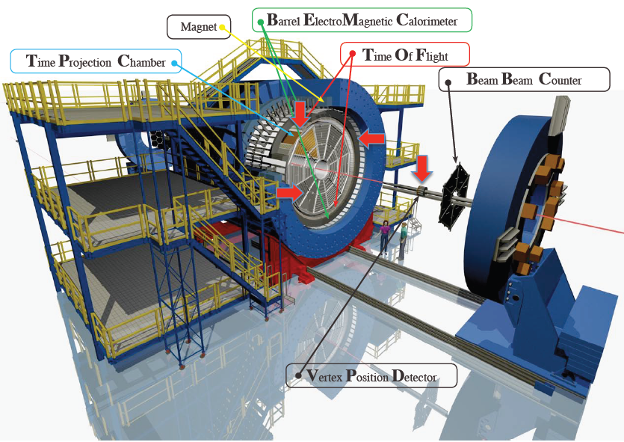
The (major) STAR Detector for Heavy Flavor Measurements
Time Projection Chamber:
$\left|η\right|≤1.0$, full azimuth
Tracking.
PID through dE/dx
Barrel Electromagnetic Calorimeter
$\left|η\right|≤1.0$, full azimuth
BTOW:
Tower: $∆φ×∆η=0.05×0.05$
p/E for electron ID
Fast online trigger
BSMD:
Double layer High spatial resolution MWPC.
$∆φ×∆η=0.0064×0.1$
$∆φ×∆η=0.1×0.0064$
e/h separation.
Time of Flight:
$\left|η\right|≤0.9$, full azimuth .
PID through TOF
Timing resolution: ~85 ps.

Slide 4
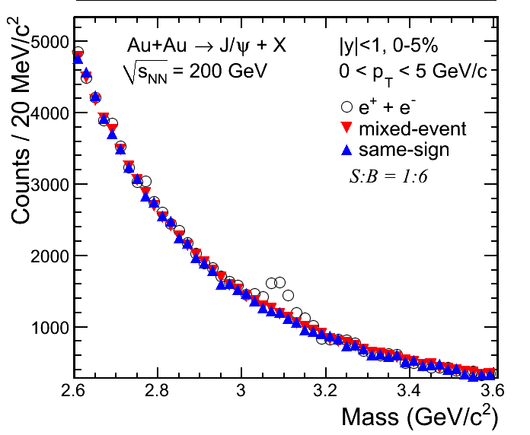
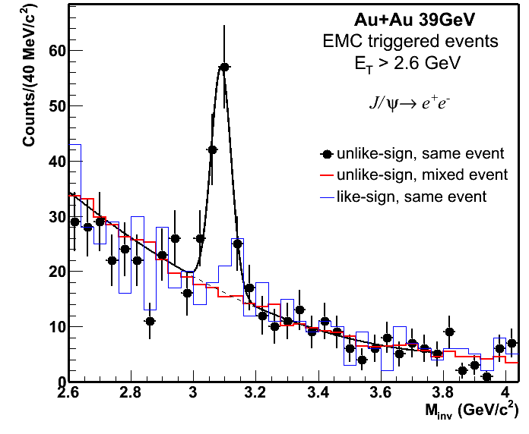
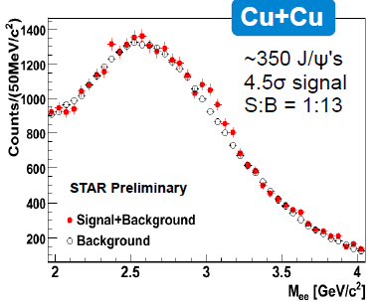
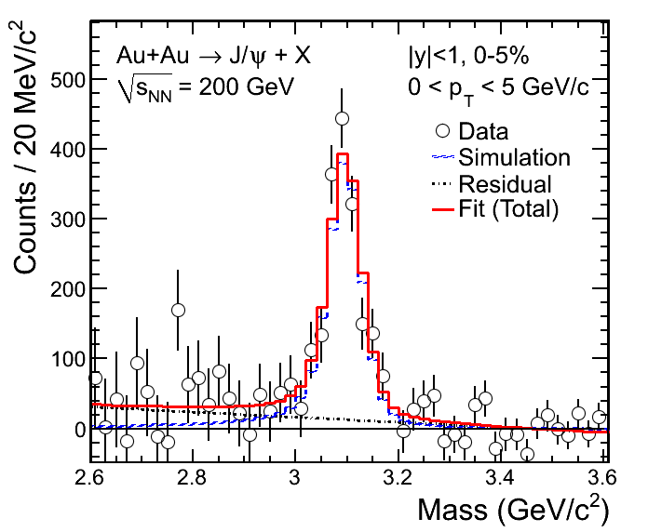
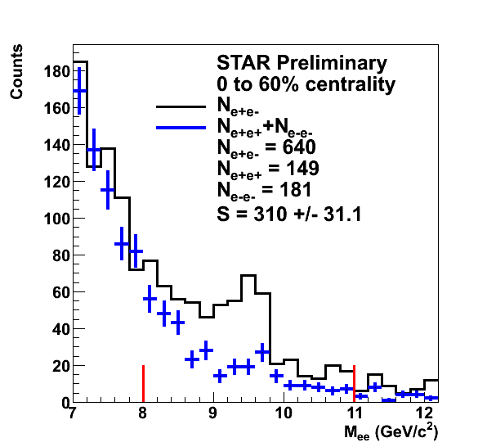
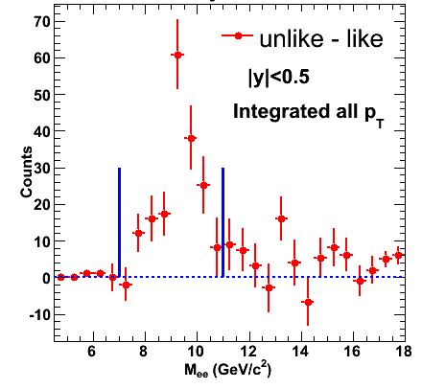
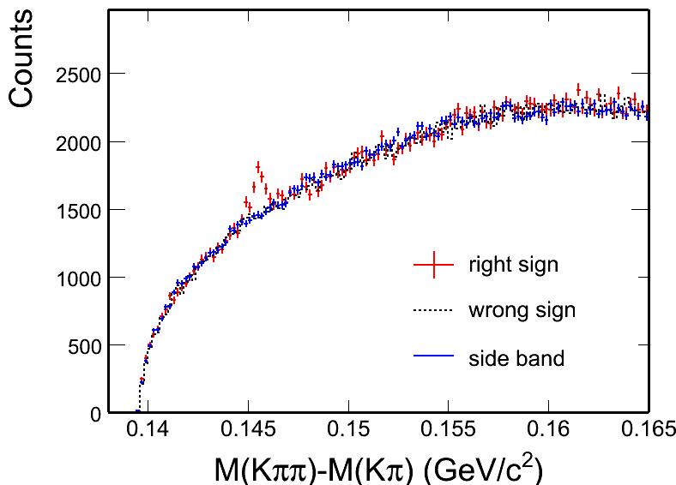
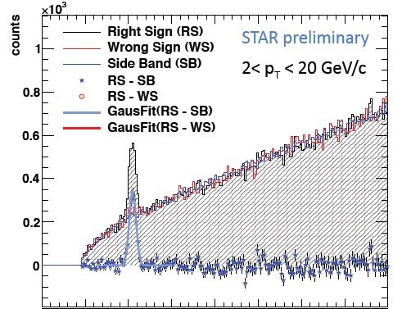
Signals Observed in STAR
STAR Preliminary
STAR can measure heavy flavor
of all different kind
(J/ψ, D⁰, D*, electron …)
in broad p_{T} range.
in all collision species.
d+Au
STAR Preliminary
Au+Au
D* p+p 200 GeV
D⁰ Au+Au 200 GeV
forward J/ψ
D* p+p 500 GeV

Slide 5
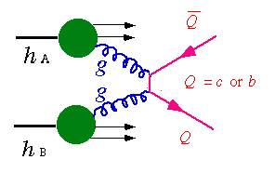
Open Heavy Flavor Production
K⁺
e⁻/μ⁻
D⁰
ν_{l}
Non-photonic electron
K⁻
π⁺
D⁰

Slide 6
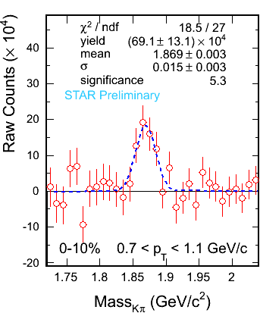
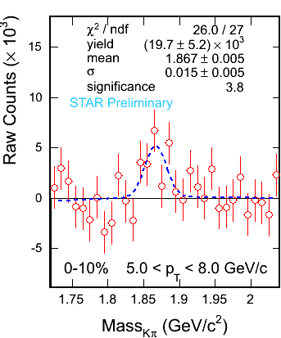
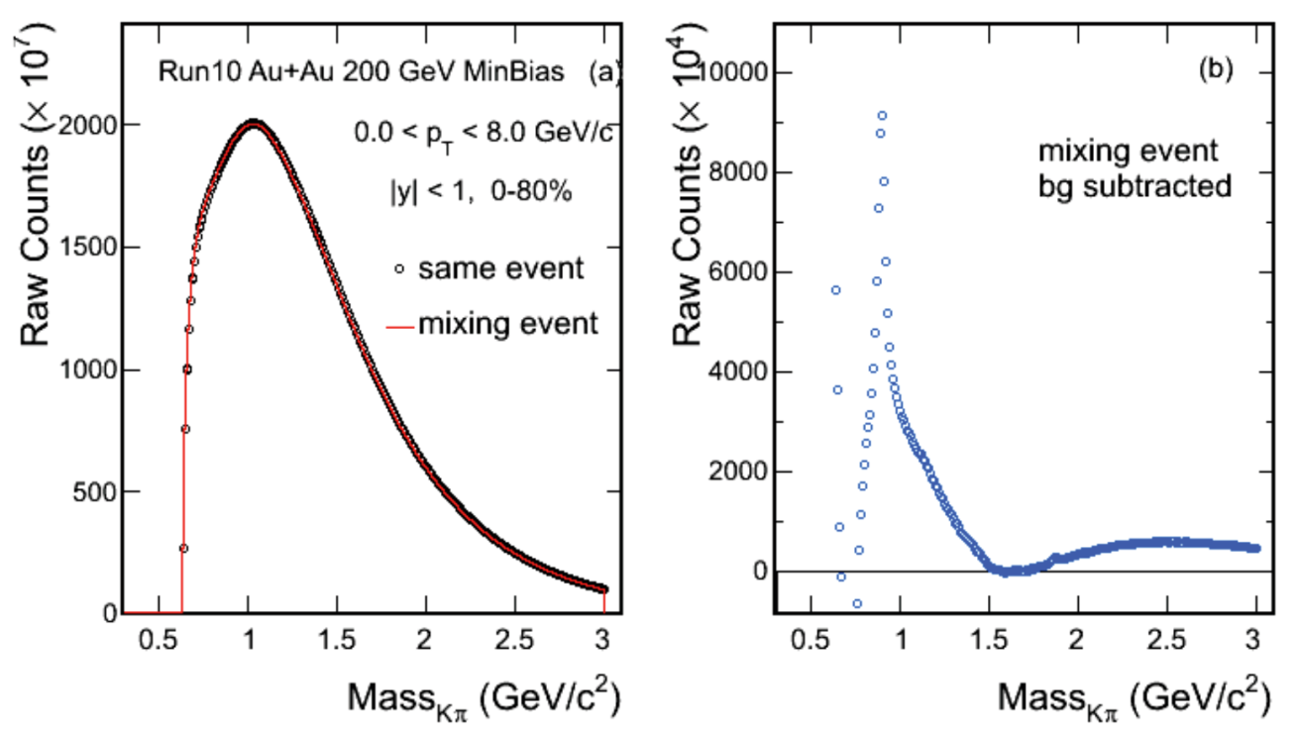
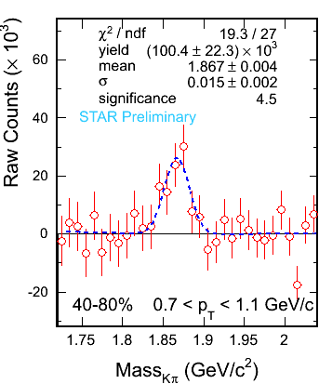
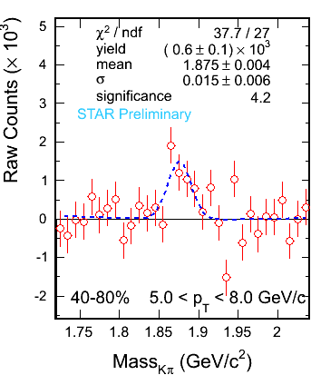
D⁰ Signal in Au+Au 200 GeV
Combining data from Run2010 & 2011.
Total: ~800 M Min.Bias events
Significant signals are observed
In collisions of all centralities
D. Tlusty: Parallel 6A

Slide 7
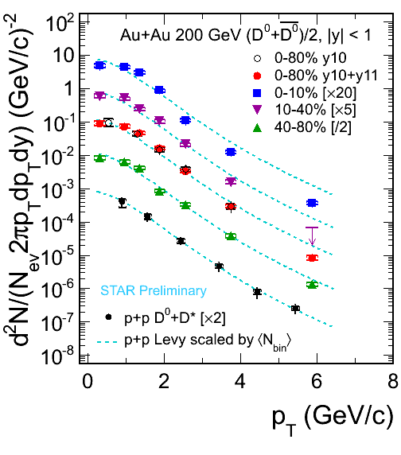
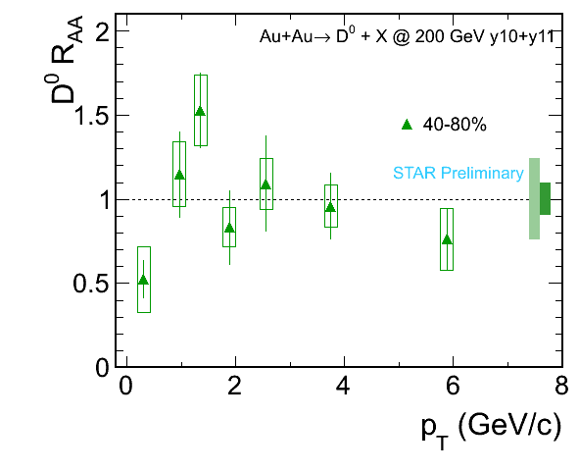
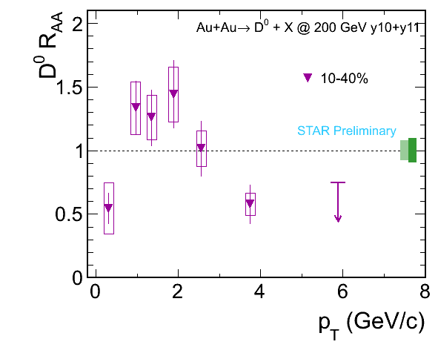
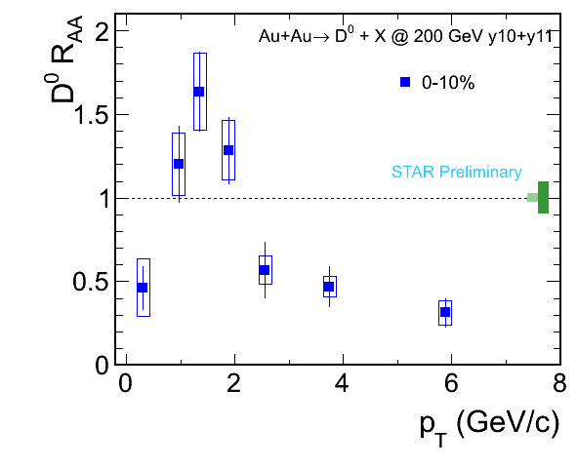
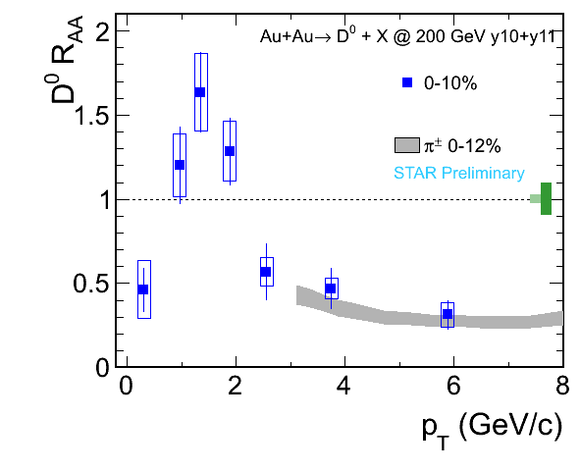
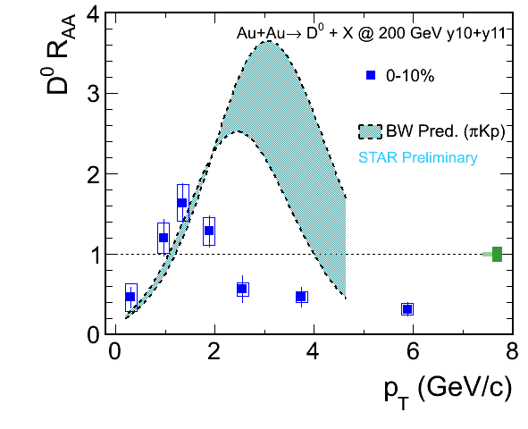
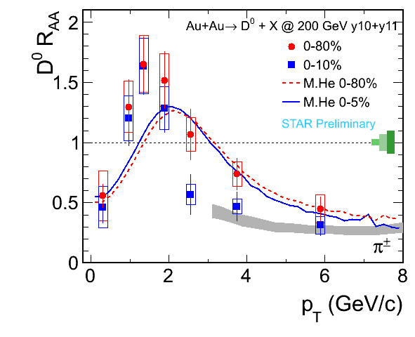
D⁰ Spectra in Au+Au 200 GeV
He,Fries,Rapp: PRC86,014903; arXiv:1204.4442; private comm.
Suppression at high p_{T} in central and mid-central collisions
Enhancement at intermediate p_{T}.
D0 freeze out earlier than light hadron and/or
D0 does not have much radial flow as light quarks

Slide 8
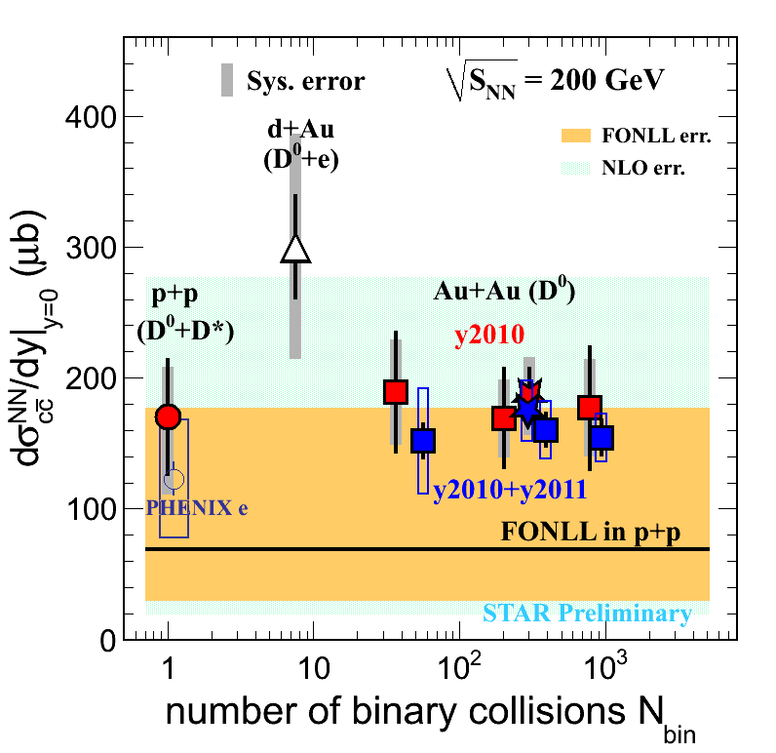
Charm cross section vs N_{coll} in Au+Au 200 GeV
Run2003 d+Au : D⁰ + e
Run2009 p+p : D⁰ + D*
Run 2010 & 2011 Au+Au: D⁰
Assuming N_{D0} / N_{cc} = 0.56 does not change for total cross sections.
The charm cross section at mid-rapidity:
The charm total cross section :
$σ_{c\overline{c}} (p+p)= 797±210 \left(stat.\right){}_{−295}^{+208}{ (sys)} μ$b
${ σ}_{c\overline{c}} \left(AuAu\right)=822±62 \left(stat.\right)±192 μ$b
$\frac{dσ}{dy}$|${}_{y=0}^{c\overline{c}}{ (p+p) =}170±45 (stat.){}_{−59}^{+38}{ \left(sys.\right) μ}b$
$\frac{dσ}{dy}$|${}_{y=0}^{c\overline{c}}{ (AuAu) =}175±13 \left(stat.\right)±23 (sys) μb$
[1] STAR d+Au: J. Adams, et al., PRL 94 (2005) 62301
[2] FONLL: M. Cacciari, PRL 95 (2005) 122001.
[3] NLO: R. Vogt, Eur.Phys.J.ST 155 (2008) 213
[4] PHENIX e: A. Adare, et al., PRL 97 (2006) 252002.
Charm quarks are mostly produced via initial hard scatterings.
Quantify other sources of production via high luminosity and upgrade.

Slide 9
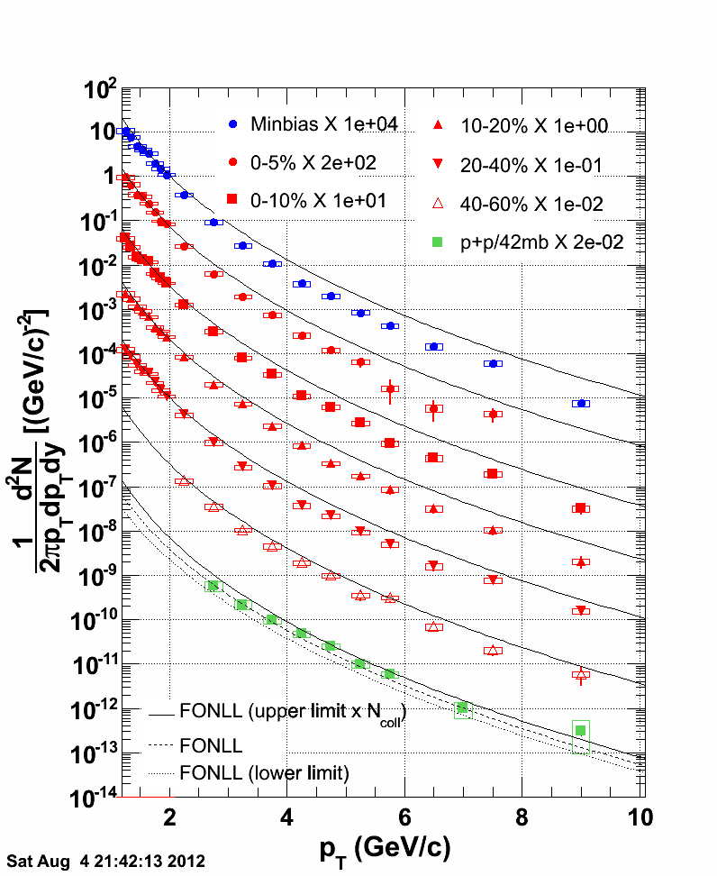
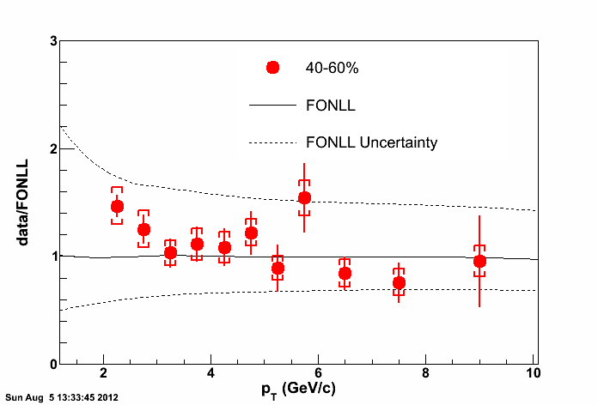
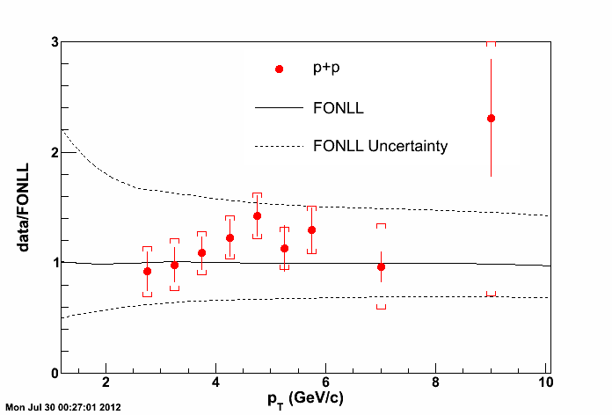
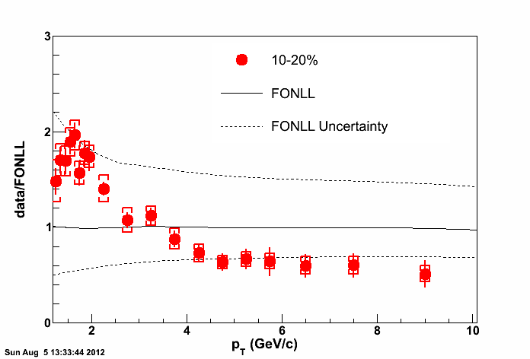
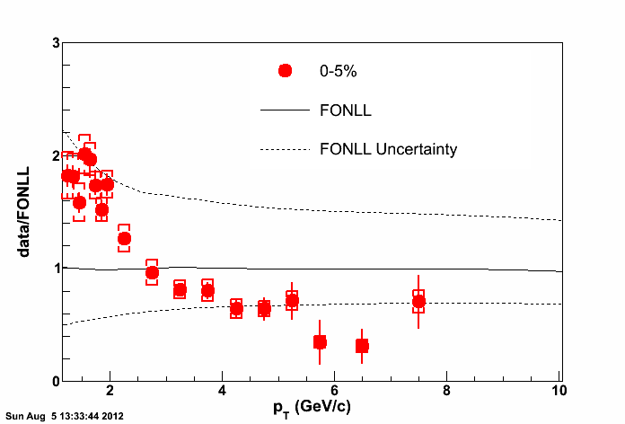
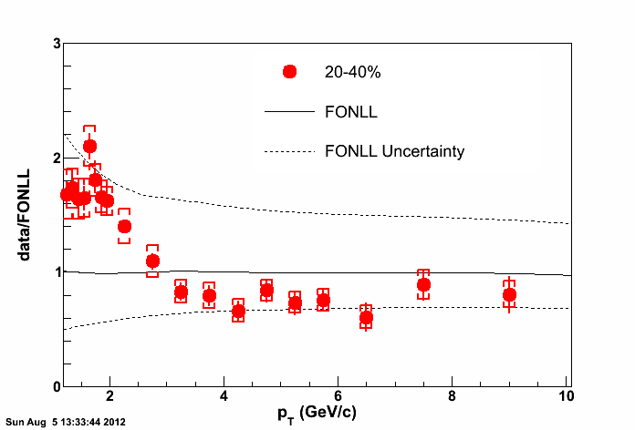
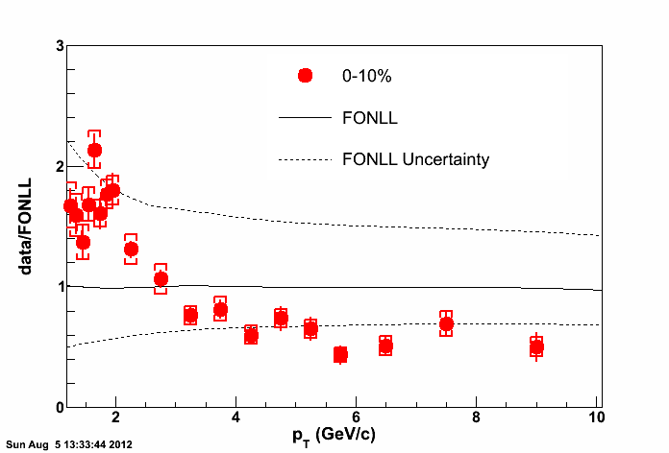
Non-photonic Electron Spectra in Au+Au 200 GeV
~1 nb⁻¹ sampled luminosity in Run2010 Au+Au collisions.
~6 pb⁻¹ sampled luminosity in Run2005 and Run2008 p+p collisions.
M. Mustafa: Parallel 7A

Slide 10
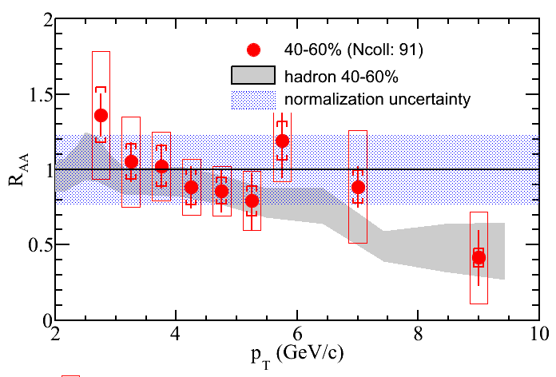
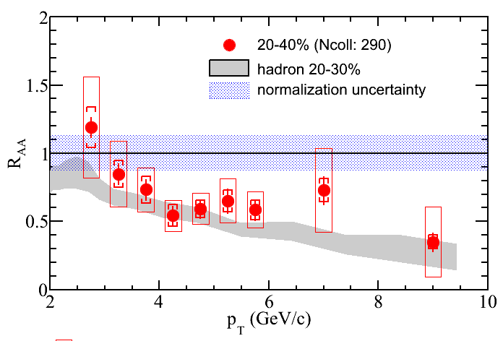
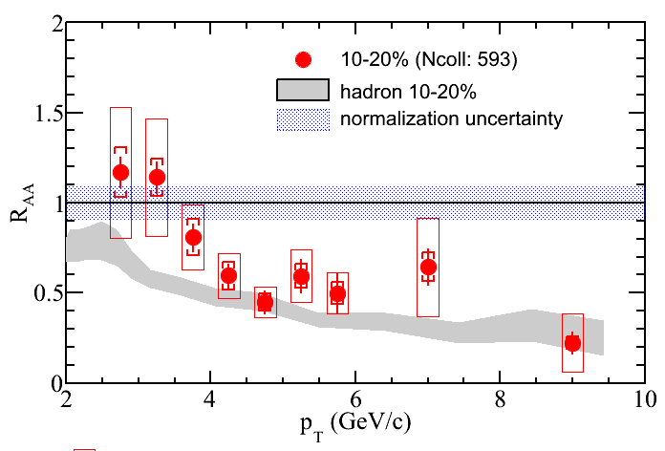
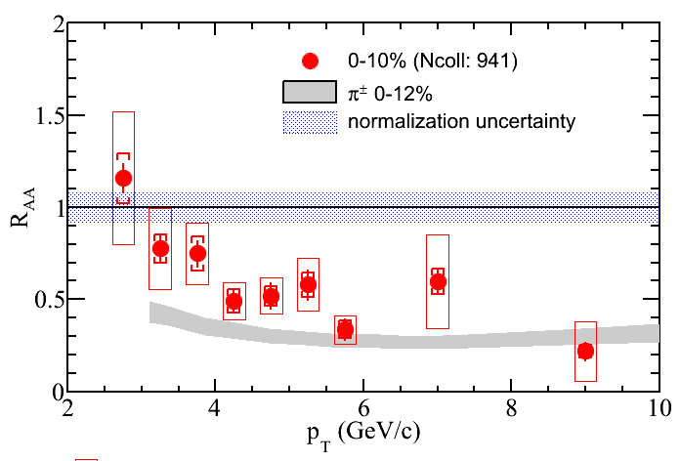
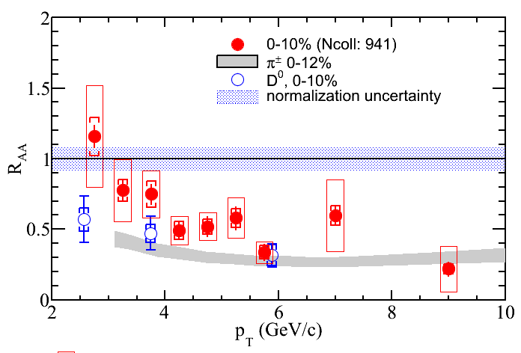
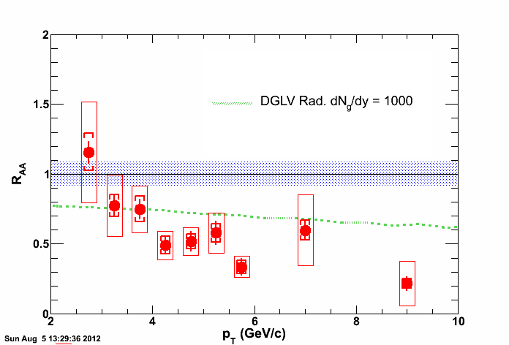
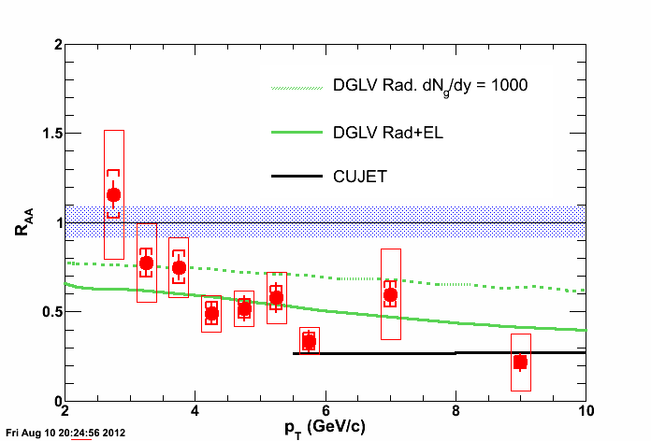
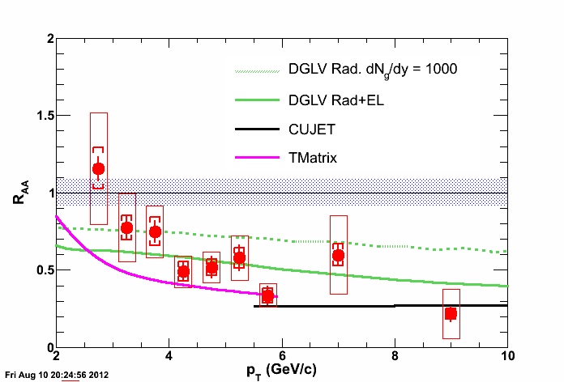
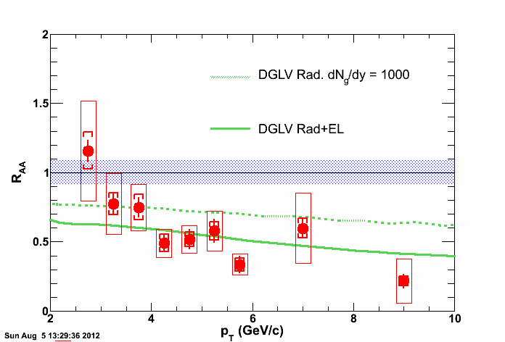
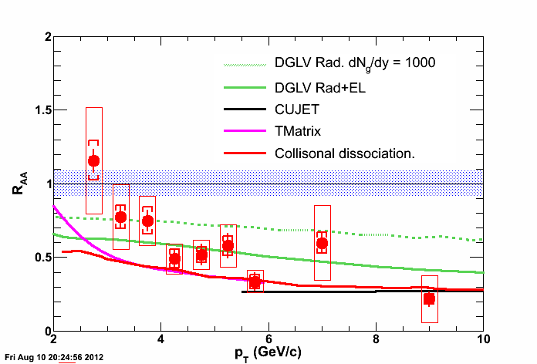
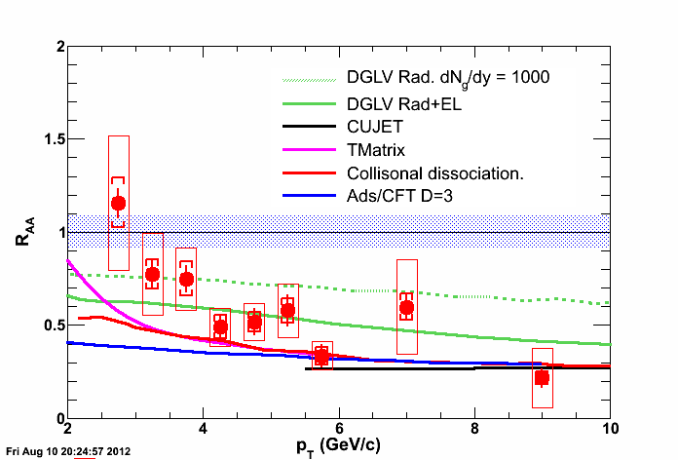
Non-photonic Electron R_{AA} in Au+Au 200 GeV
Strong suppression at high p_{T} in central collisions
D0, NPE results seems to be consistent → kinematics smearing & charm/bottom mixing
Models with radiative energy loss alone underestimate the suppression
Uncertainty dominated by p+p result.
Compare with Au+Au spectra directly, if possible.
High quality p+p data from Run09 and Run12 are on disk.
DGLV: Djordjevic, PLB632, 81 (2006)
CUJET: Buzzatti, arXiv:1207.6020
T-Matrix: Van Hees et al., PRL100,192301(2008).
Coll. Dissoc. R. Sharma et al., PRC 80, 054902(2009).
Ads/CFT: W. Horowitz Ph.D thesis.

Slide 11
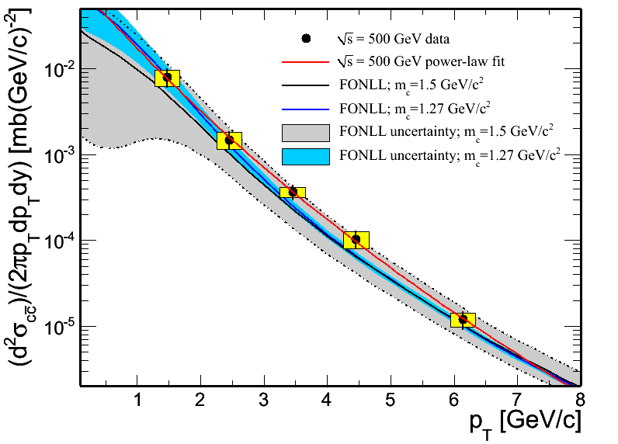
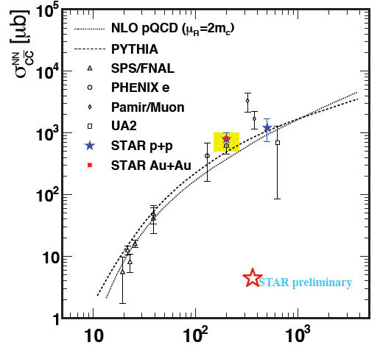
D mesons in 500 GeV p+p Collisions
FONLL: R. Vogt, private communication
Data are consistent with FONLL prediction within uncertainties.

Slide 12
Heavy Quarkonia Production
e⁻/μ⁻
e⁺/μ⁺

Slide 13
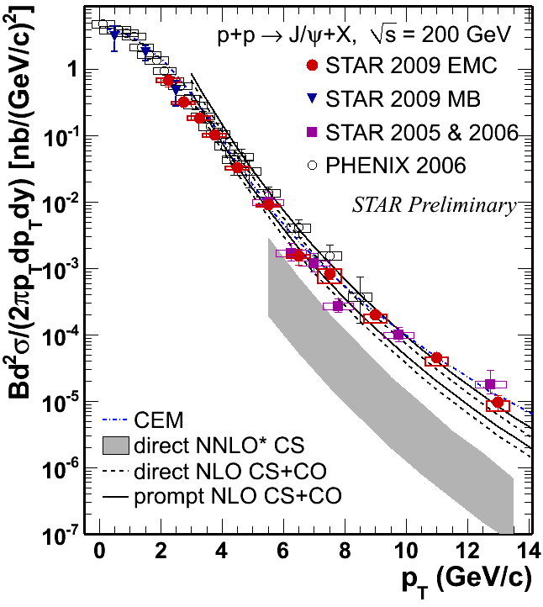
J/ψ Production in 200GeV p+p Collisions
Color singlet model (NNLO*CS):
P. Artoisenet et al., PRL. 101, 152001 (2008), and J.P. Lansberg private communication.
Include no feeddown from higher mass state.
LO CS+ color octet (CO):
Y.-Q. Ma, K. Wang, and K.-T. Chao, Phys. Rev. D84, 51 114001 (2011), and private communication
Agree with the data
Color Evaporation Model:
M. Bedjidian et al., hep-ph/0311048; R. Vogt private communication
Include feeddown from Xc and ψ’
Agree with the data
STAR: Phys. Rev. C80, 041902(R) (2009)
STAR: JPG 38, 124107 (2011)
PHENIX: Phys. Rev. D 82, 012001 (2010)
B. Trzeciak: Parallel 1D

Slide 14
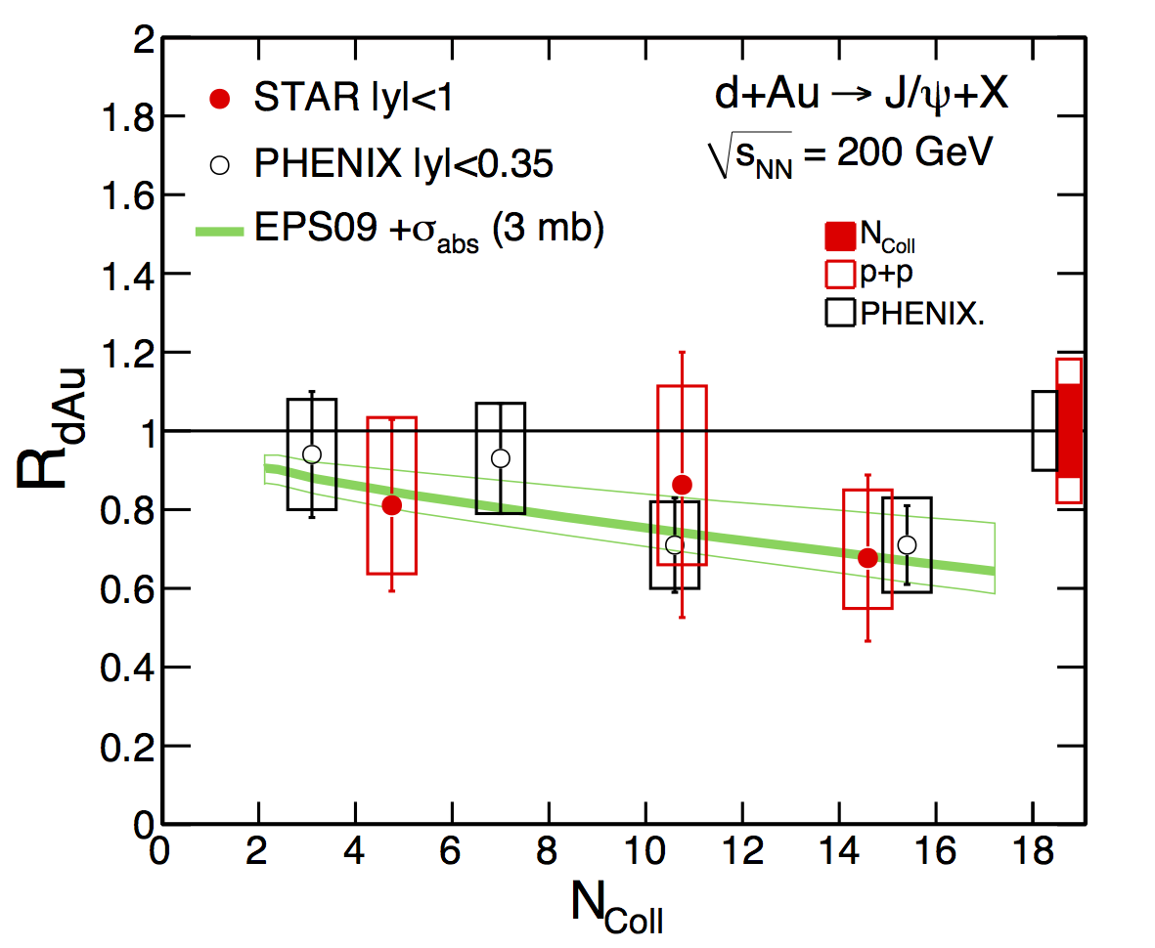
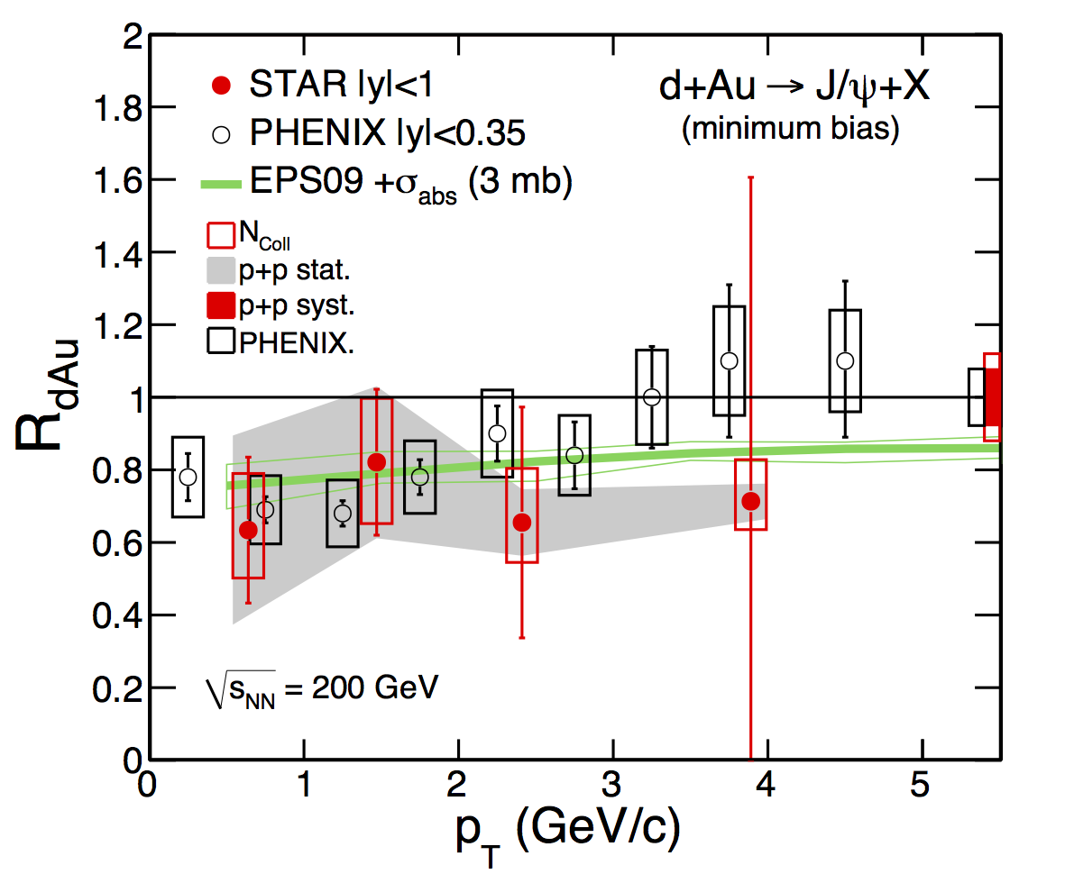
J/ψ R_{AA} in 200GeV d+Au Collisions
STAR and PHENIX results are consistent with each other
Nuclear absorption cross section ${σ_{abs}}_{}^{J/ψ}$ =
Based on model predictions using EPS09 nPDF parametrization.

Slide 15
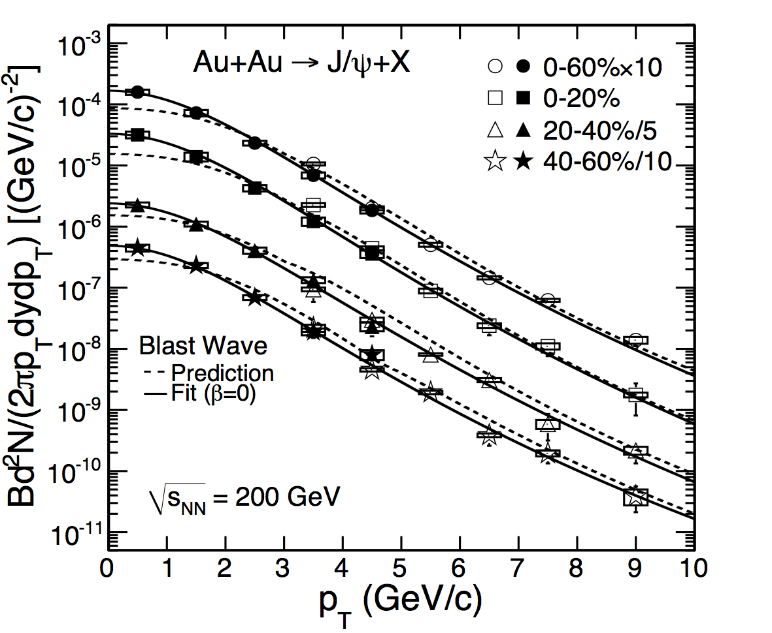
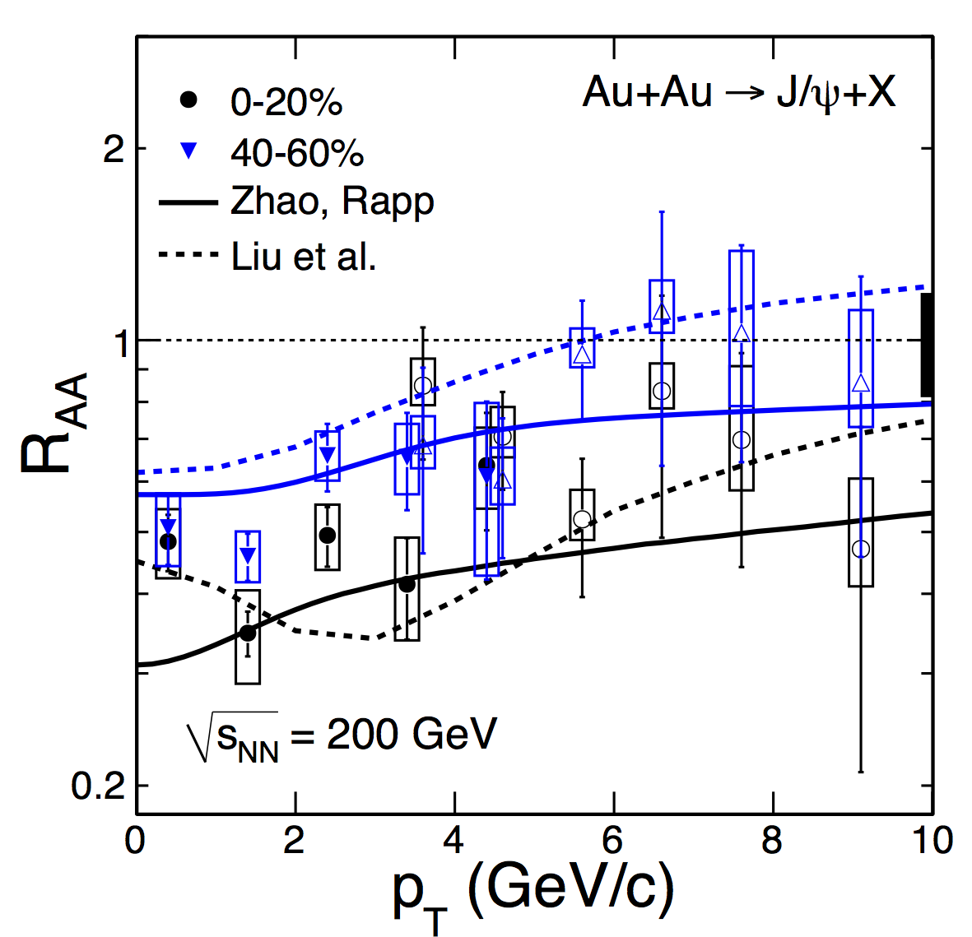
J/ψ spectra in 200GeV Au+Au collisions
Broad p_{T} coverage from 0 to 10 GeV/c
J/ψ spectra significantly softer than light hadrons
Much smaller radial flow?
Regeneration at low p_{T}?
Systematically higher at high p_{T} in all centralities
Suppression in central collisions at high p_{T}
formation time effect?
Cronin effect?
Tsallis Blast-Wave model: ZBT et al., arXiv:1101.1912
Yunpeng Liu et al.,, PLB 678:72 (2009) and private comminication
Xingbo Zhao et al., PRC 82,064905(2010) and private communication

Slide 16
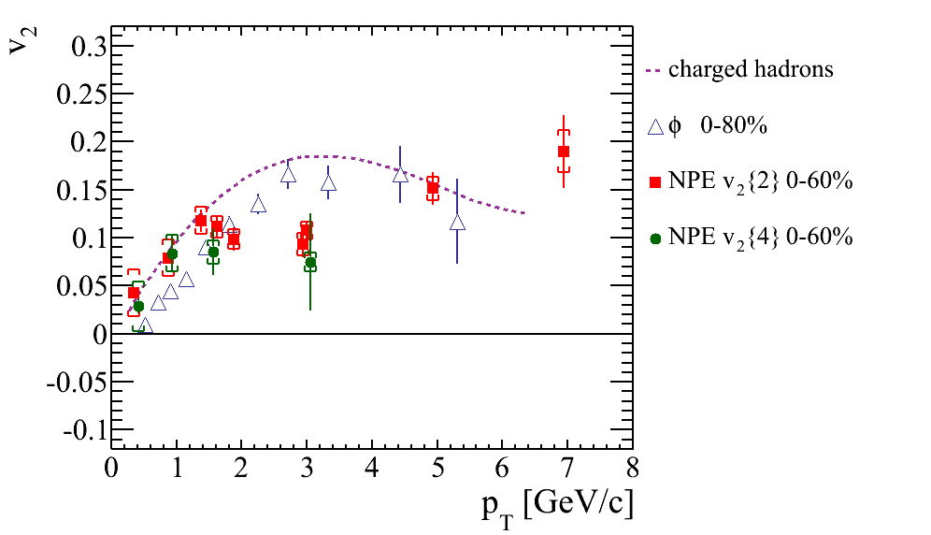
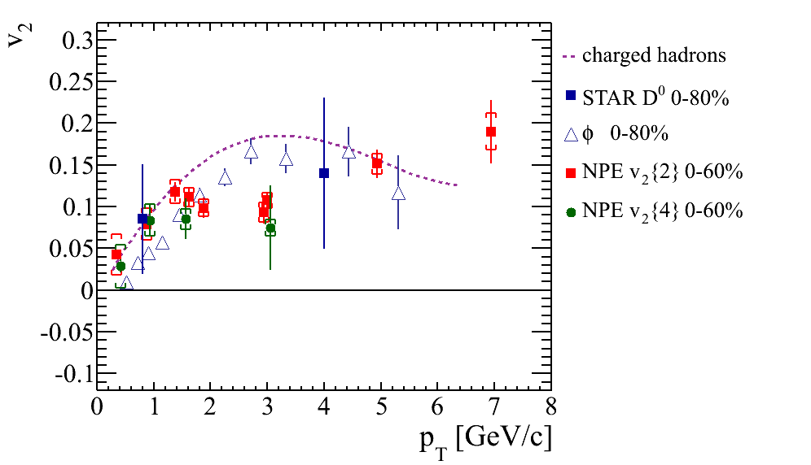
v₂ Measurements from NPE, D0 and J/ψ
200 GeV Au+Au:
Large NPE v₂ observed at low p_{T}→strong charm-medium interaction
v₂ increase at p_{T} > 3 GeV/c
path length of energy loss
Jet-like correlation.
39 and 62.4 GeV Au+Au:
v₂ consistent with zero
Might suggest charm –medium interaction is not as strong as in 200 GeV
Finite v₂ from charm quark coalescence ?
Further inputs from Run2011 data.
disfavors the case that J/Ψ with p_{T} > 2GeV/c is produced dominantly by coalescence from thermalized charm and anti-charm quarks.

Slide 17
Upsilon: a Cleaner Probe
Compared to J/ψ
recombination can be neglected at RHIC
Final state co-mover absorption is small.
Significantly improved p+p measurements w/ ~2.5x more lum.
More suppression in more central collisions
Consistent with prediction from a model requiring strong 2S and complete 3S suppression.
STAR Preliminary
STAR Preliminary
STAR Preliminary

Slide 18
Future of Heavy Flavor Measurement at STAR
MTD (MRPC)
PIXEL:
high hit resolution: 18.4µm X 18.4µm pitch
low thickness: 0.37% X₀
Muon identification
Muon trigger
significantly enhance STAR capability on measuring heavy flavor production at RHIC, e.g.
Direct reconstruction of D mesons at both low p_{T} and high p_{T}
B→J/ψ→µµ +X, disentangle upsilon 1S/2S/3S.
Study QGP thermal dilepton radiation
Understanding background through e-muon correlation.
See details in
Huan Huang: parallel 6C
Frank Geurt: plenary IVA

Slide 19
Summary
Observe large suppression of heavy quark production through NPE and D⁰ meson measurements in 200 GeV Au+Au collisions
Observe larger NPE v₂ in 200 GeV than in 39 and 62.4 GeV Au+Au collisions, indicating the strength of charm-medium interaction increase with energy.
J/ψ v₂ measurements disfavor the case that coalescence dominate the production at p_{T} > 2 GeV/c.
Observe Upsilon suppression, consistent with prediction from a model requiring strong 2S and complete 3S suppression
STAR HFT and MTD upgrades together with existing subsystems and RHIC II luminosities will provide STAR with the unprecedented opportunity to study heavy quark production at RHIC.
19

Slide 20
List of Heavy Flavor Talks and Posters
“STAR Upgrade Plan for the Coming Decade”, H. Huan for Collaboration, parallel 6C
“Measurements of Non-photonic Electrons Production and Elliptic Flow in 39, 62.4 and 200 GeV Au+Au Collisions from STAR at RHIC”, M. Mustafa for STAR Collaboration, parallel 7A
“Quarkonia production in the STAR experiment”, B. Trzeciak for STAR Collaboration, parallel 1D
“Open charm hadron production in p+p and Au+Au collisions at STAR”, D. Tlusty for Collaboration, parallel 6A
“Heavy Flavour Electron azimuthal anisotropy v₂ from 2- and 4-particle correlations in Au+Au collisions at $\sqrt{s_{NN}} =$200, 62 and 39 GeV at STAR”, D. Kikola for STAR Collaboration, poster session
“J/ψ production in $\sqrt{s_{NN}}$= 39 GeV and 62.4 GeV Au+Au collisions from STAR”, Wangmei Zha for STAR Collaboration, poster session.

Slide 21
Backup Slides

Slide 22
Comparison of J/ψ v₂ with Models
Models | $${χ^{2}}/{NDF}$$ | P-value
Initially produced | 1.8/3 | 6.2e-1
Coalescence at freezeout | 22.6/3 | 4.9e-5
Coalescence In transport | 13.9/3 | 3.0e-3
Coalescence In fireball | 4.8/3 | 1.8e-1
Coalescence +initial mix | 2.9/3 | 4.0e-1
Coalescence +initial mix | 1.8/4 | 7.7e-1
Hydro T=120 w/viscosity | 16.5/3 | 9.2e-4
Hydro T=165w/ viscosity | 14.9/3 | 1.9e-03
Hydro T=120 w/o viscosity | 191.6/3 | 2.7e-41
Hydro T=165w/o viscosity | 237.3/3 | 0.0
STAR Preliminary
[1] V. Greco, C.M. Ko, R. Rapp, PLB 595, 202 (minbias)
[2] L. Ravagli, R. Rapp, PLB 655, 126.(minbias)
[3] L. Yan, P. Zhuang, N. Xu, PRL 97, 232301. (b =7.8 fm)
[4] X. Zhao, R. Rapp, 24th WWND, 2008. (20-40%)
[5] Y. Liu, N. Xu, P. Zhuang, Nucl. Phy. A, 834, 317. (b = 7.8 fm)
[6] U. Heinz, C. Shen, priviate communication. (20-60%)
disfavors the case that J/Ψ with pT > 2GeV/c is produced dominantly by coalescence from thermalized charm and anti-charm quarks.
Notes:
Note: centrality mistatchs between data and models

Slide 23
Heavy Flavor v2 Measurements
If charm quark flows. J/ψ from recombination also flow.
If the observation is consistent with zero flow, it could mean
J/ψ does not flow OR
Flow is small due to mass ordering effect OR
Recombination is not a dominant process.
J/ψ
Yan,Zhuang,Xu
PRL 97, 232301 (2006)
Need to measure v₂ from both open and close charm

Slide 24
Particle Identification from TOF+dE/dx
|1/β-1|<0.03
Extend hadron PID to intermediate p_{T}
Important for open charm measurements.
TOF/TPC allows electron PID down to very low momentum
Important for charmonia measurements.

Slide 25
Electron Identification from TPC + BEMC
2.5 < pT<3.0 GeV/c
8.0< pT<10 GeV/c
High pT electron PID:
TPC+BTOW:
Associate TPC tracks with BTOW clusters.
cut p/E ~1.0
Cut on number of BSMD strips per cluster:
Associate TPC tracks with BSMD clusters.
Higher for electron.

Slide 27
D⁰ signal in p+p 200 GeV
arXiv:1204.4244.
$$D^{0}\left(\overline{D^{0}}\right)→K^{∓}π^{±}$$
B.R. = 3.89%
p+p minimum bias 105 M
4-σ signal observed.
Different methods reproduce combinatorial background.
Consistent results from two background methods.

Slide 28
D* signal in p+p 200 GeV
$$D^{∗±}→D^{0}\left(\overline{D^{0}}\right)+π^{±}→K^{∓}π^{±}+π^{±}$$
arXiv:1204.4244.
Background recomstruction:
Wrong sign:
D⁰ and π⁻, $\overline{D^{0}}$ and π⁺
Side band:
1.72< M(Kπ) < 1.80 or
1.92 < M(Kπ) < 2.0 GeV/c²
Minimum bias 105M events in p+p 200 GeV collisions.
Two methods to reconstruct combinatorial background: wrong sign and side band.
8-σ signal observed.

