Slide 1





Recent Spin Physics Highlights
(Fresh Powder Faceshots from the Spin Piste)
Gluon polarization
Sea quark polarization
Transversity
W.W. Jacobs, for the STAR Collaboration
LLWI, Chateau Lake Louise, 17-23 February, 2013, Alberta, CA

Slide 2

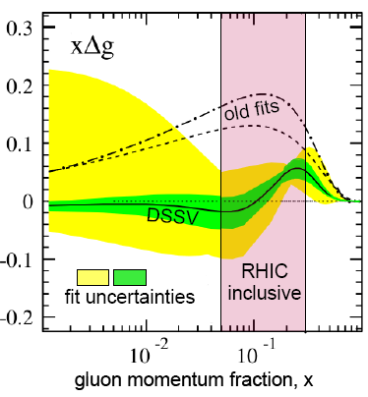
Probing our Understanding of Nucleon Substructure w/ Spin
The leading twist quark distribution functions that describe the nucleon are:
unpolarized longitudinal polarization transverse polarization
and historically much of our information comes from DIS (and more recently SIDIS). Polarized proton hard partonic scattering data at the RHIC collider now impact!
Longitudinal Spin:
DIS ~ 0.3
poorly constrained
w/ 2006 RHIC results
Proton spin
measure at RHIC!
DIS data consistent with quark helicity contribution only ~ 30% , and limited gluon spin constraint => “spin crisis”!
RHIC polarized proton data is directly sensitive to gluons & provides improved/direct flavor-spin separation vs. SIDIS.
Transverse Spin:
measure at RHIC!
Data sparse: h1 can be extracted from pp di-hadron data to high x … connects to the tensor charge (calculable on the lattice).
measure at RHIC!
Transverse momentum distr. effects in pp relate to orbital angular momentum.

Slide 3
Longitudinally Polarized pp Collisions at RHIC
Hard collisions provide pQCD probes of spin-dependent partonic structure!
Assumes factorization works
+
large spin correlations at partonic level
LO pQCD
pp → hX
“soft” parton distribution functions
“soft” frag. function
∧
“hard” dσ_{QCD} parton-parton
Longitudinal double Spin Asymmetry:
Use (high x) polarized quarks as a probe (e.g., of gluon polarization)!
Δf: polarized parton distribution functions

Slide 4
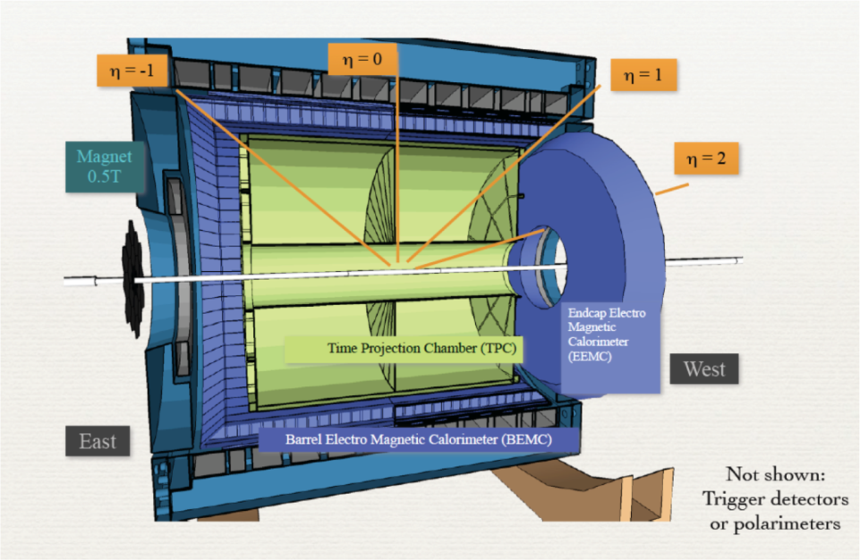

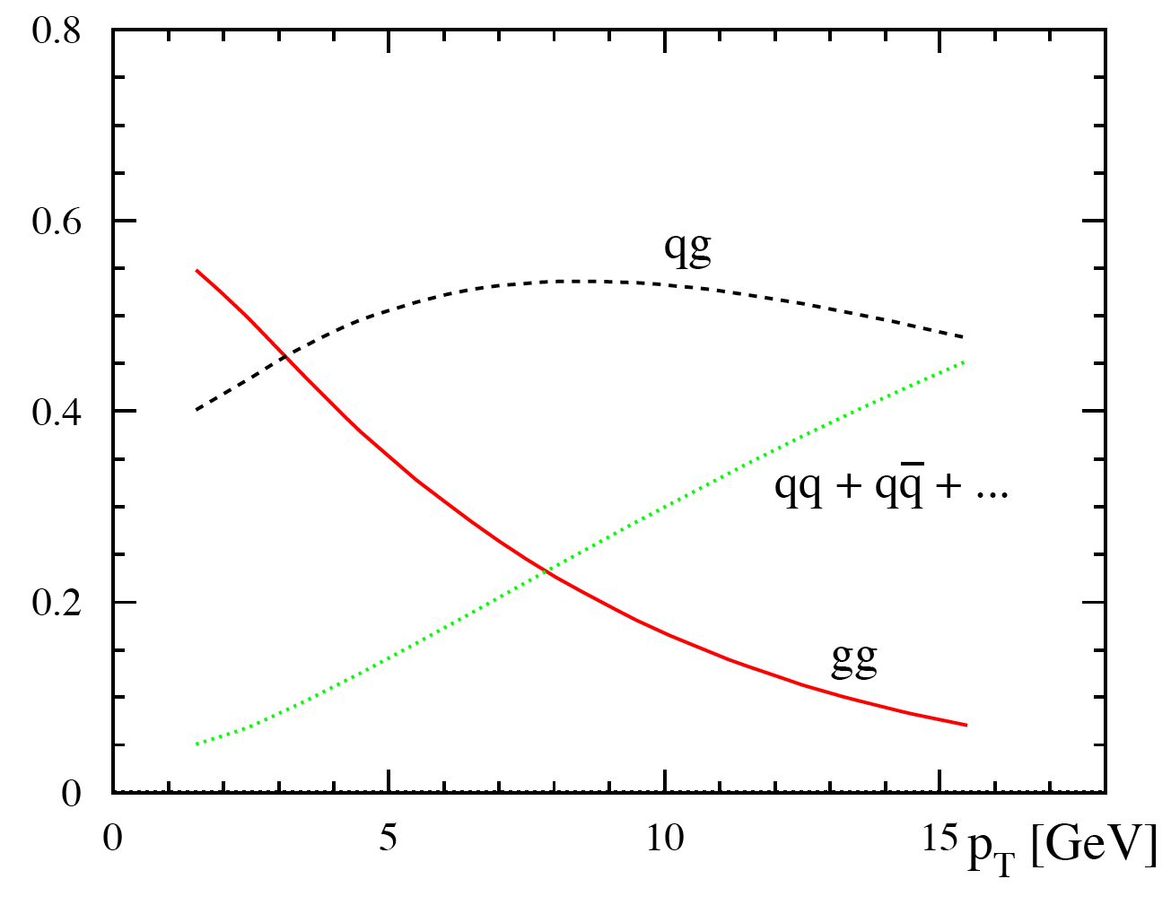
STAR Detector, Jet Reconstruction and Gluons
Midpoint cone algorithm (hep-ex/0005012)
Seed energy E_{T}^{seed} = 0.5 GeV
Cone radius R = √Δη²+Δφ² = 0.7
Split/merge fraction f = 0.5
PYTHIA + GEANT to quantify det. response
STAR:
TPC
EMCs
Data jets MC jets
Detector
GEANT
RHIC kinematics: gg and qg dominate, jets/ hadrons A_{LL} sensitive to gluon polarization.
Particle
PYTHIA
10
20
30 p_{T}(GeV)

Slide 5
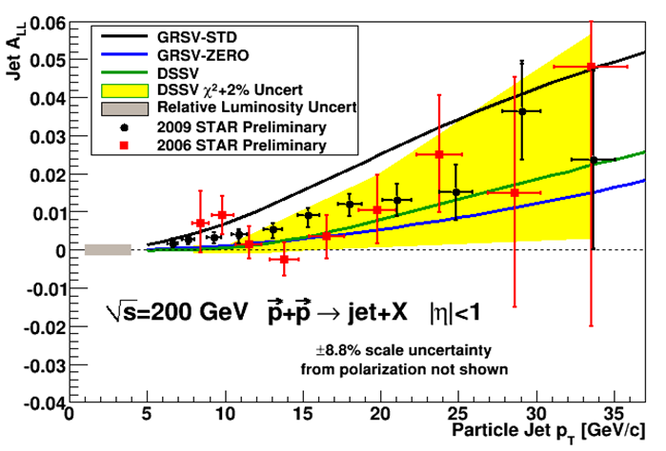
2009 STAR Inclusive Jet Results
arXiv:1106.5769v1
2009 data are in black; 2006 data are in red.
DSSV global fit (green) curve includes the 2006 RHIC data
Note: the yellow band is the χ²+2% DSSV uncertainty
Exploited in 2009 greatly improved RHIC performance in luminosity, polarization; lowered EMC trigger thresholds + focused on high-p_{T} region [2009 data are factor of 3 (high-p_{T}) to > 4 (low-p_{T}) more precise than 2006].
2009 results fall between predictions from DSSV and GRSV-STD indicating gluon contribute in the sensitive kinematic region!

Slide 6
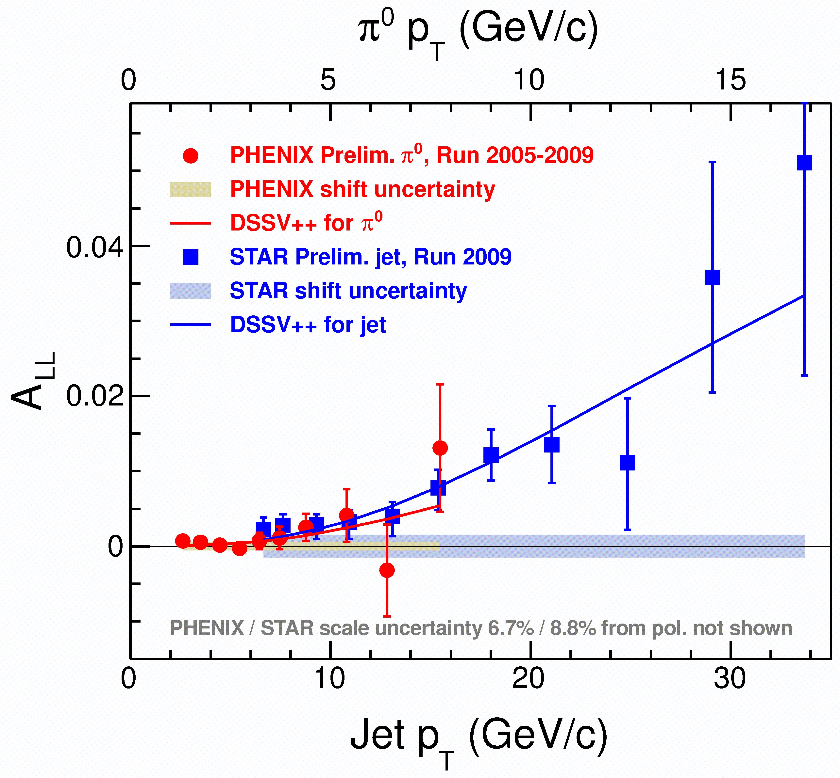
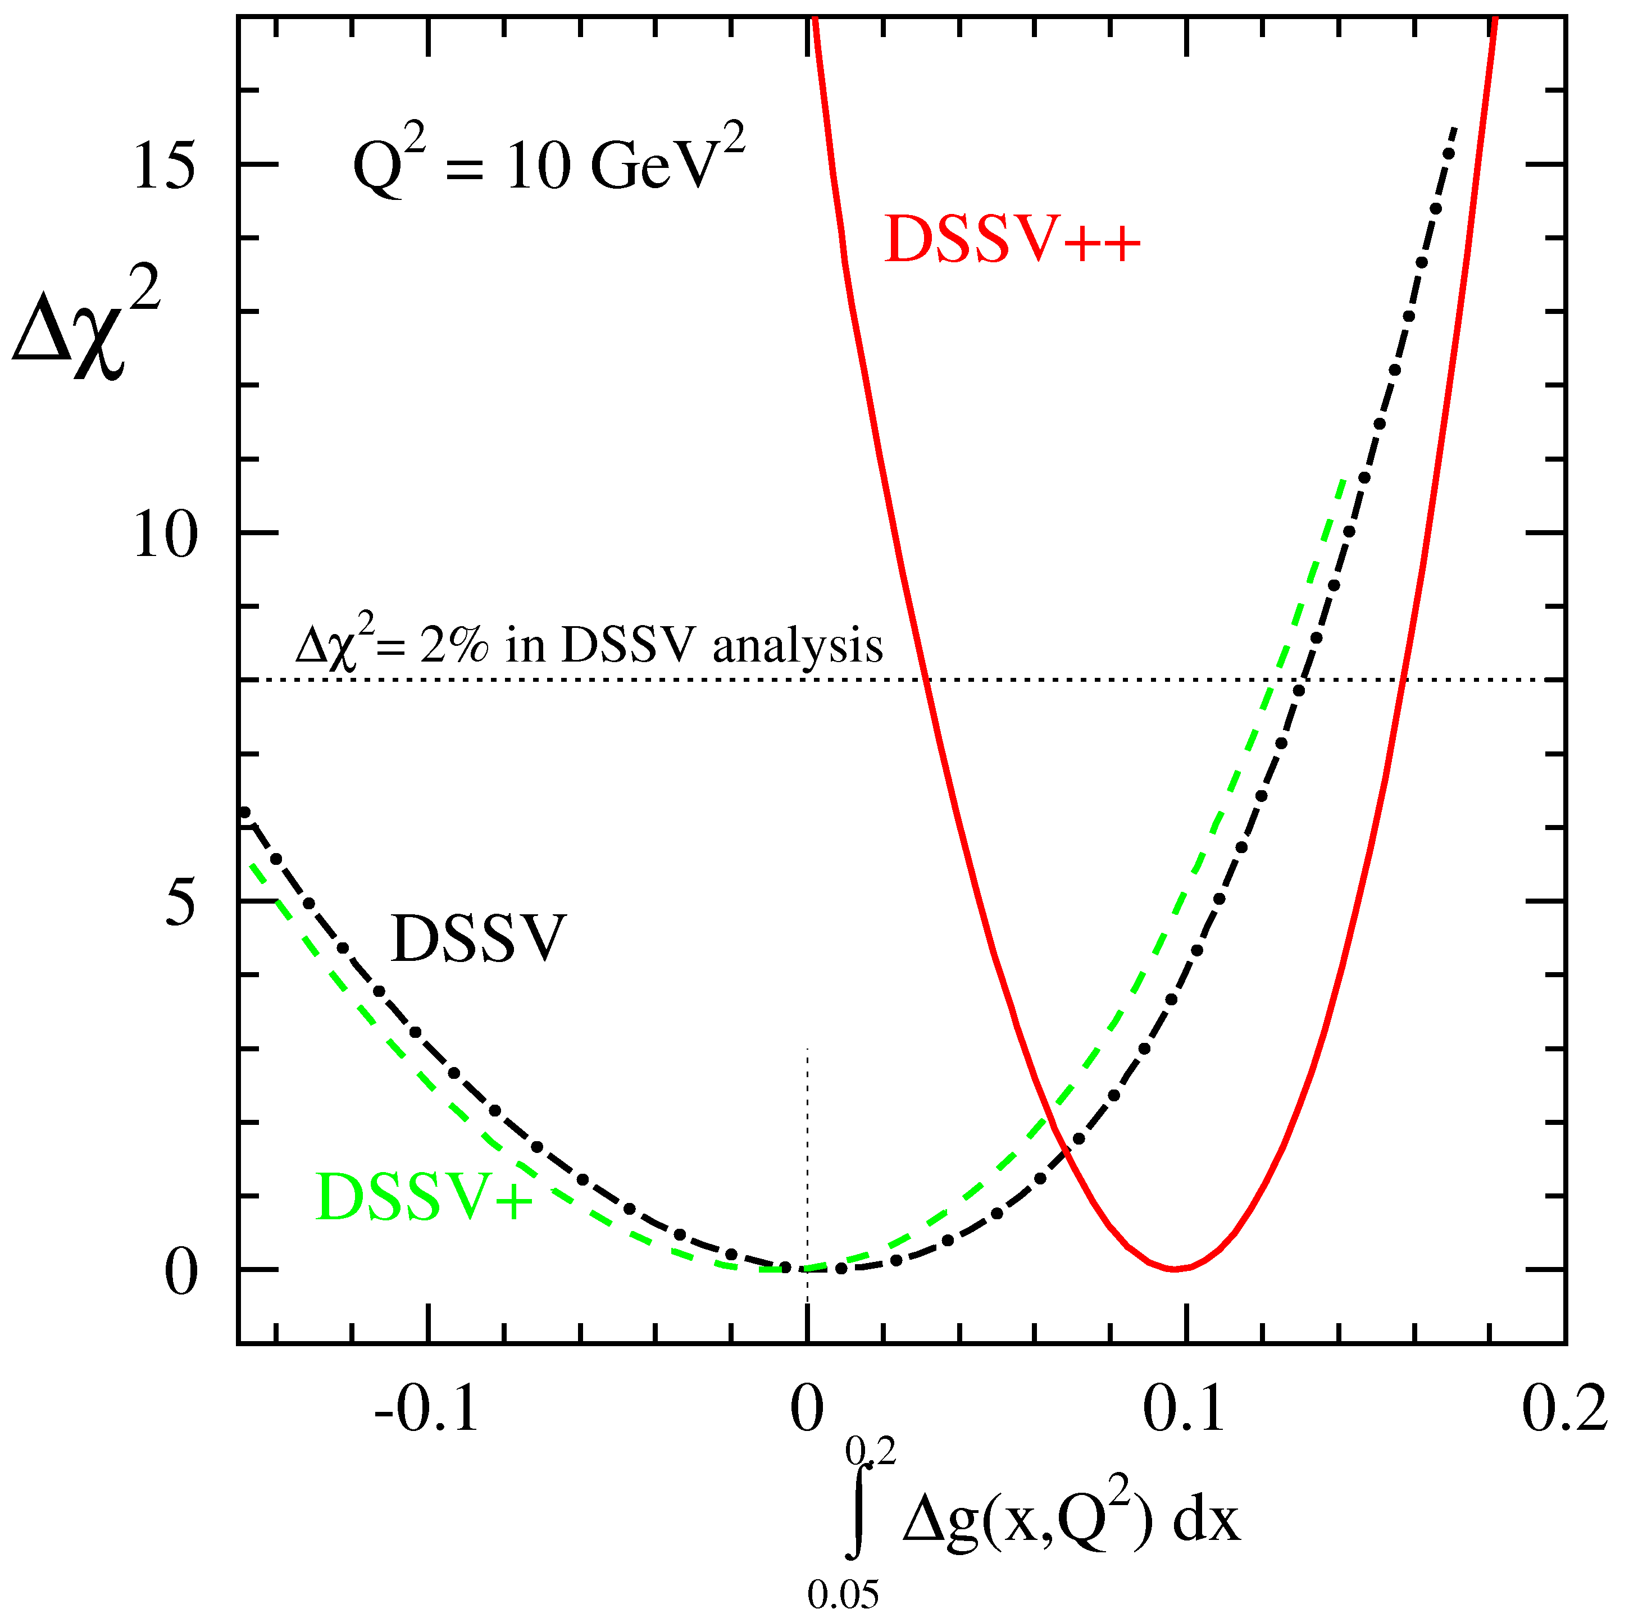
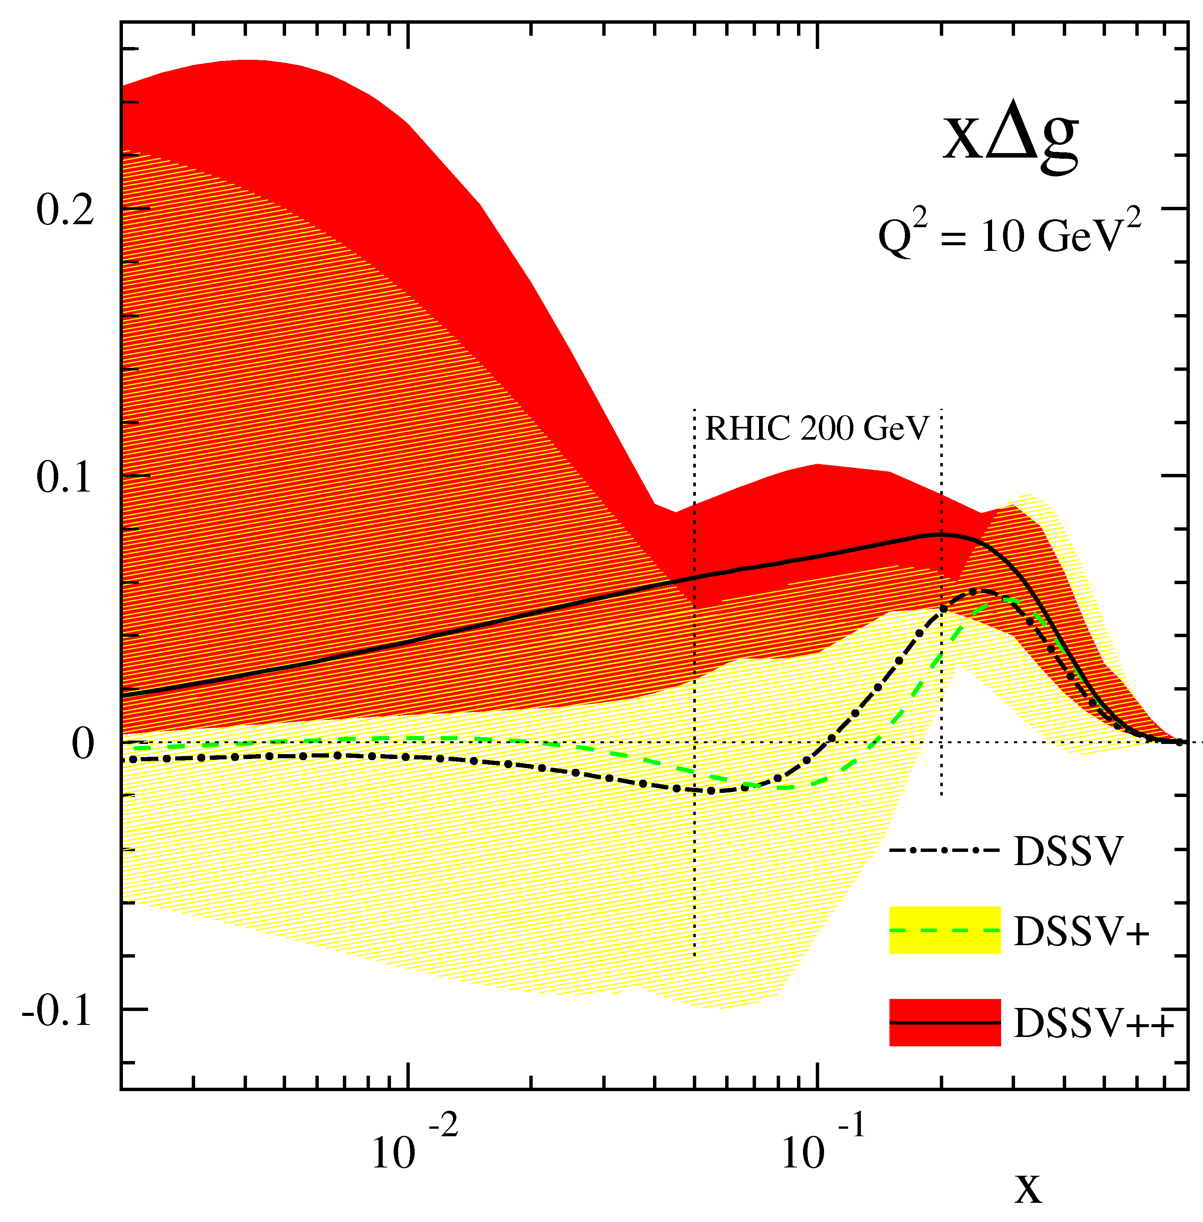
New global analysis with 2009 RHIC data
Curve “DSSV++” is a new, preliminary global analysis from the DSSV group that includes 2009 A_{LL} measurements from PHENIX π⁰ and STAR inclusive jets.
First evidence of non-zero gluon polarization in the RHIC range (0.05 < x < 0.2); integral (w/ big error bars) comparable to the quark contribution to the proton spin.
The next efforts: di-jet (and γ-jet) coincidence measurements sensitive to “shape” of xΔ g(x); e.g., significant di-jet results expected from ongoing 2009 analyses and of data at 500 GeV for sampling the lower x region … more data in bank & to come.

Slide 7
Sea Quarks

Slide 8
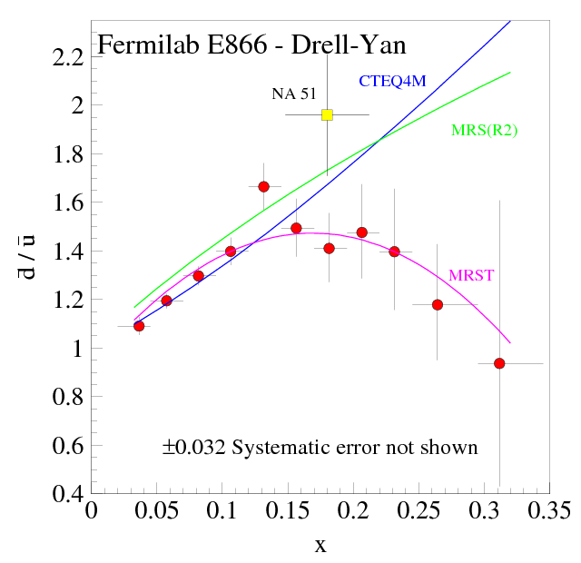
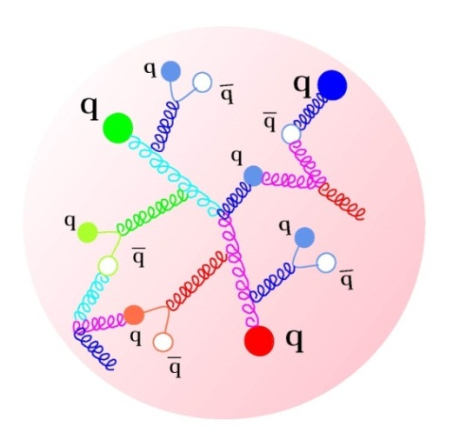
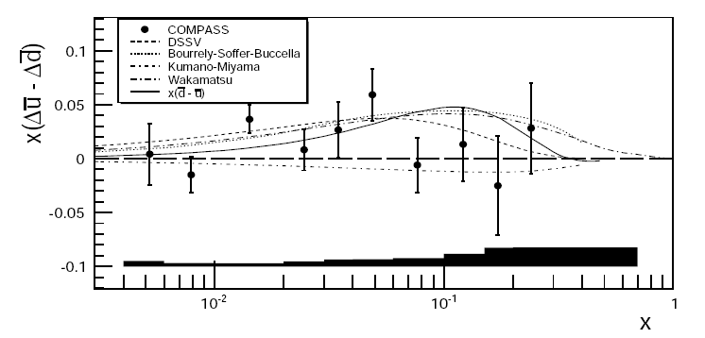
Origin and Symmetry of the Quark Sea
Unpolarized Distributions:
PRL 80, 3715 (1998)
u
d
u
¯
d
d
p⁺
n
E866 data qualitatively consistent w/ pion cloud, instanton and chiral quark models.
Perturbative: equal numbers of light anti-quarks.
Q² = 54GeV
Polarized Flavor Asymmetry:
arxiv1007.4061
DSSV global fit suggested a positive difference to a sensitivity (arXiv:0904.382).
Recent semi-inclusive COMPASS data hint at such behavior.

Slide 9
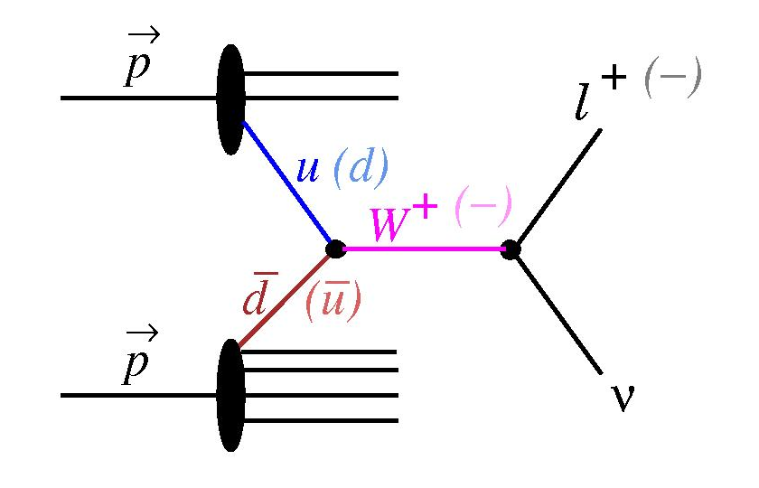
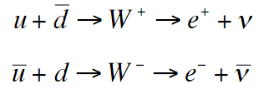
W Boson Production; Sea Quark Spin Selectivity
Detect W’s through e⁺/e⁻ decay channels.
Typically find x_{q} > x_{q} → W highly boosted.
V-A coupling → perfect spin separation.
LH W’s = LH quarks + RH anti-quarks.
ν helicity gives preferred direction in decay.
W¯ preserves initial state kinematics; decay electron emitted along W¯ trajectory (and conversely for W⁺ where decay positron is anti-parallel to trajectory).
Measure parity-violating single-spin asymmetry:
(Helicity flip in one beam while averaging over the other)
Re; quark sum:

Slide 10
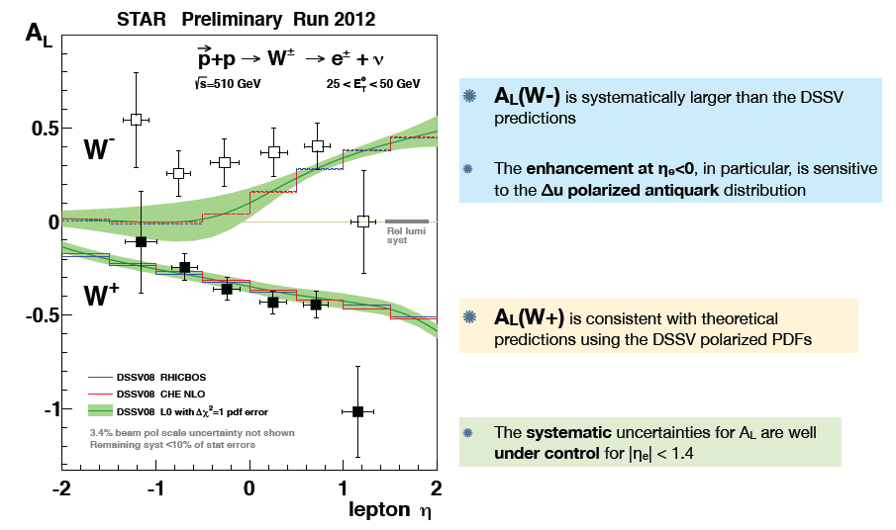

Run 12 (2012) W+/- Results from STAR

Slide 11
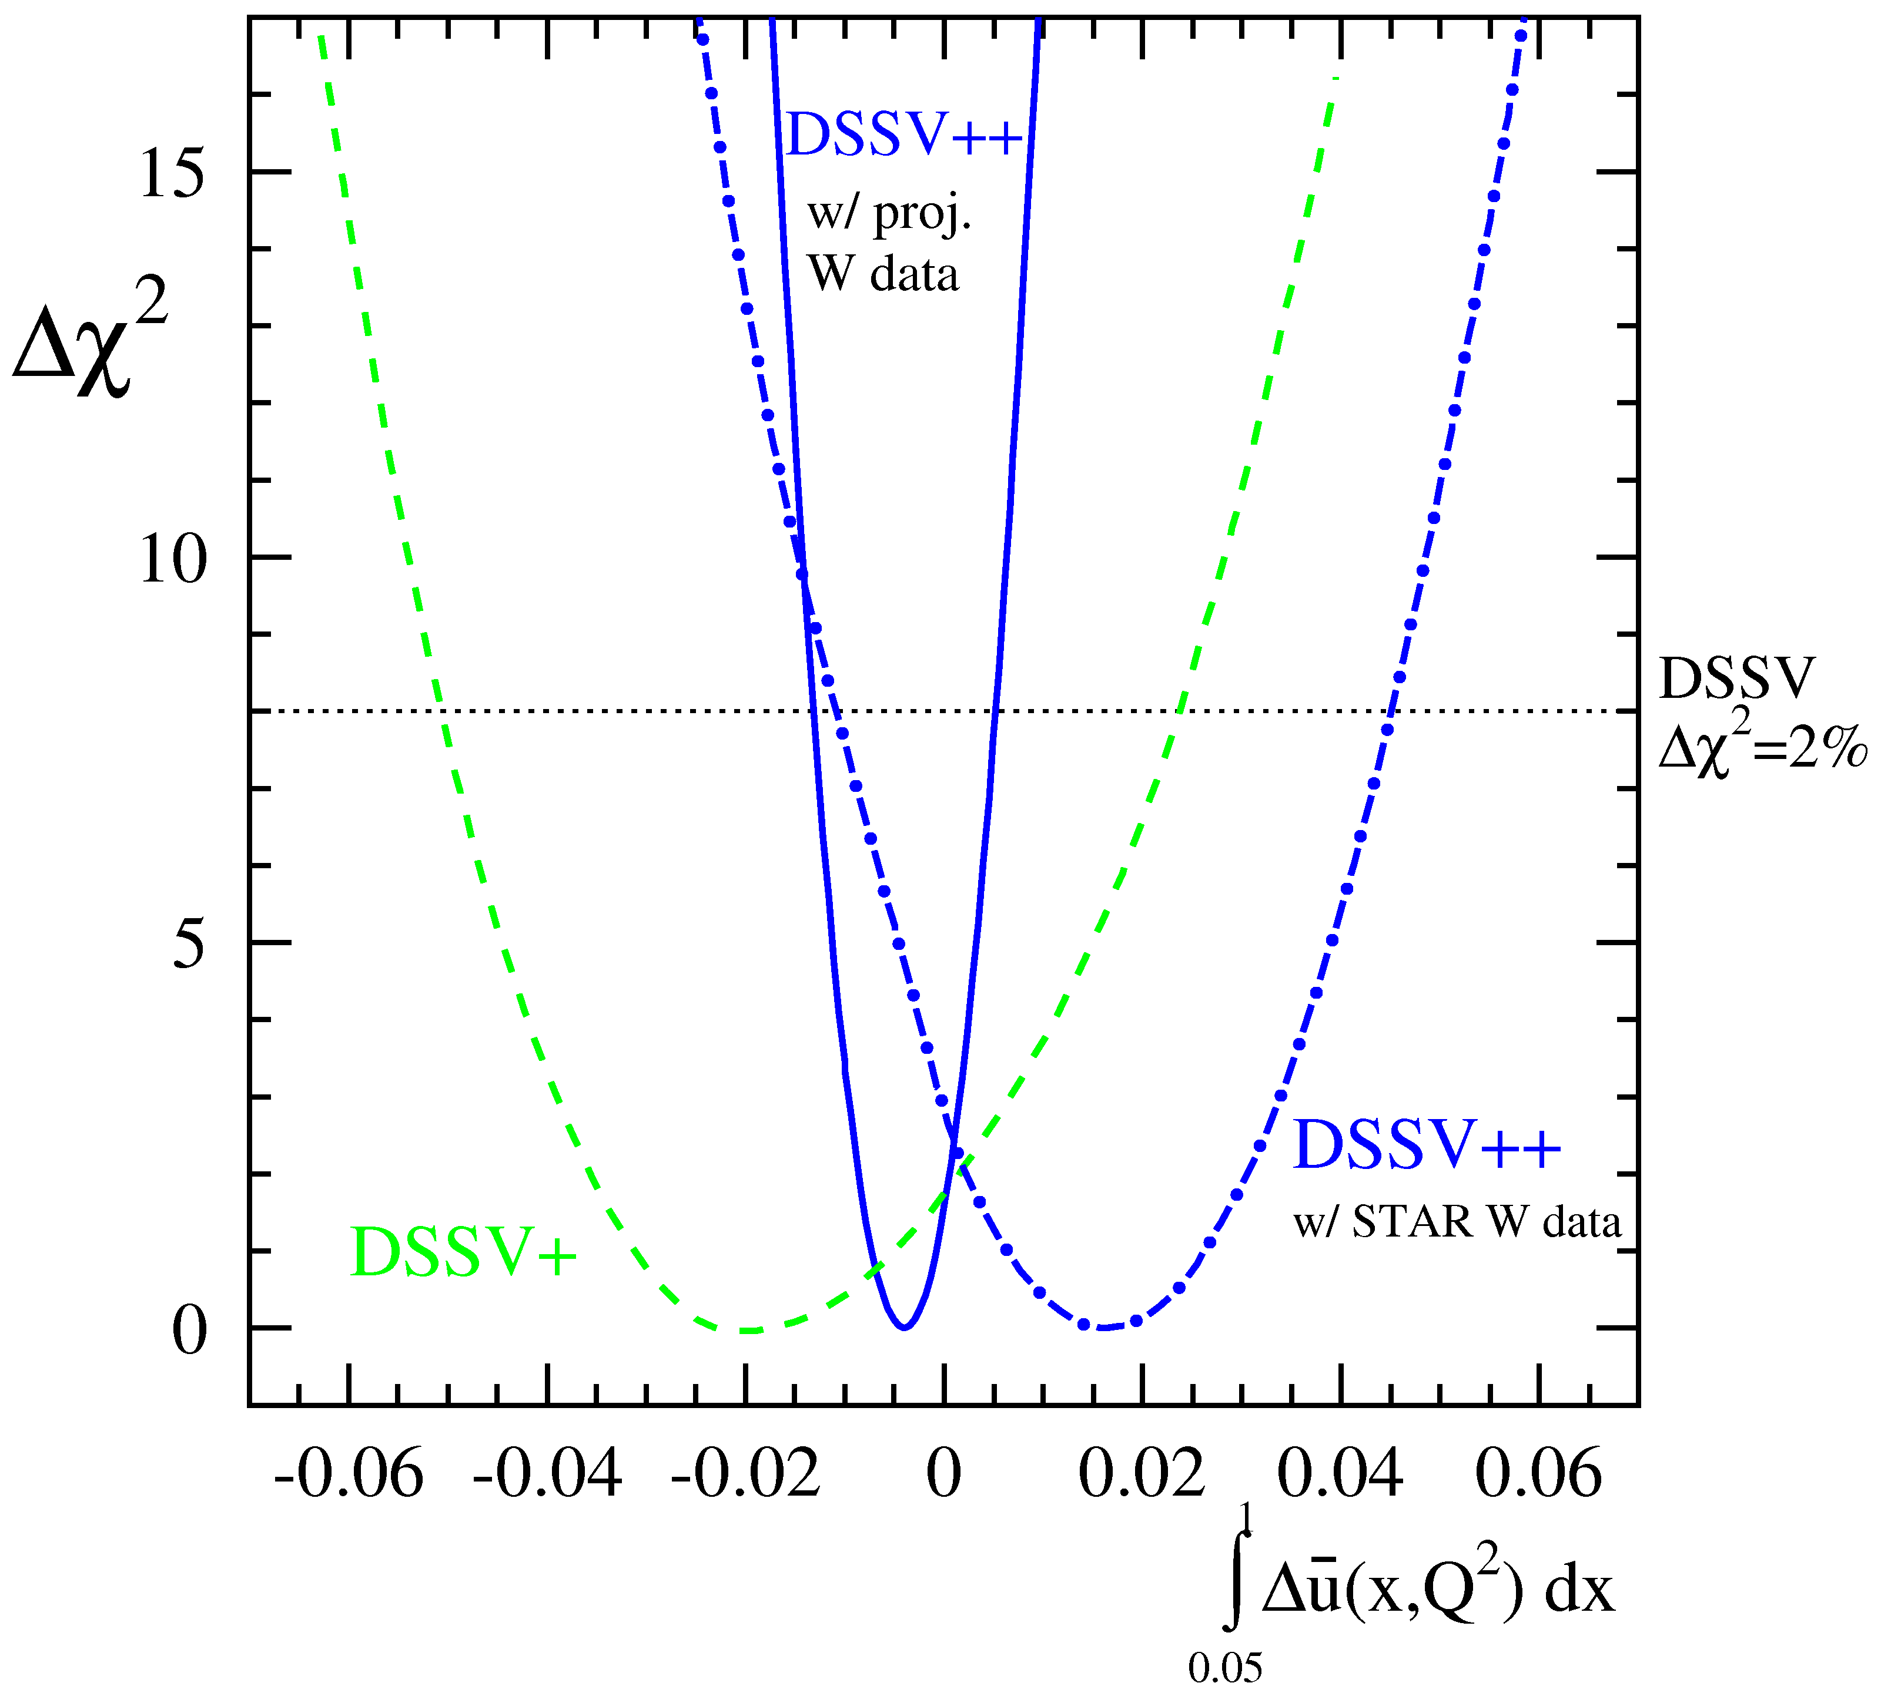
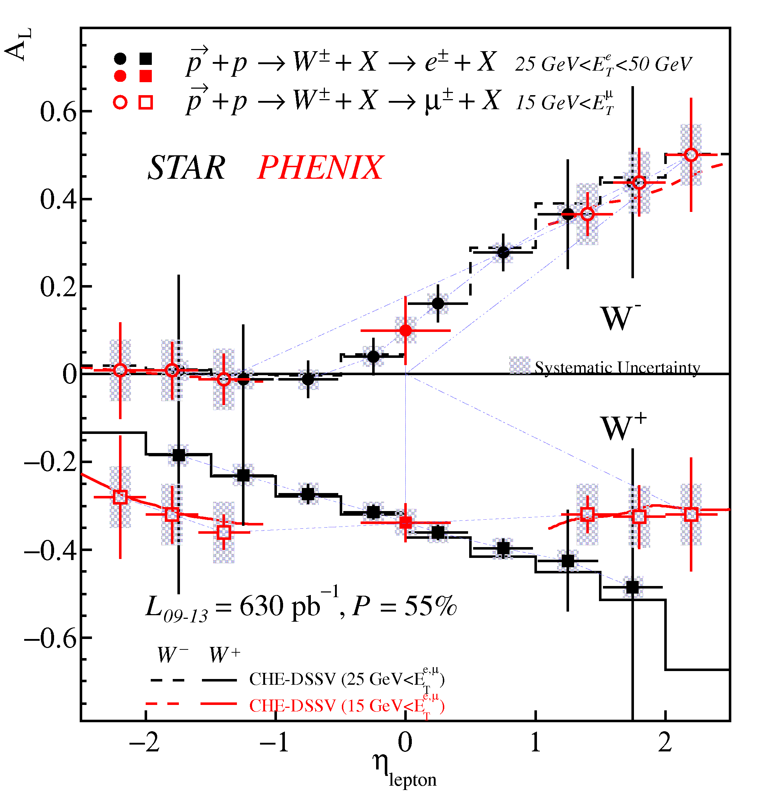
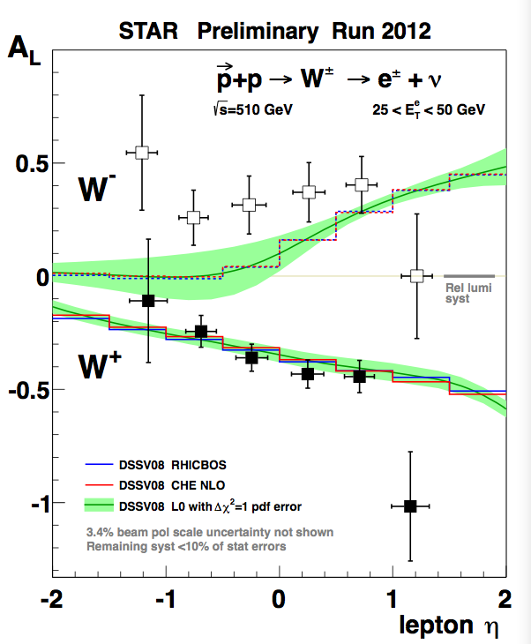
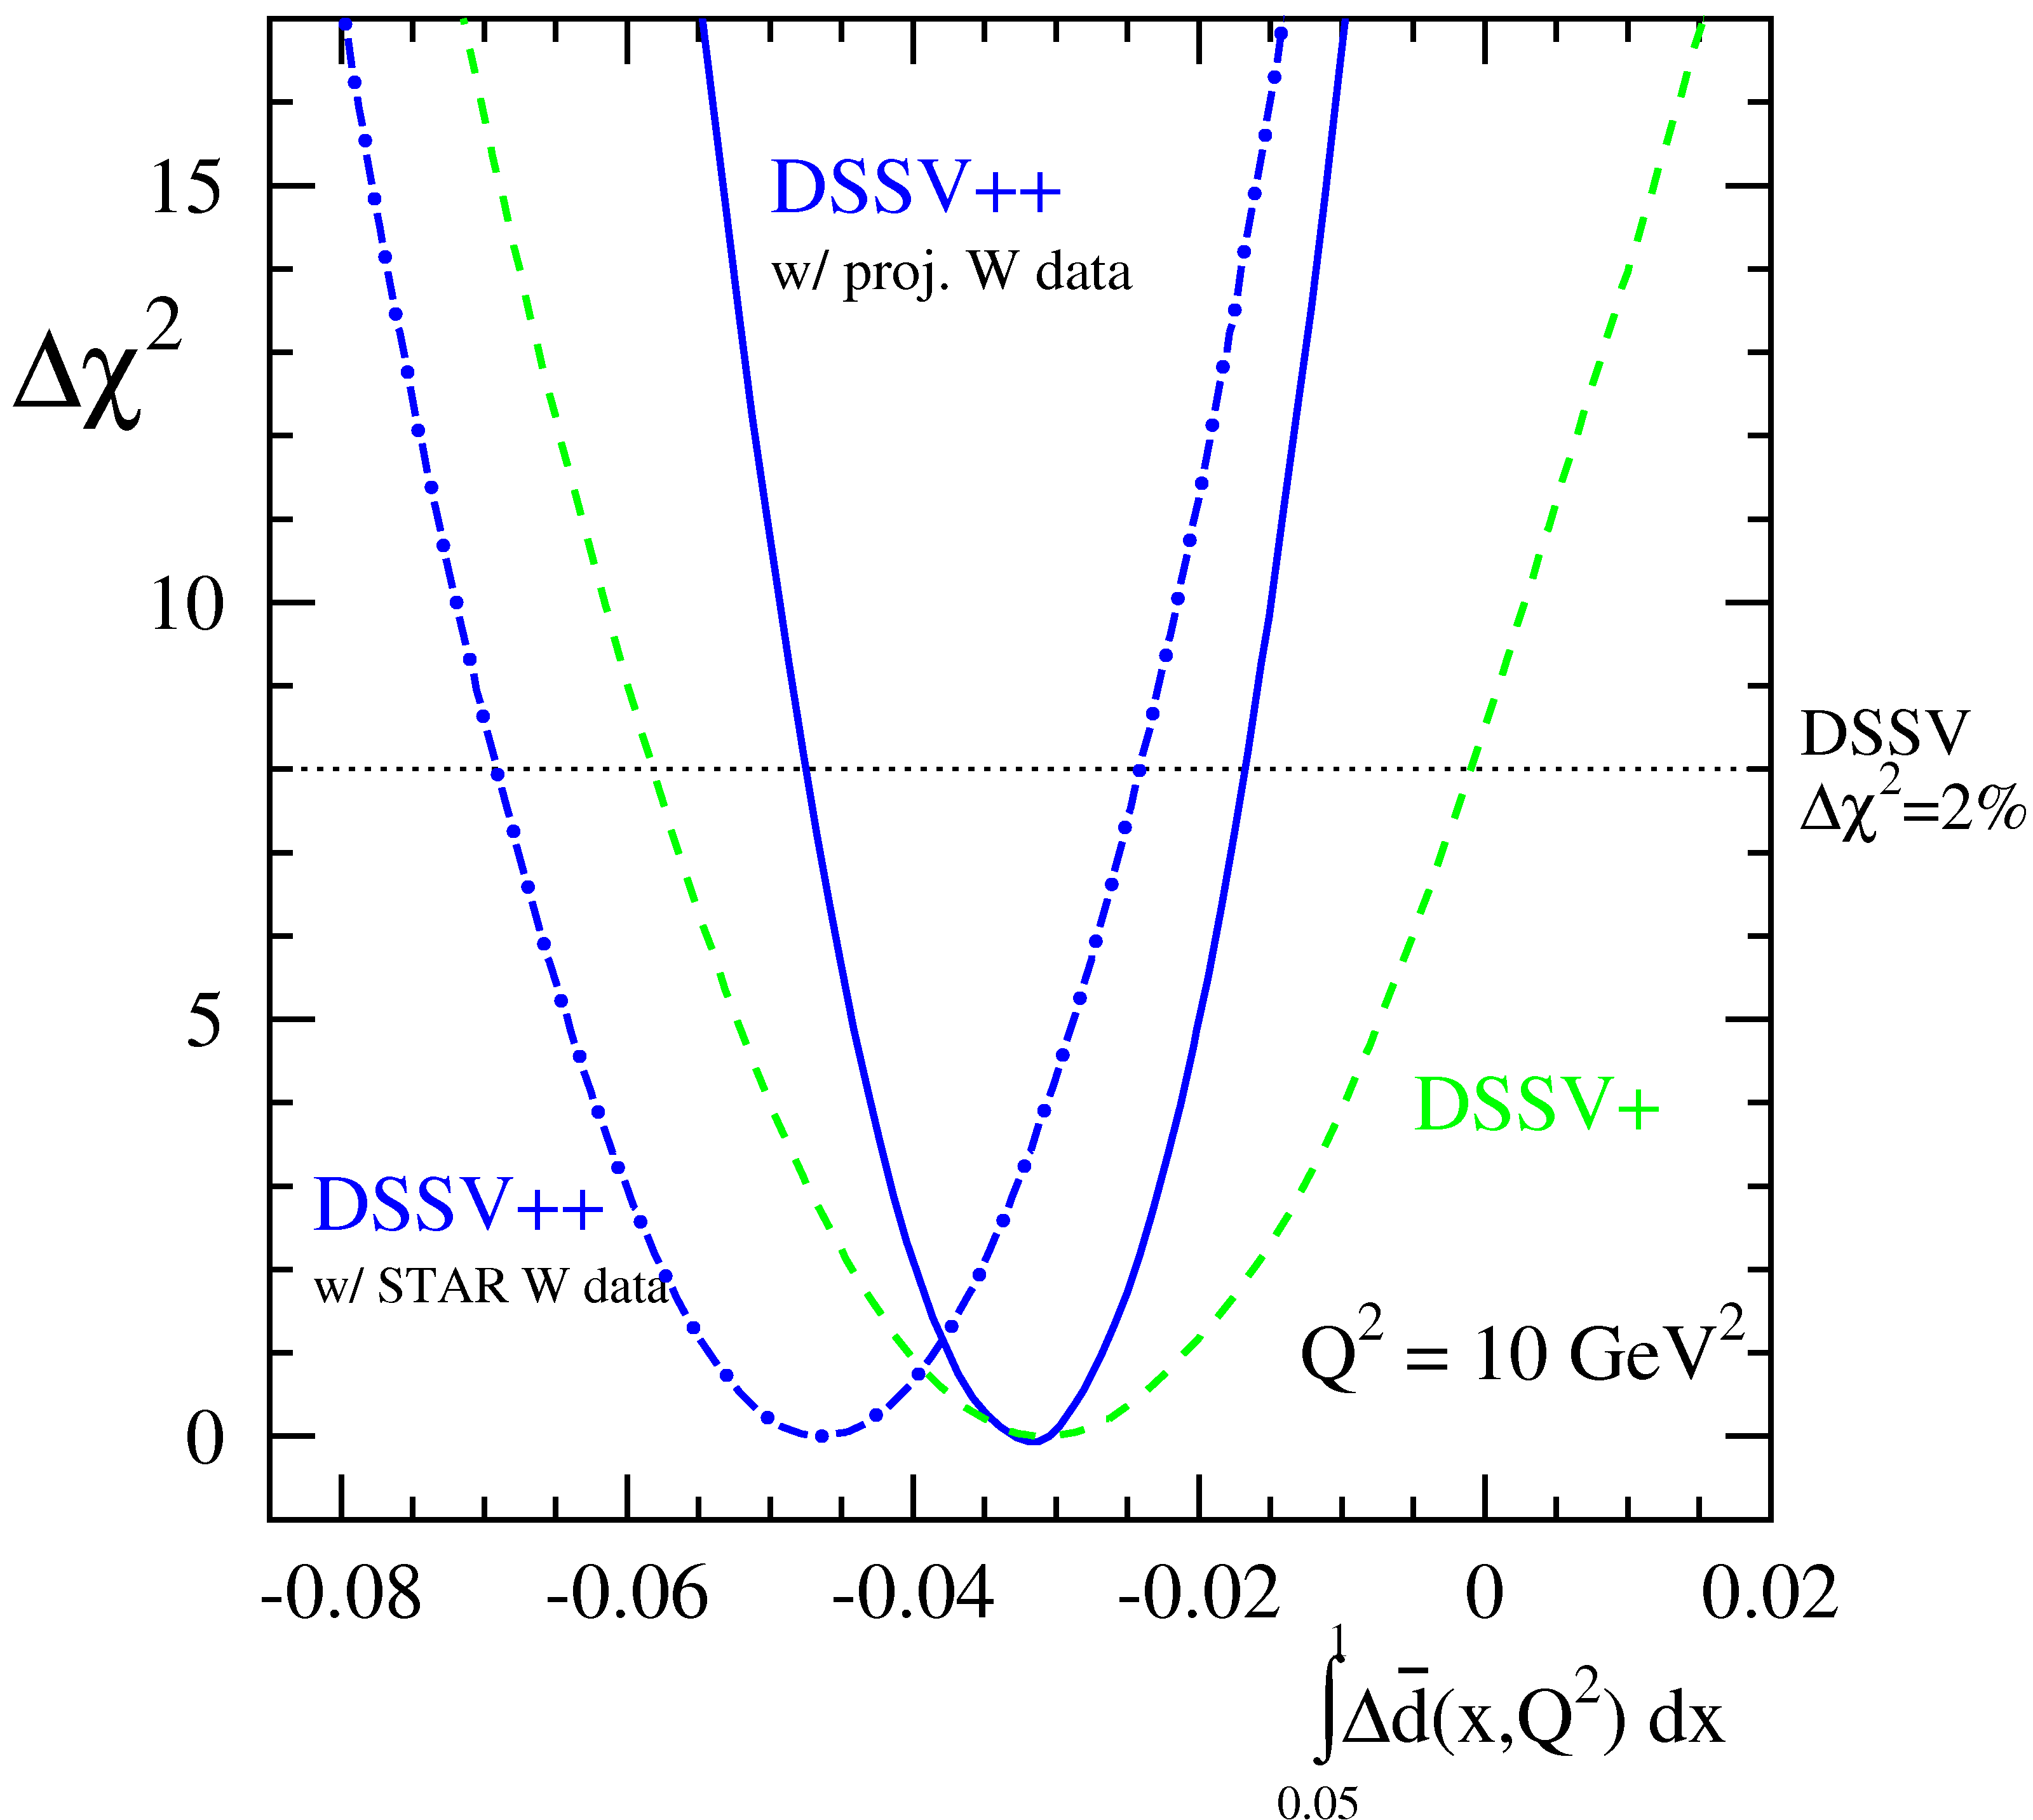
Global Analysis: Run 12 and Future Data
Δu
PHENIX and STAR
through 2013 run
Δd
First preliminary results from 2012 already provide substantial sensitivity.
Future results will provide a dramatic reduction in the uncertainties.

Slide 12
Transversity

Slide 13

Transverse Spin
Transversity PDF
quark with spin parallel to the nucleon spin in a transversely polarized nucleon.
Chiral odd, poorly known … cannot be measured inclusively. Needs a chiral odd partner Fragmentation Function
h₁^{q}(x)
(Collins function, IFF, etc.)
Interference Fragmentation Function (IFF):
Fragmentation of a transversely polarized quark q into two spin-less hadron h₁, h₂ carries an
azimuthal dependence (e.g., cons. of angular momentum).
q
The azimuthal hadron dependence can be used as a transversity signal.

Slide 14
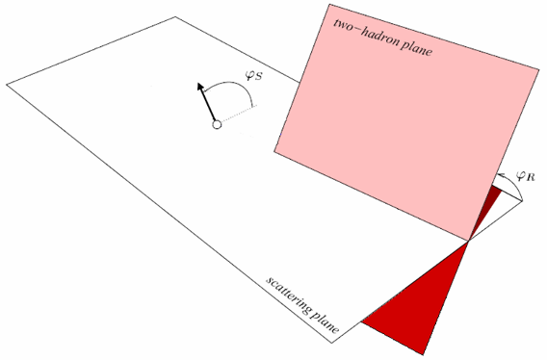
Using Hadron Pairs + IFF in pp Collisions
Measure the hadron pair asymmetry with transversely polarized protons:
<
, where
IFF
Transversity
14

Slide 15
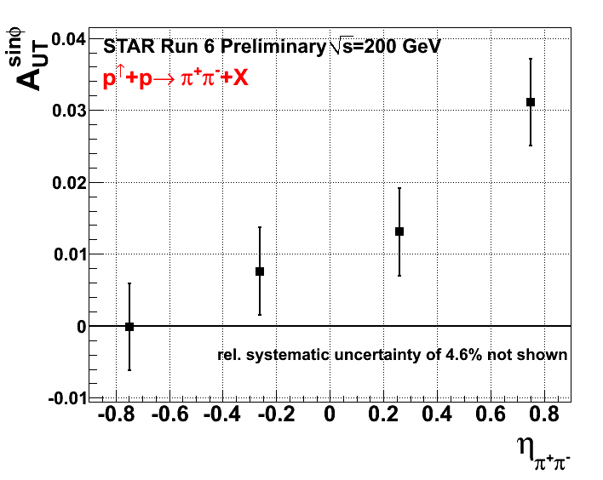
New STAR Data Shows Transversity Signal
First significant signal of transversity in polarized proton collisions
Use Charged track pairs in STAR TPC
PID for charged pions with dE/dx
Bin yield asymmetries in ϕ_{RS} and fit with sin (ϕ_{RS} ) amplitude/polarization
STAR:
TPC
EMC
Strong Rapidity Dependence
STAR upgrades will cover η<2 in the near future
<x_{Bj}> 0.25 (current) → 0.45: not probed in SIDIS yet!
Proposed STAR Forward upgrade: η<4

Slide 16

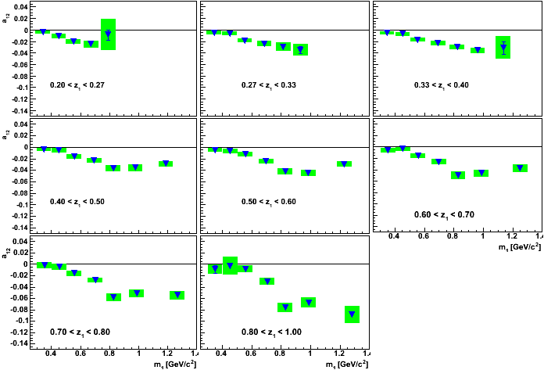
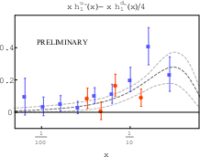

IFF from Belle and Transversity Extraction
Interference Fragmentation Functions measured at Belle detector at e⁺ e⁻ collider
positron
Anselm Vossen et. al, PRL 107, 072004(2011)
ϕ₂
ϕ₁
q₂
q₁
z₂
z₁
quark-2
spin
quark-1
spin
Asymmetry a₂
z_{1,2} relative pion pair
momenta
electron
binned in z₁
Signal requires correlation in two hemispheres:
Asym $∝H_{}^{<}\left(z_{1},m_{1}\right){\overline{H}}_{}^{<}\left(z_{2},m_{2}\right)cos⁡({φ_{1}}+φ_{2})$
Invariant mass m₁
Using COMPAS and HERMES data with
Belle IFF: initial point-by-point transverity extraction.[M. Radici at FF workshop, RIKEN, 11/2012]
STAR pp data soon to come; and push to higher x

Slide 17

Summary and Conclusions
Exciting new Spin Physics results from STAR/RHIC
First strong evidence that gluons contribute to the proton spin … STAR+PHENIX data in global fit results in ~0.1 contribution for the accessible region.
Spin-flavor separated sea quark polarization w/ W boson production; with an updated (DSSV++) global analysis, suggests a larger u polarization compared to initial predictions.
Transverse spin pp shows first strong di-hadron signal at mid-rapidity; coupled with fragmentation functions from Belle, will lead to an extraction of transversity.
Thank you!

Slide 18
Backup Slides

Slide 19
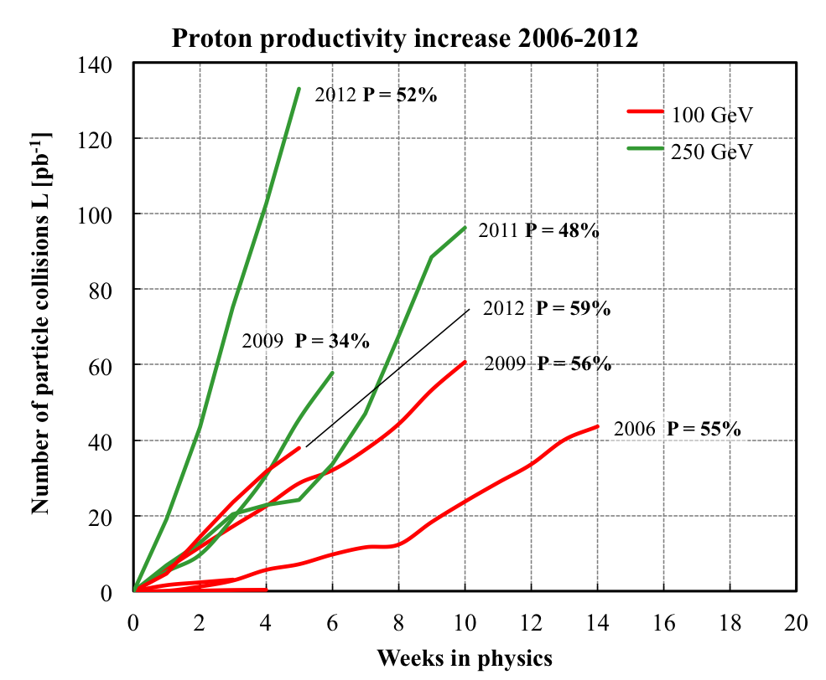
RHIC: Polarized pp Collider & QCD Machine
Absolute Polarimeter (H↑ jet)
RHIC pC Polarimeters
E-Lens and Spin Flipper
A_{N}DY/ BRAHMS
Siberian Snakes
Siberian Snakes
PHENIX
STAR
Spin Rotators
(longitudinal polarization)
Spin Rotators
(longitudinal polarization)
Pol. H⁻ Source
LINAC
EBIS
BOOSTER
Helical Partial
Siberian Snake
200 MeV Polarimeter
AGS
AGS pC Polarimeter
Strong AGS Snake
Versatility:
Polarized p+p Sqrt(s) collisions at 62.4 GeV, 200 GeV and 500 GeV
Recent Spin Runs:
2009: first 500 GeV polarized running (longitudinal)
2011, 2012: 510 GeV polarized running (longitudinal and transverse).

Slide 20
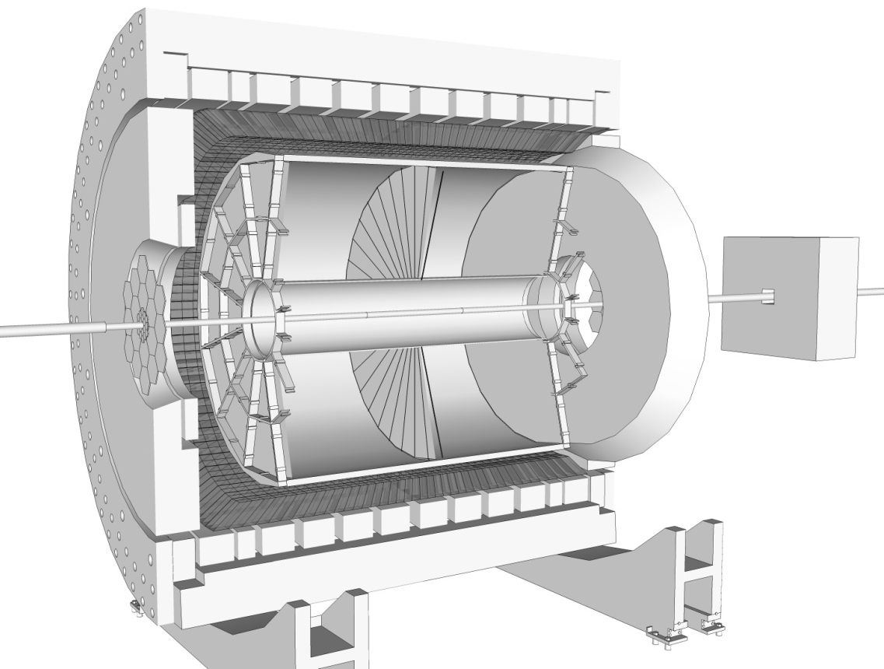
Solenoidal Tracker at RHIC
Time Projection Chamber (TPC)
Charged Particle Tracking |η|<1.3
η = 0
Endcap Electromagnetic Calorimeter:
1<η<2
η = 1
η = - ln(tan(θ/2))
Barrel Electromagnetic Calorimeter (BEMC):
|η|<1

Slide 21
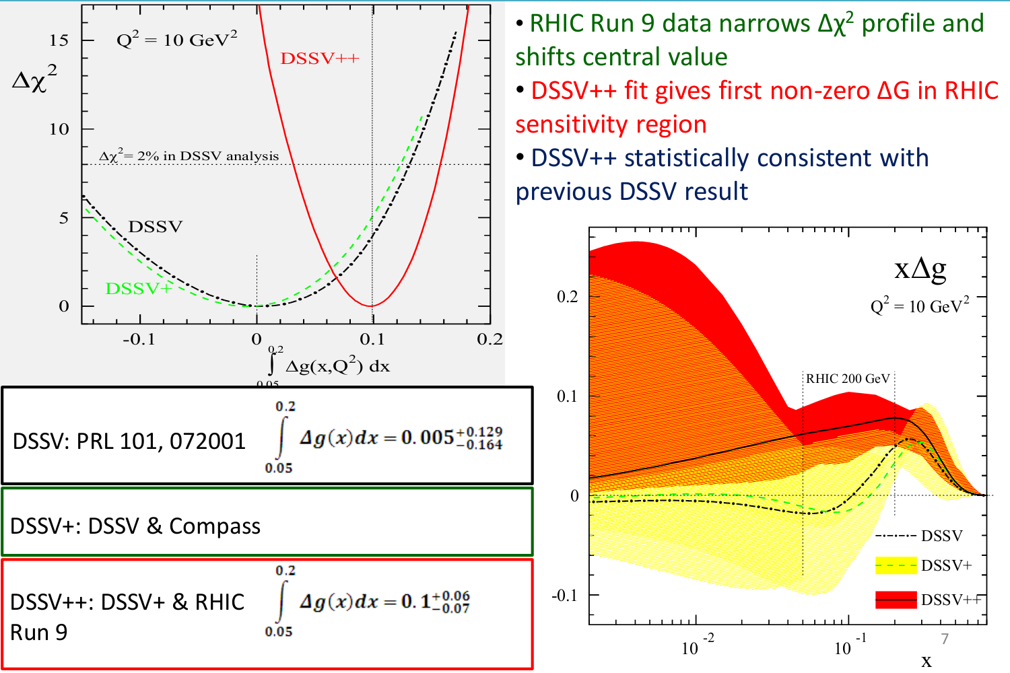
Impact of Run 9 on ΔG
[for DSSV++, etc., see: http://www.bnl.gov/npp/docs/RHIC-Spin-WriteUp-121105.pdf]

Slide 22
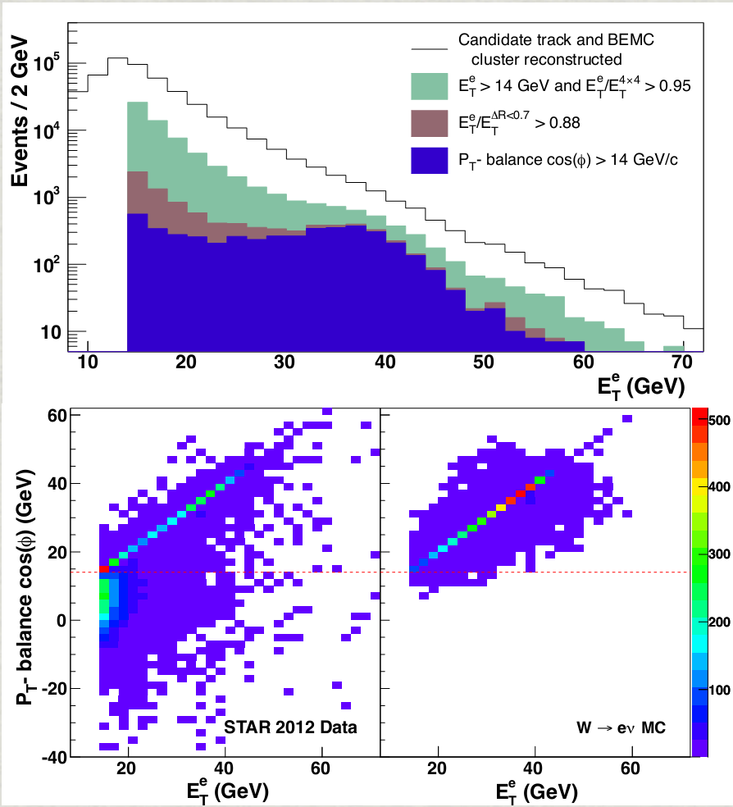
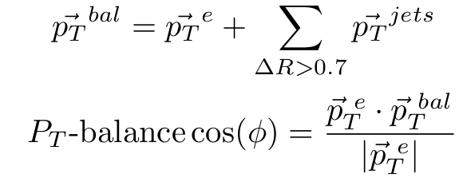
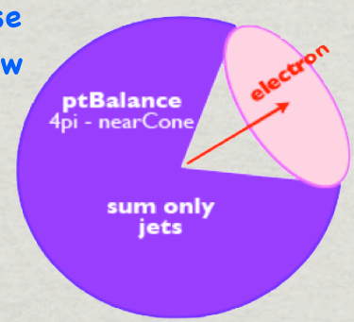
Finding W’s in pp Collisions at STAR
Match p_{T} > 10 GeV track to EMC cluster
Isolation Ratios
P_{T}-balance
p_{T}

Slide 23
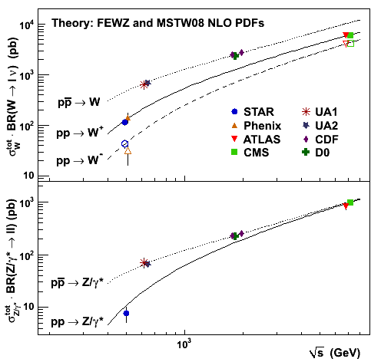
World data set: W production in pp and pp colliders
First cross sections for W and Z production at pp colliders (RHIC and LHC) measured at the same time.
Data from J. Stevens thesis (IU, 2012).
Excellent agreement between the measured and expected cross sections.

Slide 24
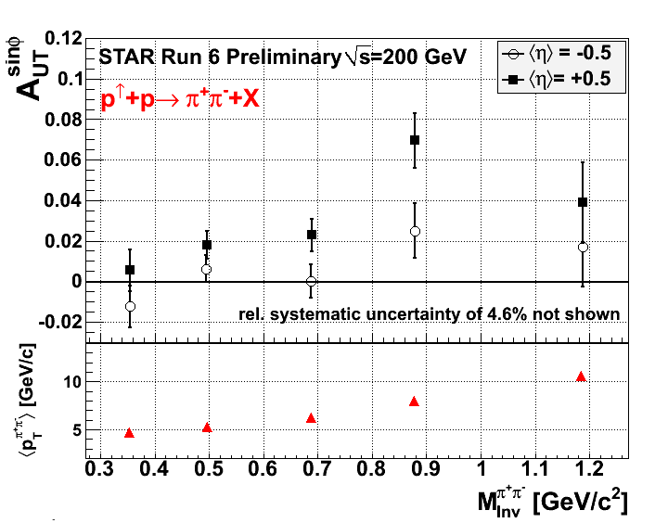
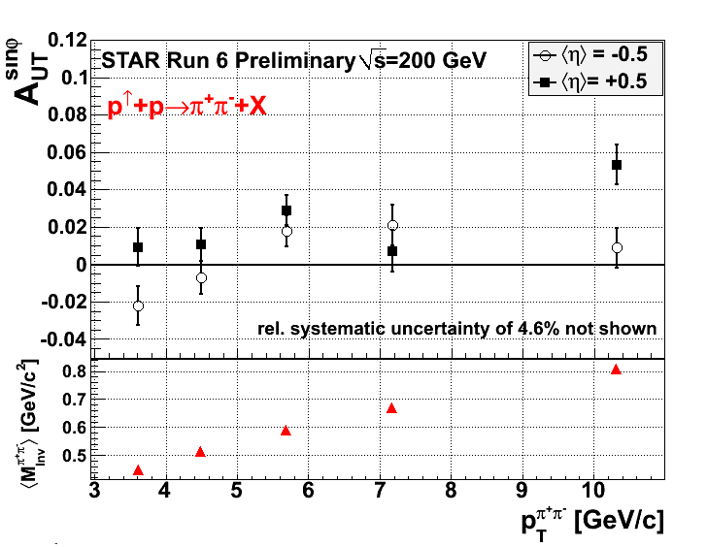
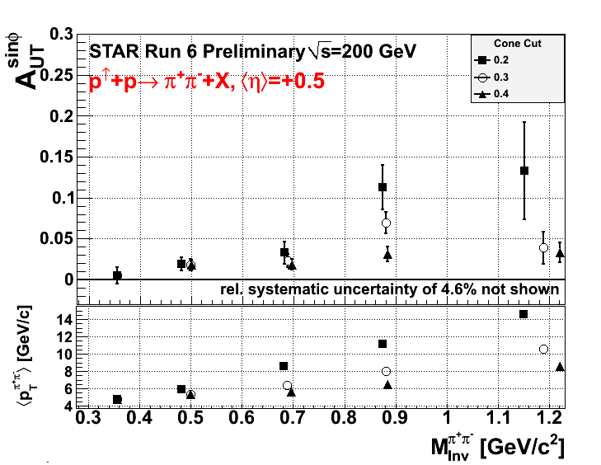
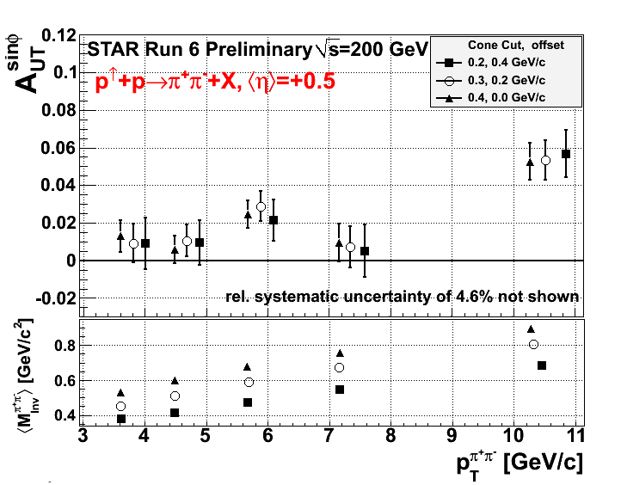
STAR Transverse Spin di-Hadron Correlation

Slide 25
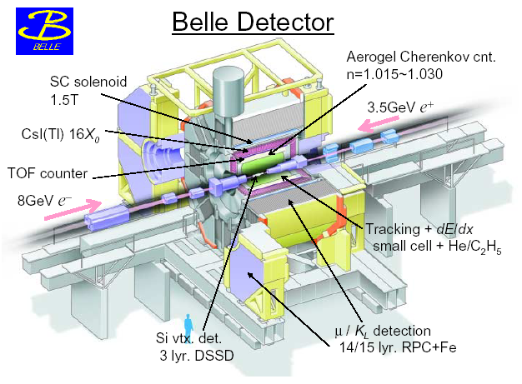
KEKB: L>2.11x10³⁴cm⁻²s⁻¹
Asymmetric collider: 8GeV e⁻+3.5 GeV e⁺
ϒ(4S): 702.6 pb⁻¹ on/ 89.5 pb⁻¹ off
Center-of-mass Energy 10.58/1.52 (on/off)

