Slide 1
Ω production in p+p, Au+Au and U+U collisions at STAR
STAR
Xianglei Zhu (Tsinghua University)
For the STAR Collaboration
5/21/2014

Slide 2
Outline
Motivation
STAR detector and Ω reconstruction
Ω spectra
Strangeness enhancement factors
Particle ratios
Nuclear modification factors
Summary
Xianglei Zhu, QM2014

Slide 3
Motivation
Strange quark
current mass ~100 MeV < T_{c}
pair produced in heavy-ion collisions (total S = 0)
Baryon with only strange quarks: $Ω$ (sss), $\overline{Ω}$($\overline{s}\overline{s}\overline{s}$)
small hadronic cross section
no feed down from excited states
sensitive to the early stage dynamics of the medium
Key observables:
Strangeness enhancement factors – canonical suppression
Particle ratios – chemical equilibration
Nuclear modification factors – interplay of strange quark energy loss and recombination/coalescence
Xianglei Zhu, QM2014
Notes:
3

Slide 4
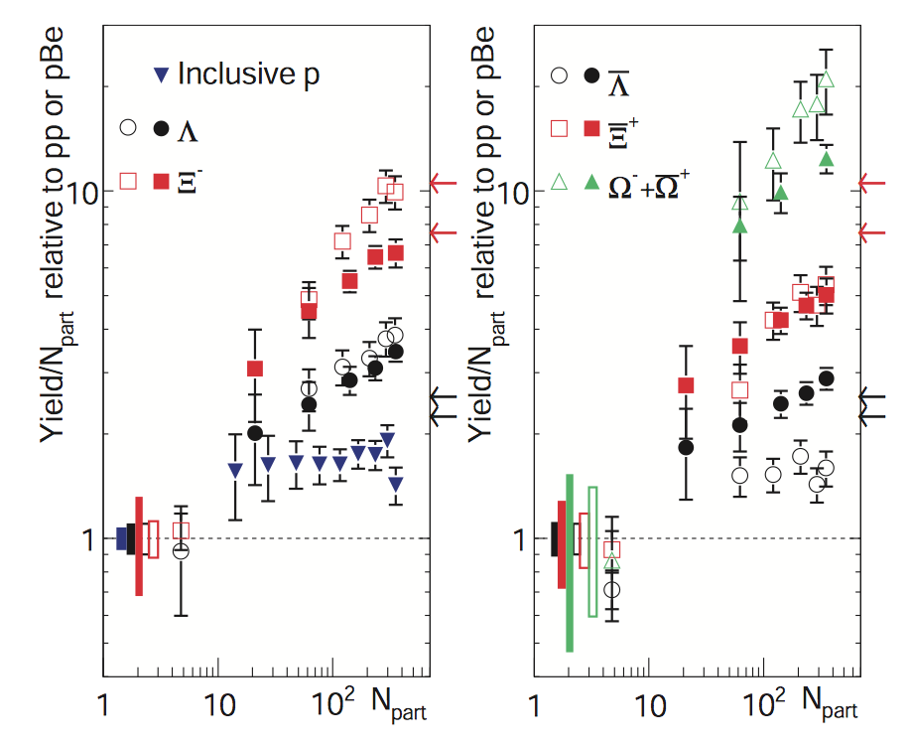
Motivation
Ω in p+p 200 GeV
provide the baseline for strangeness enhancement study
Large errors (2001-2002 data)
~18 times more p+p data were taken in year 2009!
STAR, Phys. Rev. C 77 (2008) 044908
Xianglei Zhu, QM2014

Slide 5
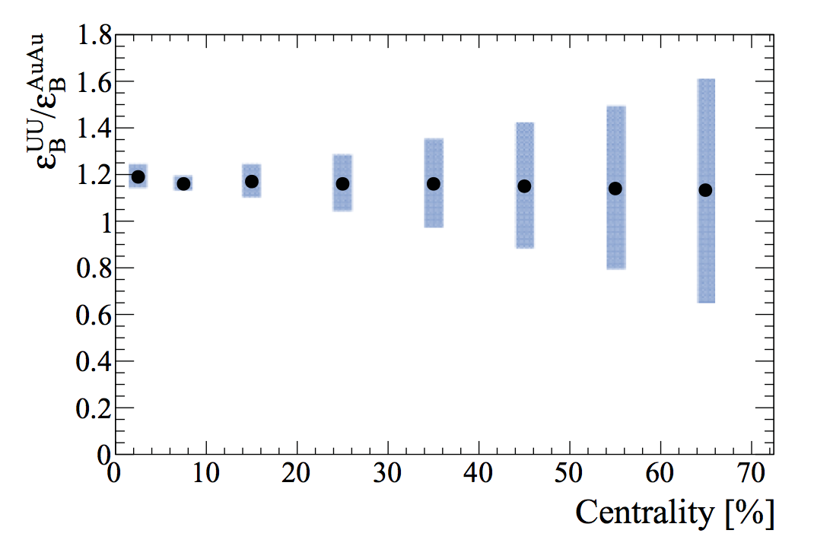
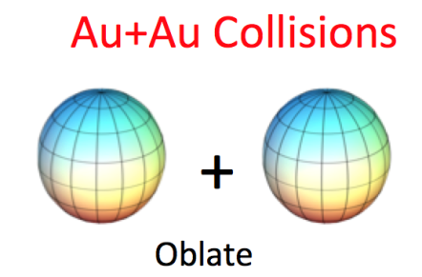
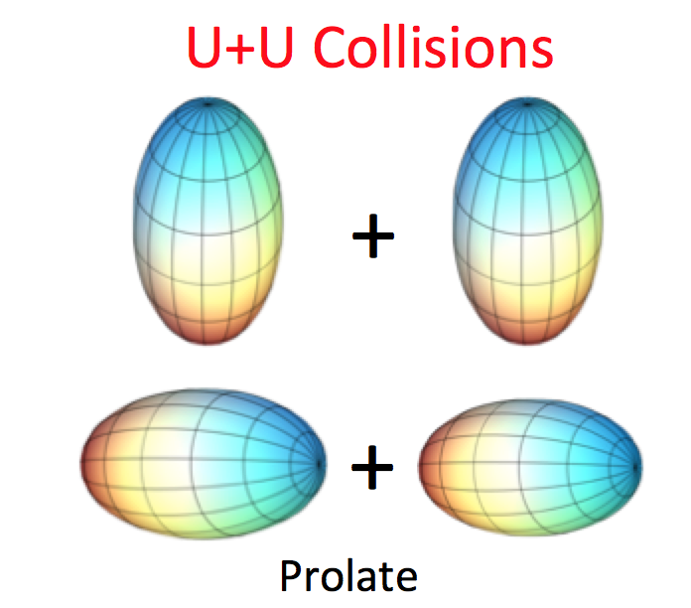
Motivation
Ω in Au+Au vs in U+U
U+U collisions expected to have 20% higher energy density
How is the Ω enhancement in U+U?
Ω yield suppressed at high p_{T} in Au+Au? and even more suppressed in U+U?
Kikola, Odyniec, Vogt, Phys. Rev. C 84 (2011) 054907 Masui, Mohanty, Xu, Phys. Lett. B 679 (2009) 440
Xianglei Zhu, QM2014

Slide 6
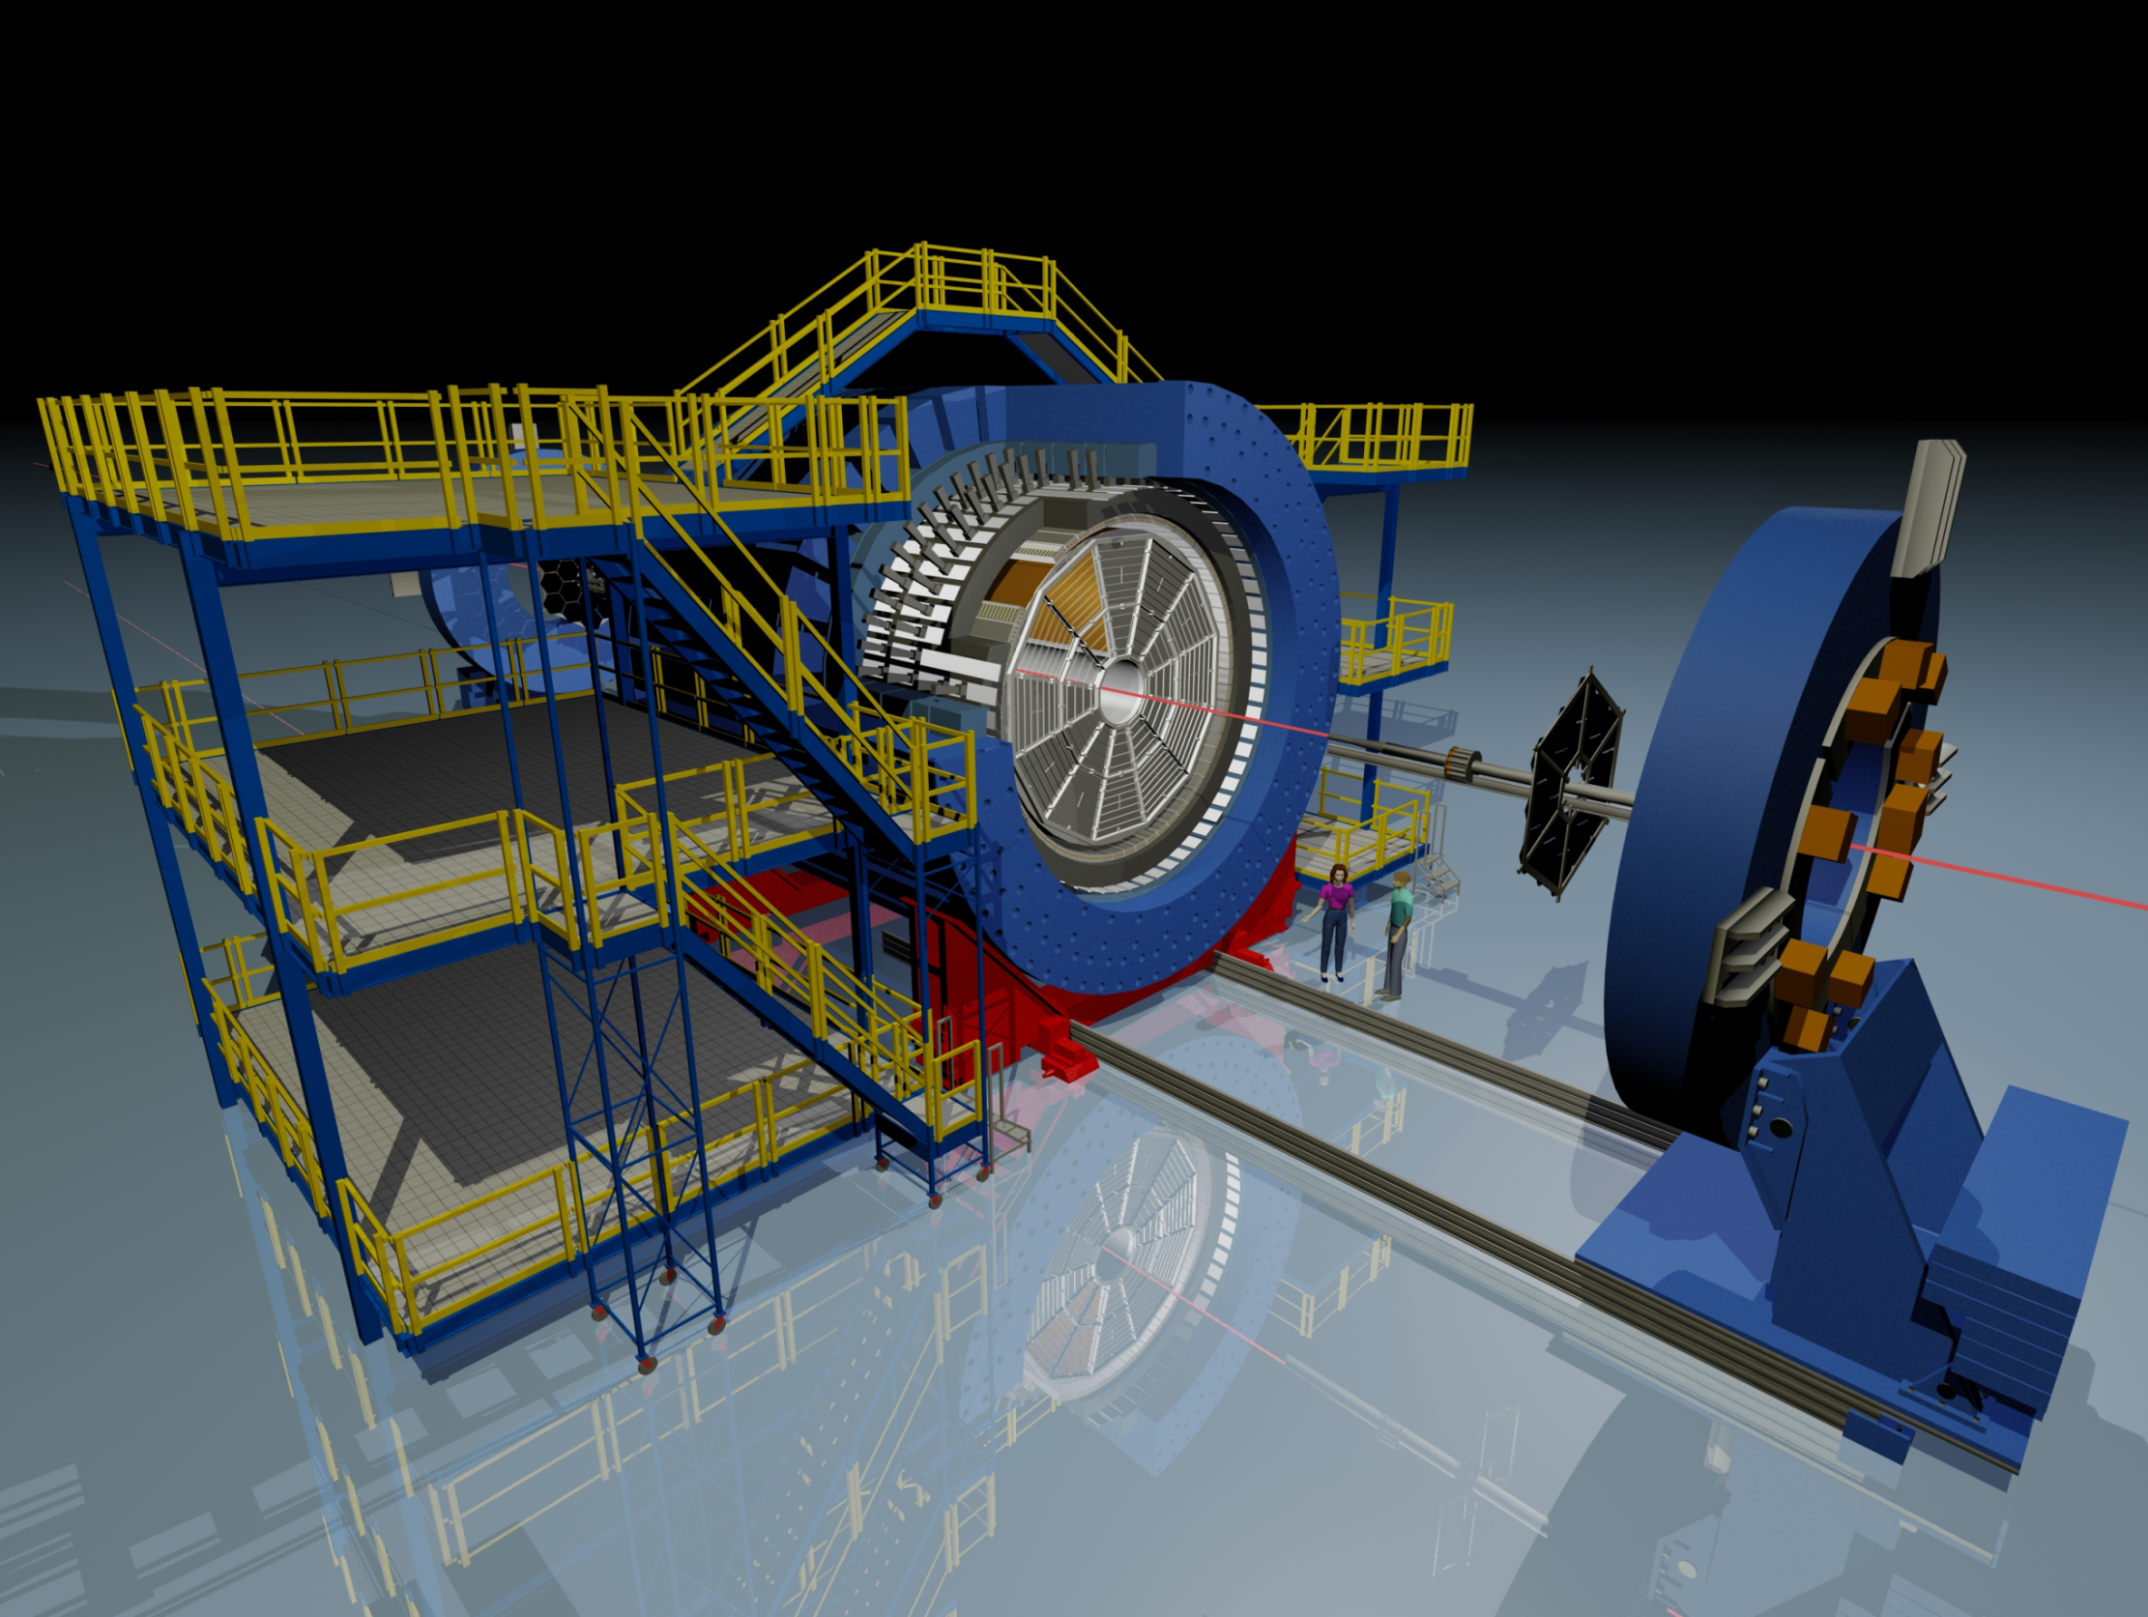
The Solenoidal Tracker At RHIC (STAR)
BEMC
Magnet
EEMC
TOF
TPC
BBC
upVPD
Year | System | √s_{NN} (GeV) | Minimum bias events in Million
2009 | p+p | 200 | ~ 107 M
2011 | Au+Au | 200 | ~ 480 M
2012 | U+U | 193 | ~ 270 M
© Maria & Alex Schmah

Slide 7
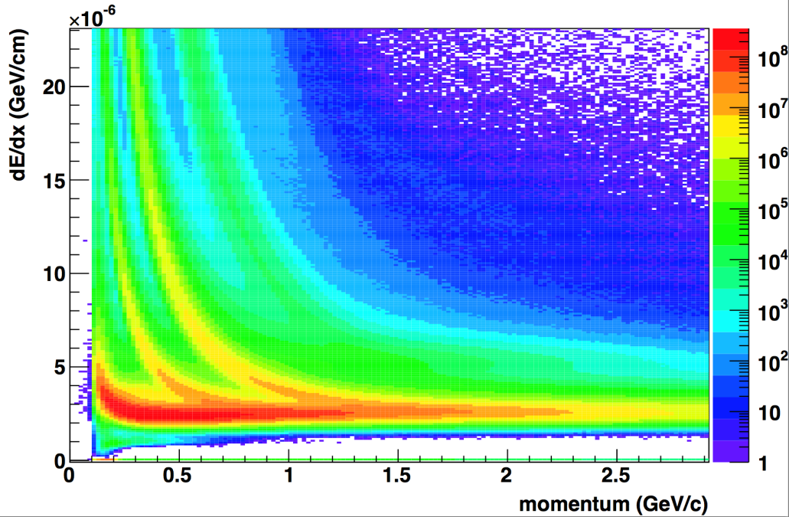
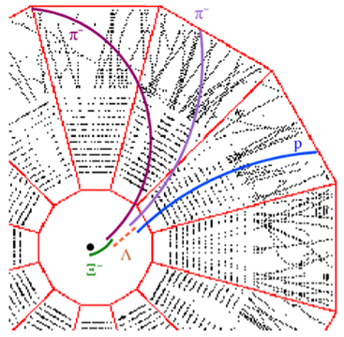
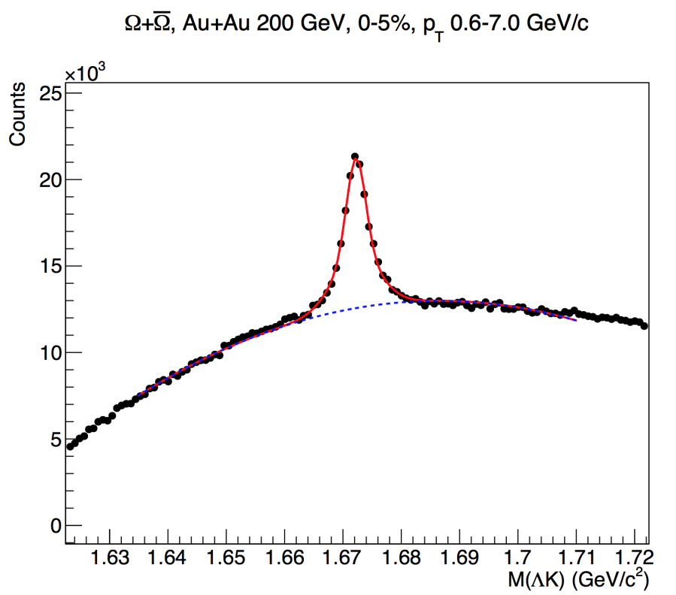
Ω reconstruction in STAR
$$K^{−}$$
p
K
π
$$Ω$$
$$Ω+\overline{Ω}$$
Ω → Λ + K → (p+π) + K
π ,K, p are identified with TPC dE/dx
reconstruct the secondary vertex
STAR preliminary
Xianglei Zhu, QM2014

Slide 8
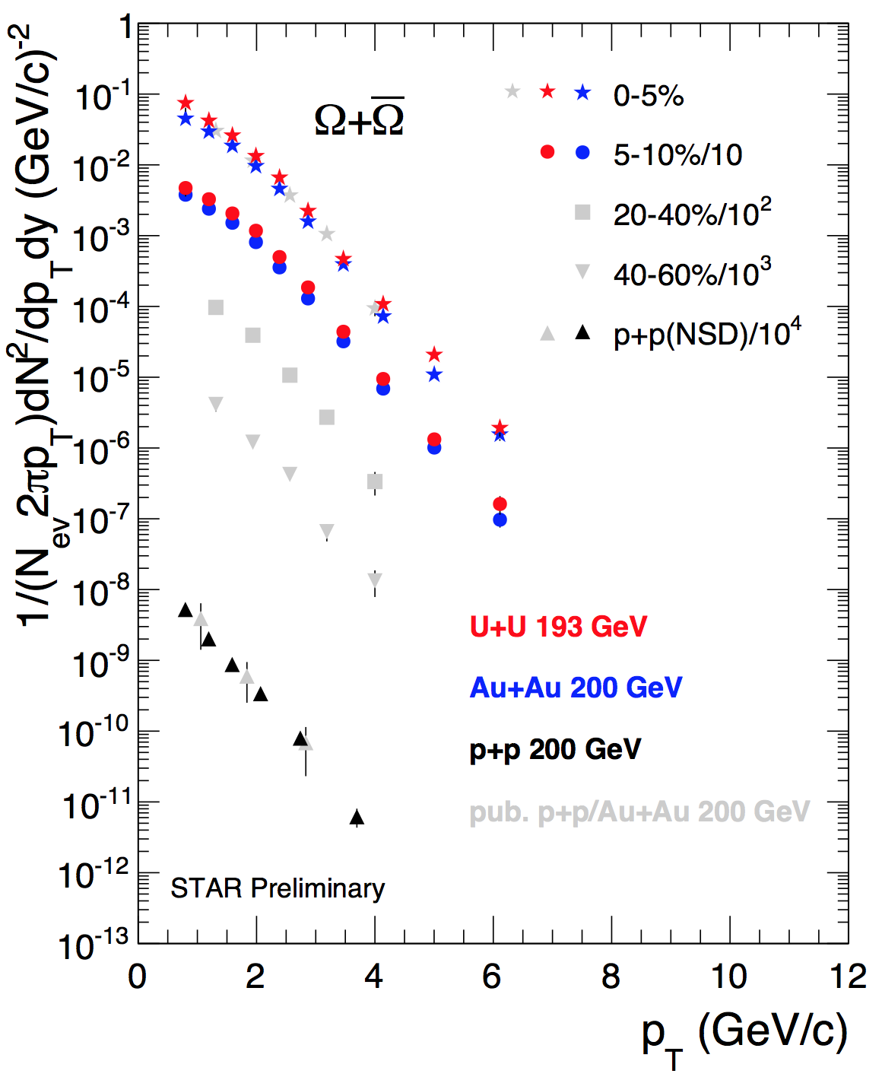
p_{T} spectra
* |y|<0.5, statistical error only
STAR, Phys. Rev. C 75 (2007) 064901 STAR, Phys. Rev. Lett. 98 (2007) 062301
* only central (0-5, 5-10%) new Au+Au and U+U data available so far
Maximum p_{T} ~ 6 GeV/c for both Au+Au and U+U central collisions
Yields (U+U > Au+Au)
Xianglei Zhu, QM2014

Slide 9
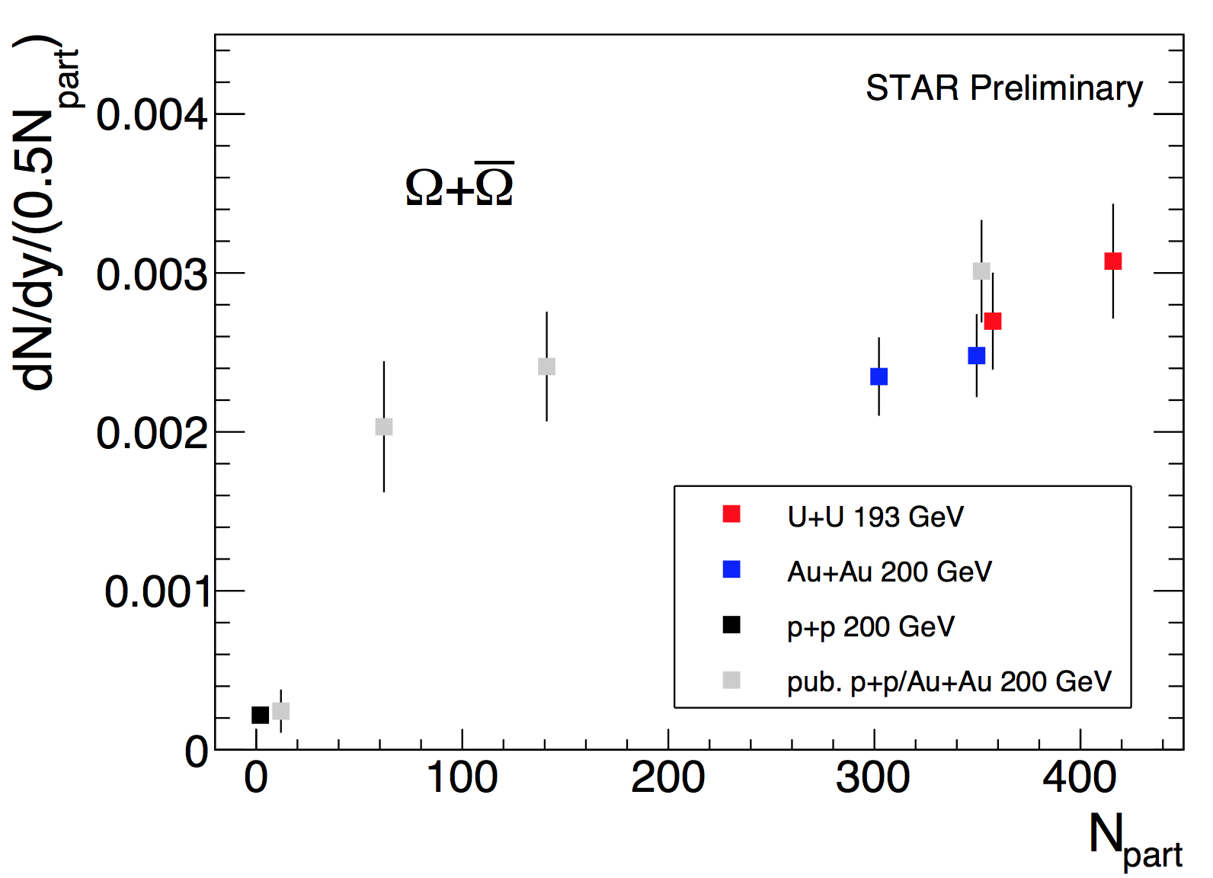
Centrality dependence of yields
|y|<0.5 for new p+p, Au+Au and U+U data
Systematic errors dominate
STAR, Phys. Rev. C 75 (2007) 064901 STAR, Phys. Rev. Lett. 98 (2007) 062301
Ω baryon yield per participant increases with N_{part}
Xianglei Zhu, QM2014

Slide 10
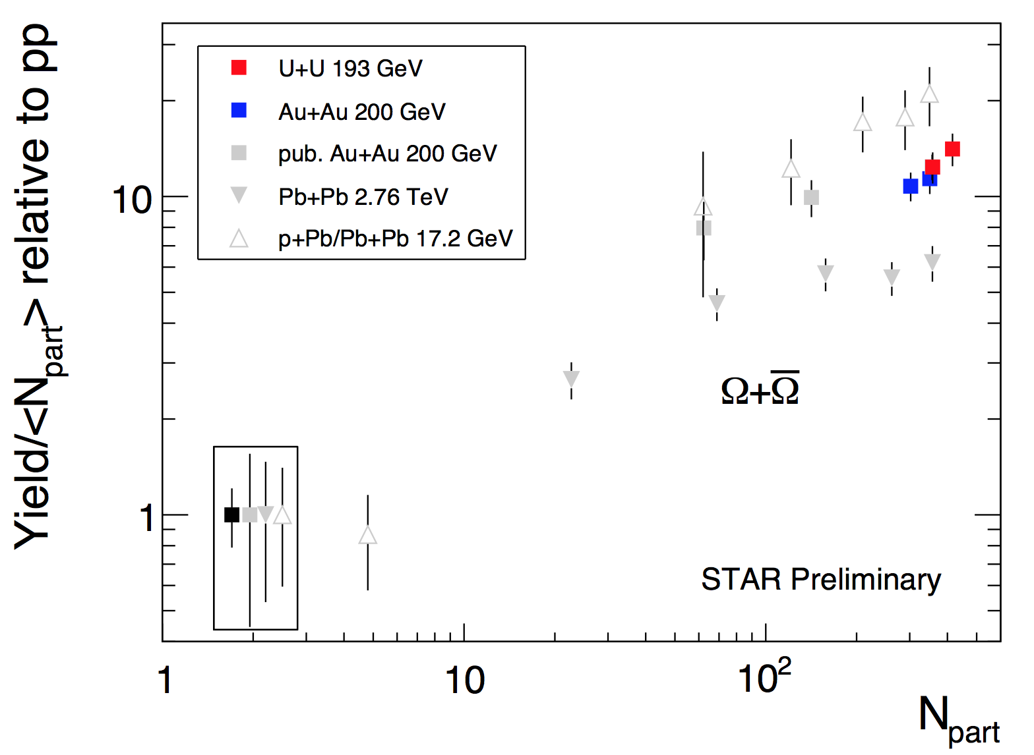
Strangeness enhancement factor
New p+p 200 GeV data as reference for both new Au+Au 200 GeV and U+U 193 GeV
ALICE, Phys. Lett. B 728 (2014) 216 NA57, J. Phys. G 32 (2006) 427; NA57, J. Phys. G 37 (2010) 045105 STAR, Phys. Rev. C 77 (2008) 044908
Significantly reduced reference uncertainty at RHIC
Larger enhancement than LHC, lower than SPS
Larger enhancement in central (0-5%) U+U than in central (0-5%) Au+Au (strangeness enhancement not saturated)
Xianglei Zhu, QM2014

Slide 11
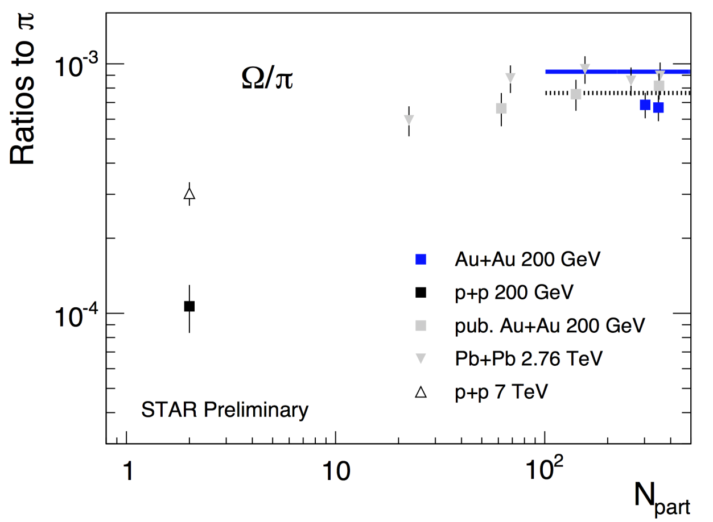
Ratios to pion
Thermal models:
Fitting to RHIC, Andronic, et al., Phys. Lett. B 673 (2009) 142; Phys. Lett. B 678 (2009) 516
Fitting to LHC, Stachel, et al., arXiv: 1311.4662
RHIC data is lower than LHC
Lower than thermal model fitting results for RHIC
Ω/π (LHC>RHIC) in p+p, canonical suppression
Xianglei Zhu, QM2014

Slide 12
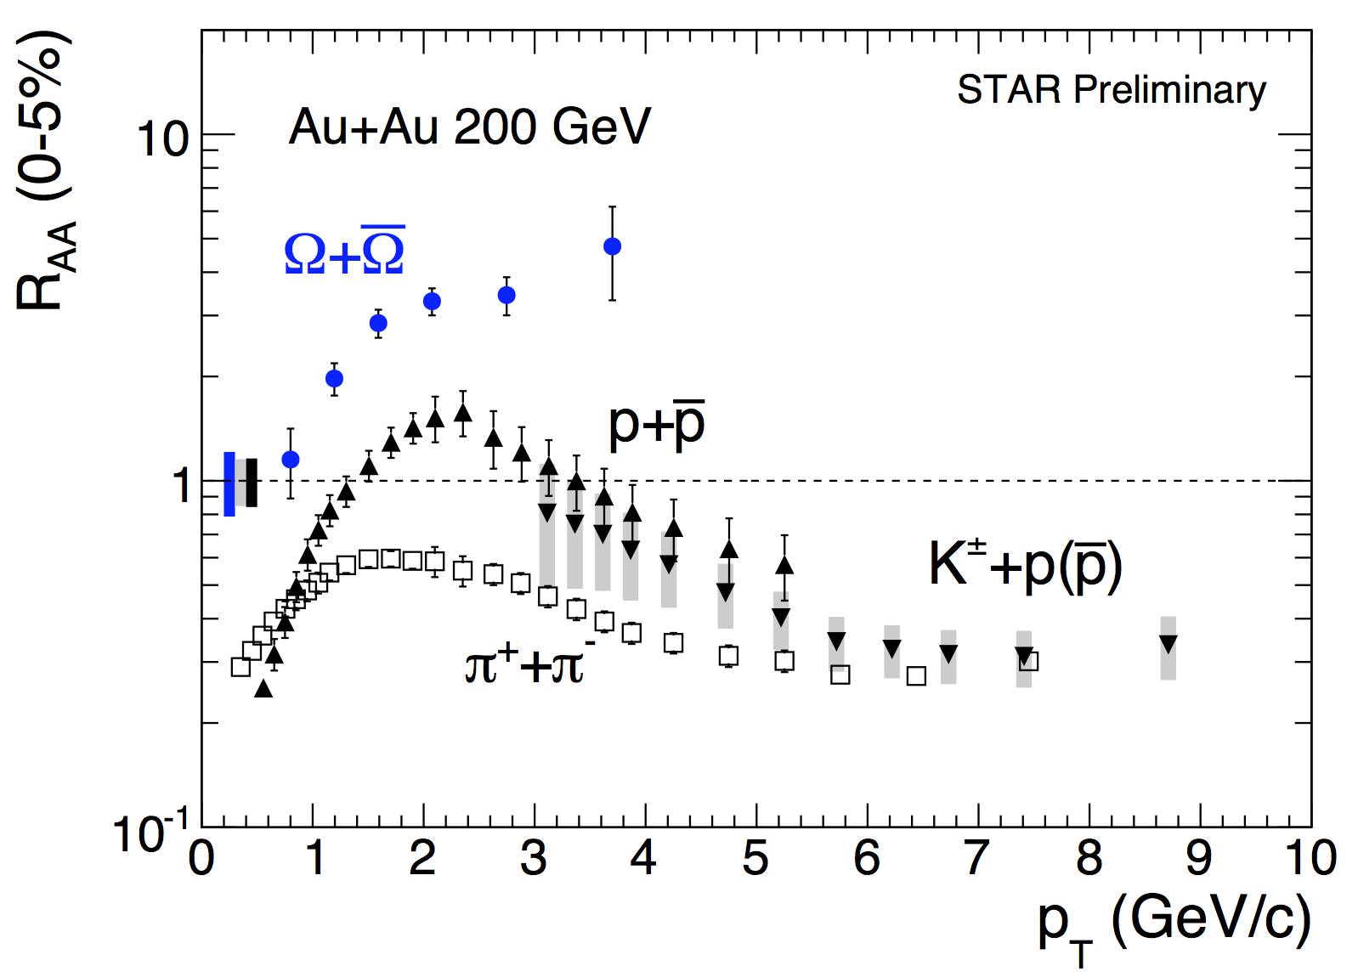
Nuclear modification factor (R_{AA})
Statistical error only for Ω
$π^{+}+π^{−} and p+\overline{p}$: 0-12%, STAR, Phys. Rev. Lett. 97 (2006) 152301 STAR, Phys. Lett. B 637 (2006) 161 STAR, Phys. Rev. C 81 (2010) 054907
$K^{±}+p(\overline{p})$: 0-12%, STAR, Phys. Rev. Lett. 108 (2012) 072302
Ω baryon R_{AA} much larger than proton/pion up to 4 GeV/c
→ Interplay of strange quark energy loss and coalescence or recombination
Xianglei Zhu, QM2014

Slide 13
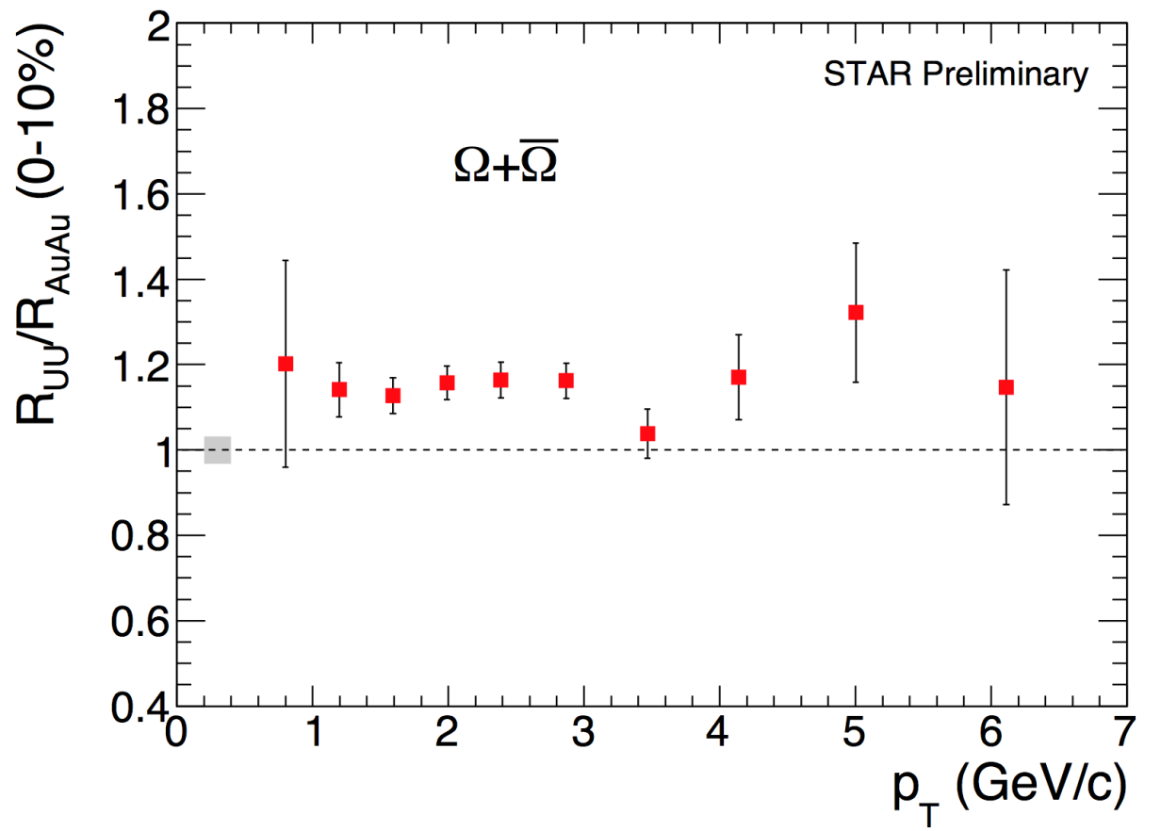
Ratio of nucl. mod. factors (R_{UU}/R_{AuAu})
Higher energy density → Jet more quenched R_{UU}/R_{AuAu} < 1 at high p_{T}
→ Strangeness enhancement (Coalescence?) R_{UU}/R_{AuAu} > 1 at intermediate p_{T}
* Au+Au 200 GeV 0-10%
N_{part} = 325 ± 4; N_{bin} = 941 ± 26 * U+U 193 GeV 0-10% N_{part} = 387 ± 4; N_{bin} = 1151 ± 18
Statistical error only
The energy density in central U+U is expected to be 20% higher, but N_{bin}-scaled high p_{T} Ω yield is not suppressed
→ Ω formed through coalescence/recombination up to p_{T} ~ 6 GeV/c ?
Xianglei Zhu, QM2014

Slide 14
Summary
Precision measurement for Ω was made at STAR with high statistics p+p, Au+Au, U+U at top RHIC energies
Ω enhancement factors from RHIC are in between SPS and LHC
Ω canonical suppression may still remain in central Au+Au collisions
Larger strangeness enhancement in central U+U
Lower Ω/π ratio than LHC and thermal model
Ω R_{AA} (0-5%) is above 3 up to 4 GeV/c and R_{UU}/R_{AuAu} (0-10%) does not show suppression up to 6 GeV/c → Ω formation in central collisions may be dominated by strange quark coalescence/recombination up to p_{T} ~ 6 GeV/c
Xianglei Zhu, QM2014

